Slide 1
Data Science with Deep Learning
DS101-2024-01
From dataset understanding to result presentation and how to employ deep acyclic graph models in Predictive Analytics
Lec. Phd. Eng. Andrei Ionut DAMIAN, As. Eng. Stefan SARAEV

Slide 2
What is Deep Learning
Just Neural Networks? Not really…
Problem specific
No “Neural Network to bind them all and rule them all”
Complex neural graphs based on connected components
There is no boundary anymore between Computer Vision, Natural Language Processing and/or other areas

Slide 3
Data Scientist
Programmers: around 26-30 millions in the world
Data Scientists: ~1.5M “declared” and ~250k with degrees
Deep Learning Data Scientists: less then 25% of above…
And yes, we can do incredible magic-like stuff!

Slide 4
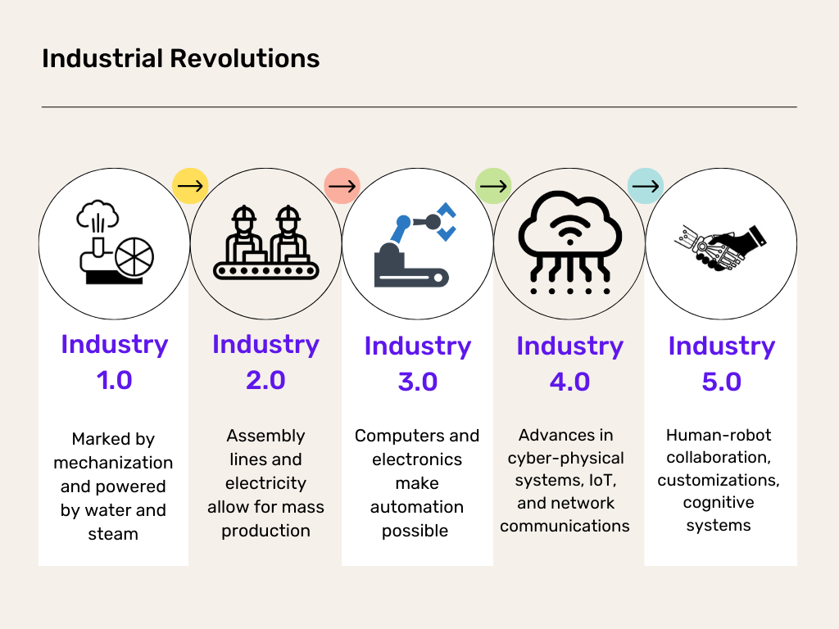
Data Scientist

Slide 5
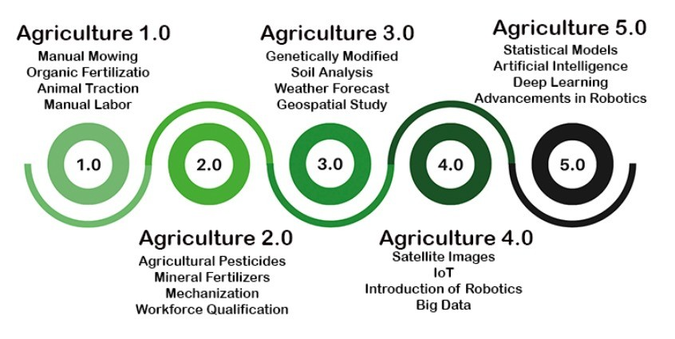
Data Scientist

Slide 6
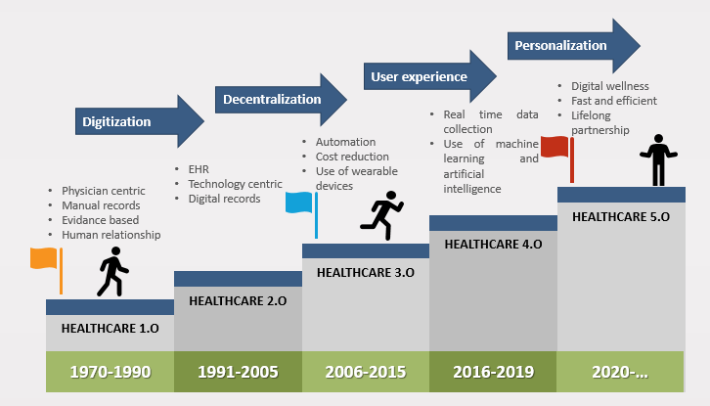
Data Scientist

Slide 7
Operational stuff
Graded project - real-life problem: 70% (minimum 30% for grading)
Research paper (important) presentation individual: 30%
Secondary project (optional extra-credit): 15%
2nd Research paper (optional research highlight pres.): 15%
Important: https://github.com/NaeuralEdgeProtocol/DS101-2024

Slide 8
Operational stuff
Mon 17h00-19h00 – Teams (will be recorded)
Maybe or maybe not split lecture and project
Mand. Paper presentation planning
Final Project planning

Slide 9
Operational stuff
Stefan SARAEV:
Paper presentations – Google Docs
Project – Google Docs
MsC Projects registrations – Google Docs

Slide 10
Prerequisites
Linear algebra: tensors, matrix mul, inverse, broadcast, etc
Partial derivatives
Python
R (optional)
Basic web-scrapping skills
Data structures understating (SQL optional)
Basic Machine Learning optional (linear models, decision trees)

Slide 11
What we will do
Overview basic Machine Learning: all eyes on optimization
Understand How to Frame a Data Science Real Life Problem
Use modern dev tools
Apply main stages of a Data Science project to various problems
ETL ☹, Exploration & Visualization, Model architecture ☺, Presentation of results
Apply Deep Learning cross-domain knowledge and model architecture
Use LLMs in Data Science
Maybe contribute to state-of-the-art

Slide 12
What we will do
Overall course structure (not the lecture sequence):
Introductory lecture(s)
Data Scientist dev environment
End-to-end experiment: naïve price inference on real-world data
Understanding use-cases: a real-world pharma project journey
Representational learning: embedding for the win
End-to-end experiment: from restaurant reviews to restaurant prices
Customer churn: another real-world Data Science problem
Deep learning tools bags
Demand forecasting 101
Recommender systems and beyond
Paper presentations and take aways
Project presentations and take aways

Slide 13
Basic Machine Learning
Tools, tools, tools
Classification vs Regression
Deterministic vs Generative
Supervised vs Unsupervised
“Do not underestimate the power of the Linear Model”

Slide 14
Basic Machine Learning - Pipeline
STEP 1.1: Extraction
STEP 1.2: Transformation
STEP 1.3: Loading
STEP 2.1: Analysis (manual / automated) and sanity-checks
STEP 2.2: Cleaning
STEP 2.3: Visuals of loaded data (histograms, etc)
STEP 2.4: Batch-ification
STEP 3.1: Design model
STEP 3.2: Train model (try to overfit maybe)
STEP 3.3: Validate – Tune – Validate – Tune ….
STEP 4: Prepare and present results

Slide 15
Basic Machine Learning - Metrics
How good we are at our task?
100 observations with 80 false and 20 positives

Slide 16
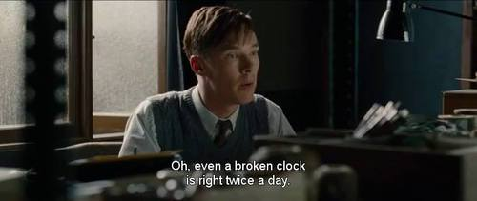
Basic Machine Learning

Slide 17
Machine Learning Basics
The Data:
How it should look
how it looks
Purpose
objectives

Slide 18
Machine Learning Basics
The ETL:
Who?
When?
1st rule: “Sanity Check”

Slide 19
Machine Learning Basics
The Exploration:
Is separable
Can we run some Euclidean dist stuff?
Do we have inconsistencies
MORE SANITY CHECKS

Slide 20
Machine Learning Basics
The Looks:
Graphs (matplolib)
Graphs (bokeh)
Graphs (plotly)

Slide 21
Machine Learning Basics
The Brain:
General architecture
Hyperparameter search
Actual parameter search (optimization)

Slide 22
Machine Learning Basics
The Results:
Start again with … Sanity Check
Visualize the results (label your graphs!)
O P E R A T I O N A L I Z E !

Slide 23
Back to actual science
What do we aim for: Create a function that can approximate our cognitive process.
How we do it: basically same as 40 years ago…

Slide 24
The cornerstones
Our goal:
Find the optimal coefficients W of the function F(X | W) that reads our input X & infers a …“conclusion”.
“conclusion”, whatever is that… (not necessarily we do have a ground truth)

Slide 25
Optimization
How do we most basically do that:
Find W*, the coefficients that minimize a function L (loss) that tells us how “off” our function F(X|W) is from what it should infer or predict.
W* = argmin L(F(X)|Y)
W

Slide 26
Optimization
Classical regression problem: real estate is quite linear
Normal eq: W* = (X^{T}X)⁻¹X^{T}Y
and/or
Gradient Descent: W* = W* - α(dL/dW)

Slide 27
Summary

Slide 28
1st project
www.imobiliare.ro:
Scrap
Clean
See!
Transform
Calculate (model)
Test
Production!

