Slide 1
Getting Started

Slide 2
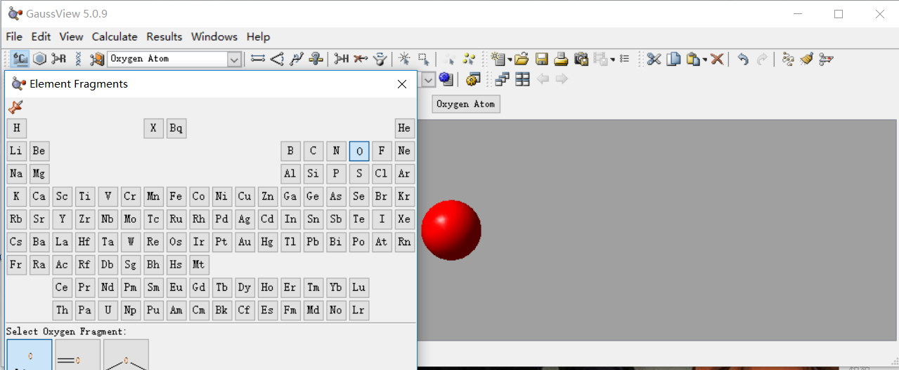
Building Formaldehyde

Slide 3
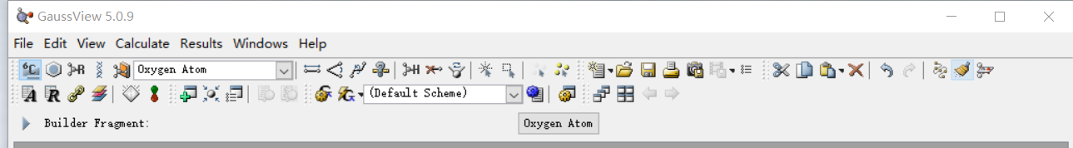
Building Formaldehyde
clean

Slide 4
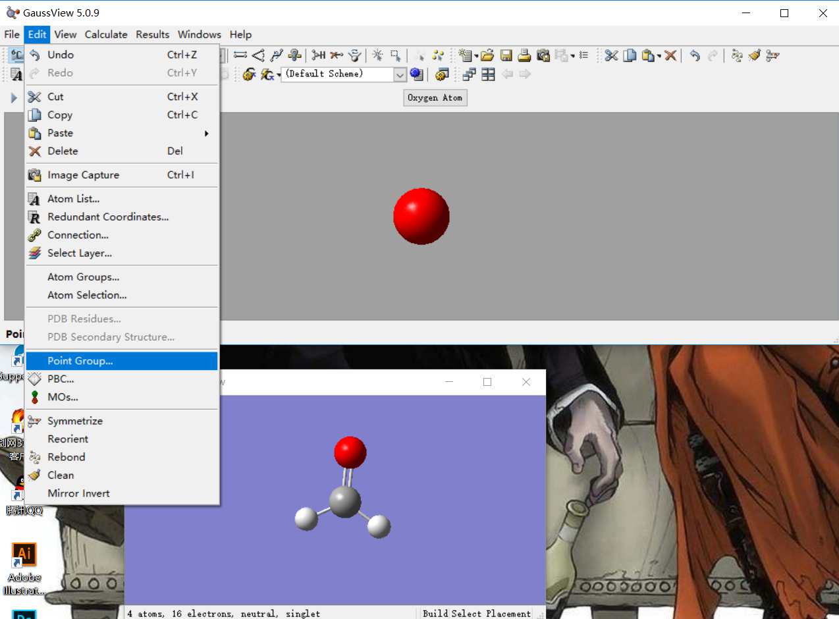
Imposing Symmetry

Slide 5
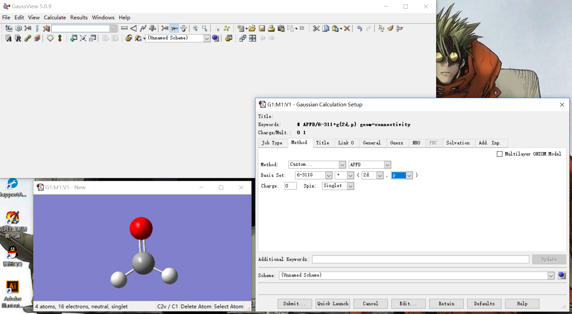
Gaussian Calculation Setup

Slide 6
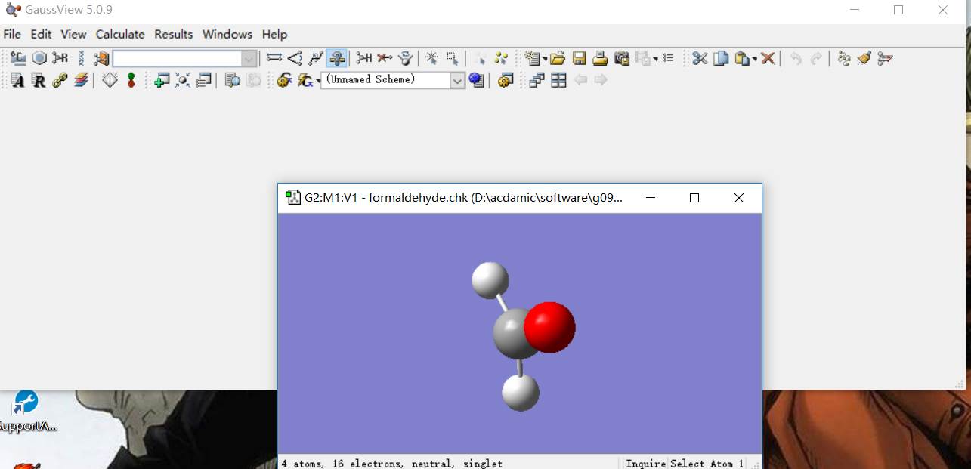
After Calculation Complete

Slide 7
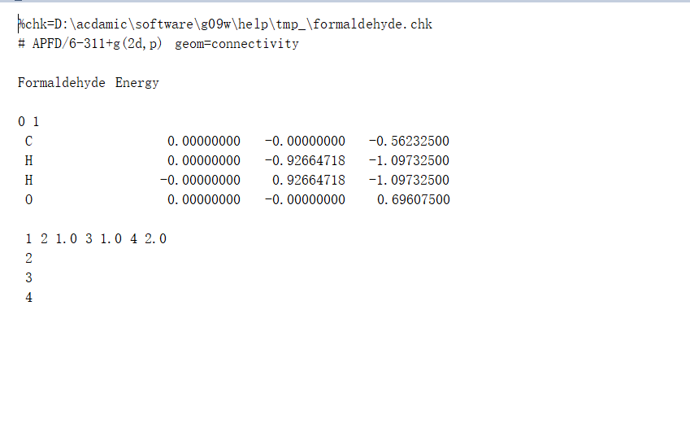
Gaussian Input File
Required blank
Required blank
Charge & spin multiplicity
Required blank
Atom connectivity information
Required blank

Slide 8
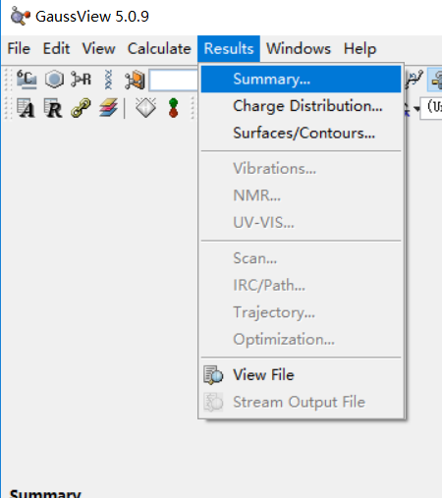
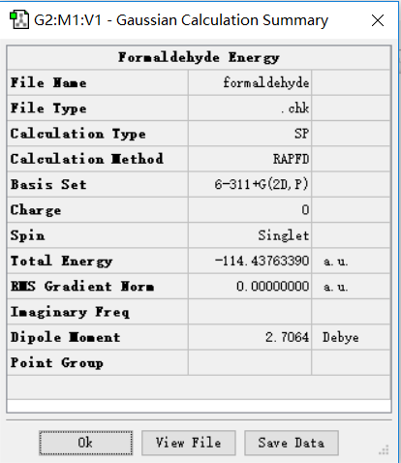
Gaussian Calculation Results
Structures built with visualization software are somewhat arbitrary. In general, when we compare energies, we will do so only for structures that we have optimized.

Slide 9
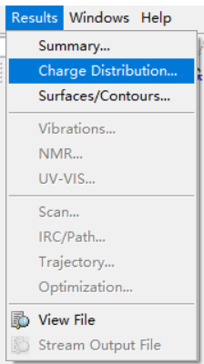
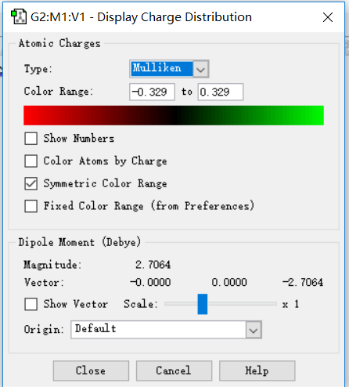
Dipole and Higher Multipole Moments
电量也在这里了

Slide 10
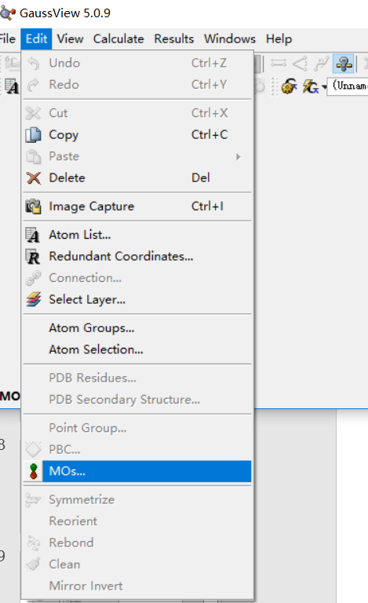
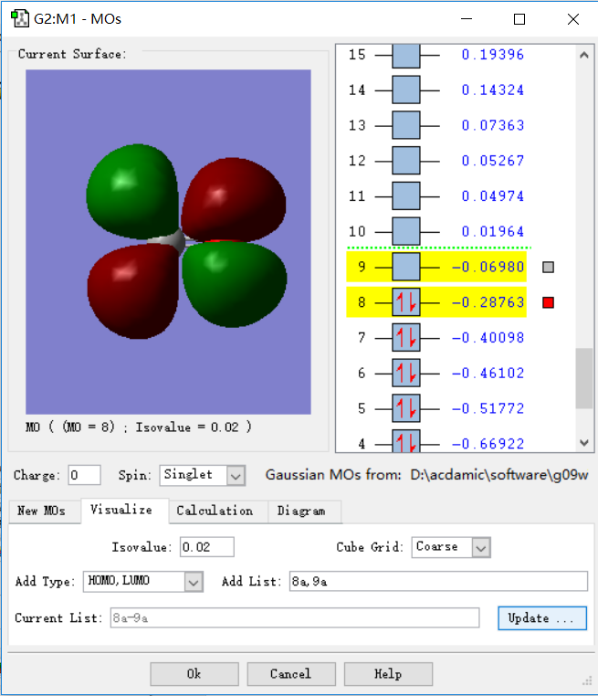
Molecular Orbitals
A molecular orbital is mathematical function that describes the behavior of an electron or pair of electrons within a molecule.
click

Slide 11
Minimizing Molecular Structures: Opt + Freq Calculations
Most geometry optimizations attempt to locate minima on the potential energy surface for a molecule, thereby predicting equilibrium structures of molecular systems. Sometimes optimizations are performed in order to locate transition structures.
Once an optimization has completed successfully, however, we must ensure that the predicted structure is in fact a minimum and not a transition structure. This can be accomplished by running a frequency calculation at the optimized geometry.

Slide 12
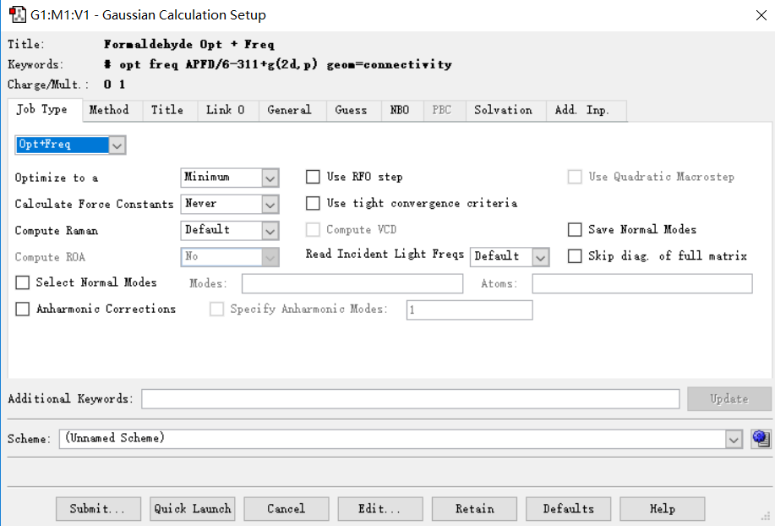
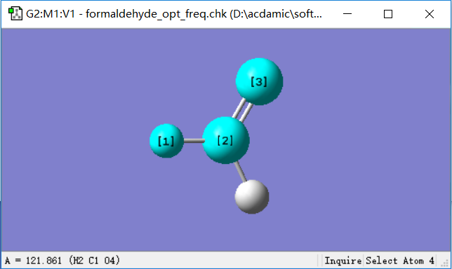
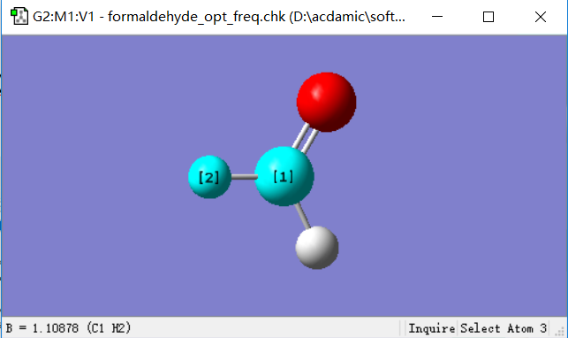
Opt + Freq
按顺序点3个原子能看到夹角，点2个能看到键长。

Slide 13
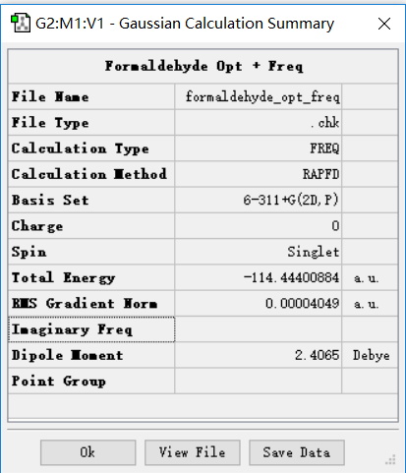
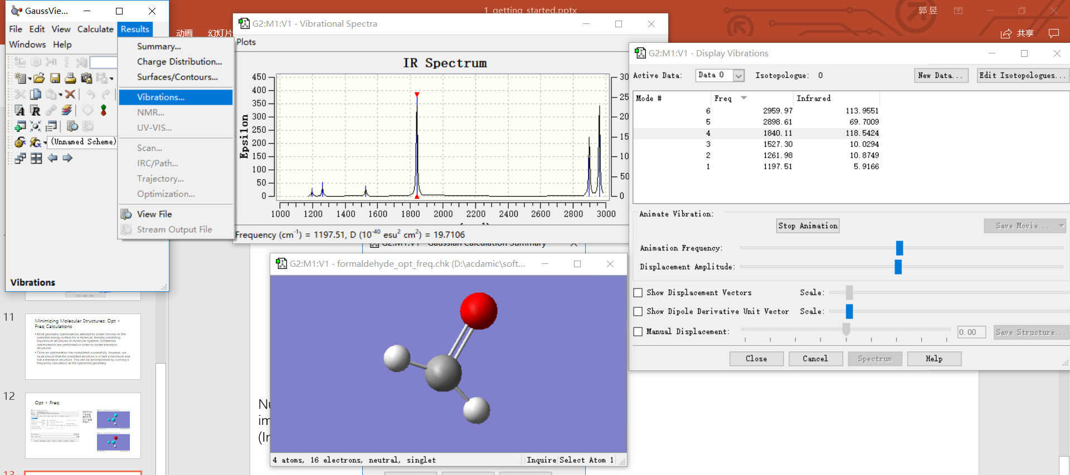
Opt + Freq
Number of imaginary freq
(In summary)
In vibrations, you can see the IR and how atoms move

Slide 14
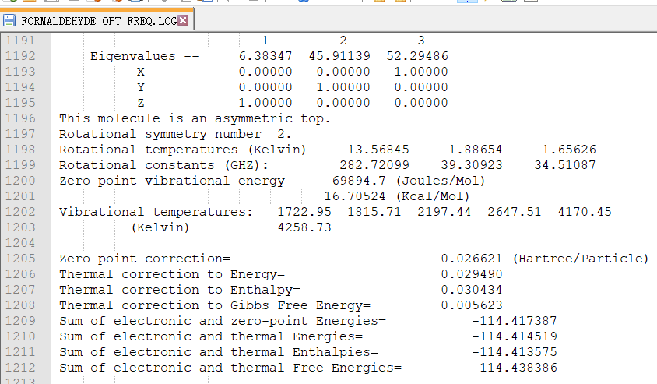
Opt + Freq
Thermal Energy Corrections
Our final task is to determine the energy for the molecule including the thermal energy correction. This data is included in the Gaussion output file in the section titled “Thermochemistry”. The corrections to the total energy are listed first, followed by computed quantities including the correction.
In general, when an energy value is required(rather than an enthalpy or free energy), the thermal-corrected energy is the value that should be used.

Slide 15
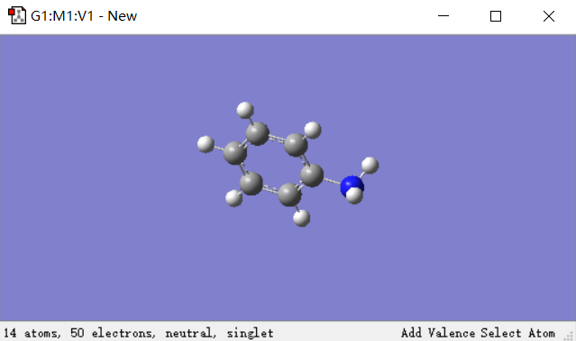
Clean vs Optimize
If you begin building this structure with a benzene molecule, replace one of the hydrogen with an NH2 group, and then execute the Clean function, the resulting structure may be a good starting point for an optimization of the ground state of aniline. However, depending on the specific building process used, it may also be distorted in ways which will ultimately be optimized to a transition state that is nearby on the molecule’s potential energy surface.

Slide 16
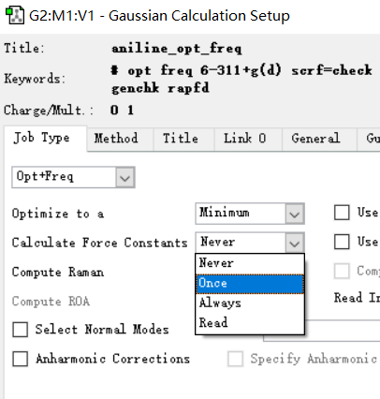
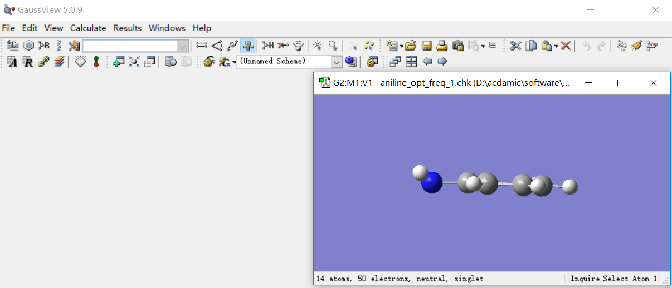
Calculate Force Constants
In some cases, the stationary located by the optimization will be a transition structure rather than the minimum we wanted. In fact, this is a common occurrence in general.
In addition, both distorted starting geometries can be successfully optimized to the minimum by computing the force constants explicitly prior to the optimization.(at the cost of some additional CPU time)

Slide 17
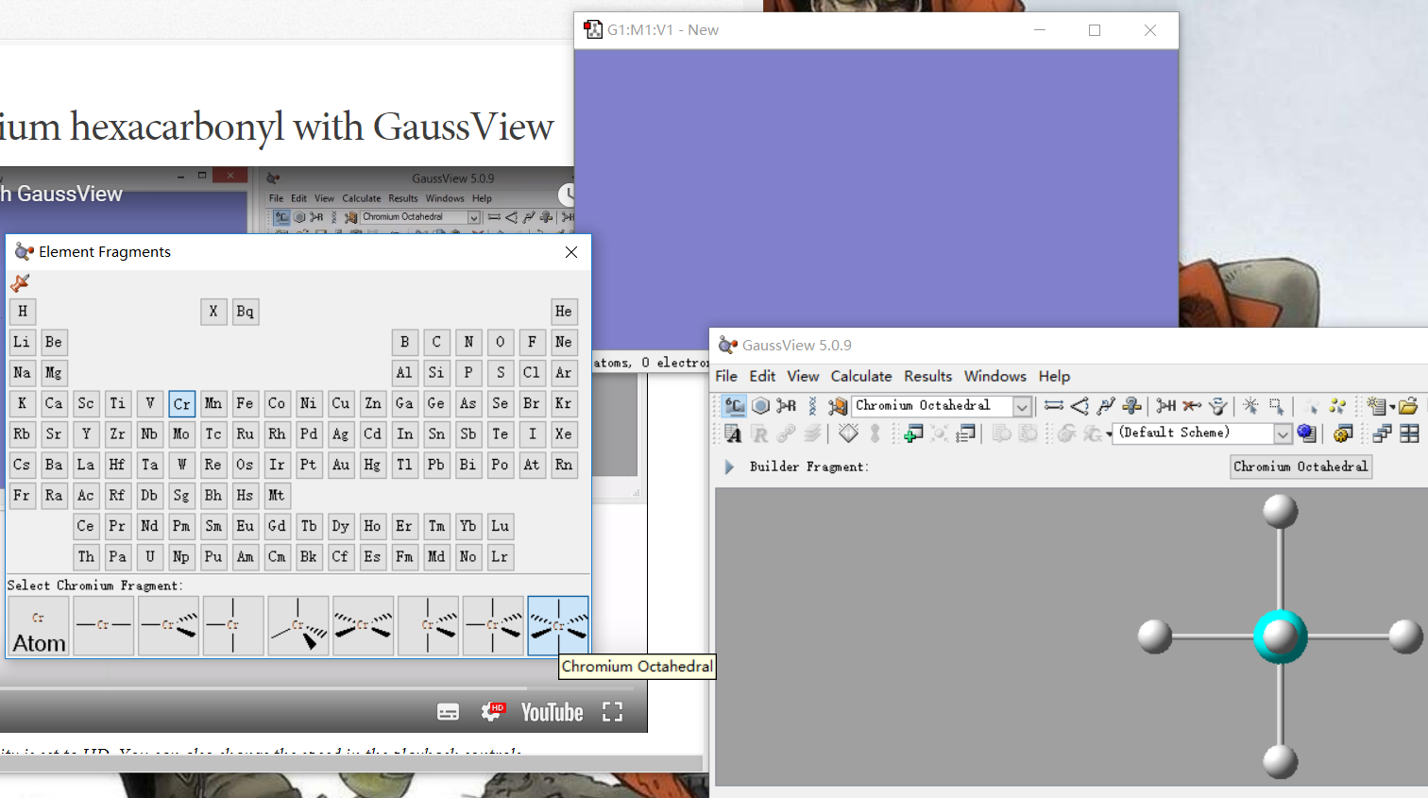
Optimize Chromium Hexacarbonyl

Slide 18
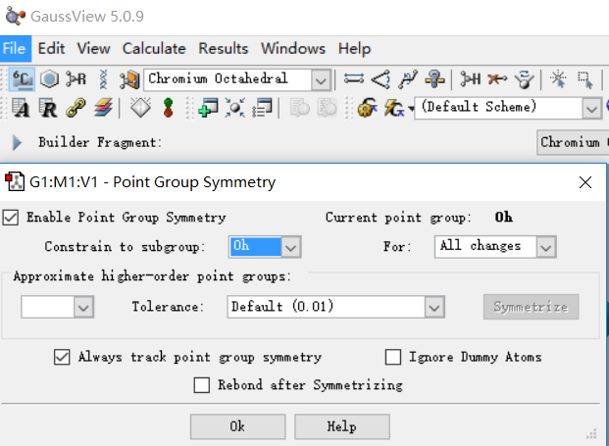
Optimize Chromium Hexacarbonyl

Slide 19
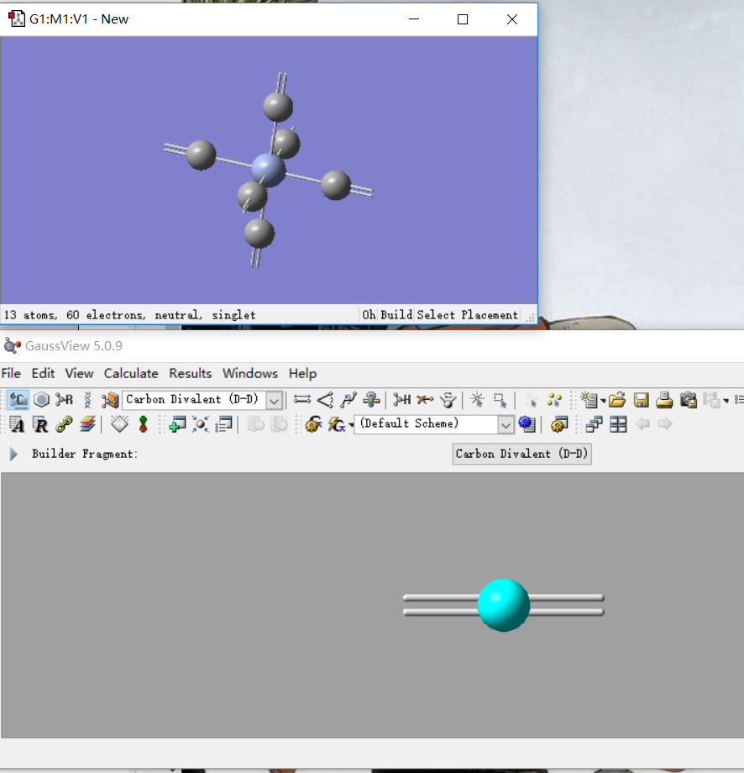
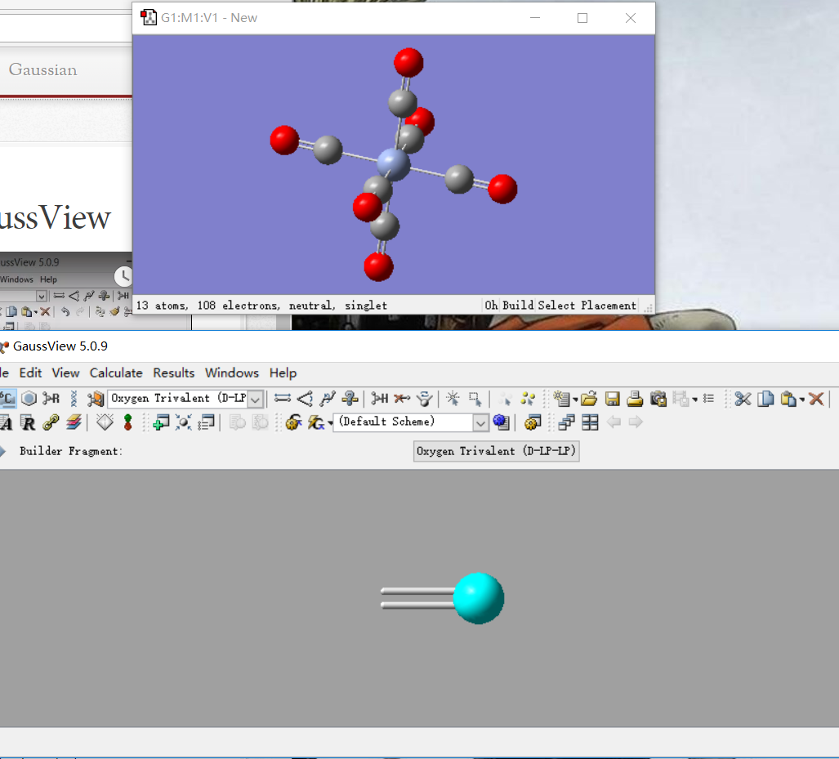
Optimize Chromium Hexacarbonyl

Slide 20
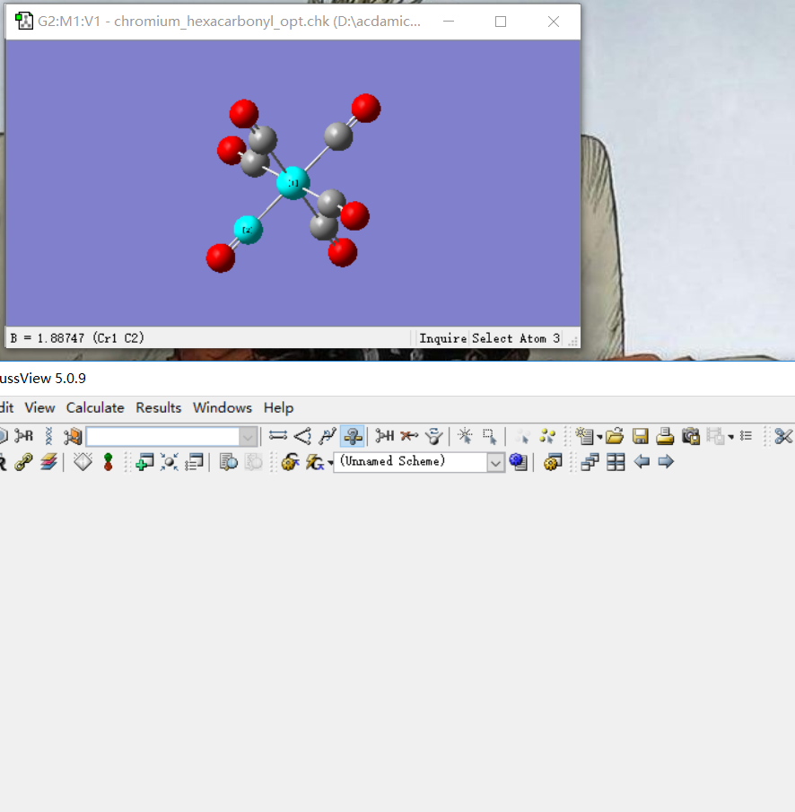
Optimize Chromium Hexacarbonyl

Slide 21
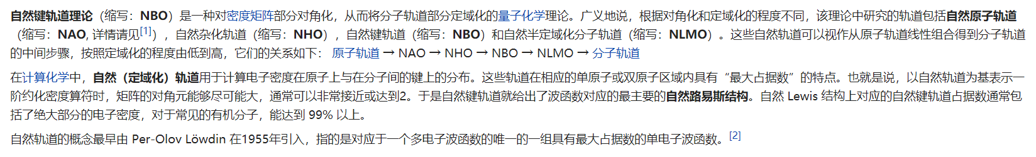
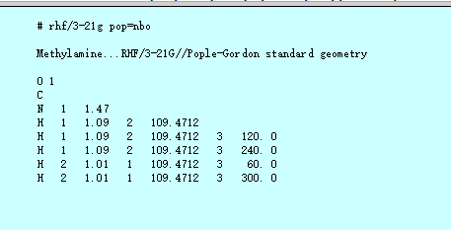
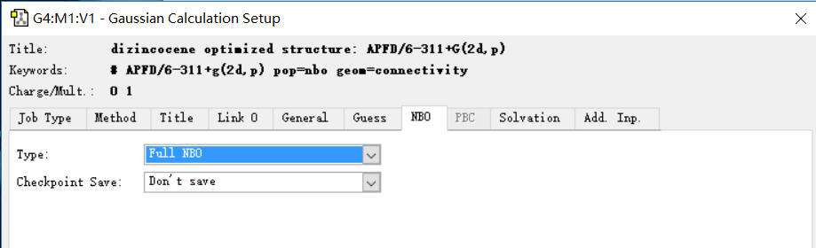
NBO

Slide 22
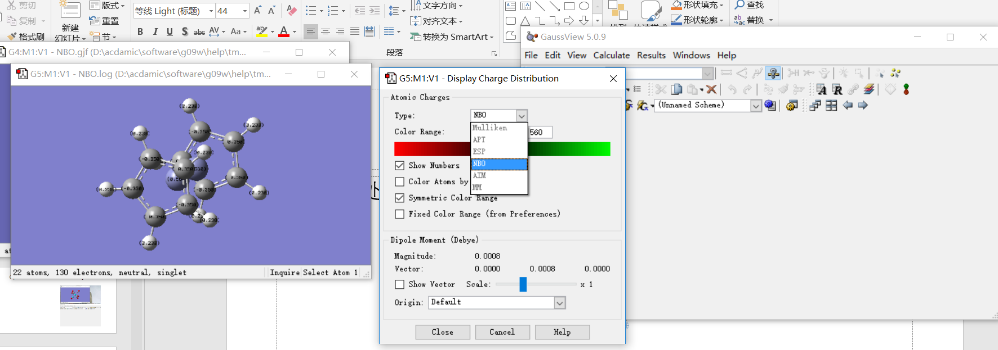
NBO
If use Mulliken method, charges on the carbon and hydrogen would be underestimated.

