Slide 1
Amber for beginner

Slide 2
contents
Basic ideas for MD
How to run MD with amber
How to generate parameter files for ligands
QM/MM
Umbrella sampling

Slide 3
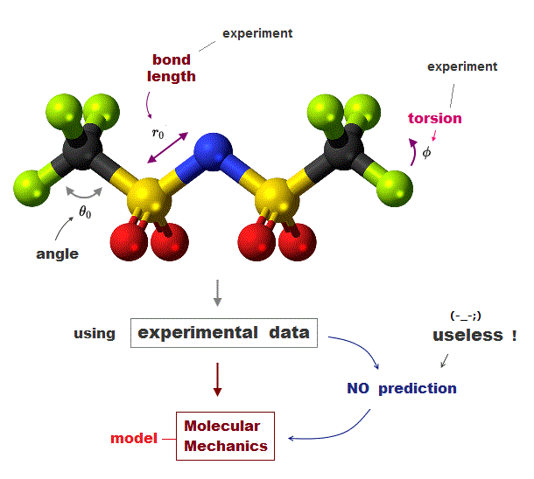
Basic Ideas For Molecular Mechanics
MM is based on a mathematical model of a molecule as a collection of balls(atoms) held together by springs(bonds).
The principle behind MM is to express the energy of a molecule as a function of its resistance toward bond stretching, bond bending, and atom crowding, and to use this energy equation to find the bond lengths, angles, and dihedrals corresponding to the minimum-energy geometry.

Slide 4
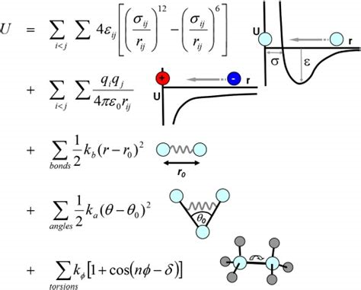



Forcefield
Forcefield function form in amber
to express the energy of a molecule as a function of its resistance toward bond stretching, bond bending, and atom crowding
(I add this for its picture)

Slide 5
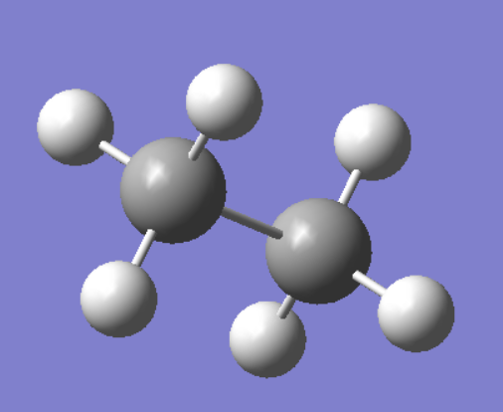
A simple example
For atom1:
Bond term: 1-3
Angle term: 1-3-2, 1-3-4, 1-3-6
Dihedral term: 1-3-6-5, 1-3-6-7, 1-3-6-8
2
1
5
3
I didn’t calculate non-bonded term here. Let’s say, for example, atom1 and atom8, there are two atoms between them, in some force field, non-bonded term would be calculated, while in some other force field, would not. But if there are three atoms between them, all force field would calculate non-bonded term.
6
4
8
7

Slide 6

Remember these laws?
$F_{x}=−\frac{∂U}{∂x}$
$F=ma$
$V_{t}=V_{0}+at$
$∆x= V_{0}t+$ $\frac{1}{2}at^{2}$

Slide 7
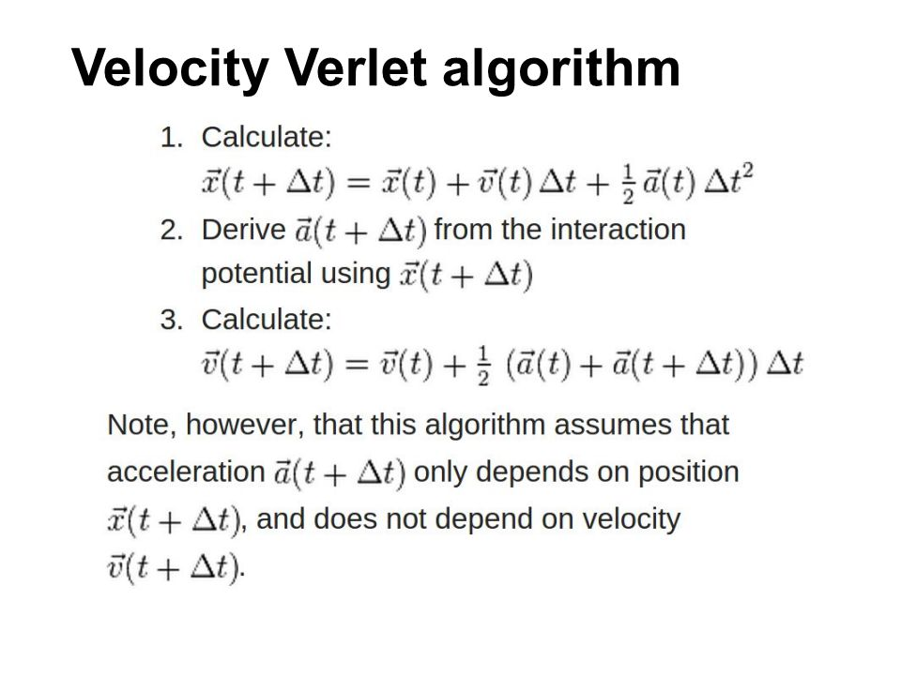

Slide 8

Leap-frog Algorithm
$v_{i}\left(t_{0}+{∆t}/2\right)=v_{i}\left(t_{0}−{∆t}/2\right)+∆t(f_{i}(t_{0})/m_{i})$
$r_{i}\left(t_{0}+∆t\right)=r_{i}\left(t_{0}\right)+∆tv_{i}\left(t_{0}+{∆t}/2\right)$
How to update r and v

Slide 9
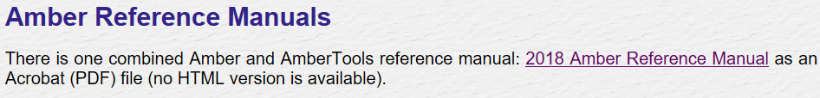
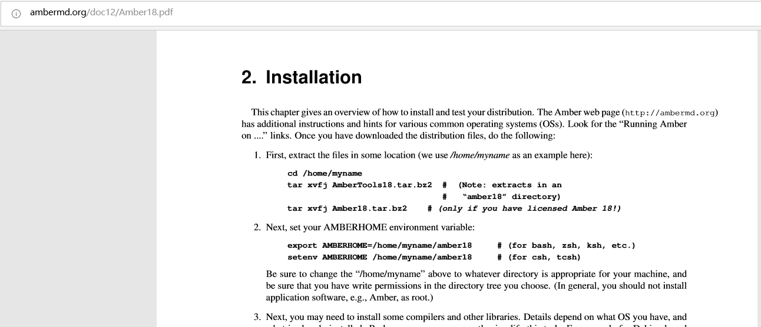
Install AmberTools and amber manual in your own computer
http://ambermd.org/Manuals.php
http://ambermd.org/AmberTools.php
Installation guide can be found in manual

Slide 10
How to use amber in hpc2?
Add these to your .bashrc
# Amber
export AMBERHOME=/share/apps/amber16
export PATH=$PATH:/share/apps/amber16/bin
export LD_LIBRARY_PATH=$LD_LIBRARY_PATH:$AMBERHOME/lib
export CUDA_HOME=/usr/local/cuda-7.5
export PATH=$PATH:$CUDA_HOME/bin
export LD_LIBRARY_PATH=$LD_LIBRARY_PATH:$CUDA_HOME/lib64
export LD_LIBRARY_PATH=$LD_LIBRARY_PATH:$AMBERHOME/lib:/share/intel/compilers_and_libraries/linux/lib/intel64
source /share/intel/impi/5.1.3.210/bin64/mpivars.sh

Slide 11
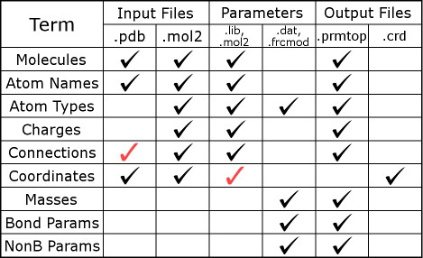
Run MD Simulation With Amber
We need to prepare two files: prmtop and crd.

Slide 12
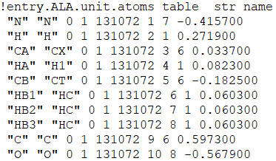
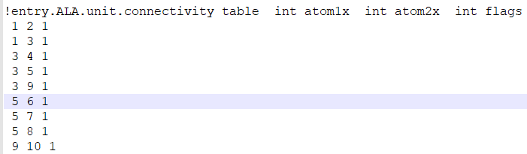
Lib File In Amber
So, charge and how atoms were connected can be found in .lib.
PDB atom name map to a amber atom type, and can be used to found related force field parameters in .frcmod.
In $AMBERHOME/dat/leap/lib, I download a amino12.lib.
How atoms are connected, for e.g, first line is 1 2 1, means atom1 is connect with atom2. Forget the third “1”. 1 2 is enough.
PDB atom name
charge
For example, atom1 which is N, is connect with atom2, which is H
Amber atom type

Slide 13
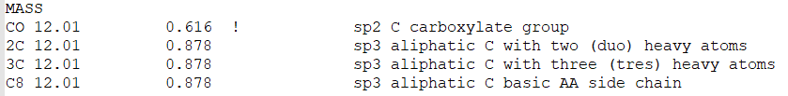
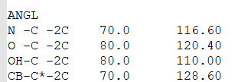
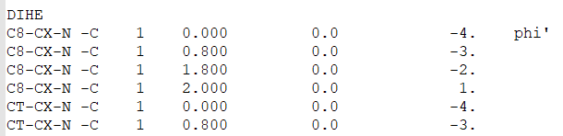

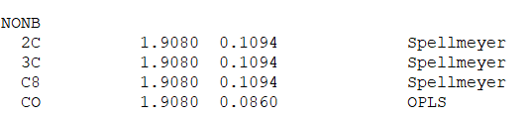

.dat or .frcmod files in amber
In $AMBERHOME/dat/leap/parm, I download a frcmod.ff14SB.
Amber Atom types
Force constant
k
equilibrium bond length
$$r_{0}$$

Slide 14
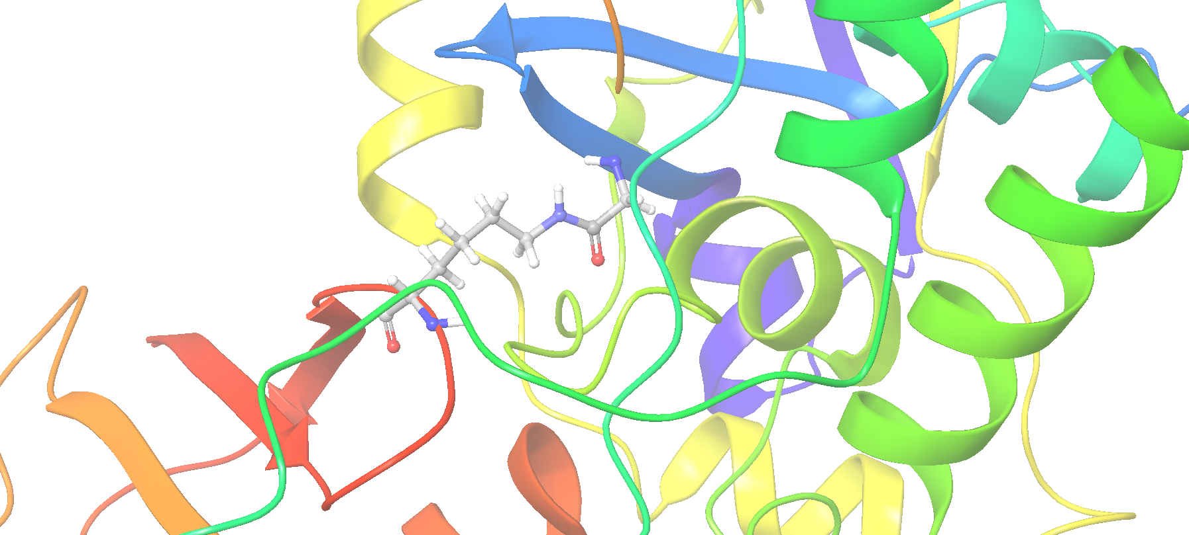
MD simulation with non-standard residues
Now, I have a structure. One Gly’s –COOH formed isopeptide bond with a Lys’s side chain. This two residues become non-standard residues, I have to generate parameter files for them.
Lys11 from chain B
Gly76 from chain C

Slide 15
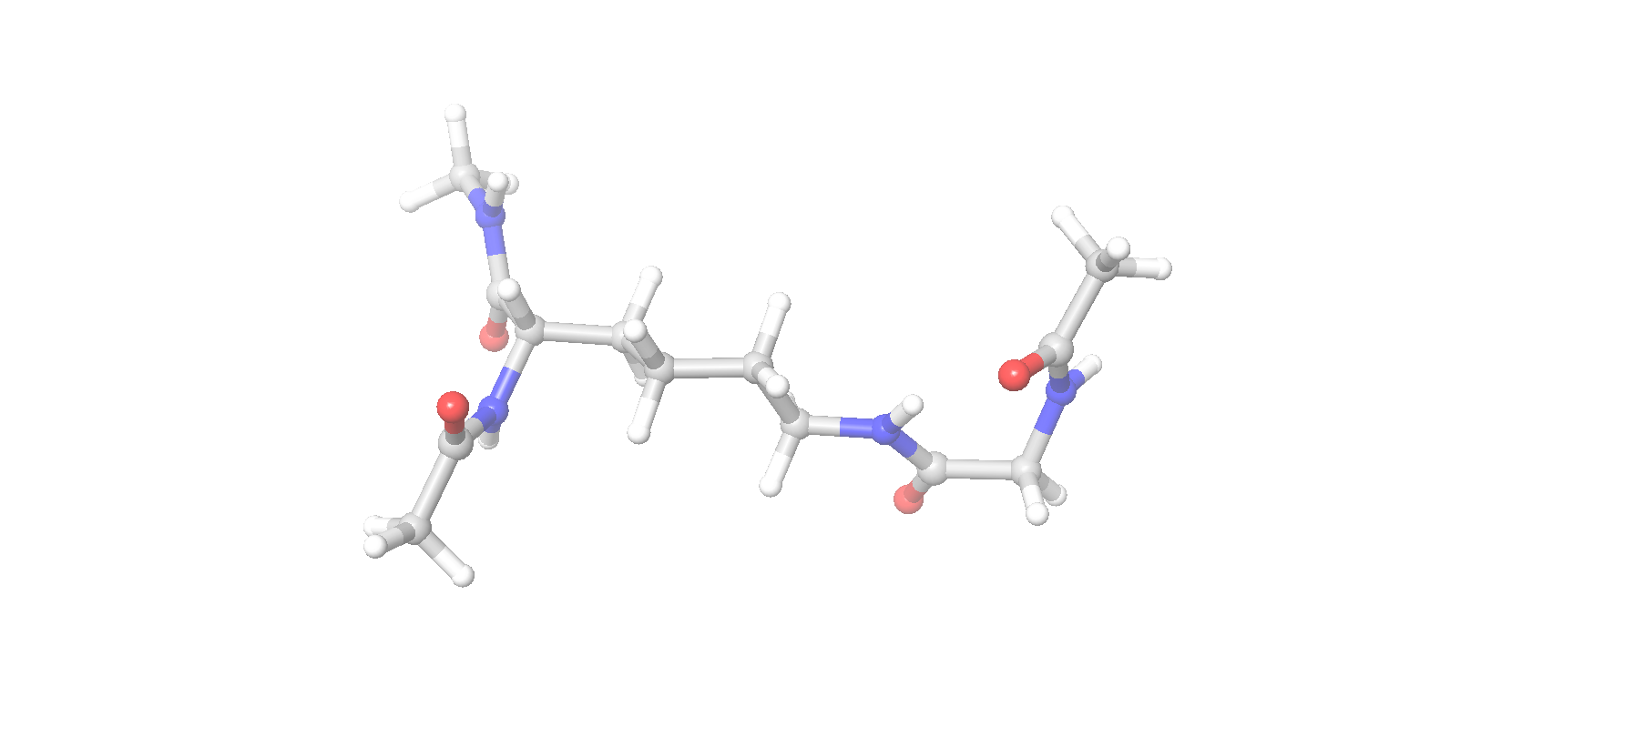
How to deal with non-standard residue
I copy these two residues to new entry, cap them with –COCH3 or –NHCH3. Save them as a new pdb named Mol_red1.pdb(This name is important for next step!!!).

Slide 16
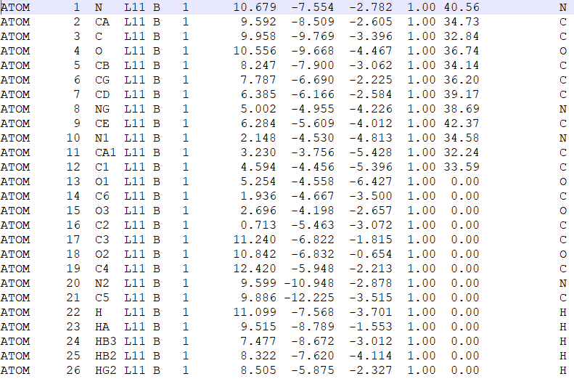
How to deal with non-standard residue
I edit the pdb file, to ensure that no two atoms have same name.
Atom number
14 15 16 36 37 38
20 21 42 43 44 45
17 18 19 39 40 41
Are capped atoms. Remember that.

Slide 17
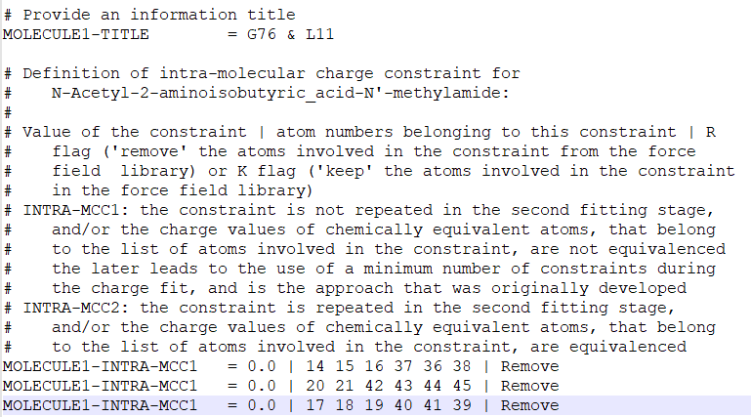
How to deal with non-standard residue
I generate a file named Project.config(this name is important!!!).
These three lines ensures that caped atoms would have zero net charge.
Compress these two files(Mol_red1.pdb, Project.config), to a Mol_red1.7z(many other types can be used.)

Slide 18
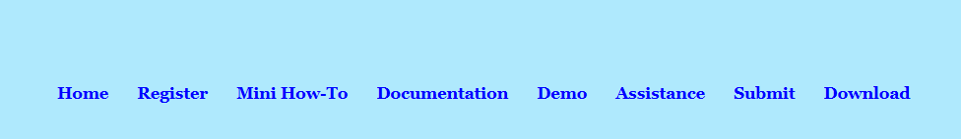
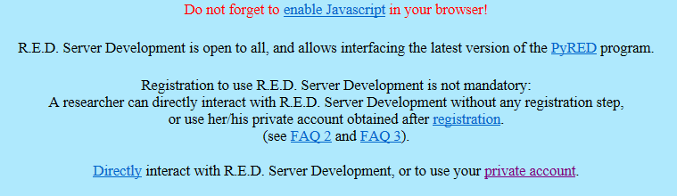

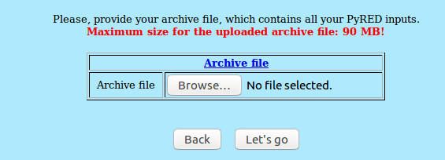
Generate lib and frcmod with PyR.E.D
http://upjv.q4md-forcefieldtools.org/REDServer-Development/
Please find and read manual!!!
Use your account
X 3
Upload zip file and go

Slide 19
Output from PyR.E.D
After the calculation is done, you will receive a e-mail with a link. It should be the fourth e-mail.
In /Data-R.E.D.Server/Data-Default-Proj, find frcmod.known and frcmod.unknown. Thank god if there is nothing in frcmod.unknown. Frcmod.known would be the forcefield file we need.
In /Data-R.E.D.Server/Mol_m1, find Statistics_m1.txt, charge data can be found. And also look for mol2 file you need, the one you need should be Mol-ia4_m1-c1.mol2.

Slide 20
Which to use
There would be two kinds of mol2 file, one like Mol-sm_m1-c1.mol2, the other Mol-ia4_m1-c1.mol2. Because I add charge restraint to exclude the cap atoms in my case, I will need files with ia in its name.

Slide 21
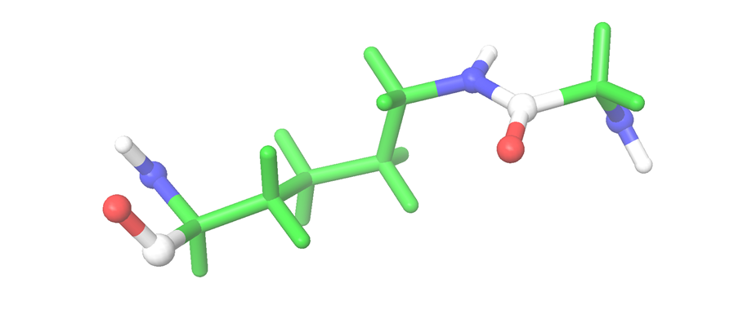
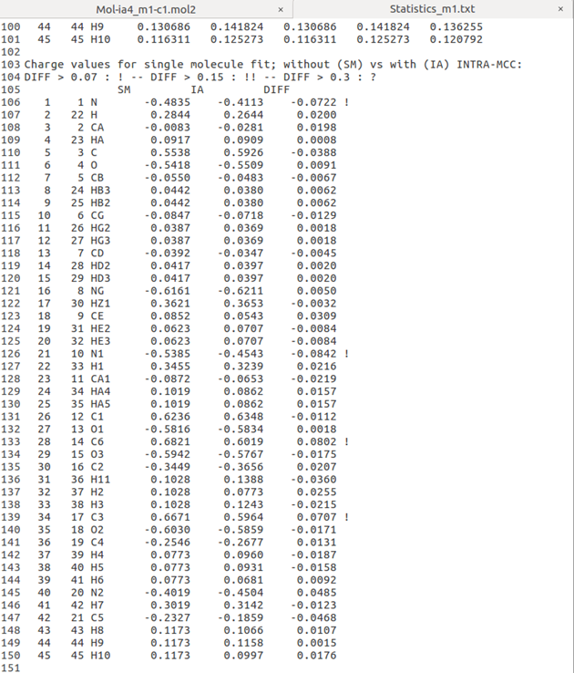
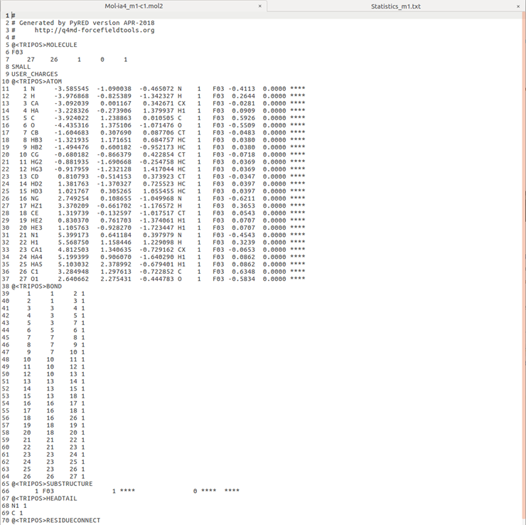
What’s in the mol2 file and Statistics_m1.txt
In Mol-ia4_m1-c1.mol2, cap atoms were deleted by the server. Because I marked cap atoms in Project.config file, remember?
That’s the charge I need, after charge fitting.
Amber atom type
I sum up these charges, it’s not zero, ah, I let go with it.
connectivity

Slide 22
Generate .lib files
From the result of PyRED I would know charge distribution. It would generate a mol2 file which contain connectivity information.
In my case here, I have two residues, but I submit them to PyRED as one. So I have to generate two individual .lib file on my own.
xleap would do the trick.

Slide 23
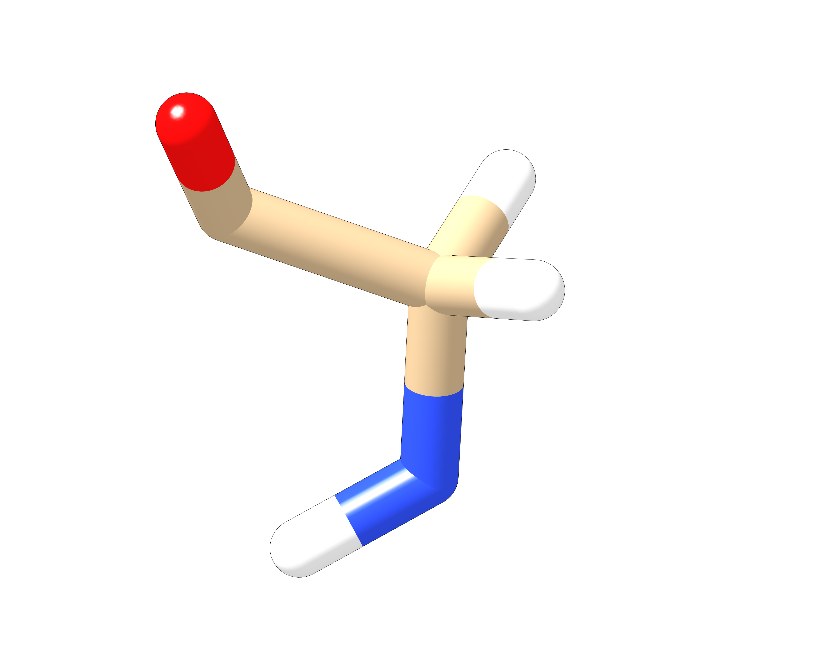
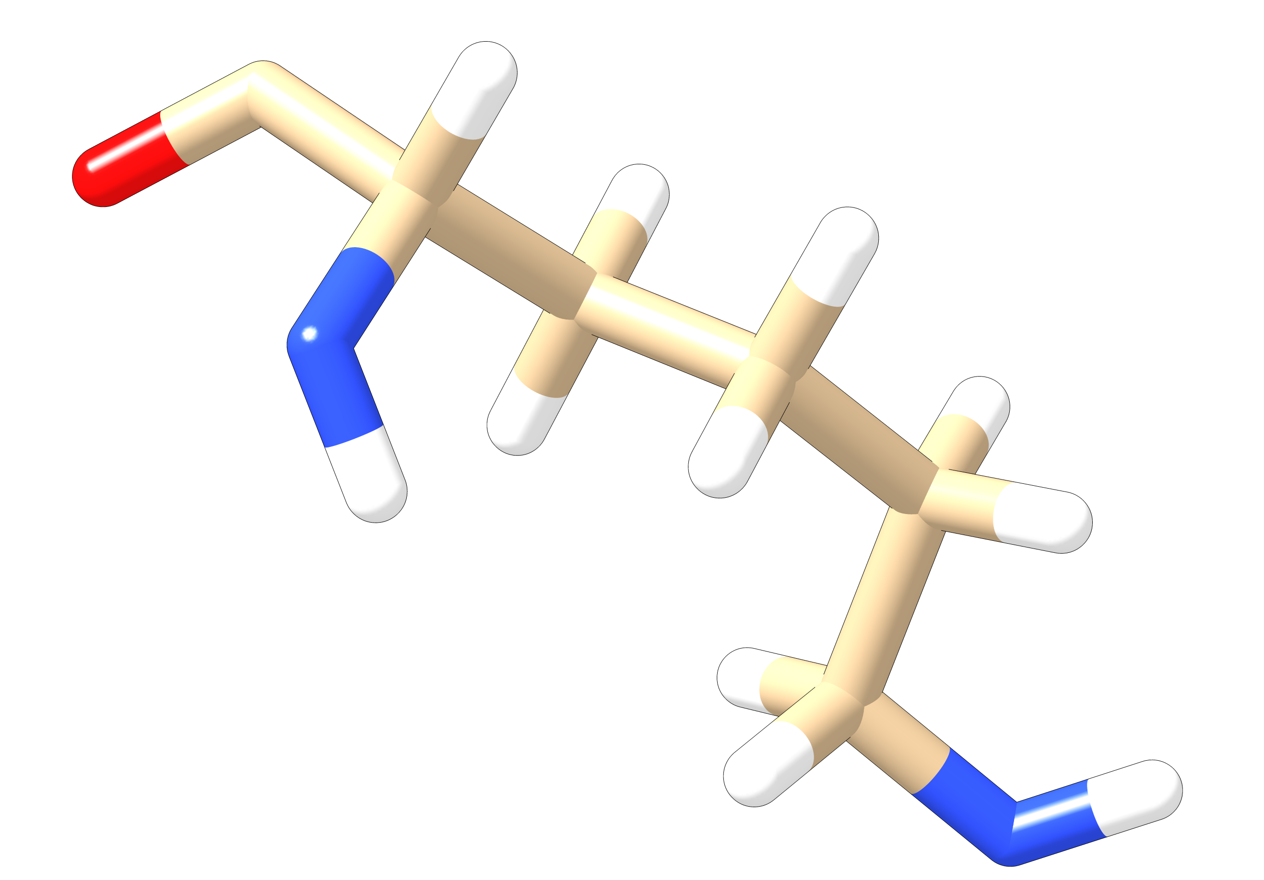
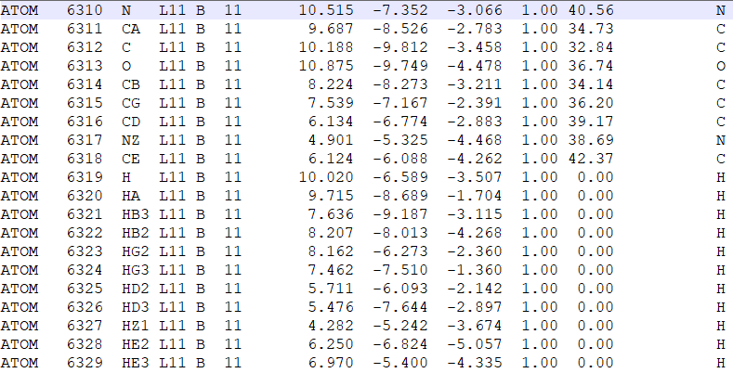
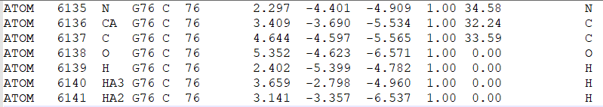
Generate two individual pdb
Retain all atom names, but rename the residue as L11
Retain all atom names, but rename the residue as G76

Slide 24
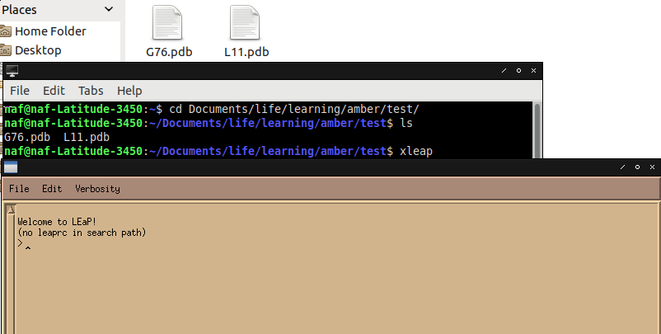
Construct .lib file in xleap
I need to generate .lib files for G76 and L11.
1. First, in a terminal, enter
xleap
2. Here enter
G76=loadPdb G76.pdb
edit G76

Slide 25
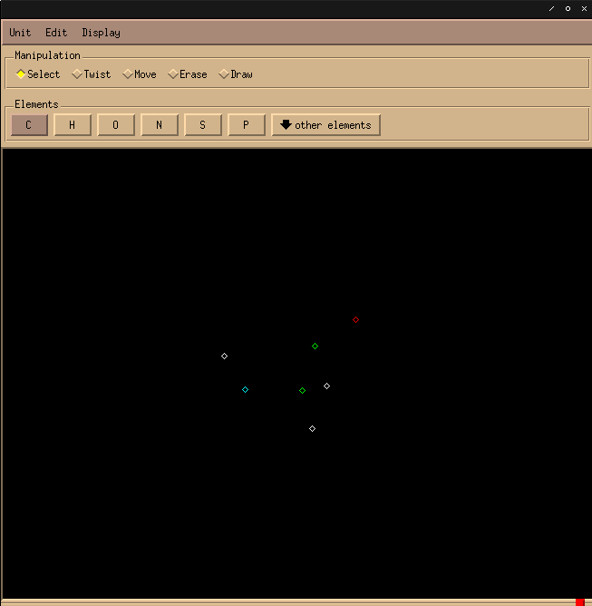
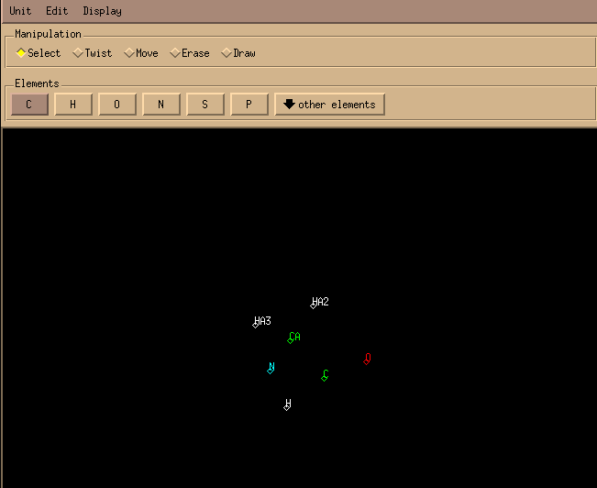
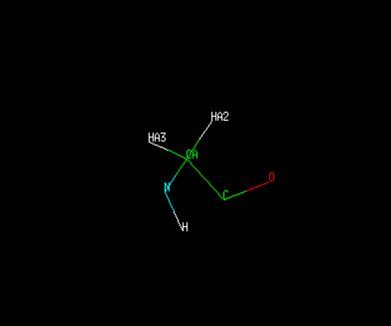
Construct .lib file in xleap
2. Use Draw, to connect atoms
A window would pop out
1. Display name

Slide 26
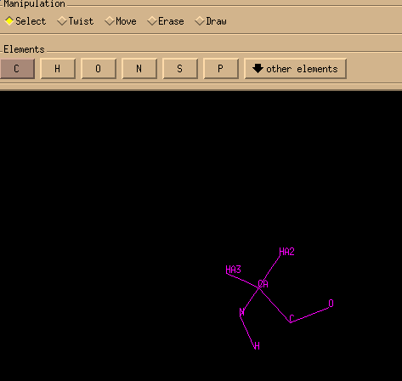
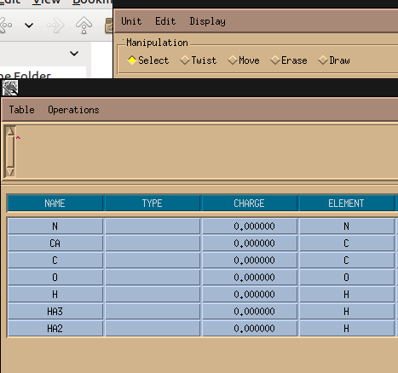
Construct .lib file in xleap
2. Then in edit, edit selected atoms
A new window would pop out
1. Select all the atoms

Slide 27
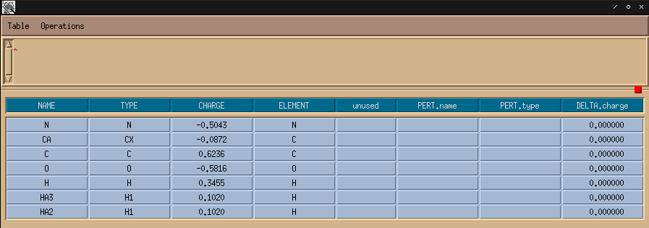
Construct .lib file in xleap
1. Fill in amber atom type and atom charge
This information come from the mol2 file generated by Py R.E.D
2. Then save
Never click that! It will exit xleap totally!!!!

Slide 28

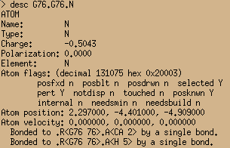
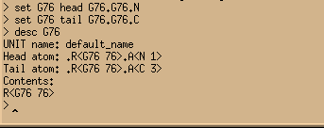

Construct .lib file in xleap
Now in xleap
1. desc G76, you could see some information
What is head and tail? In a protein, a amino acid would connect it’s last residue with its head atom, which is N; connect its next residue with it’s tail atom, which is C.
2. See, the N atom in G76
Inside a residue, how atoms are connected could be known by reading .lib file. Between residues, head and tail atoms were connected. That’s the way amber connect almost all the atoms in a protein. Some bonds like disulfide bond need further information.
3. Set head and tail
4. Now the lib is done, save it.

Slide 29
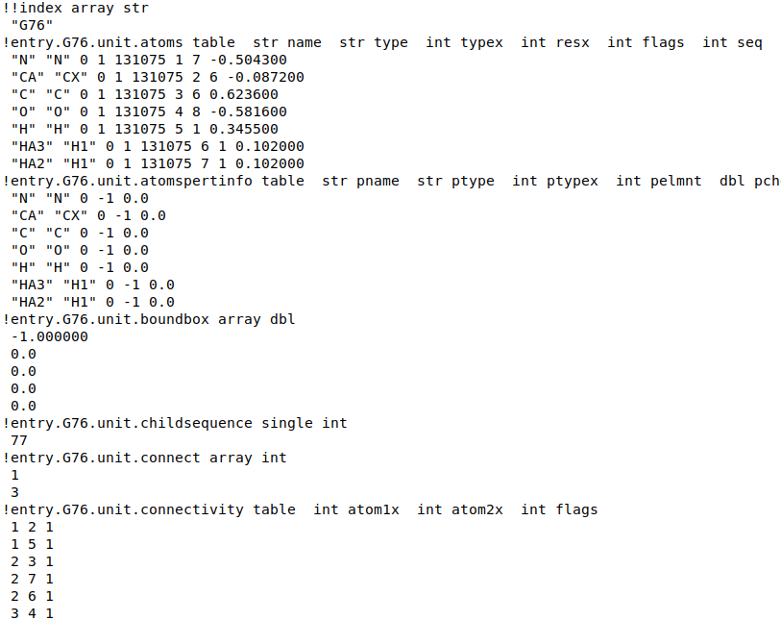
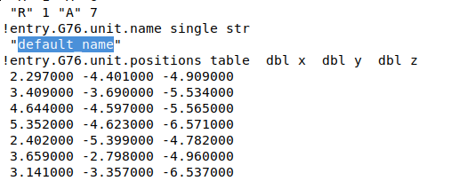
Construct .lib file in xleap
I would change this to G76
Open G76.lib, you can see pdb name
amber atom type
Charge
Connectivity
head and tail atoms.
Now a .lib file for non-standard residue is done

Slide 30
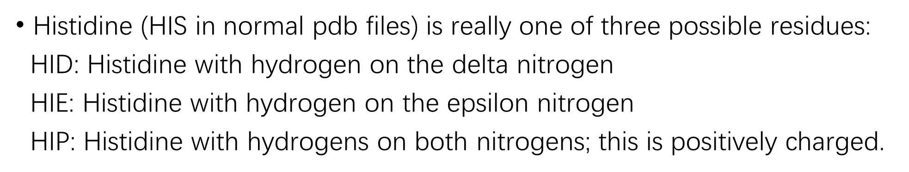
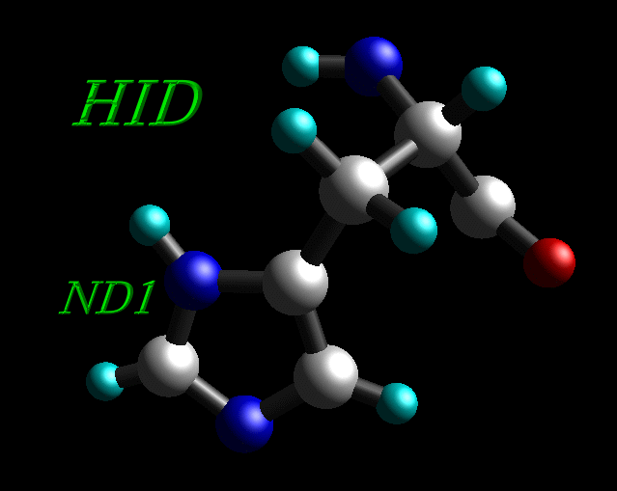
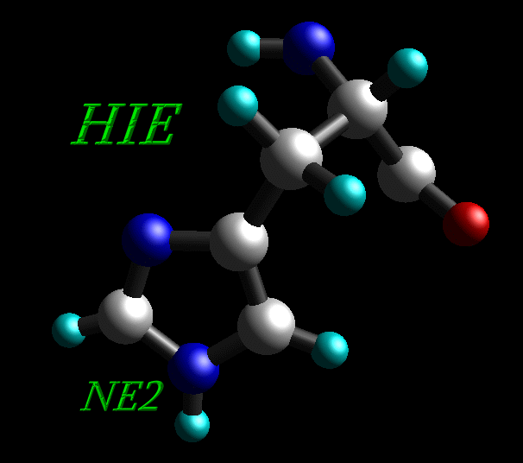
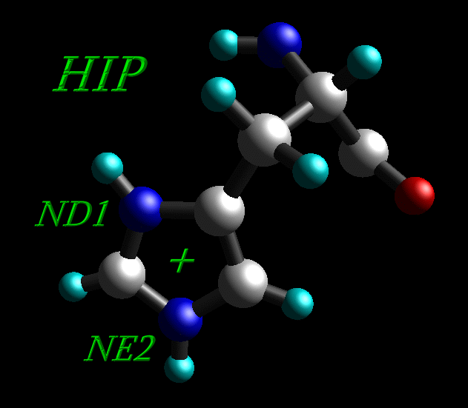
Residue naming conventions in amber
HD1
HE2

Slide 31
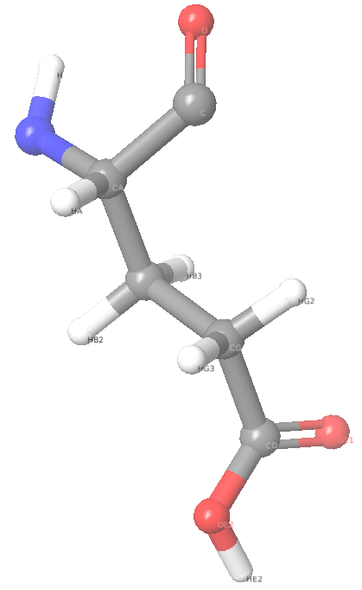
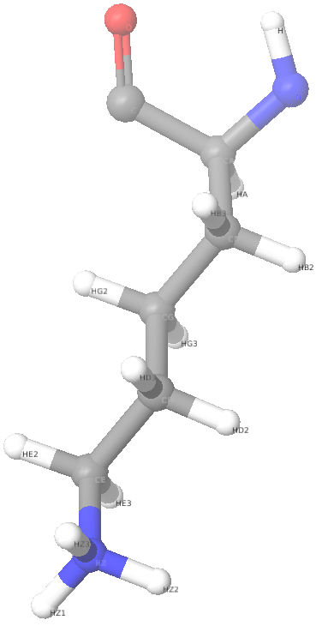
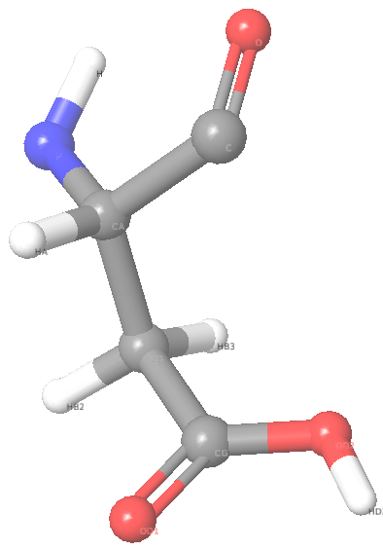
Residue naming conventions in amber
Cys: PDB residues named “CYS” are automatically converted into a free cysteine with a SH side chain end. If the cysteine is known to be in a S-S bridge, the residue name must be “CYX”. That SH would be called “HG” in PDB.
Asp, Glu, Lys: charged form would be ASP, GLU, LYS. Uncharged form must be “ASH”, “GLH”, “LYN”.
ASH
GLH
LYS
HZ1 would lost in LYN
HD2
HE2

Slide 32
Preprocess pdb file with Maestro
If we use maestro to do protein prepwizard. Usually atom names would be readable for amber. But residue name won’t change.
We should read the pdb file generated, and change it’s residue name according to H information. For example, if a GLU has a HE2, we should change it’s name to GLH. With this step, we could use maestro to generate charged state for protein and use it in amber.
I write a script to do that, usage:
python3 maestro2amber.py inputPDB outputPDB
Please read my script, ensure you understand what I am doing. If things go wrong, you’ll have to do it by hand.

Slide 33
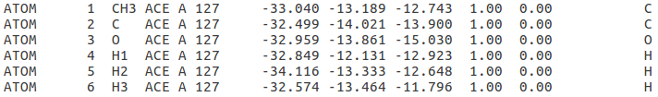
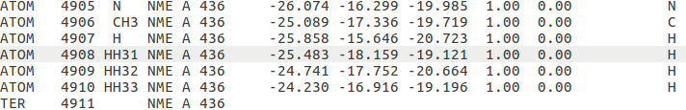
Preprocess pdb file with Maestro
In maestro, capped residues would be ACE and NMA.
In amber, corresponding residue names would be ACE and NME! And you need to change PDB atom names for ACE and NME.
For ACE, atom names would be H1,CH3,H2,H3,C,O
For NME, atom names would be N, H, CH3, HH31, HH32, HH33.
Do it by hand~

Slide 34


Rename non-standard residues
Rename the non-standard. So it has the same name with .lib file I made.

Slide 35

maestro name error
The output from maestro. Some atom name are wrong, I have to correct them by hand so it has the same name with records in .lib file.
In $AMBERHOME/dat/leap/lib, there are files called aminoacid12.lib, aminoacidnt12.lib, aminoacidct12.lib. That where you find right atom name for standard residues. For non-standard residues, look for your own .lib file.

Slide 36


Tleap and xleap
Open tleap or xleap
Load parameters for protein.
source leaprc.protein.ff14SB
source leaprc.water.tip3p
loadoff G76.lib
loadoff L11.lib
loadamberparams frcmod.known
mol = loadpdb Cez.pdb
check mol
Load parameters for water
Load self-made parameters
Load pdb file, use a variable name to hold it.
See if anything is wrong
In my case, things went wrong. Why?
If I see the pdb, for example, I will find for MET437, there are two hydrogen called H. I have to correct the atom name. look for the right atom name in .lib files

Slide 37

Save a pdb file from tleap
After adjust all atom names, in tleap, type
savepdb mol Cez_amber.pdb
If I look through this file, I will find there is a unexpected TER, delete it by hand. I don’t know why it’s here.

Slide 38

After everything is right
In a tleap or xleap:
source leaprc.protein.ff14SB
source leaprc.water.tip3p
loadoff G76.lib
loadoff L11.lib
loadamberparams frcmod.known
mol = loadpdb Cez_amber.pdb
bond mol.397.NZ mol.386.C
solvateBox mol TIP3PBOX 10.0
charge mol
addIons2 mol NA 0
saveAmberParm mol cez.prmtop cez.inpcrd
This command create a bond between two atoms
Solvate the structure
See the net charge of the mol, in this case it’s negative
Use Na+ to neutralize the charge to zero
Save .prmtop and .inpcrd files for MD simulation

Slide 39
All steps for a membrane protein
All comes from Wu Meng’s experience.
Preprocess pdb file
Use charm-GUI to generate membrane
Convert charm format files into amber readable files
Generate .lib and .frcmod files for ligands
Generate .prmtop and .inpcrd file
Run simulation

Slide 40
Use charm-GUI to generate membrane

Slide 41
Convert charm format files into amber readable files

Slide 42
Generate .lib and .frcmod files for ligands

Slide 43
Generate .prmtop and .inpcrd file

Slide 44
Run simulation

Slide 45
After simulation
In a terimal:
cpptraj
In the cpptraj:
parm cez_sol.prmtop
trajin cez_MD_continue.crd
autoimage
reference cez_sol.inpcrd
rmsd rms1 reference :1-462@CA
trajout cez_MD_continue_image_rmsfit.nc netcdf
run
quit
Now cez_MD_continue_image_rmsfit.nc is ready to be loaded into VMD

Slide 46
View result in VMD
https://www.ks.uiuc.edu/Training/Tutorials/
https://www.ks.uiuc.edu/Research/vmd/current/ug/node122.html

Slide 47
QM/MM
This is a simple QM/MM control file
Example QM/MM input for sander - gaussian interface &cntrl
imin=1,maxcyc=10, ntb=0, cut=20, ifqnt=1,
&end
&qmmm
qmmask='@11-21', qmcharge=0, spin=1, qm_theory='EXTERN', qmcut=20.0,
&end
&gau
method=B3LYP, basis=6-31G, num_threads = 8, mem='1GB’,
&end
Use QM method
Atom mask, which atoms are treated with QM
Use external software to do QM calculation
Use gaussion
8 cores for gaussion

Slide 48

Atom mask in amber

Slide 49
Umbrella sampling
I’m working on it

