Slide 1
More in Maestro

Slide 2
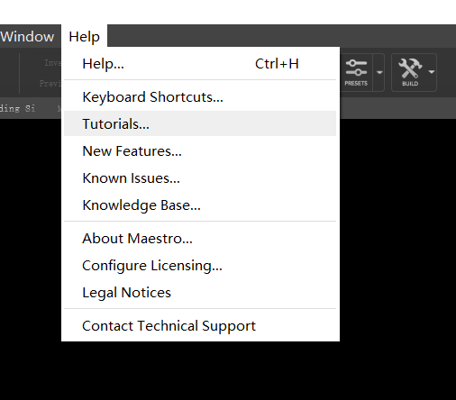
learning
这份ppt是我自己看maestro内置教程的一个随手摘录，已经不是示范了，会非常简略。
点开tutorial，自己学习吧

Slide 3
Accounting for Protein Flexibility
Protein are much more dynamic than the static pictures captured in PDB structure files and exploiting these dynamics can be a good approach to tackling difficult drug design problems
Scenarios that suggest flexibility is present
When a ligand is experimentally known to bind to a protein but rigid docking with glide is unable to capture it
When a large ligand is known to fit in a relatively small active site
When the overlay of numerous crystal structures suggest clear variation in either side chain or loop positions
When high B-factors around the protein binding site indicate mobility

Slide 4
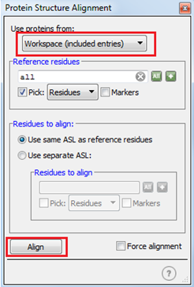
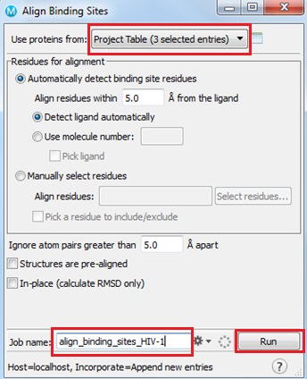
Aligning Protein Crystal Structures

Slide 5
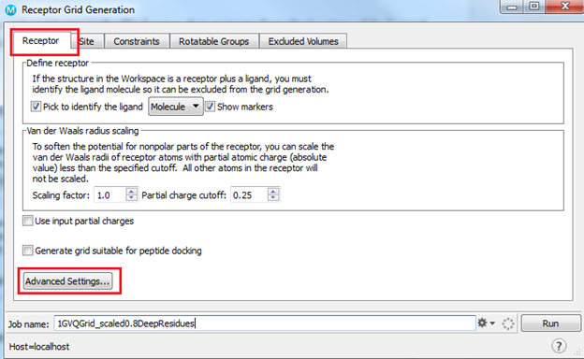
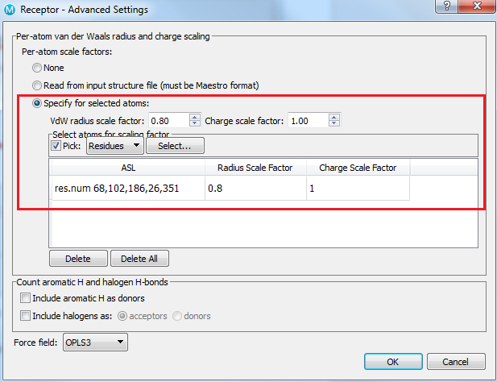
Softening the Potential in Glide
It should be clear that softening the potential will create more room by scaling back the VDW radii by some amount. This alleviates some problems of working with a rigid receptor grid, as seen in this case, but scaling back does not physically move residue coordinates. In the case of 1GVQ, which can also dock prednisone and progesterone, scaling alone would not facilitate docking of these larger molecules, and we would need to turn to a full induced fit docking protocol.

Slide 6
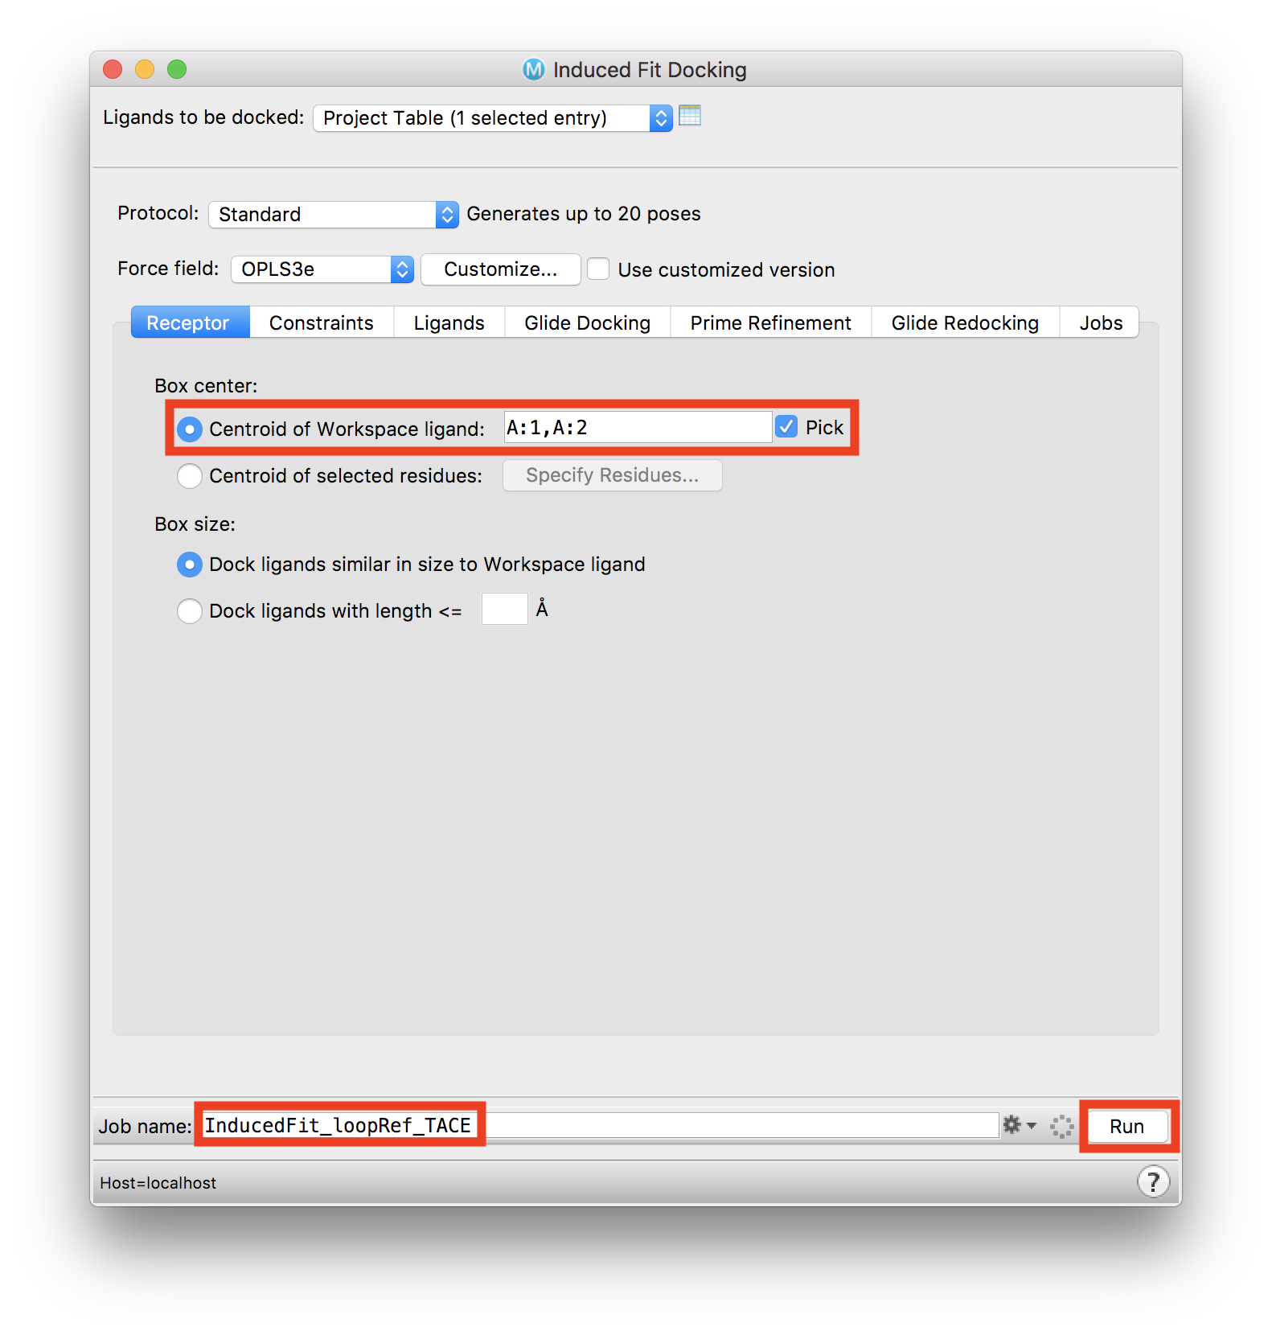
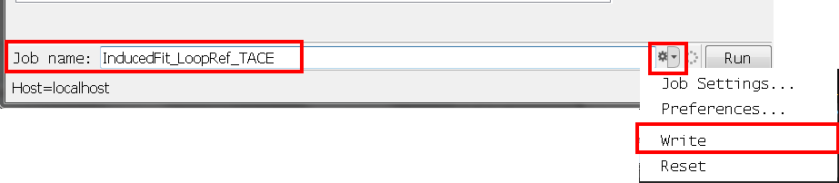
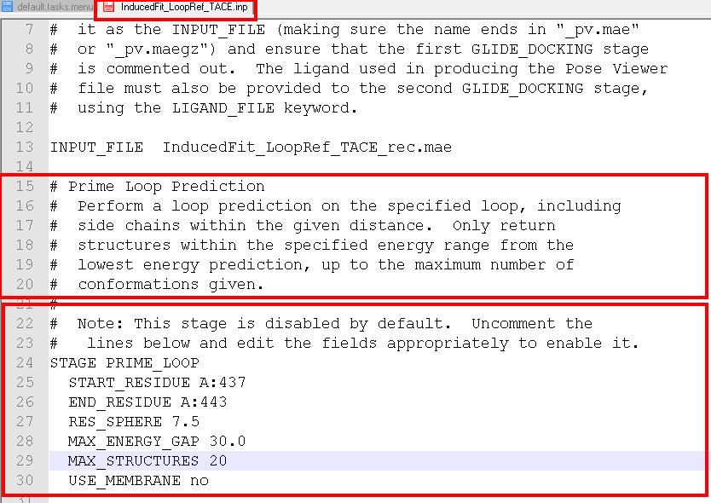
Set up a Loop Refinement in IFD
Set the Job name to InducedFit_LoopRef_TACE and use Settings (cog) > Write to write out the input files
This creates a directory, in which we will edit the *.inp file
Edit the section for Prime Loop Refinement following instructions in the text
Remove hashes
Define start residue (437) and end residue (443)
Max structures 20
Save changes to the file
We now run the job from the command line. A job that typically takes 2+ days to complete on a single CPU is more ideally suited to a cluster and should be submitted to a queue
Type $SCHRODINGER/ifd -h for details on job options
Using Job Control Options, choose where the job should be run. Pregenerated results are provided that are analyzed in the next section
To run the job, in a terminal type the following plus any job options: $SCHRODINGER/ifd InducedFit_LoopRef_TACE.inp

Slide 7
Building QSAR Models with AutoQSAR/DeepChem
Quantitative structure–activity relationship models (QSAR models) are regression or classification models used in the chemical and biological sciences and engineering. Like other regression models, QSAR regression models relate a set of "predictor" variables (X) to the potency of the response variable (Y), while classification QSAR models relate the predictor variables to a categorical value of the response variable.
In QSAR modeling, the predictors consist of physico-chemical properties or theoretical molecular descriptors of chemicals; the QSAR response-variable could be a biological activity of the chemicals. QSAR models first summarize a supposed relationship between chemical structures and biological activity in a data-set of chemicals. Second, QSAR models predict the activities of new chemicals.

Slide 8
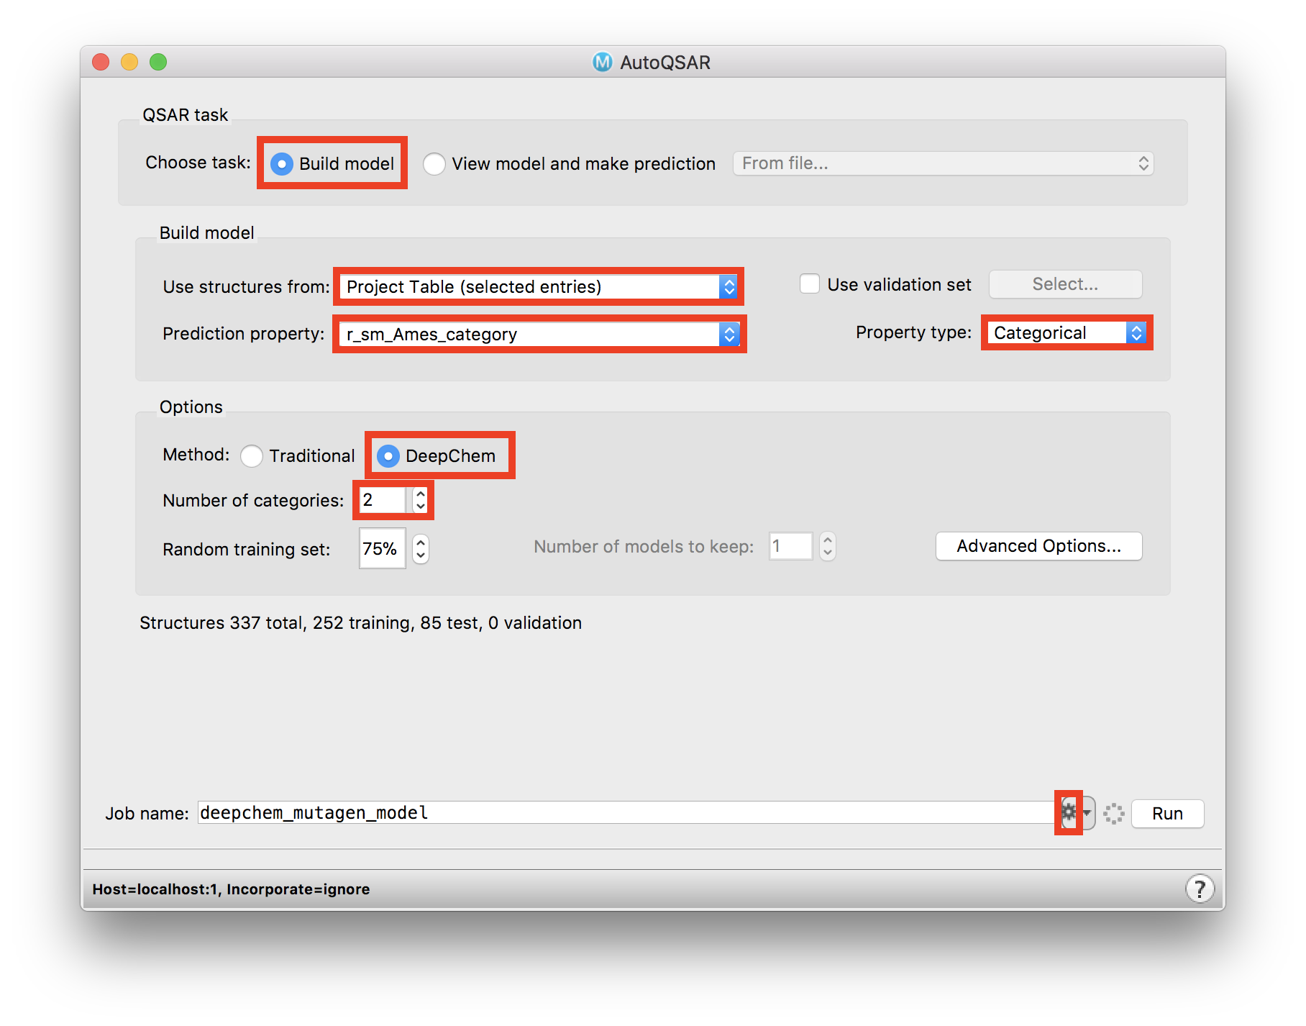
Building QSAR Models with AutoQSAR/DeepChem

Slide 9
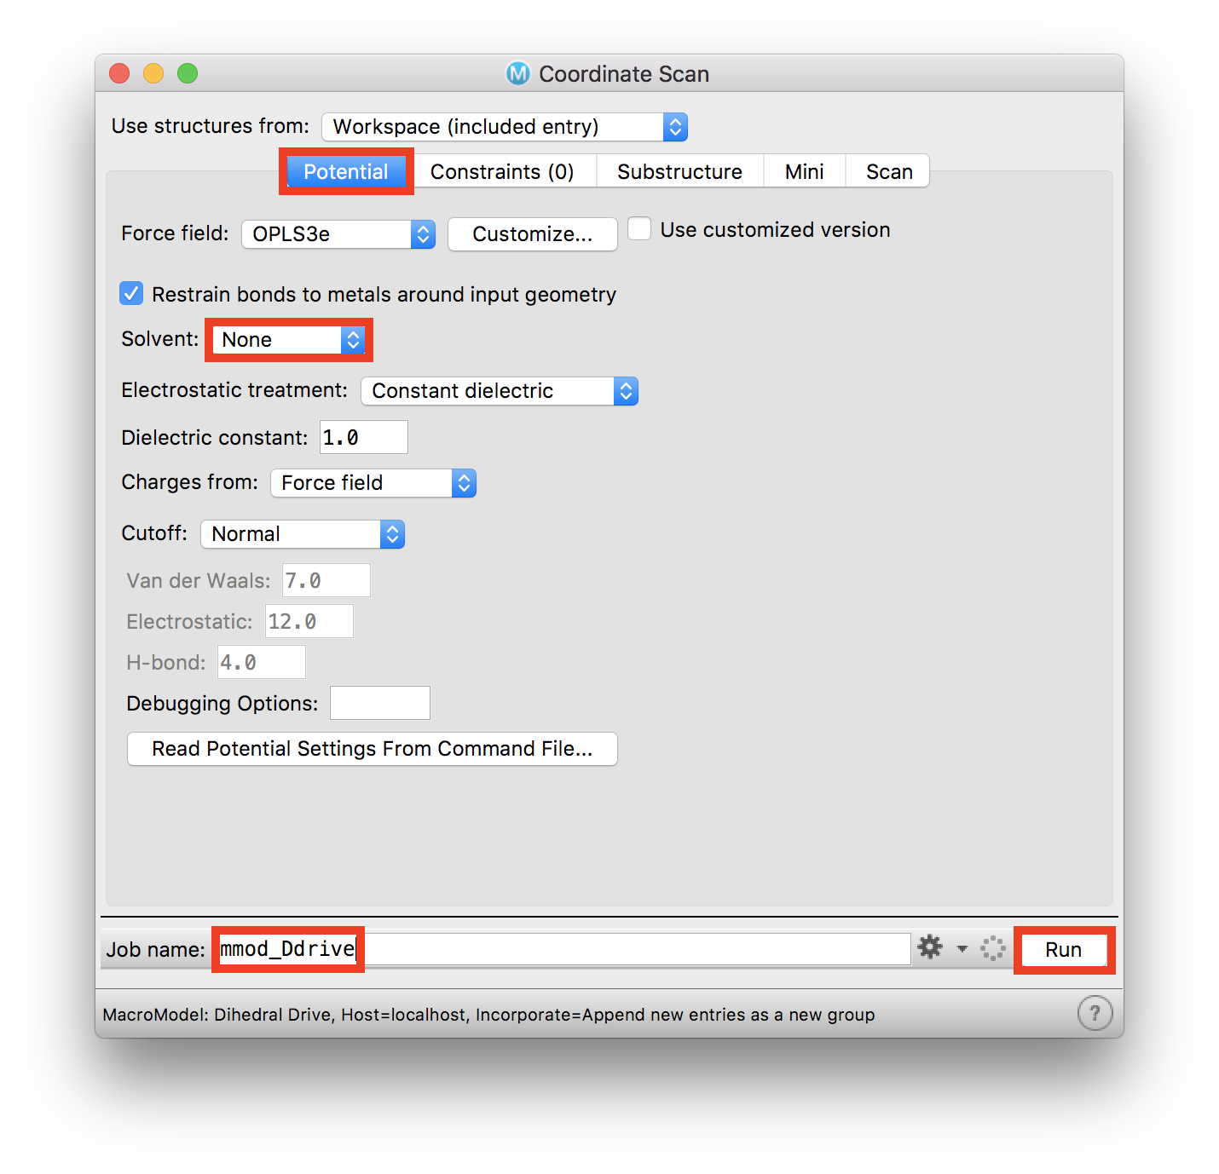
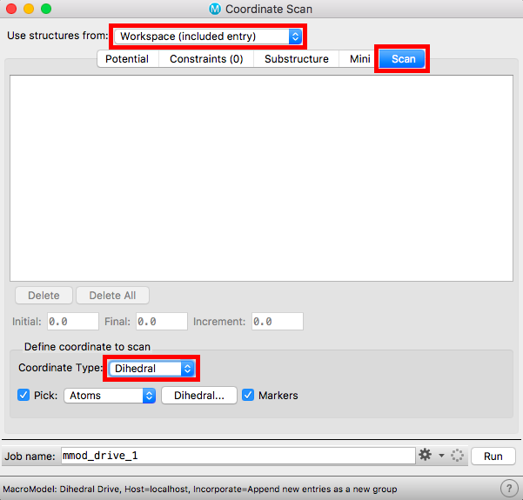
Conformational Analysis for Small Molecules Using MacroModel and ConfGen
Scanning Torsions

Slide 10
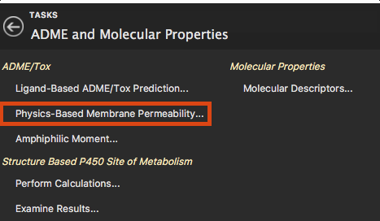
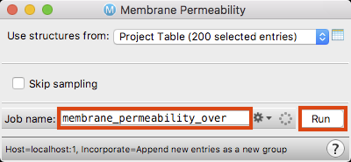
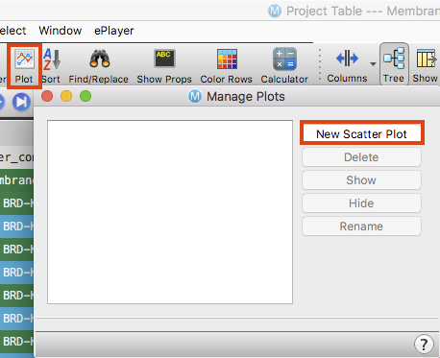
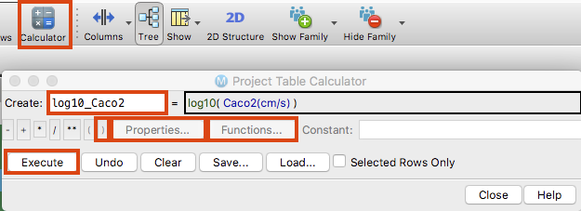
Predicting Membrane Permeability

Slide 11
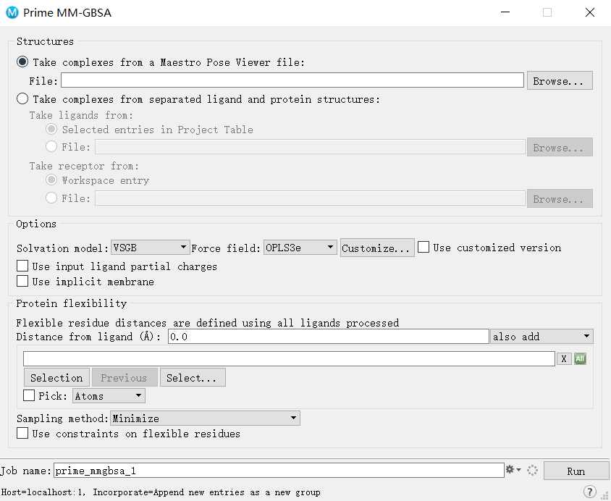
MM-GBSA
可以用于微调结合构像，把结果变得更好

Slide 12
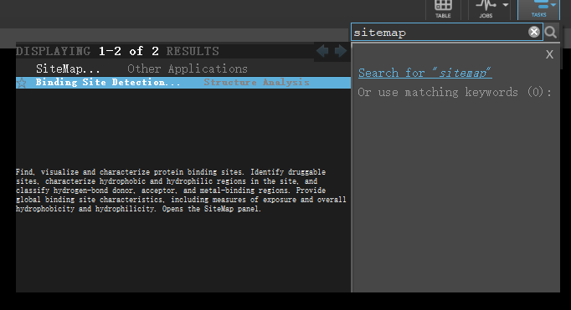
Sitemap
找口袋

Slide 13
And more......

