Slide 1
Free Energy Calculation

Slide 2
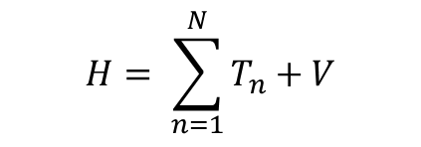


Hamiltonian
$$H=T+V$$
The Hamiltonian can represent the total energy of the system, which is the sum of kinetic and potential energy, traditionally denoted T and V
$$H= \sum_{n=1}^{N}{T_{n}+V}$$
$$V=V(1,2,3,4…N)$$
For many particle system, the Hamiltonian is the sum of all particle’s kinetic energy and a potential energy related to all particles.
In a word, Hamiltonian represent the total energy of the system, which can be separate into kinetic energy and potential energy.

Slide 3
Ensemble
系综
an ensemble (also statistical ensemble)
is an idealization consisting of a large number of virtual copies (sometimes infinitely many) of a system, considered all at once, each of which represents a possible state that the real system might be in.
In other words, a statistical ensemble is a probability distribution for the state of the system.
假设我们想要知道一个骰子掷出6的概率，通常是把时间延长，进行无数多次投掷实现的。但也可以通过把无数多同样的骰子分给众人，让众人在相同条件下同时掷骰子（系综）来实现。
a MD simulation
at
NVT ensemble: number of particles, volume and temperature are fixed
constant volume and temperature
NPT ensemble: number of particles, pressure and temperature are fixed
constant pressure and temperature

Slide 4
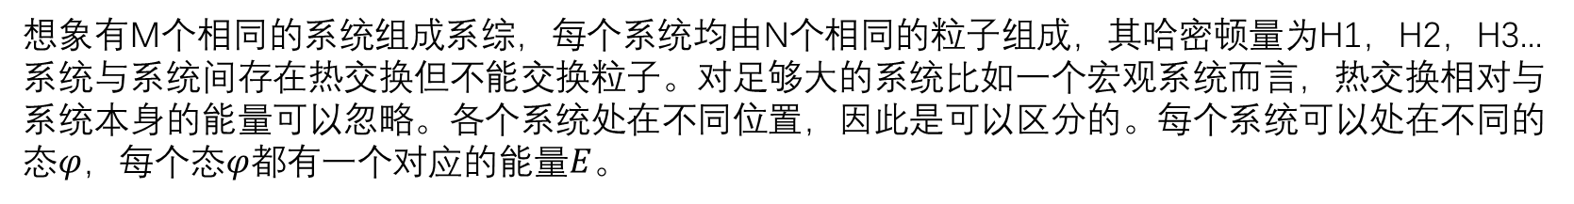
NVT ensemble
正则系综
想象有M个相同的系统组成系综，每个系统均由N个相同的粒子组成，其哈密顿量为H1，H2，H3...系统与系统间存在热交换但不能交换粒子。对足够大的系统比如一个宏观系统而言，热交换相对与系统本身的能量可以忽略。各个系统处在不同位置，因此是可以区分的。每个系统可以处在不同的态$φ$，每个态$φ$都有一个对应的能量$E$。
假设只知道系综总能量为$ε$，并不知道某系统处在哪个态$φ_{j}，$那某系统处在态$φ_{j}$上的概率是多少？

Slide 5
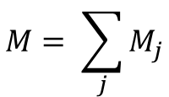
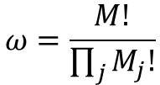
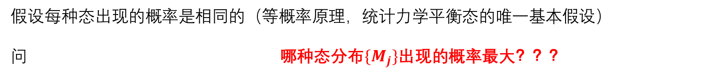
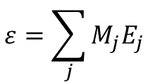
NVT ensemble
设系统总数为$M$，系综总能量为$ε$，$M_{j}$表示在$φ_{j}$态上的系统数，$E_{j}$表示第$j$个态上的能量。
则有
$$M= \sum_{j}{M_{j}}$$
$$ε=\sum_{j}{M_{j}E_{j}}$$
总的系统数
总能量
给定一个态的分布$\{M_{j}\}$（此分布表示给定每种态含有的系统数目，其中有$M_{j}{处于φ}_{j}$态， $j$不特指某个态）
但各系统的状态没有决定，比如知道有3个系统在$j_{1}$态，但不知道是哪3个系统。
则有对某一种分布$\{M_{j}\}$，系综可能的态数为
$$ω=\frac{M!}{\prod_{j}{M_{j}!}}$$
证明$:M$个系统所有不同排列的总数是$M!$，但同一状态的系统之间的交换不产生新的态，应除去
比如一个由三个系统组成的小系综，如果一个系统处在$j_{1}$态，二个系统处在$j_{2}$态，系综的态数为$ω=\frac{3!}{1!2!}=3$
假设每种态出现的概率是相同的（等概率原理，统计力学平衡态的唯一基本假设）
问 哪种态分布$\{M_{j}\}$出现的概率最大？？？

Slide 6
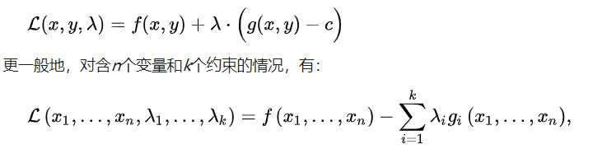
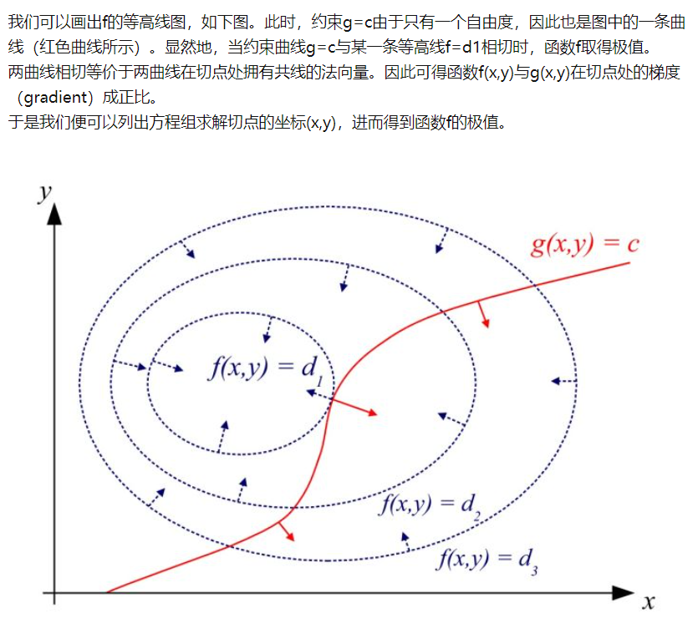
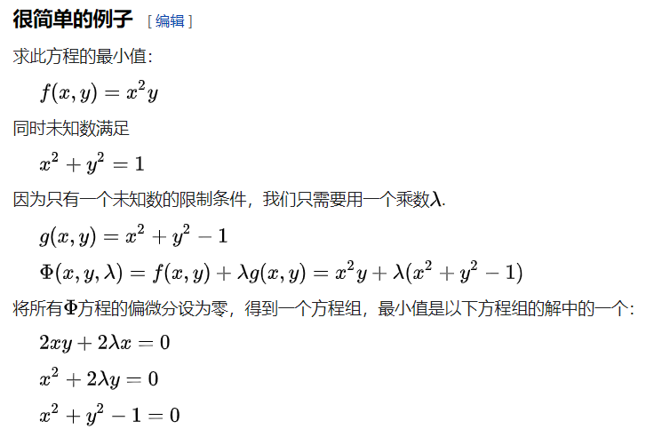
拉格朗日乘子法

Slide 7


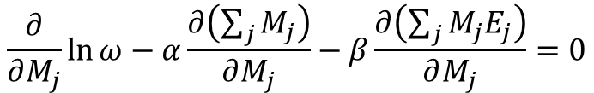


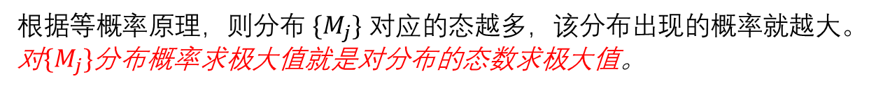
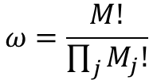

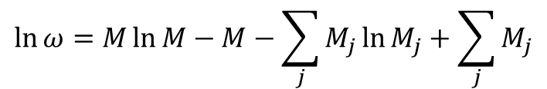


NVT ensemble
根据等概率原理，则分布$\{M_{j}\}$对应的态越多，该分布出现的概率就越大。对$\{M_{j}\}$分布概率求极大值就是对分布的态数求极大值。
使用拉格朗日乘子法，极值的条件是
$$\frac{∂}{∂M_{j}}\ln{ω}−α\frac{∂\left(\sum_{j}{M_{j}}\right)}{∂M_{j}}−β\frac{∂\left(\sum_{j}{M_{j}E_{j}}\right)}{∂M_{j}}=0$$
式1
当$M≫1$时，有斯特林公式$\ln{n!}≈n\ln{n}−n$
$$ω=\frac{M!}{\prod_{j}{M_{j}!}}$$
得到
$$\ln{ω}=M\ln{M}−M−\sum_{j}{M_{j}\ln{M_{j}}+\sum_{j}{M_{j}}}$$
由于
由于$M$是固定的
有
$$\frac{∂\ln{ω}}{∂M_{j}}=−\ln{M_{j}}$$
$$\frac{∂M}{∂M_{j}}=1$$
$$\frac{∂ε}{∂M_{j}}=E_{j}$$
代入式1，对某一$M_{j}$求偏导
$$−\ln{M_{j}−α−βE_{j}=0}$$
有
$$M_{j}=e^{−α−βE_{j}}$$

Slide 8
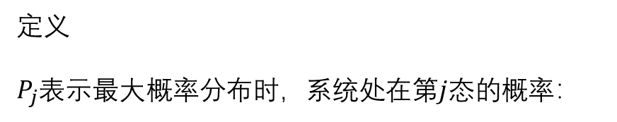


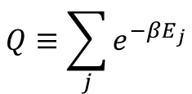
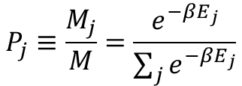
配分函数
我们有了
$$M_{j}=e^{−α−βE_{j}}$$
定义
$P_{j}$表示最大概率分布时，系统处在第$j$态的概率：
$$P_{j}≡\frac{M_{j}}{M}=\frac{e^{−βE_{j}}}{\sum_{j}{e^{−βE_{j}}}}$$
定义
配分函数
$$Q≡\sum_{j}{e^{−βE_{j}}}$$
可以证明$β=\frac{1}{kT}$

Slide 9
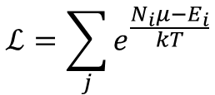



配分函数与亥姆霍兹自由能（NVT系综）以及吉布斯自由能（NPT系综）
亥姆霍兹自由能
$$F=−kT\ln{Q}$$
对NPT系综
$$ℒ=\sum_{j}{e^{\frac{N_{i}μ−E_{i}}{kT}}}$$
配分函数
$μ$为粒子的化学势
吉布斯自由能
$$G=−kT\ln{ℒ}$$

Slide 10
Ergodic theory
The idea behind Molecular Dynamics simulations is precisely that we can study the average behavior of a many-particle system simply by computing the natural time evolution of that system numerically and averaging the quantity of interest over a sufficiently long time.
即用对时间的平均代替对系综的平均
虽然只要时间足够长，体系可以遍及相空间中所有允许的相格，但是实际计算中这个时间可能真的是需要无穷长！而且由于算法的原因，分子动力学模拟程序也不能保证用的程序能满足这个遍历假设。所以，一般说来我们都觉得多条较短的轨迹一定比一条较长的轨迹“好”。

Slide 11
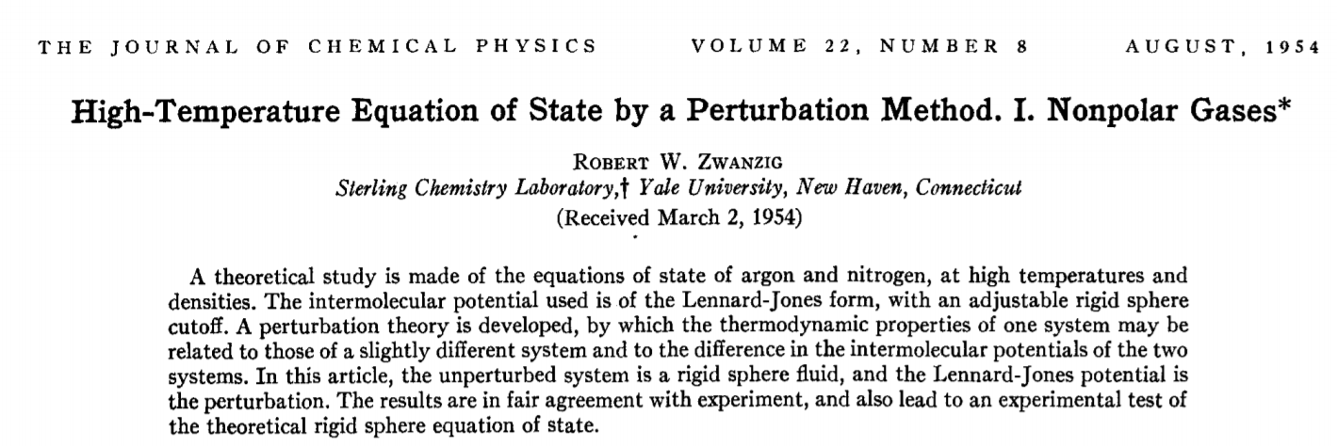
Free energy perturbation
Free energy perturbation (FEP) is a method based on statistical mechanics that is used in computational chemistry for computing free energy differences from molecular dynamics or Metropolis Monte Carlo simulations.
The FEP method was introduced by Robert W. Zwanzig in 1954.

Slide 12
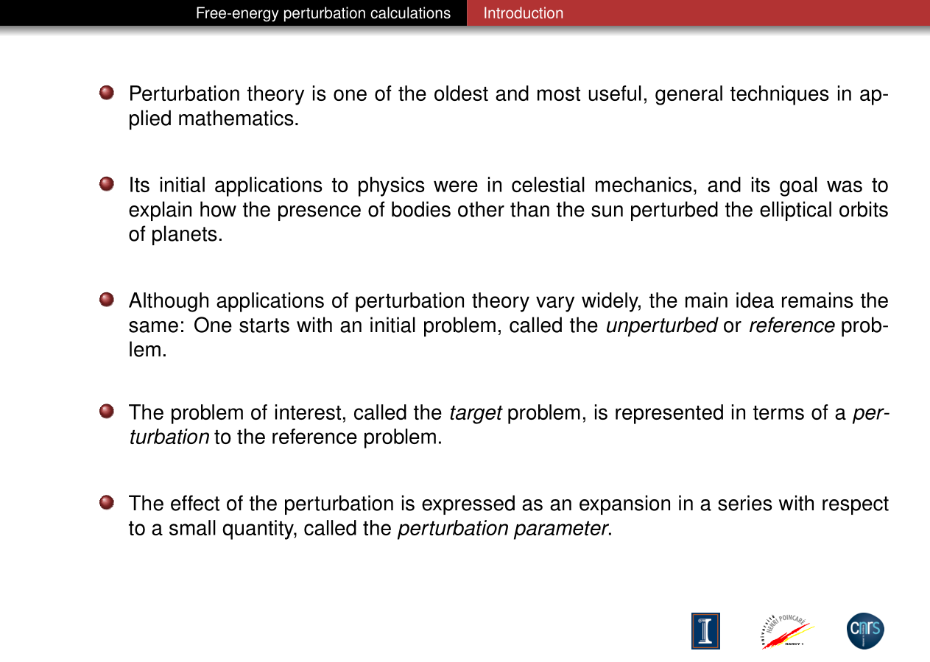
https://www.ks.uiuc.edu/Training/Workshop/Urbana_2010A/lectures/TCBG-2010.pdf

Slide 13
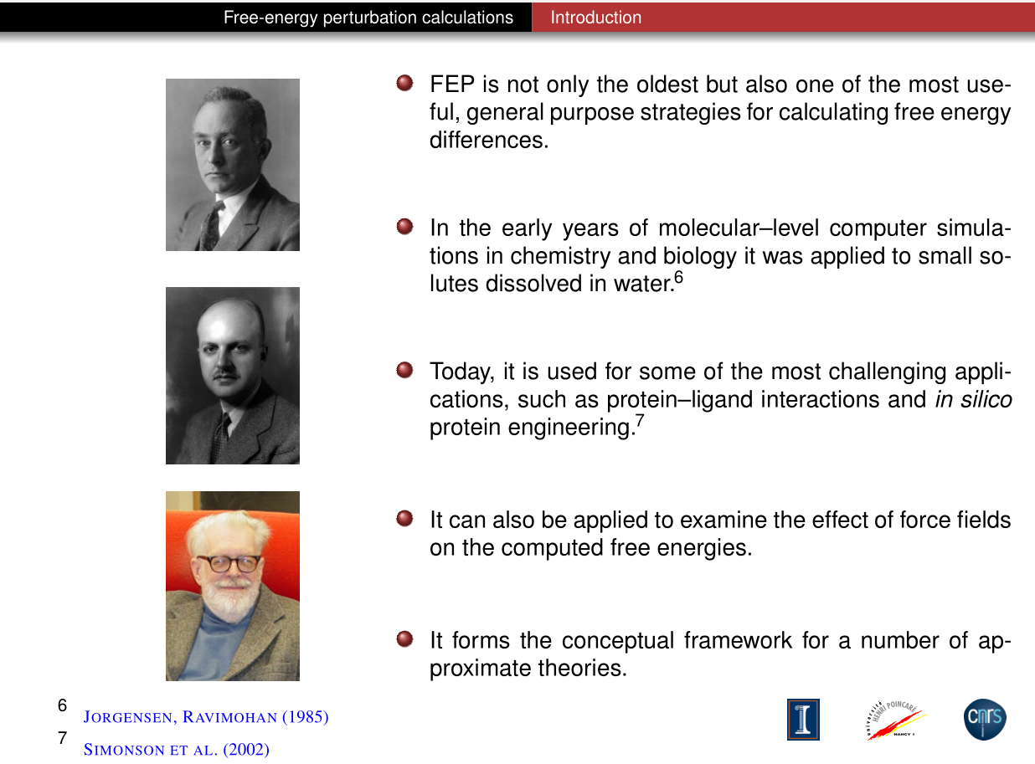

Slide 14
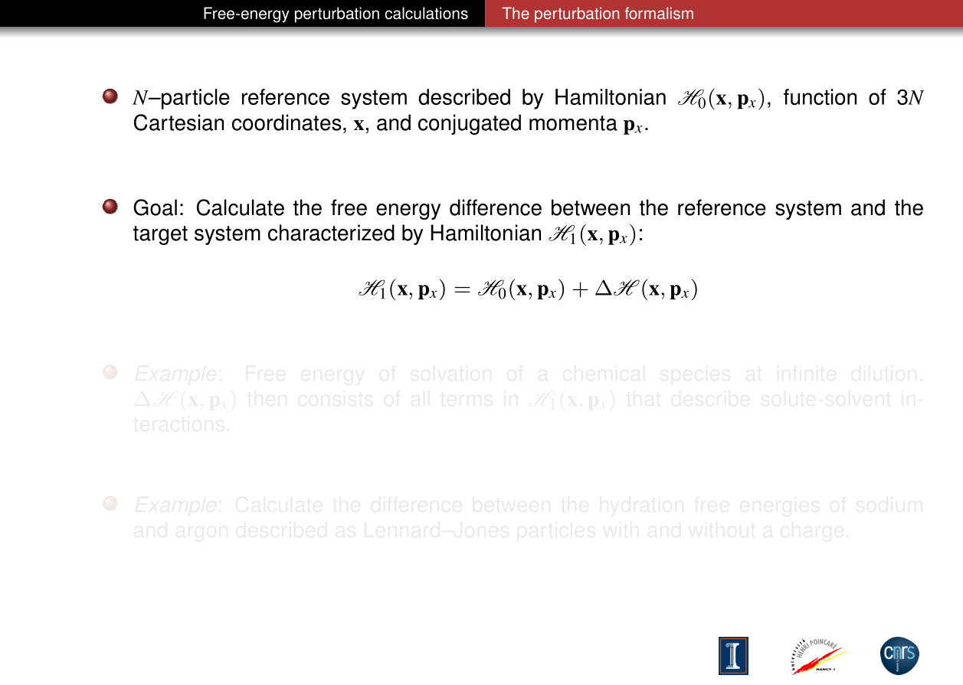
在这里哈密顿量是体系内所有粒子坐标以及动量的函数

Slide 15
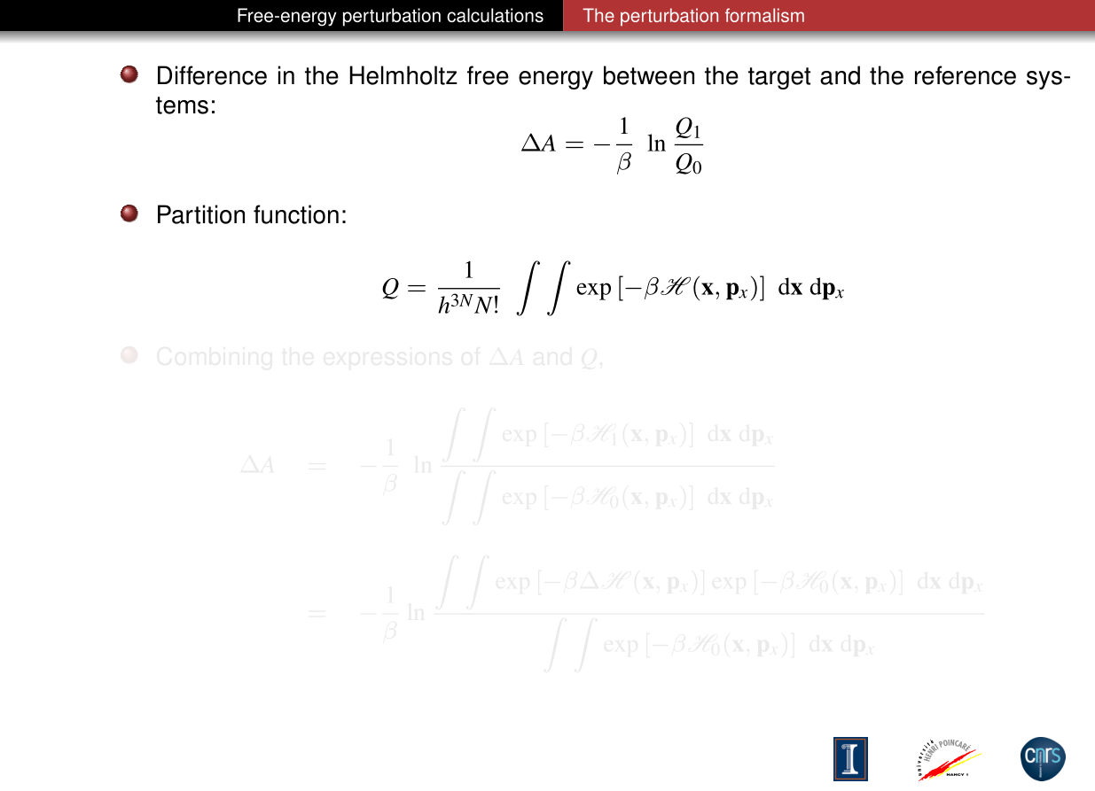
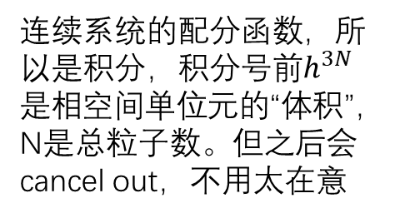
连续系统的配分函数，所以是积分，积分号前$h^{3N}$是相空间单位元的“体积”，N是总粒子数。但之后会cancel out，不用太在意

Slide 16
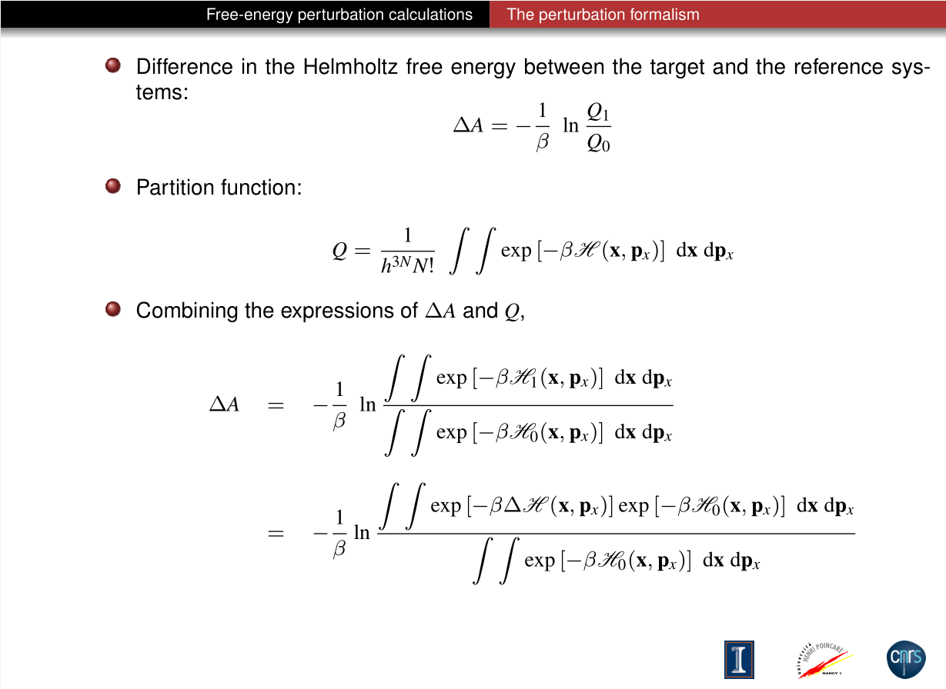

注意$∆H=H_{1}−H_{0}$
仔细观察这部分

Slide 17
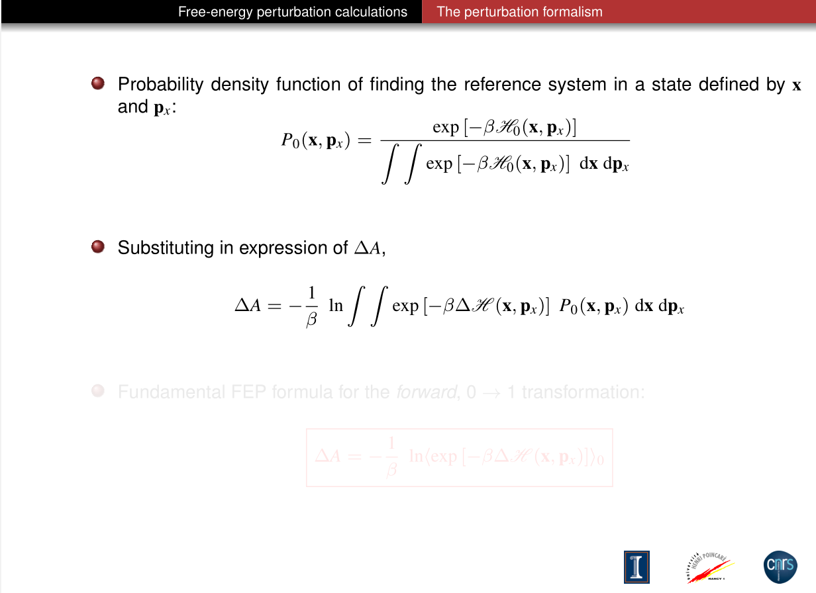

Slide 18
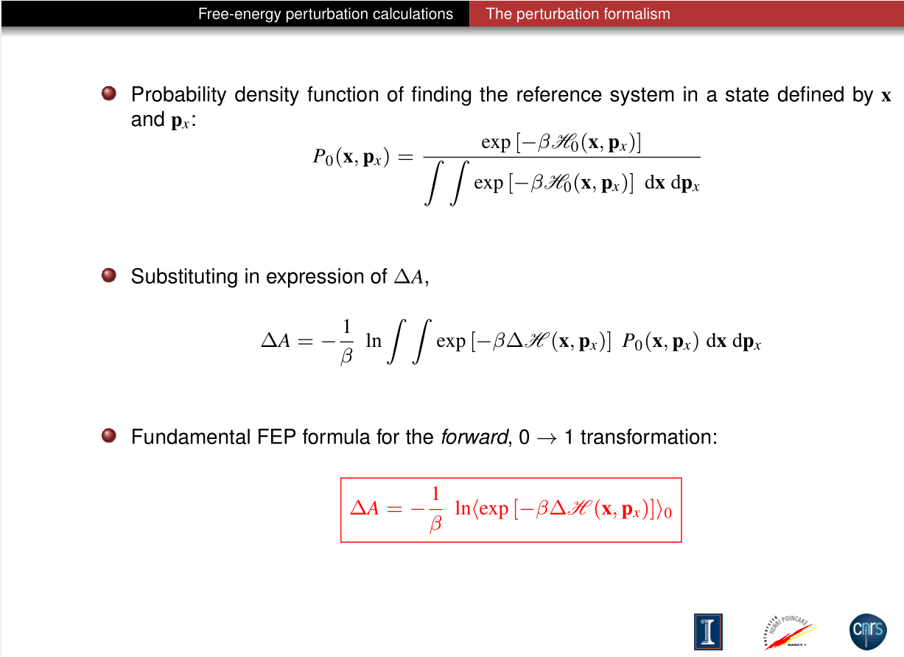
体系0中系统的概率密度

Slide 19
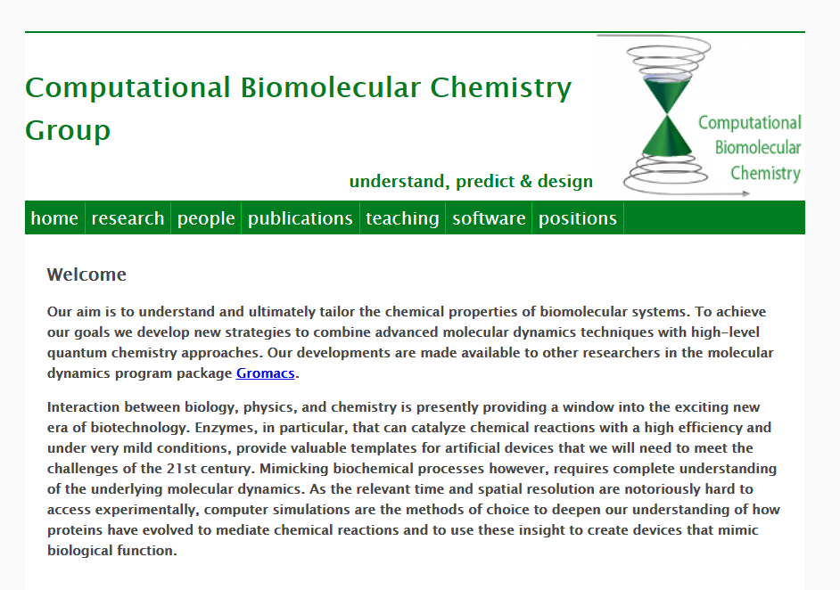
An example from here
http://wwwuser.gwdg.de/~ggroenh/

Slide 20
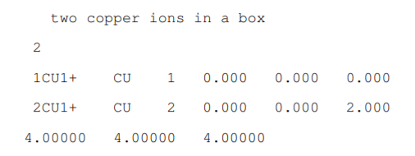
We will compute the free energy associated with an electron transfer between a Cu(I) and Cu(II) ion. How large is this free energy?
there is a 1+ charge on the first copper ion and a 2+ charge on the second copper, state A. The purpose of the exercise is to compute the free energy difference between state A and state B, in which the charge of the first copper ion is 2+ and that of the second 1+.
http://wwwuser.gwdg.de/~ggroenh/exercise_html/exercise1.pdf

Slide 21
genbox -cp conf.gro -cs spc216.gro -p -o solvated.pdb
加水
grompp -f minimize.mdp -c solvated.gro -p topol.top
能量最小化
mdrun -v
grompp -c confout.gro -f minimize.mdp -p topol.top
平衡电荷
genion -s topol.tpr -nname CL- -nn 3 -nq -1 -np -pname NA+ -pq 1 -o neutr
进行动力学模拟直到体系平衡
equilibration simulation
perform a simulation, and use this trajectory for FEP
用于FEP的成品模拟

Slide 22
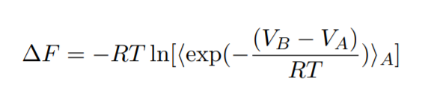
Exponential Averaging Steps
After the simulation is done, we will use the -rerun option of MD run to calculate VB − VA for every frame in the trajectory.
change the state A topology (CU1 with 1 charge, CU2 with 2 charge) to state B (CU1 with 2 charge, CU2 with 1 charge)
Create the tpr file and rerun with old trajectory file belonging to state A
mdrun -rerun traj.trr -s state_B.tpr
Get access to the energies stored in the edr file with g_energy and select the potential energy (why?). Extract also the potential energy from the previous simulation (state A)
calculate the free energy from the Zwanzig equation

Slide 23
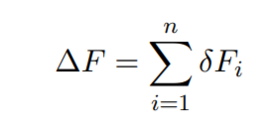
the error would be quite large because we have not sampled enough configurations
To reduce the error, we will perform the FEP is smaller steps. Consider the situation in which compute the free energy for smaller steps
Cu++Cu2+ →Cu1.1++Cu1.9+,
Cu1.1++Cu1.9+ →Cu1.2++Cu1.8+, and so on.
The total free energy is the sum of the free energies associated with these smaller steps.
with
the result would improve, but still not good enough

Slide 24
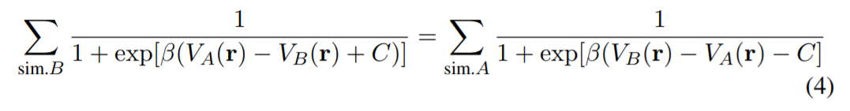
Acceptance Ratio
the statistical error of each FEP step is minimized if
where the sum is over the number of snapshots at which we wrote the potential energy to the edr file (nstenergy). The optimal free energy is that C for which the above equation is true: ∆F = C
In order to use the data from the multi-step FEP exercise, we need to evaluate for all steps i:
Learn more about BAR at
http://www.alchemistry.org/wiki/Bennett_Acceptance_Ratio

Slide 25
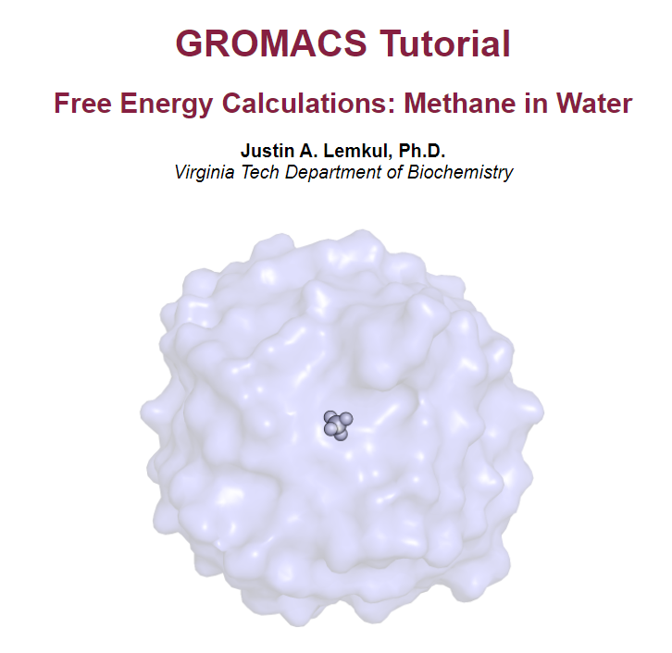
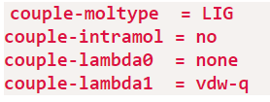
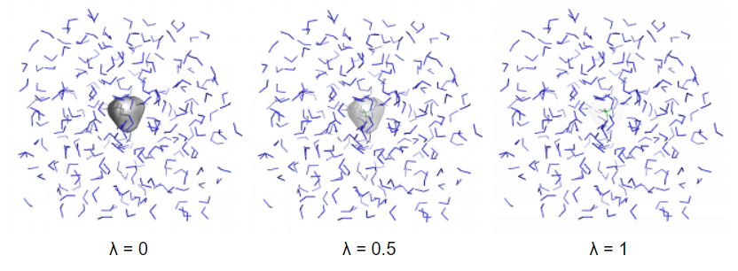
作者用BAR方法计算了范德华作用在甲烷溶解于水的过程中相关的自由能
一个完全相互作用的物种(例如配体)到“哑”物种(与配体构型相同的一组原子中心, 与周围没有任何非键相互作用)的转变, 需要关闭待研究溶质的与其周围环境之间的范德华相互作用与库伦相互作用.
用调整lambda值的形式调整vdw作用
Gromacs中提供了多样的方式
http://www.mdtutorials.com/gmx/free_energy/index.html
http://jerkwin.github.io/GMX/GMXtut-6/
翻译版本

Slide 26
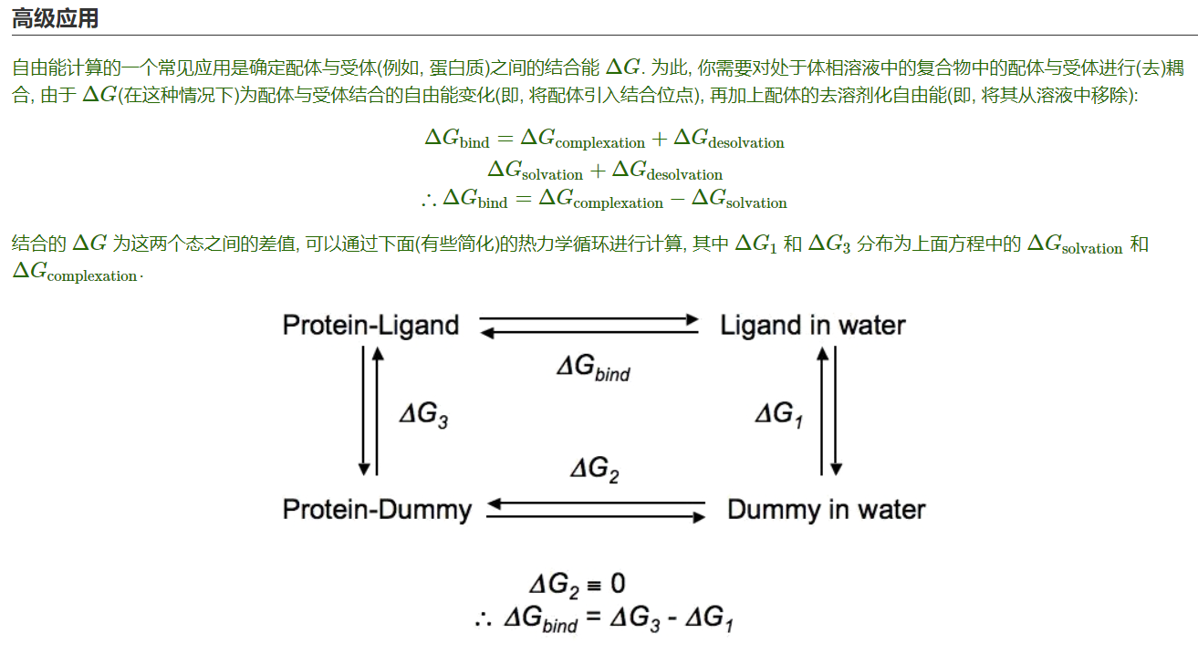

Slide 27
Learn more at
http://www.alchemistry.org/wiki/GROMACS_4.6_example:_Direct_ethanol_solvation_free_energy
http://www.mdtutorials.com/gmx/free_energy/index.html
important
http://www.alchemistry.org/wiki/Absolute_Binding_Free_Energy_-_Gromacs_2016
important
http://wwwuser.gwdg.de/~ggroenh/exercise_html/exercise1.html
http://www.alchemistry.org/wiki/Main_Page
http://www.gromacs.org/Documentation_of_outdated_versions/Tutorials

