Slide 1
STM32 with Motor driver
Student Lab 2b
01.11.2024

Slide 2
Lab2 content
Lab2a: Setting up hardware
- Connection of Motor driver board to NUCLEO board for driving Mirror’s motors
- Connection of 4 (four) buttons
Lab2b:
- Forward and reverse of motor using buttons (one button and four buttons)

Slide 3
!! Before entering Lab 2b !!
The students must done Lab2a
All connection must be checked first by the Instructor

Slide 4
Lab2b
Forward and reverse of motor using buttons
Notes:
F:\AEE\AEE2\BSW\BSW Goals\ST firmware\StudentLab2024\Lab1a\Lab1a_LED_Button

Slide 5
Lab2b: Forward and reverse of motor using buttons
In this lab, we will drive Mirror’s motors (2 motors) forward and reverse using one and four buttons
Driving Mirror’s motors forward and reverse using one button:
First pressing → motor 1 runs in forward direction for 1s
Second pressing → motor 1 runs in reverse direction for 1s
Third pressing → motor 2 runs in forward direction for 1s
Fourth pressing → motor 2 runs in reverse direction for 1s
Another pressing will come back to first pressing, and so on
No button is pressed → no motor running
Driving Mirror’s motors forward and reverse using four buttons:
Button 1 is pressed → motor 1 runs in forward direction until button 1 is released
Button 2 is pressed → motor 1 runs in reverse direction until button 2 is released
Button 3 is pressed → motor 2 runs in forward direction until button 3 is released
Button 4 is pressed → motor 2 runs in reverse direction until button 4 is released
No button is pressed → no motor running
Notes:
F:\AEE\AEE2\BSW\BSW Goals\ST firmware\StudentLab2024\Lab1b\Lab1b_LED_Button

Slide 6
Lab2b: Forward and reverse of motor using buttons
There will be error flag reading from the Driver
If there is Open Load flag, the Driver will not stop.
If there is Over Current or Over Thermal flag, the Driver will stop.
Notes:
F:\AEE\AEE2\BSW\BSW Goals\ST firmware\StudentLab2024\Lab1b\Lab1b_LED_Button

Slide 7
Lab2b: Forward and reverse of motor using buttons
We will also learn to read truth table and implement it in code
We will use FreeRTOS based code
Please refer to previous lab to set up the STM32CubeMX and STM32CubeIDE project
Notes:
F:\AEE\AEE2\BSW\BSW Goals\ST firmware\StudentLab2024\Lab1b\Lab1b_LED_Button

Slide 8
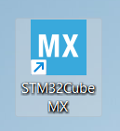
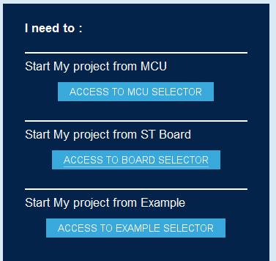
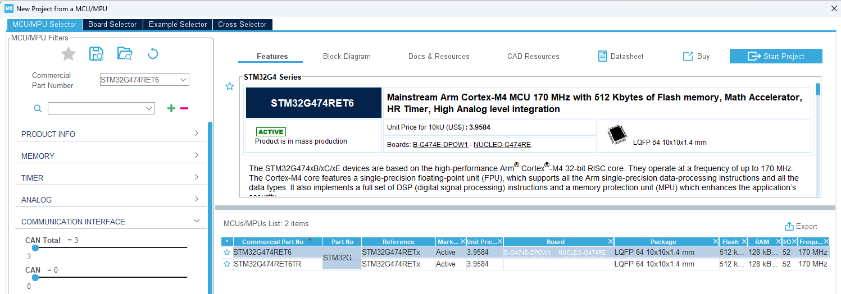
Lab2b: Forward and reverse of motor using buttons
Open STM32MCubeMX
Click
Click
Notes:
F:\AEE\AEE2\BSW\BSW Goals\ST firmware\StudentLab2024\Lab1b\Lab1b_LED_Button

Slide 9
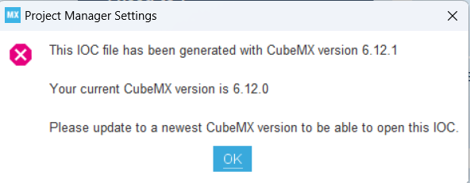
Lab2b: Forward and reverse of motor using buttons
Caution!
The .ioc file in the project uses STM32CubeMX version 6.12.1.
If you have different type of version that older than this version, you will not be able to open it and you need to update it or to download the new installation from ST website
STM32CubeMX - STM32Cube initialization code generator - STMicroelectronics
Notes:
F:\AEE\AEE2\BSW\BSW Goals\ST firmware\StudentLab2024\Lab1b\Lab1b_LED_Button

Slide 10
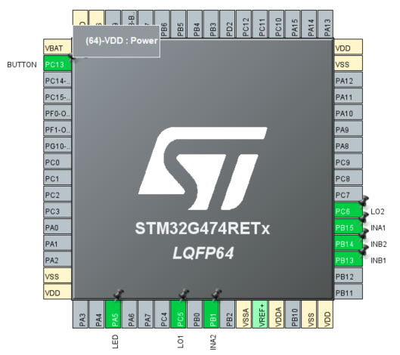
Lab2b: Forward and reverse of motor using buttons
For code with 1 button function, B1 (Blue Button) will be used
This code is used to check your Driver and Mirror’s motors connection
Set the MCU pins in STM32CubeMX as described.
Four GPIO output pins
PB15 for INA1
PB1 for INA2
PB13 for INB1
PB14 for INB2
Four external input pins for buttons
PC13 (GPIO_EXTI13) for BUTTON (B1 or Blue Button)
Two GPIO input pins for feedback LO1 and LO2
PC6 for LO1
PC5 for LO2
Caution! These two pins MUST be connected to pull-up connection.
PA5 is additionally set as TIM2_CH1 and can be used for debugging/testing purpose.
Notes:
F:\AEE\AEE2\BSW\BSW Goals\ST firmware\StudentLab2024\Lab1a\Lab1a_LED_Button

Slide 11
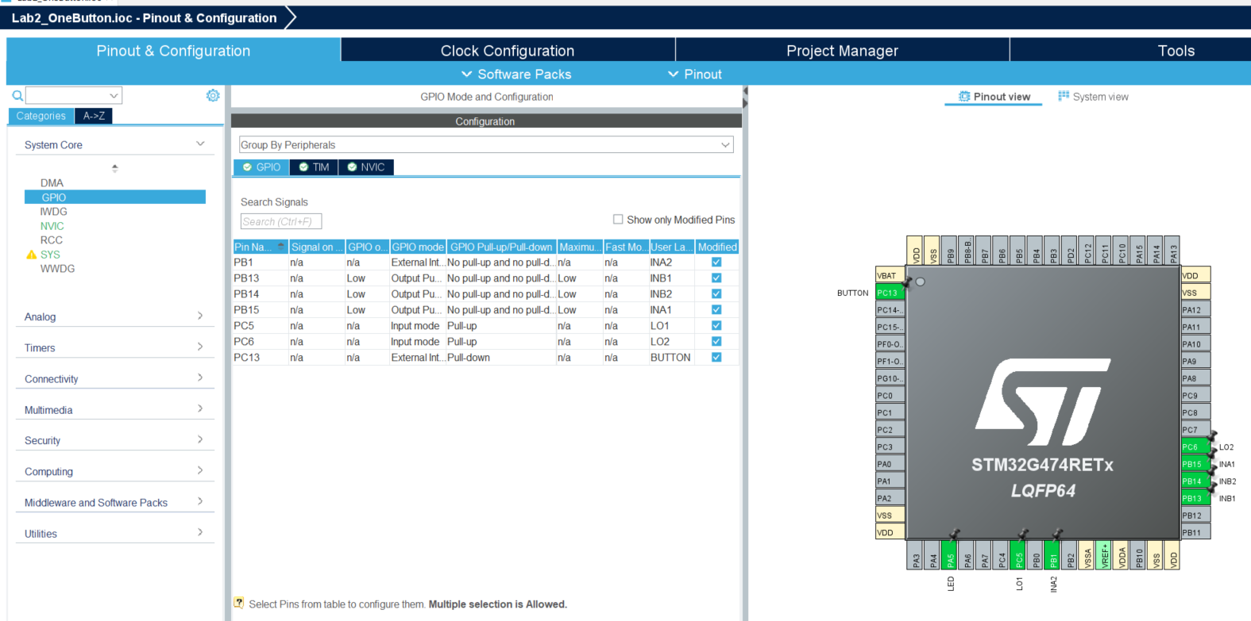
Lab2b: Forward and reverse of motor using buttons
Set GPIO Mode and Configuration as below:
Notes:
F:\AEE\AEE2\BSW\BSW Goals\ST firmware\StudentLab2024\Lab1b\Lab1b_LED_Button

Slide 12
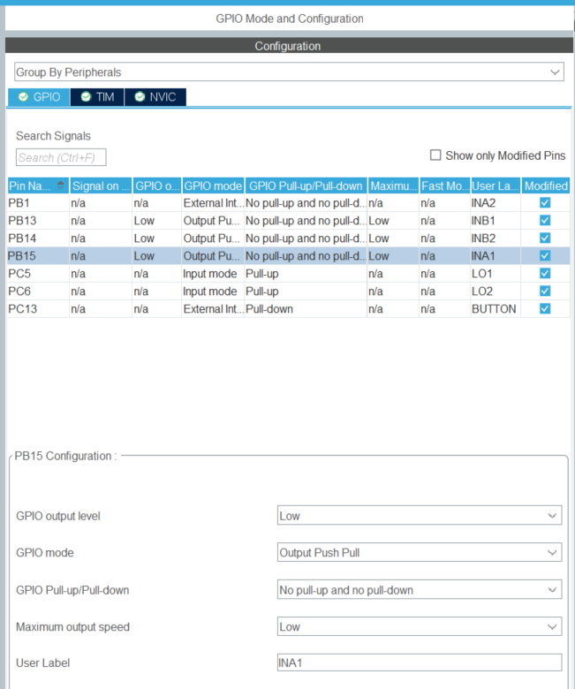
Lab2b: Forward and reverse of motor using buttons
Example: INA1 setting
Notes:
F:\AEE\AEE2\BSW\BSW Goals\ST firmware\StudentLab2024\Lab1b\Lab1b_LED_Button

Slide 13
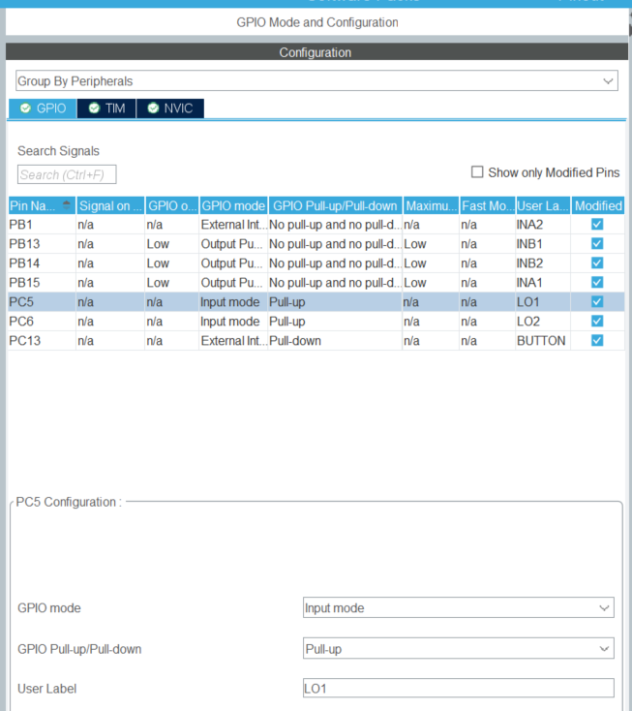
Lab2b: Forward and reverse of motor using buttons
Example: LO1 setting
Notes:
F:\AEE\AEE2\BSW\BSW Goals\ST firmware\StudentLab2024\Lab1b\Lab1b_LED_Button

Slide 14
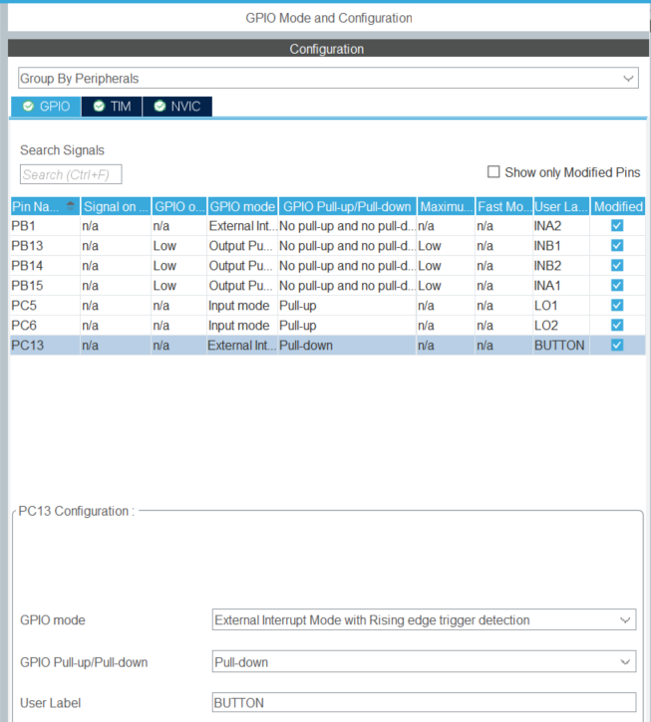
Lab2b: Forward and reverse of motor using buttons
Example: BUTTON setting
Notes:
F:\AEE\AEE2\BSW\BSW Goals\ST firmware\StudentLab2024\Lab1b\Lab1b_LED_Button

Slide 15
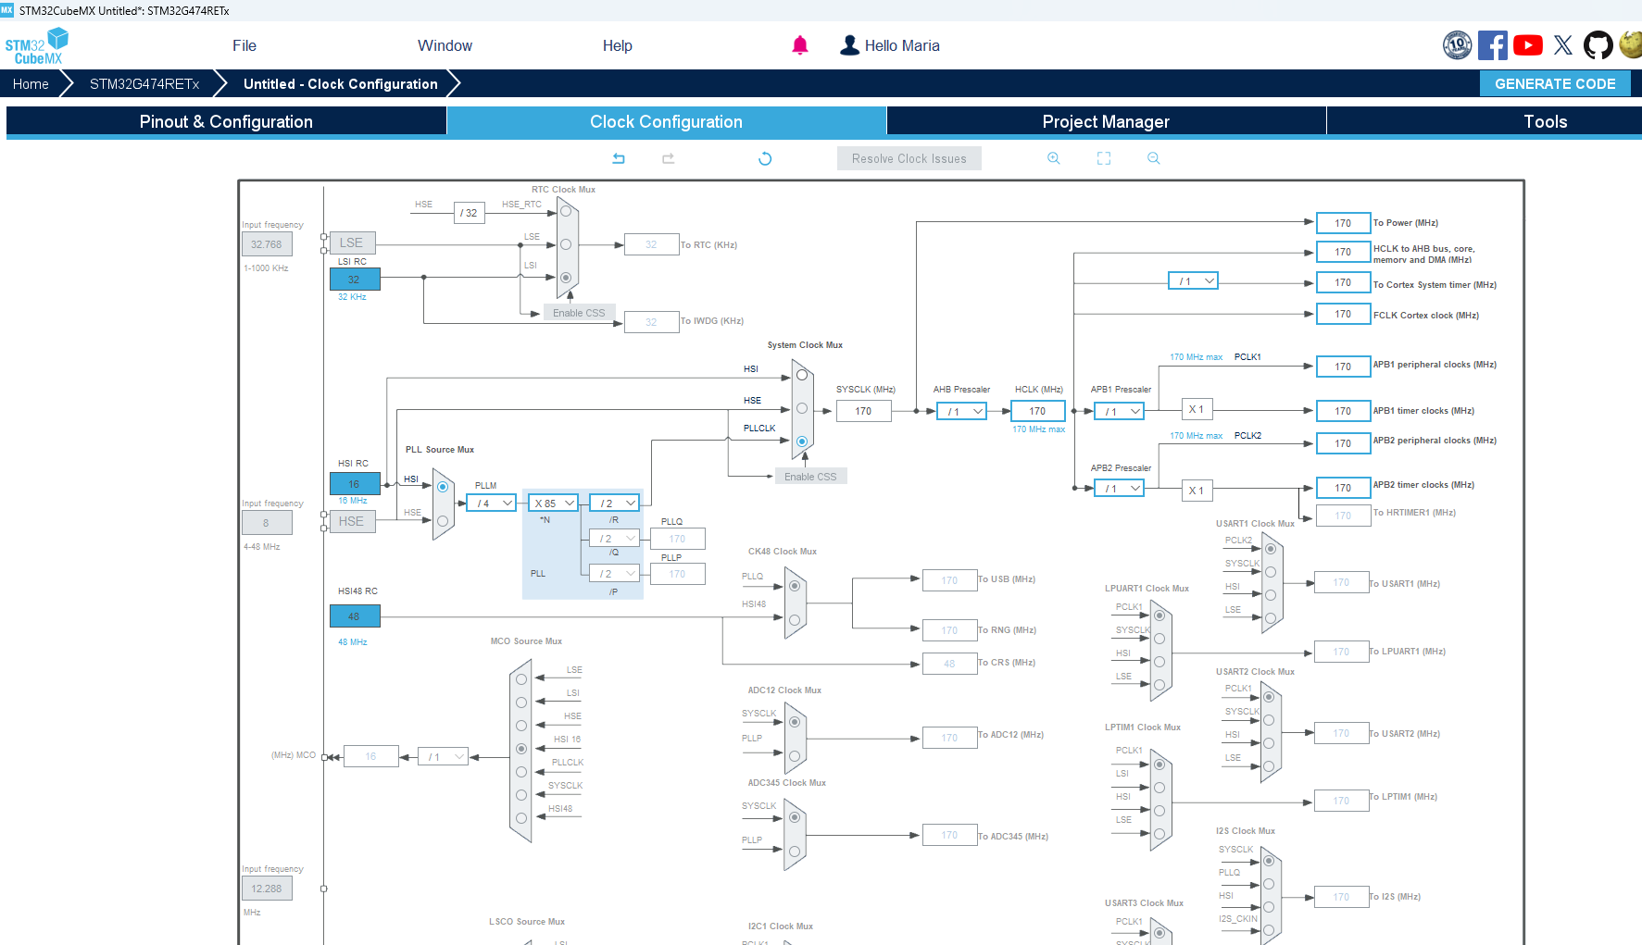
Lab2b: Forward and reverse of motor using buttons
Fill with 170 and it will find the solution automatically
Notes:
F:\AEE\AEE2\BSW\BSW Goals\ST firmware\StudentLab2024\Lab1b\Lab1b_LED_Button

Slide 16
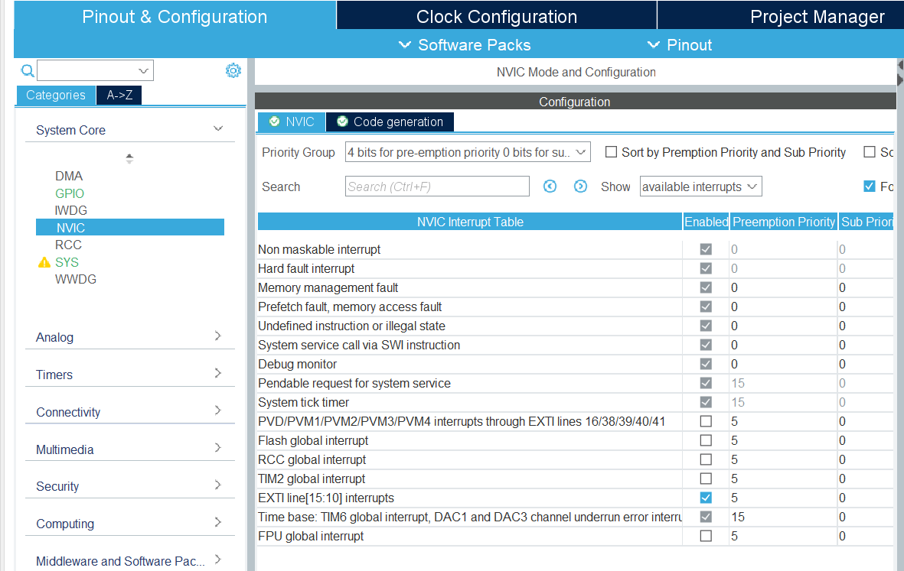
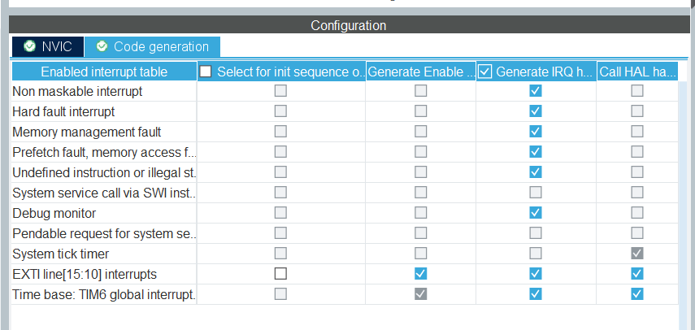
Lab2b: Forward and reverse of motor using buttons
Check or set NVIC Mode and Configuration as below:
Notes:
F:\AEE\AEE2\BSW\BSW Goals\ST firmware\StudentLab2024\Lab1b\Lab1b_LED_Button

Slide 17
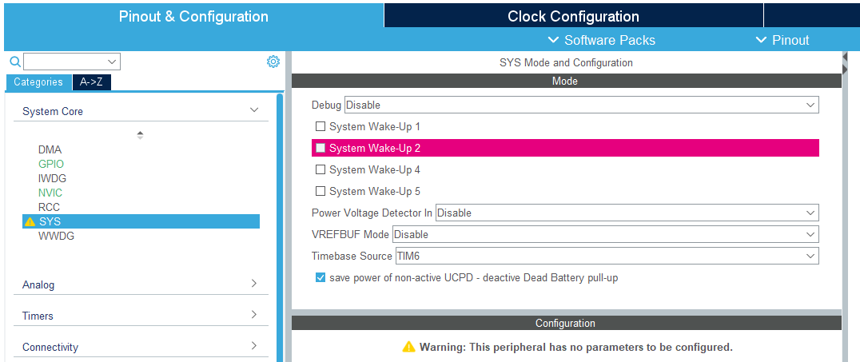
Lab2b: Forward and reverse of motor using buttons
Set SYS Mode and Configuration as below:
Select Timebase Source other than SysTick
for FreeRTOS based code
Notes:
F:\AEE\AEE2\BSW\BSW Goals\ST firmware\StudentLab2024\Lab1b\Lab1b_LED_Button

Slide 18
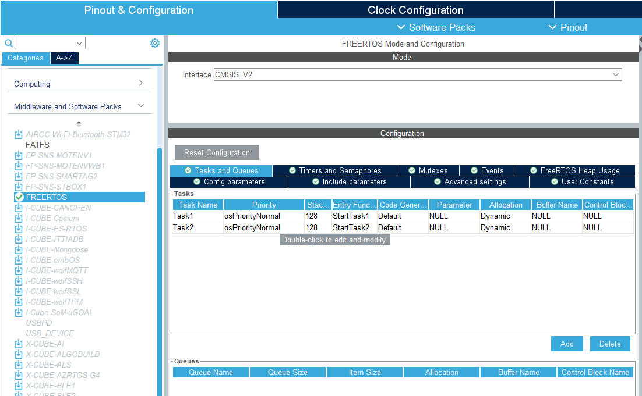
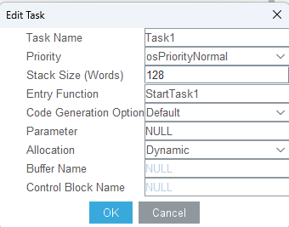
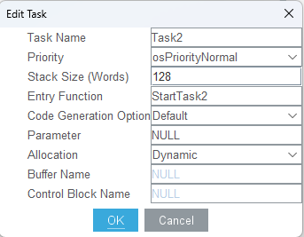
Lab2b: Forward and reverse of motor using buttons
Set FREERTOS Mode and Configuration as below:
Notes:
F:\AEE\AEE2\BSW\BSW Goals\ST firmware\StudentLab2024\Lab1b\Lab1b_LED_Button

Slide 19
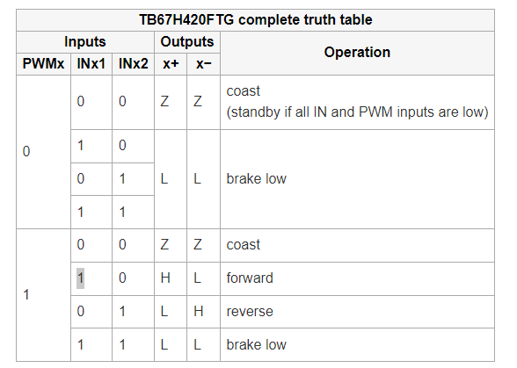
Lab2b: Forward and reverse of motor using buttons
Truth table of INx1, INx2, and PWMx
Because we will not connect PWMx pins of the Driver board to NUCLEO pins, we will keep the level of PWMx to be HIGH (1)
Notes:
F:\AEE\AEE2\BSW\BSW Goals\ST firmware\StudentLab2024\Lab1b\Lab1b_PWM_FreeRTOS1

Slide 20
Lab2b: Forward and reverse of motor using buttons
Truth table of INx1, INx2, and PWMx
In this case, motor will run when one of INx pin level is HIGH and the other is LOW
Notes:
F:\AEE\AEE2\BSW\BSW Goals\ST firmware\StudentLab2024\Lab1b\Lab1b_PWM_FreeRTOS1

Slide 21




Lab2b: Forward and reverse of motor using buttons
The code related to truth table
Forward
Reverse
Notes:
F:\AEE\AEE2\BSW\BSW Goals\ST firmware\StudentLab2024\Lab1b\Lab1b_PWM_FreeRTOS1

Slide 22
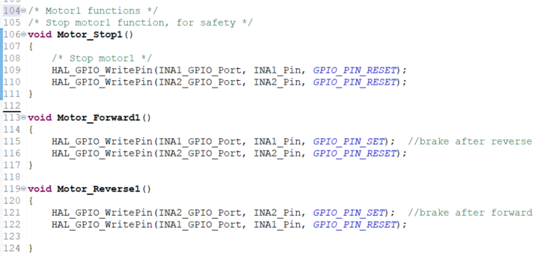
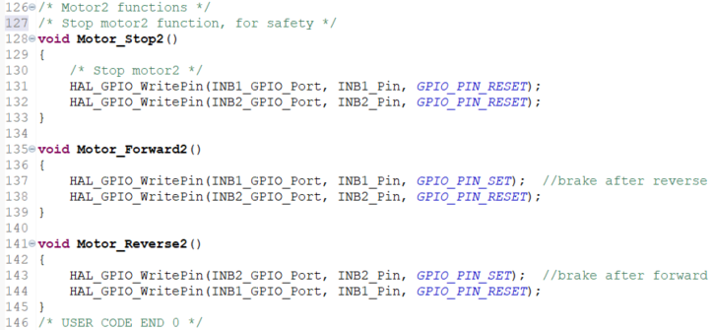
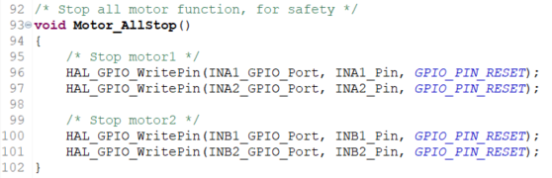
Lab2b: Forward and reverse of motor using buttons
Implementation: in main.c
Notes:
F:\AEE\AEE2\BSW\BSW Goals\ST firmware\StudentLab2024\Lab1b\Lab1b_PWM_FreeRTOS1

Slide 23
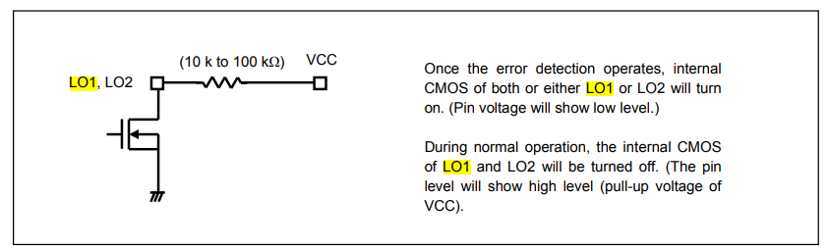
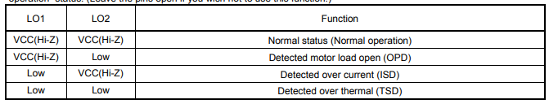
Lab2b: Forward and reverse of motor using buttons
To be noticed for LO1 and LO2
Truth table of LO1 and LO2
Compare these rows with the code of the next page
Notes:
F:\AEE\AEE2\BSW\BSW Goals\ST firmware\StudentLab2024\Lab1b\Lab1b_PWM_FreeRTOS1

Slide 24
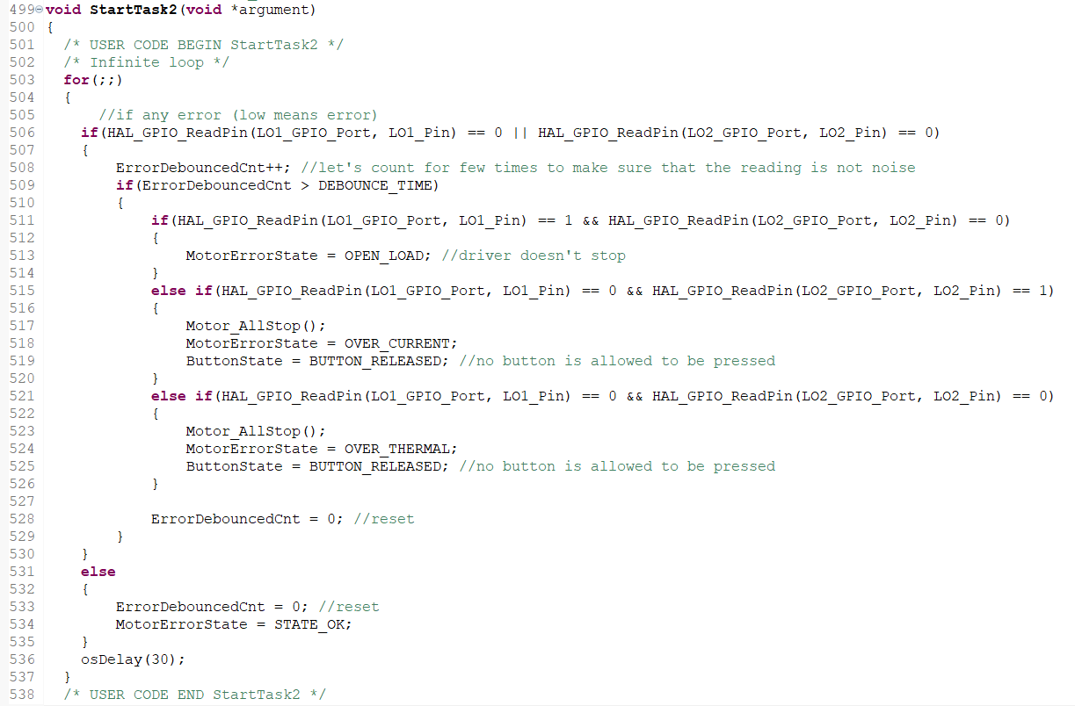


Lab2b: Forward and reverse of motor using buttons
Implementation: in main.c
Notes:
F:\AEE\AEE2\BSW\BSW Goals\ST firmware\StudentLab2024\Lab1b\Lab1b_PWM_FreeRTOS1

Slide 25

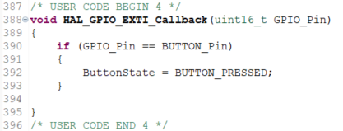
Lab2b: Forward and reverse of motor using buttons
Button implementation, in main.c
Notes:
F:\AEE\AEE2\BSW\BSW Goals\ST firmware\StudentLab2024\Lab1b\Lab1b_PWM_FreeRTOS1

Slide 26
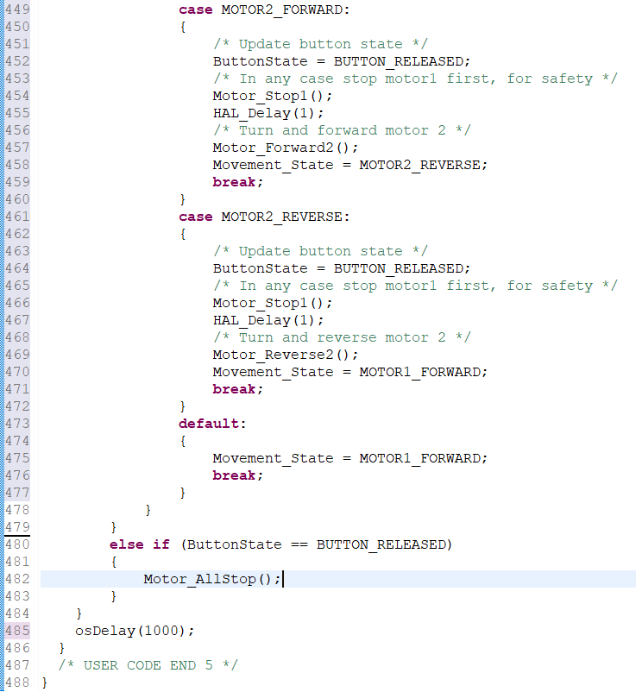
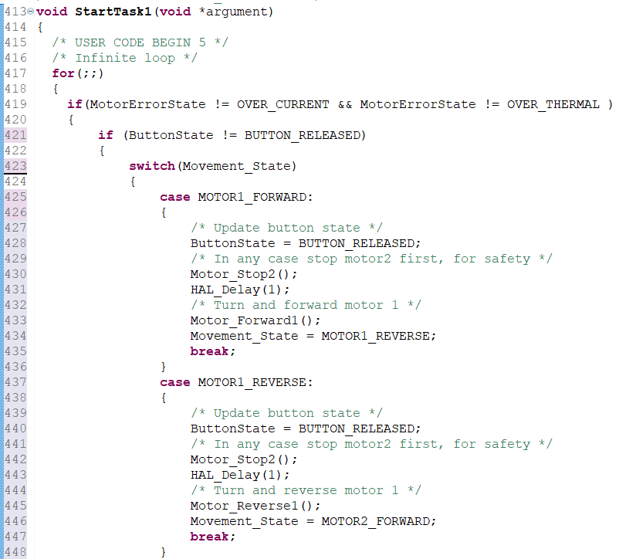
Lab2b: Forward and reverse of motor using buttons
One button implementation, in main.c
Notes:
F:\AEE\AEE2\BSW\BSW Goals\ST firmware\StudentLab2024\Lab1b\Lab1b_PWM_FreeRTOS1

Slide 27
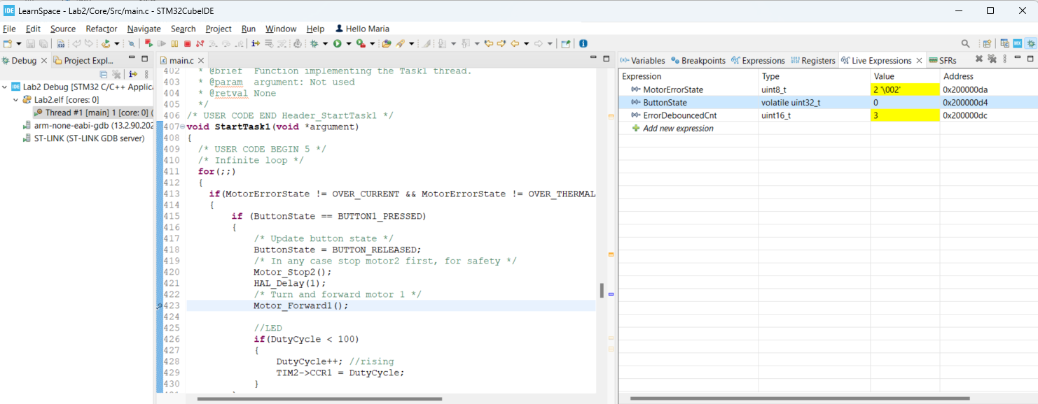
Lab2b: Forward and reverse of motor using buttons
Debugging
We can observe the variables in Live Expressions
Notes:
F:\AEE\AEE2\BSW\BSW Goals\ST firmware\StudentLab2024\Lab1b\Lab1b_PWM_FreeRTOS1

Slide 28
Lab2b: Forward and reverse of motor using buttons
Observe the behavior of mirror’s motors!
First pressing → motor 1 runs in forward direction for 1s
Second pressing → motor 1 runs in reverse direction for 1s
Third pressing → motor 2 runs in forward direction for 1s
Fourth pressing → motor 2 runs in reverse direction for 1s
Another pressing will come back to first pressing, and so on
No button is pressed → no motor running

Slide 29
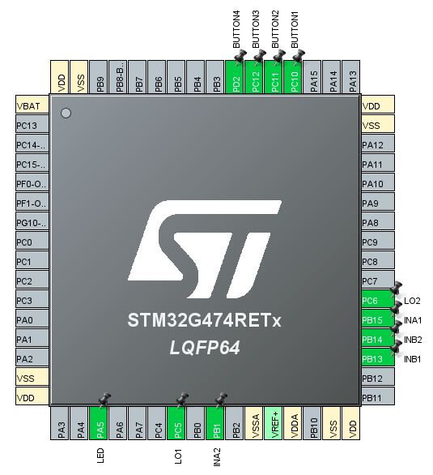
Lab2b: Forward and reverse of motor using buttons
For code with 4 buttons function
Set the MCU pins in STM32CubeMX as described.
Four GPIO output pins
PB15 for INA1
PB1 for INA2
PB13 for INB1
PB14 for INB2
Four external input pins for buttons
PC10 (GPIO_EXTI10) for BUTTON1
PC11 (GPIO_EXTI11) for BUTTON2
PC12 (GPIO_EXTI12) for BUTTON3
PD2 (GPIO_EXTI2) for BUTTON4
Two GPIO input pins for feedback LO1 and LO2
PC6 for LO1
PC5 for LO2
Caution! These two pins MUST be connected to pull-up connection.
PA5 is additionally set as TIM2_CH1 and can be used for debugging/testing purpose.
Notes:
F:\AEE\AEE2\BSW\BSW Goals\ST firmware\StudentLab2024\Lab1a\Lab1a_LED_Button

Slide 30
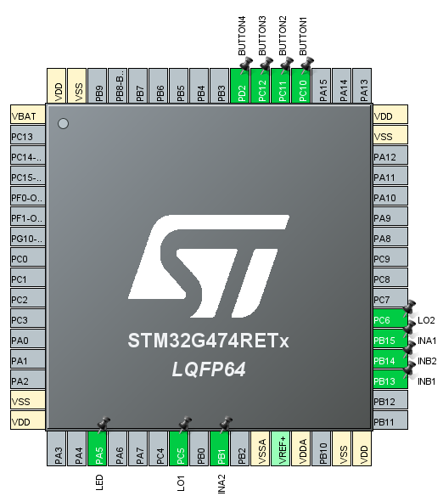
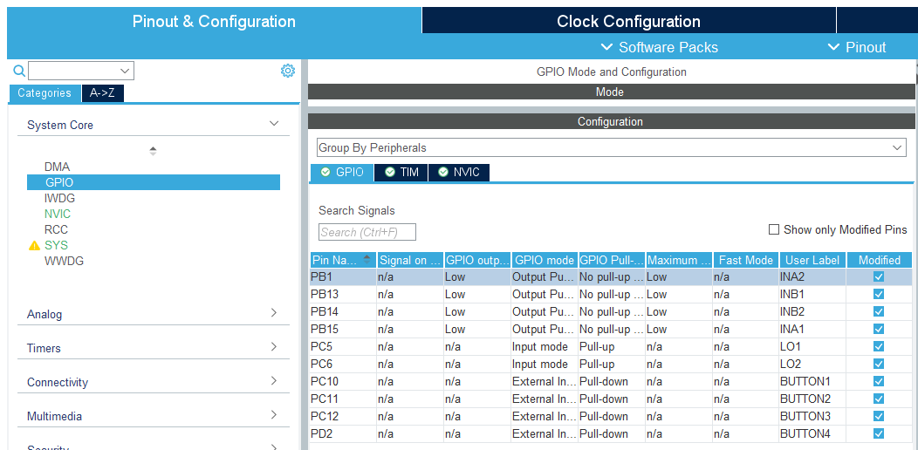
Lab2b: Forward and reverse of motor using buttons
Set GPIO Mode and Configuration as below:
Notes:
F:\AEE\AEE2\BSW\BSW Goals\ST firmware\StudentLab2024\Lab1b\Lab1b_LED_Button

Slide 31
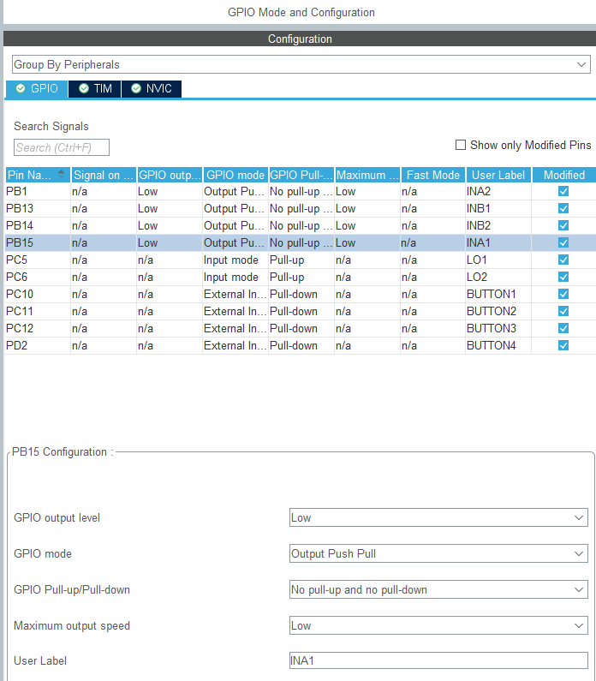
Lab2b: Forward and reverse of motor using buttons
Example: INA1 setting
Notes:
F:\AEE\AEE2\BSW\BSW Goals\ST firmware\StudentLab2024\Lab1b\Lab1b_LED_Button

Slide 32
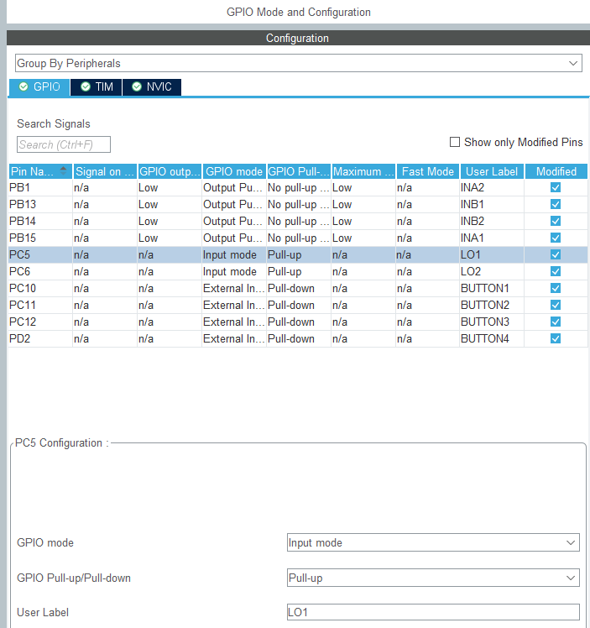
Lab2b: Forward and reverse of motor using buttons
Example: LO1 setting
Notes:
F:\AEE\AEE2\BSW\BSW Goals\ST firmware\StudentLab2024\Lab1b\Lab1b_LED_Button

Slide 33
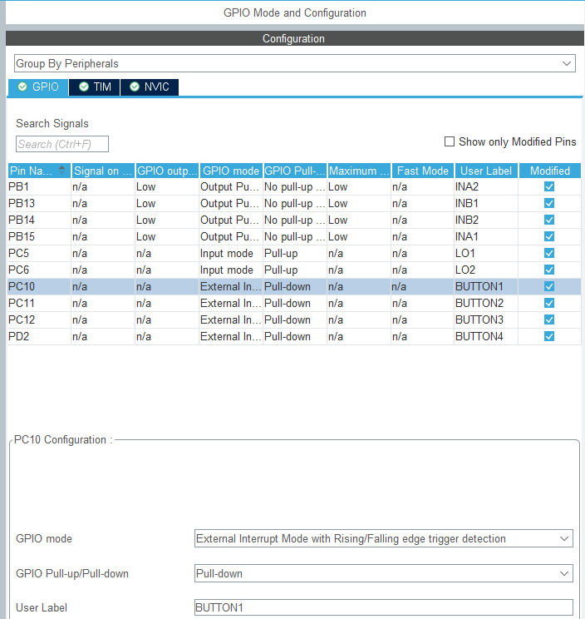
Lab2b: Forward and reverse of motor using buttons
Example: BUTTON1 setting
Notes:
F:\AEE\AEE2\BSW\BSW Goals\ST firmware\StudentLab2024\Lab1b\Lab1b_LED_Button

Slide 34
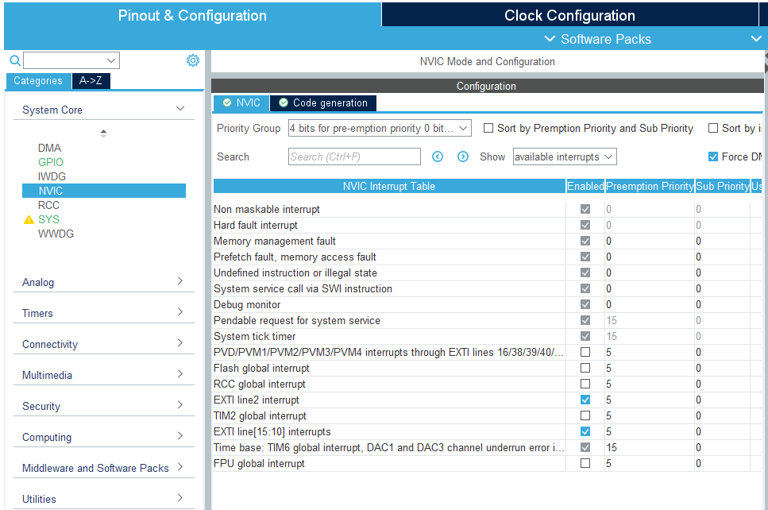
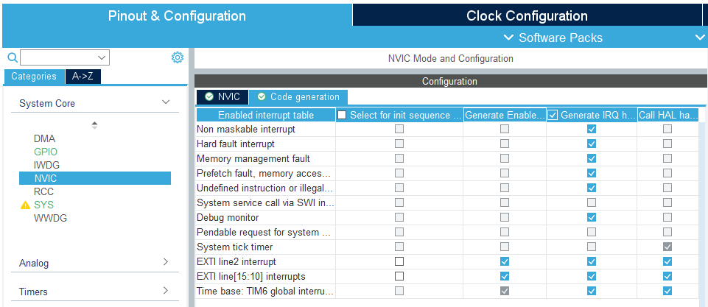
Lab2b: Forward and reverse of motor using buttons
Check or set NVIC Mode and Configuration as below:
Notes:
F:\AEE\AEE2\BSW\BSW Goals\ST firmware\StudentLab2024\Lab1b\Lab1b_LED_Button

Slide 35
Lab2b: Forward and reverse of motor using buttons
Clock Configuration, SYS Mode and Configuration,
and FREERTOS Mode and Configuration
are the same with previous exercise
Notes:
F:\AEE\AEE2\BSW\BSW Goals\ST firmware\StudentLab2024\Lab1b\Lab1b_LED_Button

Slide 36
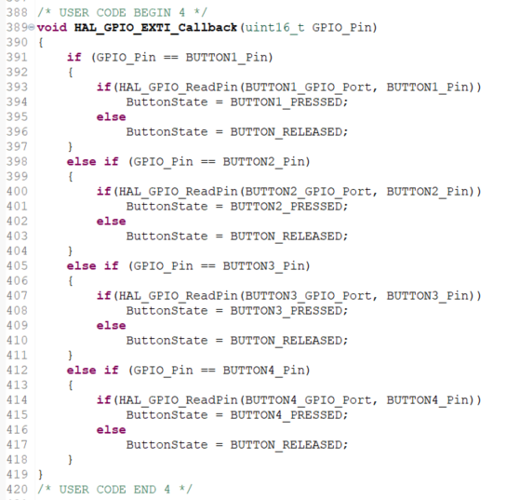

Lab2b: Forward and reverse of motor using buttons
Four (4) buttons implementation, in main.c
Notes:
F:\AEE\AEE2\BSW\BSW Goals\ST firmware\StudentLab2024\Lab1b\Lab1b_PWM_FreeRTOS1

Slide 37
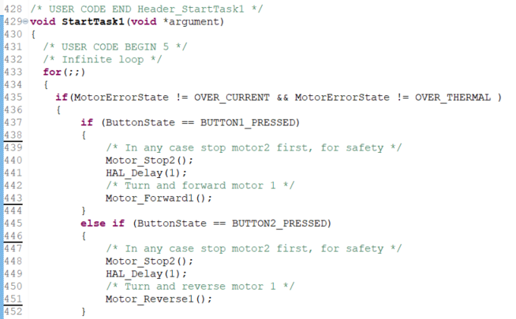
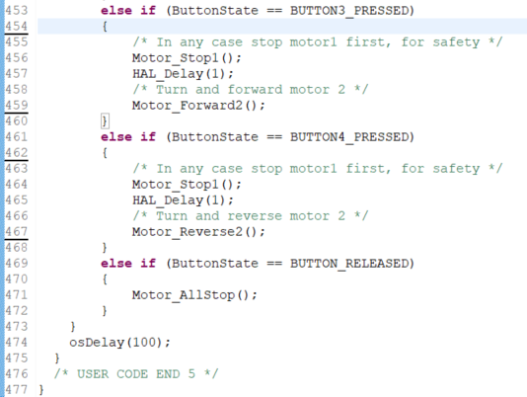
Lab2b: Forward and reverse of motor using buttons
With 4 buttons implementation, in main.c
Notes:
F:\AEE\AEE2\BSW\BSW Goals\ST firmware\StudentLab2024\Lab1b\Lab1b_PWM_FreeRTOS1

Slide 38
Lab2b: Forward and reverse of motor using buttons
Observe the behavior of mirror’s motors!
Button 1 is pressed → motor 1 runs in forward direction until button 1 is released
Button 2 is pressed → motor 1 runs in reverse direction until button 2 is released
Button 3 is pressed → motor 2 runs in forward direction until button 3 is released
Button 4 is pressed → motor 2 runs in reverse direction until button 4 is released
No button is pressed → no motor running

Slide 39
Thank you and good luck!

