Slide 1
Embedded systems in cars
Lecture 1

Slide 2
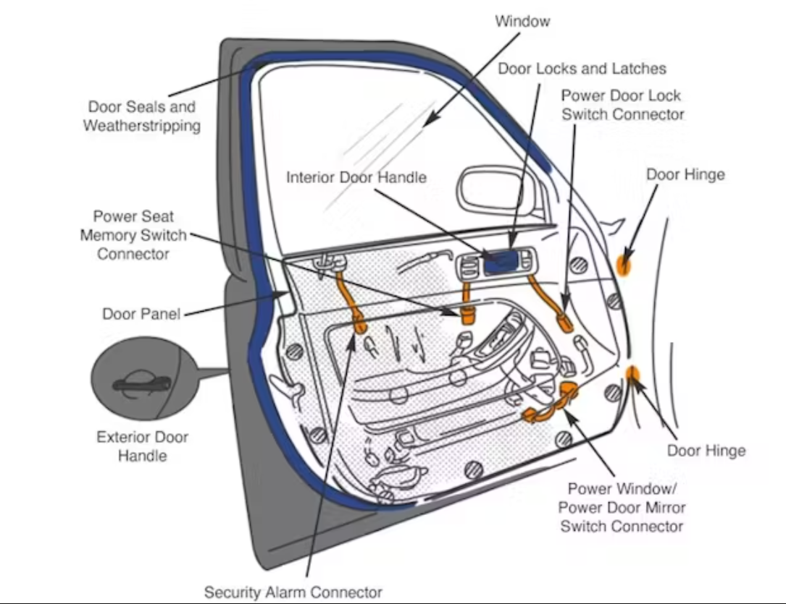
Automotive Comfort Systems Overview
Overview: Automotive comfort systems in modern vehicles include features such as automated door locks, seat adjustments, window controls, and mirror positioning.
Goal: Enhance both safety and user convenience, allowing automatic adjustments and memory settings.
Examples: Automated seat adjustments, climate control, automatic mirror folding, etc.

Slide 3
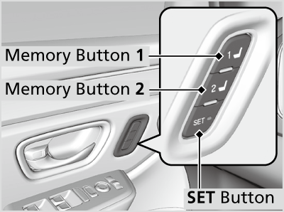
Role of Embedded Systems in Comfort Controls
Embedded systems manage comfort functions, interacting in real-time with sensors and actuators.
Key interactions with Body Control Unit (BCU) ensure integrated management.
Example: Seat memory adjustments stored for different drivers.

Slide 4
Key Terms and Modules in Automotive Comfort Electronics
DCU (Door Control Unit): Central control for door functions like locks, windows, and mirrors.
PSM (Power Seat Module): Manages seat adjustment, memory, and safety features.
Examples of Use: Controlling window lifts, storing seat positions.

Slide 5
DCU (Door Control Unit)
The DCU provides central control for various comfort features within the door, such as window lifters, mirror adjustment, and door locks.
It often interfaces with the BCU to receive commands and relay status information, ensuring smooth operation of door-related functions.

Slide 6
PSM (Power Seat Module)
PSM is responsible for seat adjustments, memory settings, and user preferences.
This module enhances driver and passenger convenience by storing individual seat positions and automating seat adjustments.

Slide 7
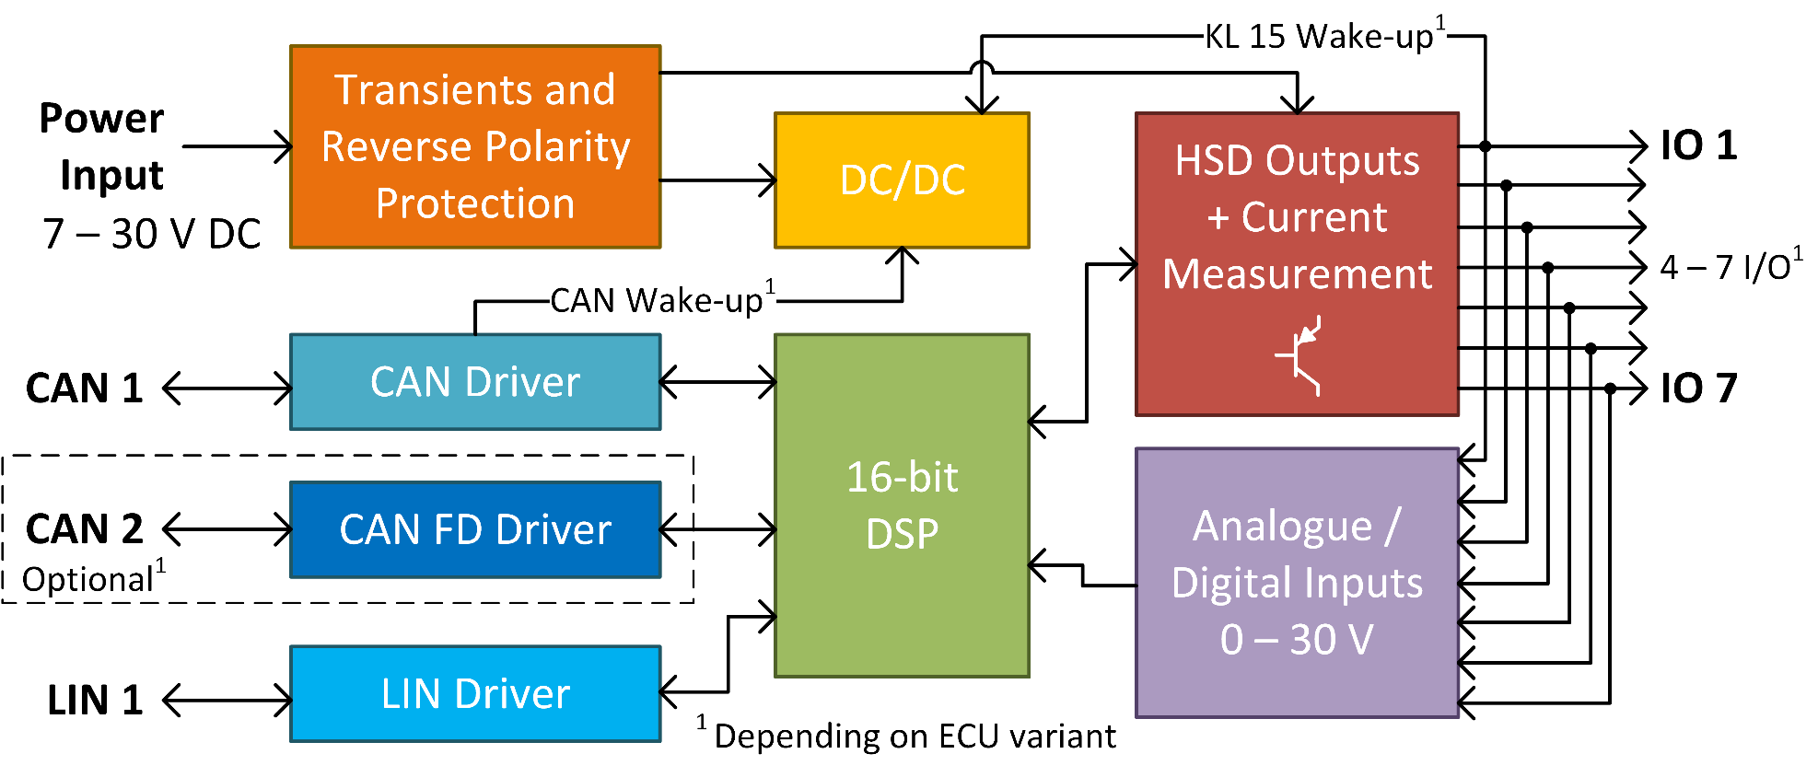
Communication Between DCU and PSM with Other Modules
Modules like DCU and PSM communicate with other comfort features over LIN or CAN buses.
This network communication allows seamless control and status sharing among different comfort systems.

Slide 8
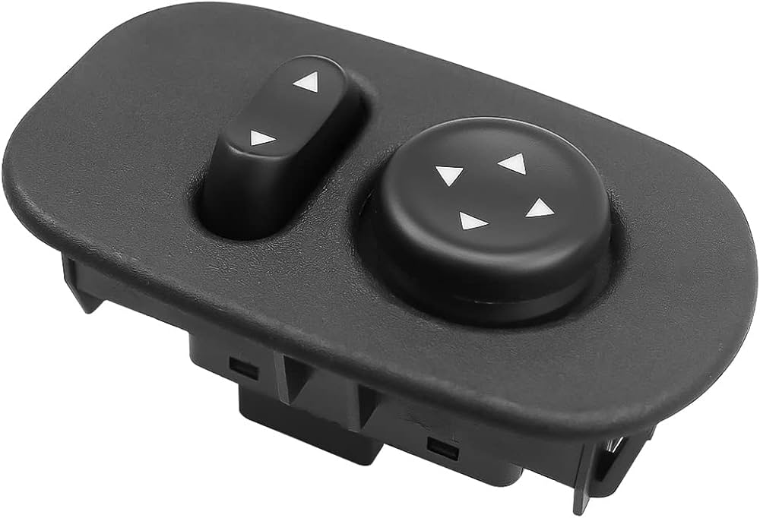
Mirror Control IC (L99DZ100)
L99DZ100 IC is often used for mirror adjustment, featuring dual H-bridge control, integrated temperature sensing, and diagnostic features.
This IC is connected to the DCU for precise mirror positioning and angle adjustments.

Slide 9
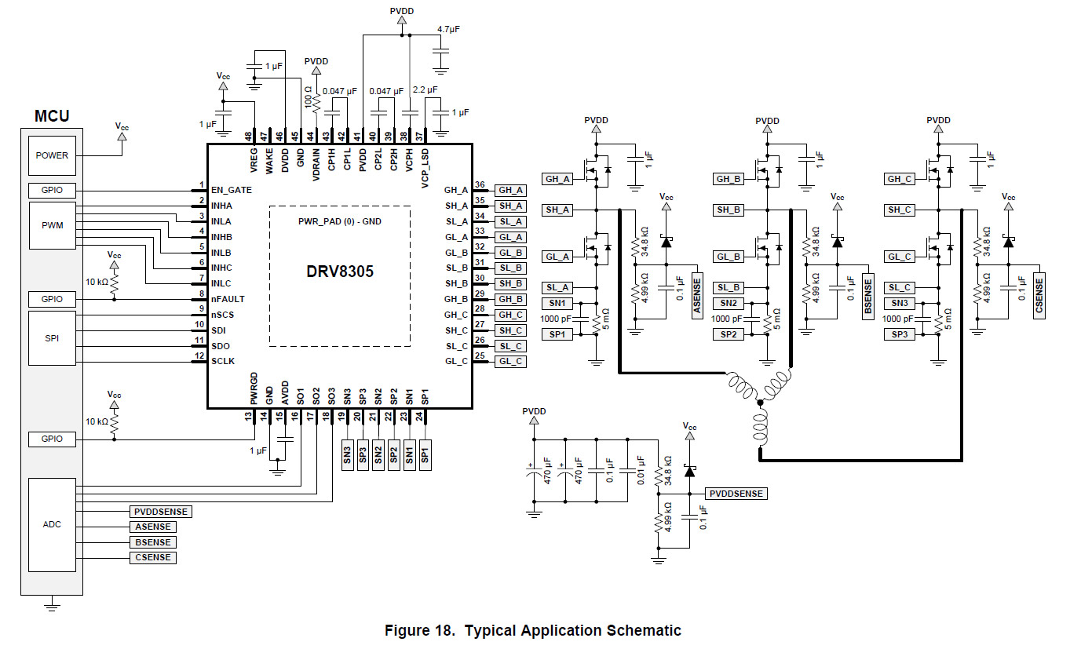
Soft-Close System Control IC (DRV8305)
DRV8305 IC is used to control soft-close door systems, which ensure smooth and safe door closure.
This IC provides three-phase motor driving capability with diagnostics for door positioning and speed control.

Slide 10
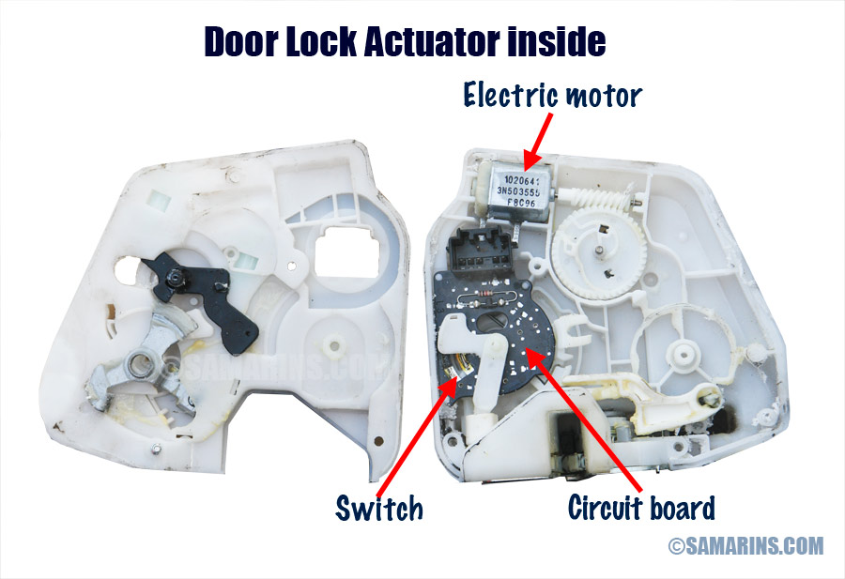
Locking Mechanisms (UJA1075A)
The UJA1075A is a transceiver IC that manages locking mechanisms with diagnostic capabilities, ensuring secure door locking and feedback.
This IC allows real-time status monitoring of the door lock's state.

Slide 11
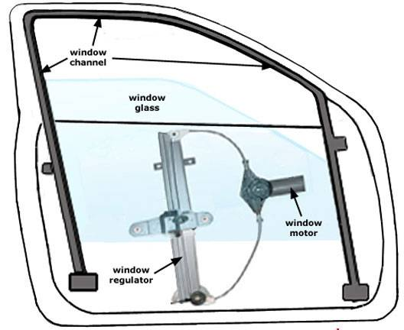
Window Lifters (TLE9201SG)
The TLE9201SG IC is a dual H-bridge driver, commonly used for controlling the window lift motors.
It provides overload and overtemperature protection, ensuring safe window operation.

Slide 12
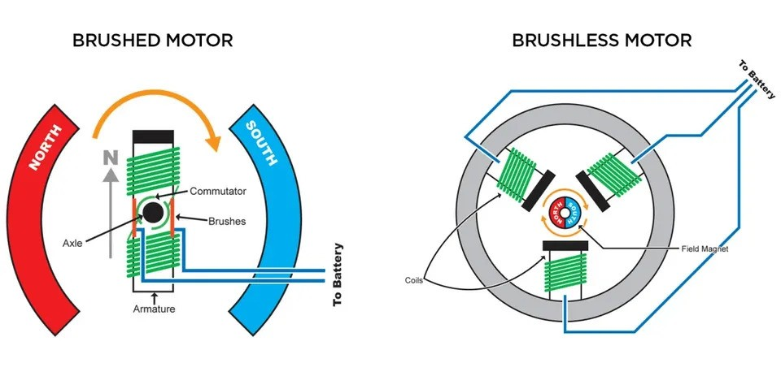
Motor Types in Comfort Systems
Brushed Motors: Commonly used for cost-effective comfort features like seat adjustments.
Brushless Motors: Preferred for high durability and efficiency.
Comparison: Brushed motors are easier to control but wear out faster, while brushless motors have longer life but require more complex control systems.

Slide 13
Motor Cascades in Comfort Electronics
Cascaded motor control allows managing multiple motors (e.g., windows and mirrors) through a single unit.
Centralized control helps reduce wiring complexity.

Slide 14
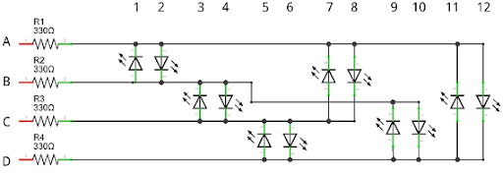
Advantages of Motor Cascades
Simplified Wiring: Fewer connections and parts reduce potential points of failure.
Optimized Architecture: Centralized unit can coordinate multiple features, lowering overall system cost.
Limitations: May have slight delays as motors operate in sequence.
Example with LEDs: (Every pair LEDs = Motor controlled for both directions)

Slide 15
Dependency Management in Cascades
Cascaded systems rely on proper dependency management, where shared power and timing constraints are taken into account and avoids overload by synchronizing motor usage based on priorities.
Example: Window motor's activation might wait for mirror adjustments to complete in order to avoid overload.

Slide 16
Setting Priorities in Control Systems
Prioritizing critical features (like locks) ensures smooth, uninterrupted operation over less critical features (e.g., seat heating).
Cascaded control is often applied to manage soft-close doors, mirrors, and windows, centralizing control over multiple comfort features.

Slide 17
Pros and Cons of Cascaded Motor Control
Pros:
Cost-Effective: Reduces component and wiring expenses.
Centralized Control: Minimizes complex wiring and simplifies control algorithms.
Cons:
Latency: Sequenced operation can lead to minor control delays.
Dependency on Central Control: Failure in the central unit impacts all cascaded functions.

Slide 18
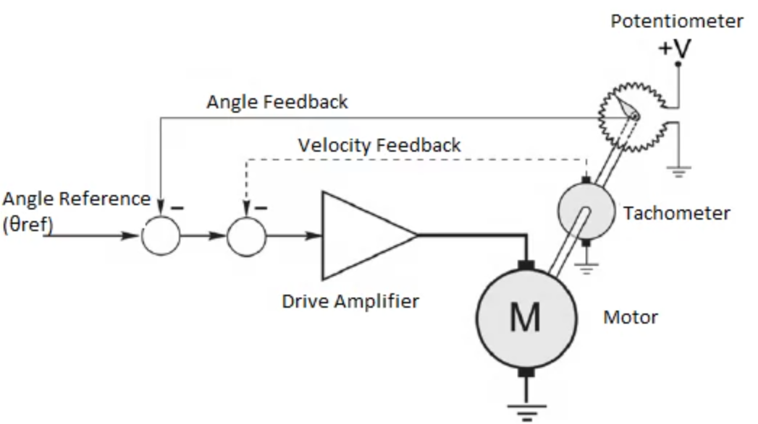
Position Feedback Mechanisms
Potentiometers offer analog feedback for accurate positioning in seat adjustments.

Slide 19
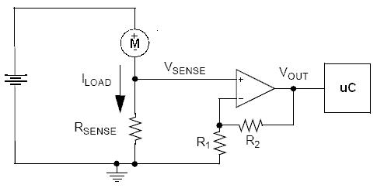
Current Feedback for Overload Protection
Operational amplifiers monitor current in real time, protecting motors from overload and short circuits.

Slide 20
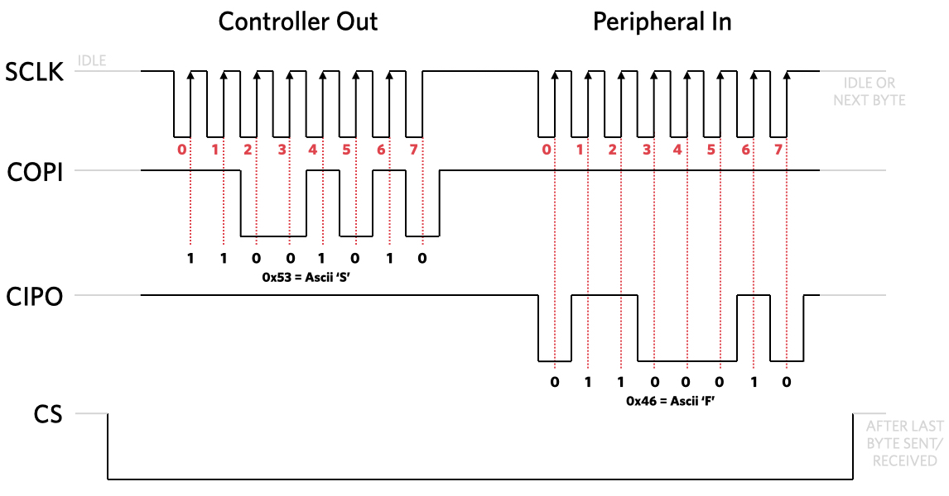
SPI Feedback for Status Monitoring
SPI protocol allows high-speed, reliable digital feedback on motor conditions for enhanced diagnostics and performance tracking.

Slide 21
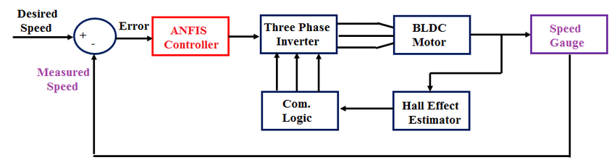
Introduction to Motor Diagnostics
Diagnostics are key to identifying and preventing system faults.
Early detection helps protect both motors and control units, maintaining the integrity of comfort systems.

Slide 22
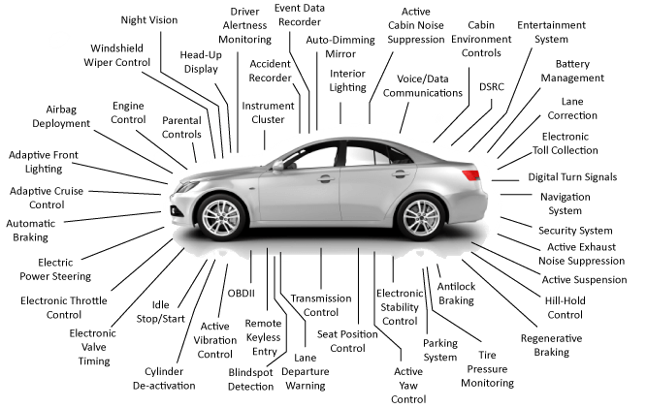
Diagnostic Standards and Compliance
Compliance with ISO 26262 and other standards is necessary to ensure safety.
Standards-based diagnostics help meet industry requirements for quality and reliability.

Slide 23
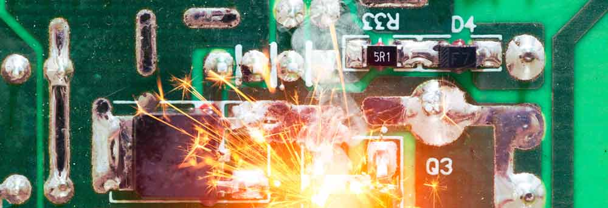
Importance of Diagnostics in Comfort Systems
Early fault detection helps prevent unexpected breakdowns and enhance safety, especially in comfort-related electronics.

Slide 24
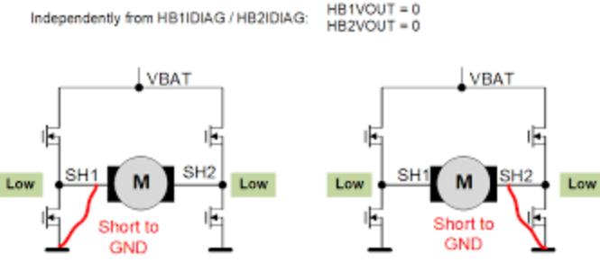
Off-State Diagnostics
This diagnostic is used while the system is inactive to check wiring, connections, and component integrity.
Useful for identifying disconnected wires or detecting a potential fault before motor operation.
Example: Ensuring motor connections are intact before startup.

Slide 25
Off-State Diagnostics Benefits and Limitations
Benefits: Prepares the system for safe activation by flagging faults before operation.
Limitations: Limited to static checks and doesn’t detect issues that may arise under load (operational faults).

Slide 26
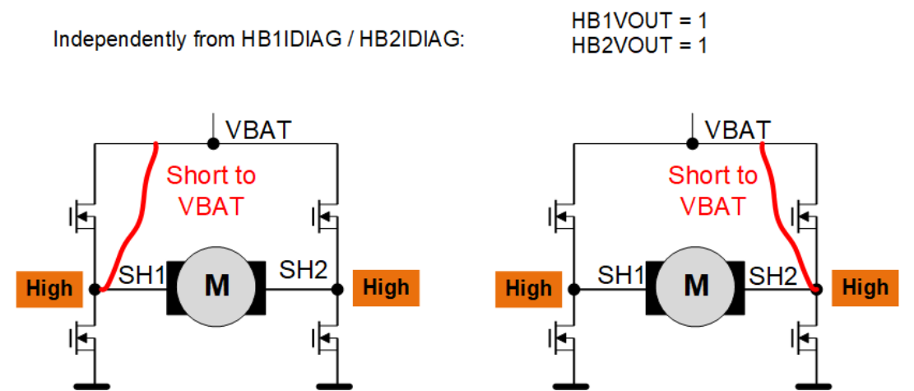
Components Monitored in On-State
Monitors critical parameters like current, voltage, and temperature during motor operation to detect any anomalies in real-time.
Active diagnostics check the system in real-time during operation.
It monitors for overcurrent, overheating, and other critical conditions.

Slide 27
On-State Diagnostics Benefits
Ensures safe motor operation in real-time by dynamically detecting overloads, overheating, or power issues.

Slide 28
Challenges of On-State Diagnostics
Complexity: Real-time monitoring is resource-intensive.
Risk of False Positives: Diagnosing transient issues incorrectly may lead to unnecessary shutdowns.

Slide 29
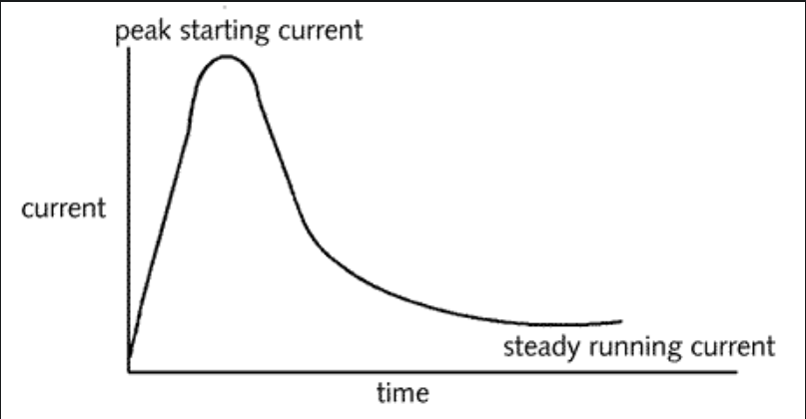
On-Demand Diagnostics
Diagnostics performed upon request, often for features activated infrequently.
Useful for systems like trunk release or other low-usage systems.
Examples: Specific diagnostics for rear-window defroster, trunk release mechanisms, or other occasionally used systems.

Slide 30
Benefits and Challenges of On-Demand Diagnostics
Benefits: Ideal for infrequent use, conserving power and resources.
Challenges: May require added configuration or introduce overhead if activated too often.

Slide 31
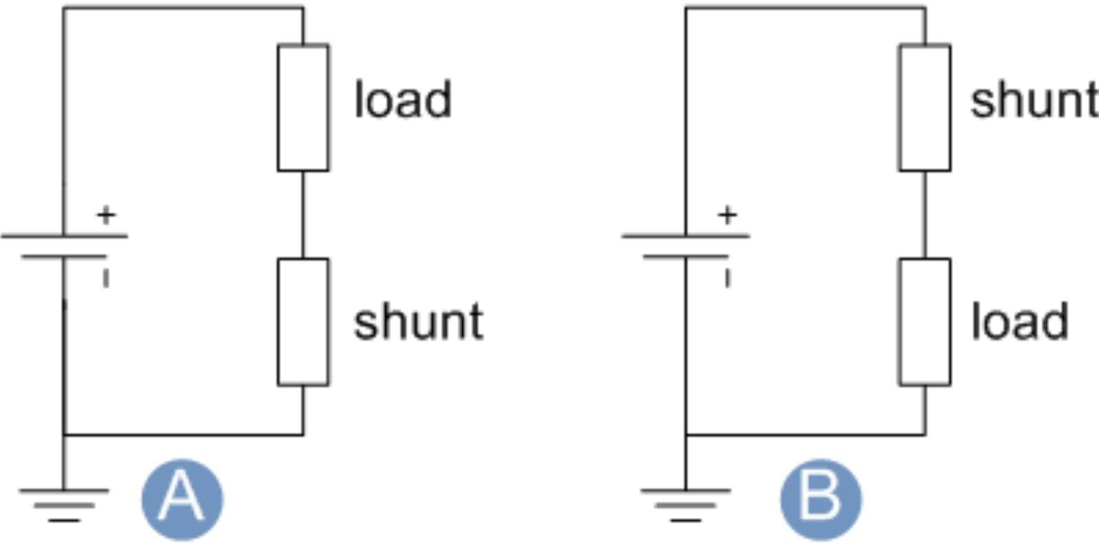
Shunt Measurement Diagnostics
Uses shunt resistors for precise current monitoring, protecting motors from overload by sensing current flow. Essential for sensitive systems.
Shunt placement allows for accurate current monitoring to ensure proper motor operation.
Provides detailed current feedback, helping the system respond immediately to overload situations.

Slide 32
Summary of Diagnostic Types
Quick summary of Off-State, On-State, On-Demand, and Shunt diagnostics.
Off-State: Detects pre-operation faults.
On-State: Monitors live operation conditions.
On-Demand: Used for infrequent features.
Shunt: Precise current monitoring for overload protection.

Slide 33
Comparison Table of Diagnostics
Off-State:
Pros: Simple and prepares system safely for activation.
Cons: Can’t detect issues under operational load.
On-State:
Pros: Real-time fault detection, enhances safety during operation.
Cons: Higher resource use, risk of false positives.
On-Demand:
Pros: Optimized for rarely used functions, saves energy.
Cons: Can cause delays if frequently checked.
Shunt Measurement:
Pros: Highly accurate current feedback, improves response to overloads.
Cons: Adds complexity to circuit design.

Slide 34
Applications in Comfort Systems Diagnostics
Window Lifters: Diagnostics prevent jamming and overheating.
Locks and Latches: Diagnostics ensure locks engage properly and alert to faults.
Seat Adjustments: Position feedback diagnostics ensure smooth and accurate seat movement.

Slide 35
Conclusion
Summary: Automotive comfort electronics heavily rely on embedded systems and robust diagnostics.
Diagnostics and control units contribute to system safety and user experience, ensuring comfort features function seamlessly across various vehicle models.

Slide 36
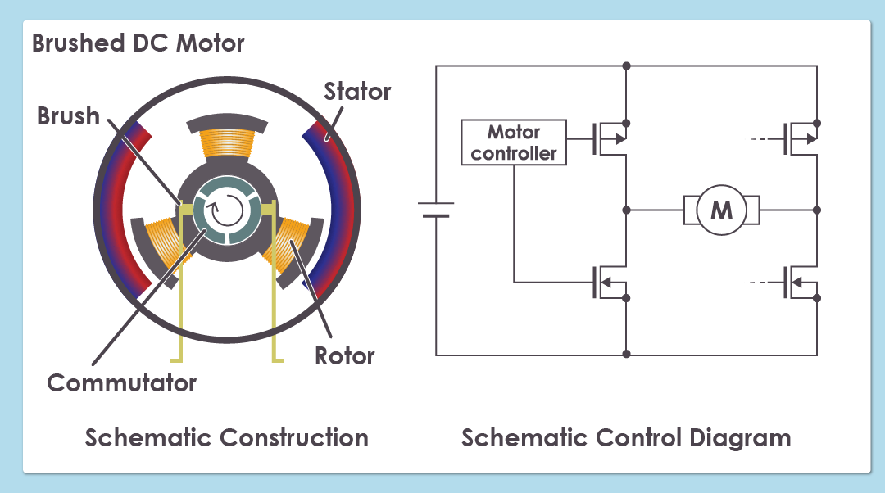
Conclusion and Q&A
Recap of key points on motor control, diagnostics, and IC selection.

