Slide 1
Embedded systems in cars
Lecture 1

Slide 2

MISRA Overview
What is MISRA?
MISRA is a set of coding guidelines for developing safe, reliable, and portable C code, primarily in automotive embedded systems.
It was introduced to reduce risks in embedded systems by preventing common coding errors in C, like memory leaks, overflow, and race conditions.
Why use MISRA?
Improves code safety, security, and portability.
Avoids undefined behaviors that could lead to system failures (e.g., the Toyota unintended acceleration case).
Key Concepts
Static memory allocation, limited pointer usage, and avoidance of dynamic memory allocation and recursion.
Rules: Mandatory, Required, and Advisory.

Slide 3

MISRA
What is MISRA?
MISRA (Motor Industry Software Reliability Association)
Is a set of software development guidelines for the C programming language, aimed at developing safe, reliable, and portable code for automotive systems.
Originally developed in 1994 for automotive systems, MISRA's guidelines have become a de facto standard in other industries where safety and mission-critical software is developed (e.g., aerospace, medical devices, and industrial control systems).
MISRA C:2012 is the most widely adopted version of these guidelines, addressing potential issues in the C language that could lead to undefined or dangerous behaviors.
These include subtle bugs like unintended memory manipulation, overflow, or race conditions, which are critical to avoid in automotive systems where failure could lead to life-threatening situations.

Slide 4

MISRA
Why Was MISRA Introduced?
To ensure safety, security, and reliability in embedded software.
As embedded systems in vehicles became more complex and critical, a need arose for strict software development practices to prevent failures.

Slide 5
MISRA
Why Use MISRA?
MISRA is crucial in automotive and safety-critical systems development for several reasons:
Safety
Reliability
Portability
Compliance
Many industries require compliance with MISRA or similar coding standards to meet regulatory and certification requirements, such as ISO 26262 for automotive functional safety.
By enforcing these rules, companies can prevent catastrophic failures, maintain high standards for safety, and reduce long-term maintenance costs. Misra rules also work hand-in-hand with static analysis tools (like PC-Lint, QAC, or Polyspace) for early bug detection, ensuring that the final system is both robust and safe.

Slide 6
MISRA
Key Principles of MISRA C:2012
MISRA C:2012 contains 143 rules and 16 directives, each falling into one of the following categories:
Mandatory: These rules must be followed. Violations are not allowed under any circumstances.
Required: These rules must be followed unless the developer provides a documented rationale.
Advisory: These rules are optional but highly recommended to improve code quality.
Key concepts include
Avoidance of dynamic memory allocation
Static memory allocation
Avoidance of recursion
Limiting pointer usage

Slide 7
MISRA real case example
Toyota Unintended Acceleration Incident
A famous case that highlights why coding standards like MISRA are important is the Toyota unintended acceleration incident.
In this case, software bugs in Toyota’s embedded system caused the vehicle to accelerate unintentionally, leading to crashes and fatalities.
One of the root causes was poor code quality, including ignoring or suppressing compiler warnings and failing to adhere to safety standards.
These kinds of bugs could have been caught or mitigated with adherence to strict coding rules, such as those outlined in MISRA.
By following MISRA, you can avoid:
Undefined behavior due to bad coding practices.
Subtle bugs that could be overlooked in system complexity.
Dangerous memory-related issues, such as buffer overflows or use-after-free errors.

Slide 8

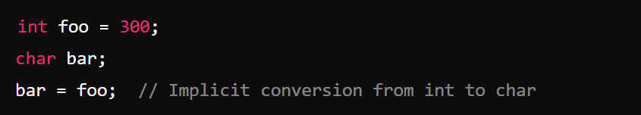



MISRA C code example
MISRA Rule 10.1: The value of an expression shall not be implicitly converted to a type that is not consistent with the essential type of the expression.
Possible problems:
different sizes for data types
data truncation or overflow
different architectures or hardware platforms
cross-platform portability
signed vs unsigned types
endianness issues
performance and optimization

Slide 9

ASPICE Overview
What is ASPICE?
ASPICE is a process model to evaluate and improve software development maturity in the automotive industry, based on ISO/IEC 15504 (SPICE).
It focuses on ensuring that software development processes are standardized, repeatable, and of high quality.
Why use ASPICE?
Reduces risks and improves safety and quality in the software lifecycle.
Ensures compliance with ISO 26262 and other standards.
Supports process improvement and alignment with OEM requirements.
Key Concepts
Capability Levels: Levels 0–5, from incomplete to optimizing processes.
V-Model: A development lifecycle model that emphasizes verification and validation at each stage.
Processes: System requirements, software development, integration, testing, quality assurance, and project management.

Slide 10
ASPICE
What is ASPICE?
ASPICE (Automotive Software Process Improvement and Capability dEtermination)
Is a process assessment model specifically tailored for the automotive industry. It is based on the broader ISO/IEC 15504 standard, commonly known as SPICE, but it focuses on the unique challenges and needs of automotive software development.
ASPICE provides a framework to assess the maturity of development processes. It covers the complete lifecycle of embedded systems in vehicles, from the initial concept through development, testing, and maintenance. By following ASPICE guidelines, organizations can ensure that their development processes are well-defined, repeatable, and capable of producing high -quality, safe, and reliable software.

Slide 11
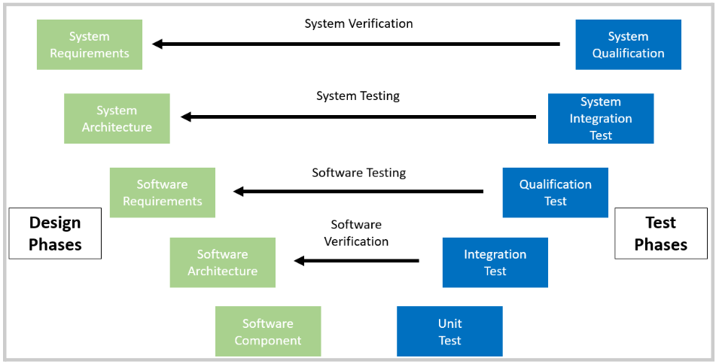
ASPICE V-model

Slide 12
ASPICE
Why was ASPICE introduced?
ASPICE was introduced to address increasing complexity in automotive systems and the growing need for standardized development processes that ensure quality and safety.
Provide a structured, repeatable process for software development.
Ensure that every phase of the development lifecycle meets quality standards.
Identify and mitigate risks early in the development process.
Establish a common language and framework that both OEMs (Original Equipment Manufacturers) and suppliers can follow to achieve process excellence.
This framework helps reduce risks in product quality, enhances collaboration across different teams, and ensures compliance with industry safety standards like ISO 26262 (Functional Safety for Road Vehicles).

Slide 13
ASPICE
Why use ASPICE?
There are several benefits to adopting ASPICE, particularly in the automotive sector:
Standardization of processes: standardized approach to software development, which is crucial in a global industry. This makes it easier to collaborate with suppliers and ensure compliance with international safety standards.
Focus on quality and risk reduction: reduce the risks of software bugs, defects, or safety issues. This is especially critical for systems such as braking, steering, and ADAS, where failures can be life-threatening.
Process improvement: framework for continuous improvement, allowing companies to refine their processes over time and achieve higher levels of maturity.
Compliance with ISO 26262: the functional safety standard for road vehicles. Necessity for safety-critical systems.
Alignment with OEMs: being ASPICE-compliant ensures that companies can meet customer expectations and deliver software that meets the required safety and quality standards.

Slide 14
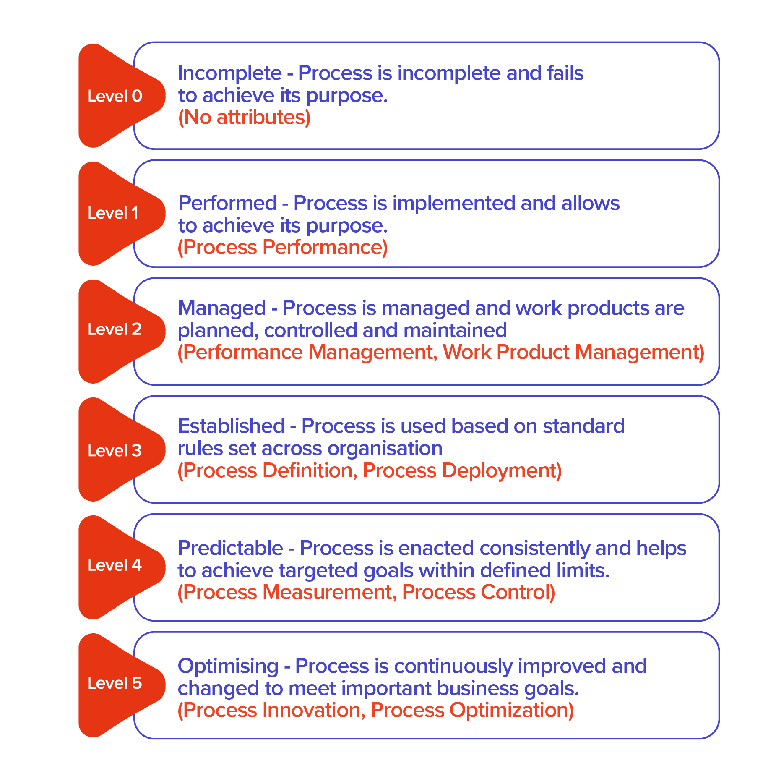
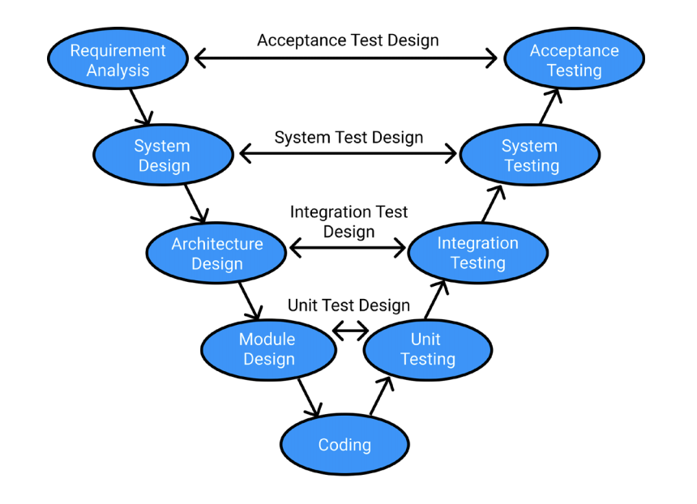
ASPICE
Key Principles and Ideology of ASPICE
ASPICE assesses the capability of a company’s development processes by using a model based on maturity levels. It is built around the V-Model and has key features that support software quality and process improvement.
Capability Levels
V-Model
Processes

Slide 15

AUTOSAR Overview
What is AUTOSAR?
AUTOSAR (AUTomotive Open System ARchitecture) is a standardized software architecture designed for the automotive industry.
It allows for interoperability, scalability, and reusability of software across different platforms
Why use AUTOSAR?
Simplifies the development of automotive systems by standardizing software structure
Enhances reusability, reduces costs, and supports safety-critical applications (e.g., ISO 26262 compliance).
Scalable for both simple ECUs and advanced systems like ADAS.
AUTOSAR Architecture
Application Layer: Contains vehicle-specific software components (e.g., engine control).
RTE (Runtime Environment): Middleware that decouples the software from hardware, ensuring modularity and communication between ECUs
Basic Software (BSW): Provides system services, hardware abstraction, and drivers, divided into sub-layers like IO Abstraction, Complex Drivers, and MCAL.

Slide 16
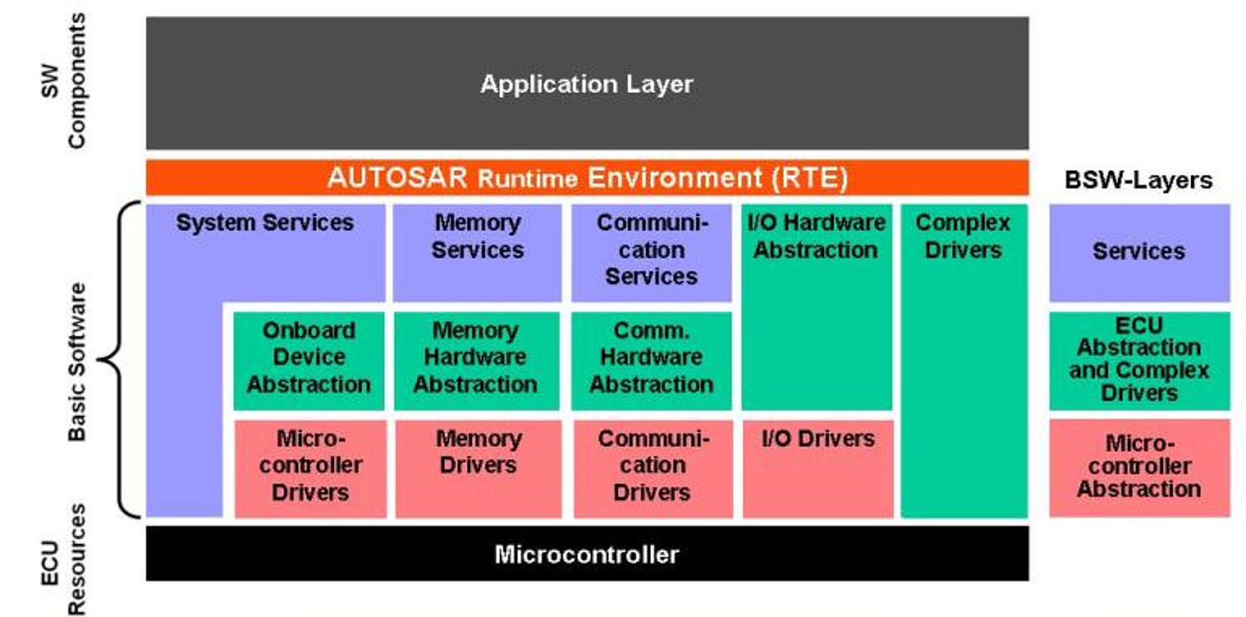
AUTOSAR

Slide 17
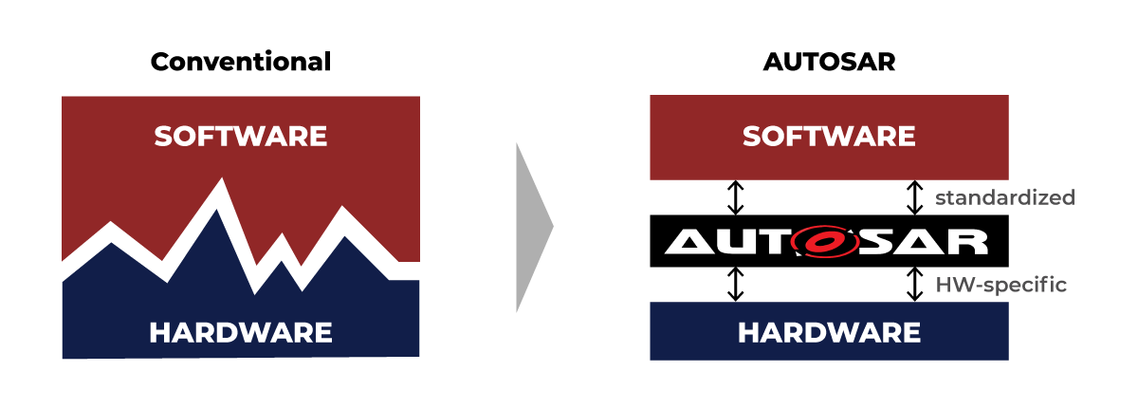
AUTOSAR
What is AUTOSAR?
AUTOSAR (AUTomotive Open System ARchitecture)
Is a worldwide development partnership of vehicle manufacturers, suppliers, and tool developers aimed at establishing a standardized software architecture for automotive systems. The goal of AUTOSAR is to facilitate the development of automotive software by creating a common platform that ensures interoperability, scalability, and reusability of components across different vehicle platforms.
AUTOSAR defines a layered software architecture that separates application software from hardware, which allows software to be reused across different hardware platforms. This modular approach simplifies the integration of components from different suppliers and allows for easier upgrades and scalability.

Slide 18

AUTOSAR
Why was AUTOSAR introduced?
AUTOSAR was introduced to address the increasing complexity of automotive systems, the growing number of ECUs (Electronic Control Units) in modern vehicles, and the need for a standardized approach to software development.

Slide 19
AUTOSAR
Why use AUTOSAR?
AUTOSAR is widely adopted in the automotive industry for several important reasons:
Interoperability: ensures that software components developed by different suppliers or teams can easily integrate into a single system
Scalability and Flexibility: supports a wide range of vehicle platforms, from simple systems to highly complex ones.
Reusability: companies can reuse the same software modules across multiple projects, reducing development time and cost.
Reduced Complexity: standardizing the architecture and communication between components.
Compliance with Industry Standards: safety and quality standards like ISO 26262.

Slide 20
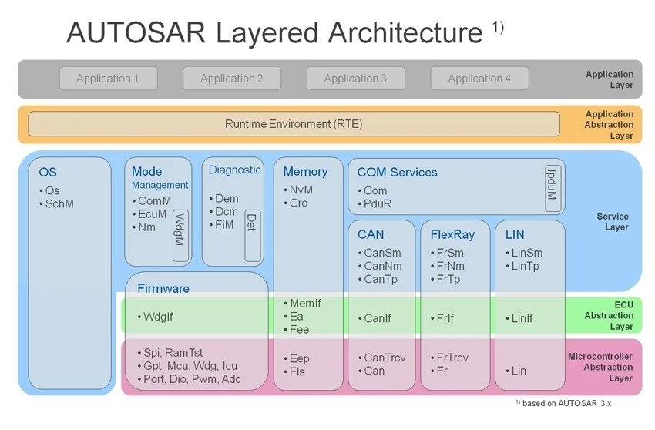
AUTOSAR
AUTOSAR Architecture
AUTOSAR is divided into multiple layers, each responsible for specific functions. These layers are designed to decouple the hardware from the application software, allowing for easier integration and scalability.

Slide 21
AUTOSAR
AUTOSAR Architecture
Application Layer: contains the application software components (SWCs) that are specific to the vehicle's functions. These SWCs are developed to perform specific tasks and are independent of the underlying hardware. The application layer focuses on high-level logic and control algorithms. Each SWC is modeled in a standardized way, with well-defined interfaces, so it can easily communicate with other components via the RTE.

Slide 22
AUTOSAR
AUTOSAR Architecture
RTE (Runtime Environment): acts as a middleware layer, providing communication between the application layer and the Basic Software (BSW) layer. The RTE handles the communication between different software components, both within the same ECU and across different ECUs via bus systems like CAN, LIN, or Ethernet. Key functions of the RTE include Inter-ECU and Intra-ECU communication, timing and scheduling.
RTE is also used as abstraction of interfaces used in the BSW layer.

Slide 23
AUTOSAR
AUTOSAR Architecture
Basic Software (BSW) layer: closest to the hardware. It provides fundamental services and functions needed by the application software, including hardware abstraction, communication, and system services. The BSW layer is further divided into several sub-layers:
IO Abstraction Layer: allows the application software to interact with hardware peripherals (e.g., sensors, actuators) in a way that is independent of the specific hardware being used. This abstraction makes it easier to port software to different microcontrollers without having to rewrite the code.
Complex Drivers: used for hardware-specific drivers that cannot be fully abstracted by the IO Abstraction Layer. These drivers are used for specific functions that require direct hardware access or high performance (e.g., DMA, Interrupts).
Services: provides system services such as diagnostics, memory management, and communication services.
MCAL (Microcontroller Abstraction Layer): provides a standardized interface between the higher software layers (like BSW and RTE) and the underlying microcontroller hardware.

Slide 24
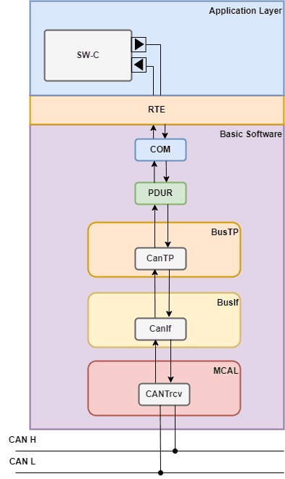
Basic Architecture for Comfort Systems
Basic Architecture for Comfort Systems:
CAN (Controller Area Network) – Physical Layer
AUTOSAR Communication Stack (COM)
RTE (Runtime Environment)
Application Layer (APPL)
BSW (Basic Software)

Slide 25
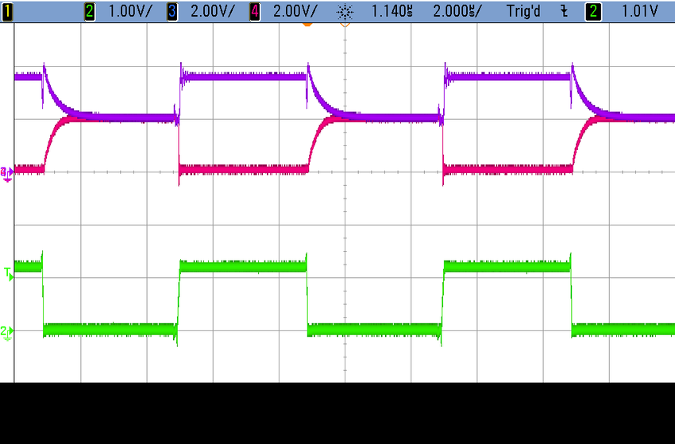
Basic Architecture for Comfort Systems
CAN (Physical Layer)
The CAN bus is the physical communication layer that allows various ECUs (Electronic Control Units) in a vehicle to communicate. It is widely used in comfort systems, such as automatic windows, seat adjustments, or climate control. This layer handles the electrical signaling and low-level data transmission between different nodes in the vehicle's network.
Example: A signal is transmitted when the user adjusts the seat position. This signal starts at the CAN physical layer as an electrical signal between ECUs.

Slide 26
Basic Architecture for Comfort Systems
AUTOSAR Communication Stack (COM)
After the physical layer, the data is passed up to the Communication (COM) stack in the AUTOSAR BSW. The COM stack abstracts the physical details and manages higher-level data handling, like message transmission and reception over the CAN bus.
COM Features:
Message packaging.
Signal processing and routing.
Interface with the RTE for communication with the application layer.
Example: The seat adjustment signal is packaged into a message, which will be sent to the right ECU (e.g., seat adjustment ECU) through the COM stack.

Slide 27
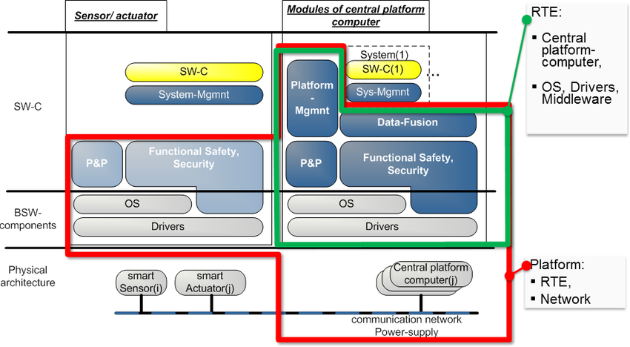
Basic Architecture for Comfort Systems
RTE (Runtime Environment)
The RTE is the middleware layer that allows communication between the COM stack and the Application Layer. It handles message routing between ECUs and ensures that the appropriate software components (SWCs) in the application layer receive the correct data.
Example: The seat adjustment message is received by the RTE, which routes it to the correct Application Layer component responsible for interpreting the signal.

Slide 28
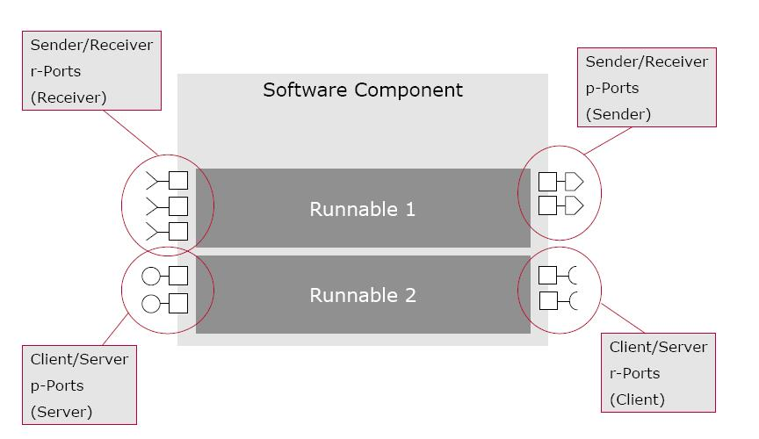
Basic Architecture for Comfort Systems
Application Layer (APPL)
The Application Layer contains the software components that handle specific functions, such as seat adjustment, climate control, or window management. These components take the data from the RTE and execute the necessary logic or algorithms to perform the required actions.
Example: The seat adjustment software component processes the message received from the RTE and adjusts the seat position based on the user input.
Window
Lifter
Locking
BLIS
Mirror

Slide 29
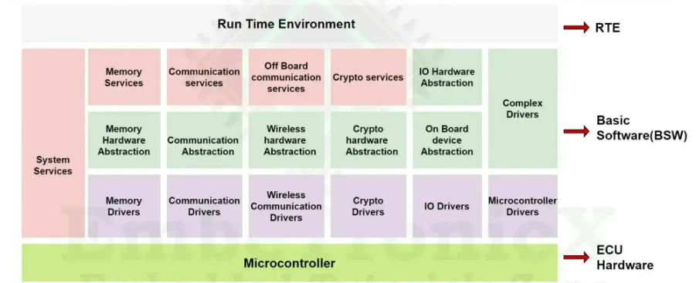
Basic Architecture for Comfort Systems
BSW (Basic Software Layer)
The BSW manages all basic system functionalities and provides hardware abstraction. In this case, the BSW manages the underlying drivers and services that allow the application layer to function without needing to deal with hardware-specific details.
Sub-layers in BSW:
MCAL (Microcontroller Abstraction Layer): Abstracts the microcontroller-specific details.
IO Abstraction: Handles communication with peripherals like motors for seat adjustment.
Complex Drivers: For handling any advanced or non-standard hardware interactions.
Example: The seat adjustment motor is controlled by the drivers within the BSW, which receives instructions from the application layer via the RTE.

Slide 30
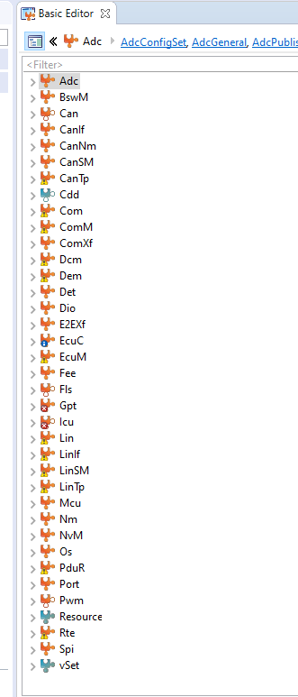
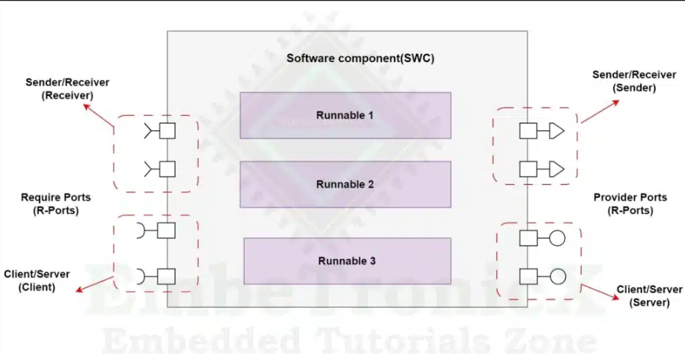
AUTOSAR Tools
For easier access, understanding and configurations in AUTOSAR we are using 2 primary tools:
Davinci Configurator
Davinci Developer
Davinci Configurator is used widely – from setup MCAL to mode switching of the system:
Danvici developer is more likely to show how components are connected each other and what interfaces are used between them.

Slide 31
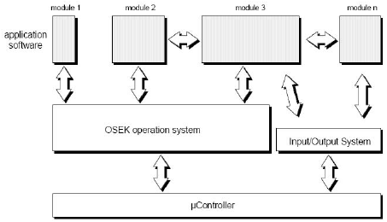
OSEK
What is OSEK?
OSEK-OS is a specification for real-time operating systems for embedded systems used in electronic data processing, adopted by the OSEK consortium.
It is mainly used on real-time systems in the field of automotive electronics .

Slide 32
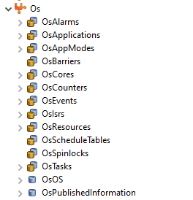
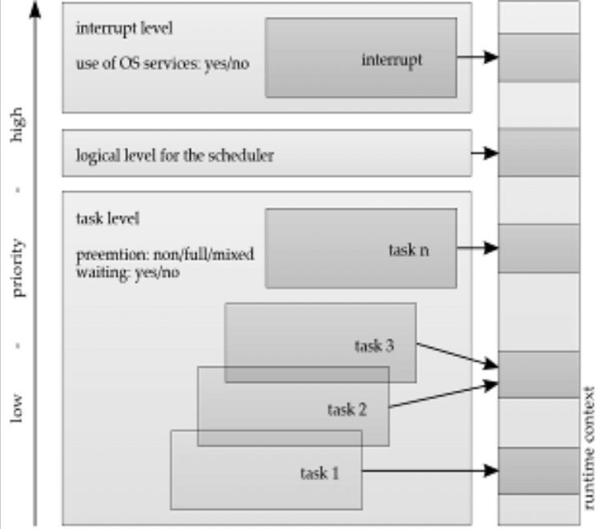
OSEK
Interfaces
The OSEK-OS standard specifies interfaces to multitasking functions and is therefore architecture-dependent.

Slide 33
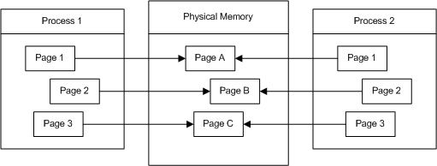
OSEK
Security (Protection)
The OSEK-OS standard is designed for controllers that do not have memory protection .

Slide 34
OSEK
Tasking
The OSEK-OS standard is static. All resources and tasks are defined and configured before compilation for the desired application: the number, types and properties of the tasks , stacks , mutex procedures, etc. It is not possible to define new tasks at runtime.
The OSEK-OS standard recognizes two different classes of tasks:
simple tasks
complex tasks
Similar to interrupts, simple tasks can only be interrupted by simple tasks with a higher priority and only end when they have been completely processed.
Complex tasks wait for resources to be released during processing and can thus be blocked.

Slide 35
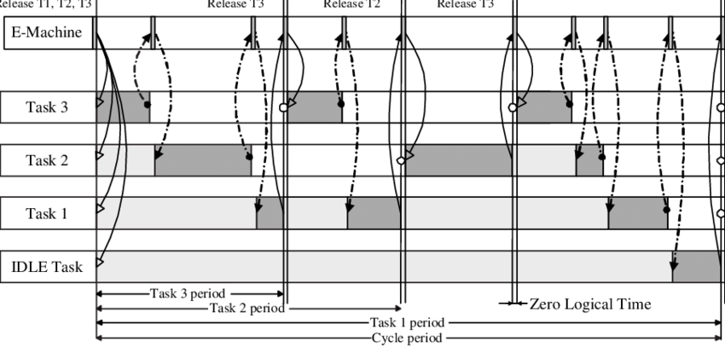
OSEK
Scheduling
Scheduling can be configured in two different ways:
With preemptive scheduling, a task can be interrupted at any time by a task with a higher priority (preemptive scheduling);
with non-preemptive scheduling, a task can only be interrupted at certain points that are configured in the code at compile time (cooperative scheduling). Mixed operation is also possible .

Slide 36
OSEK
Timing
While the OSEK-OS standard specifies an event-driven operating system, the OSEK-TIME specification (also written: OSEKtime ) is a supplement for time-driven operating systems. When configured, OSEK-TIME callback functions are processed with higher priority than the tasks configured in OSEK-OS.

Slide 37
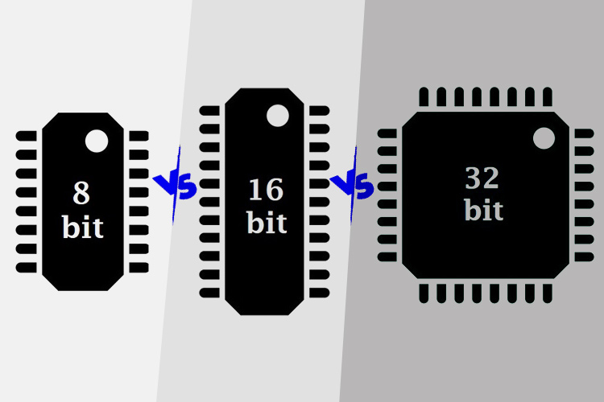
OSEK
target platforms (targets)
Common target platforms are 16- and 32-bit microcontrollers for the automotive industry, but the system is scalable and can be used practically on 8- to 32-bit microprocessors .

