Slide 1



JavaScript, React, HTML, CSS

Slide 2

By: Nafees Chand
Intern/Trainee
Graduated from Manipal Academy of Higher Education

Slide 3
Objectives

Slide 4



JavaScript and React
JavaScript is a scripting language. It is object-based, lightweight, cross-platform translated. It enables you to create dynamically updating content, control multimedia, animate images, etc.
React is a front-end JavaScript library developed by Facebook in 2011. It follows the component-based approach which helps in building reusable UI components. It is used for developing complex and interactive web and mobile UI.

Slide 5
JSX
JSX is a syntax extension of JavaScript. It is used with React to describe what the user interface should look like. By using JSX, we can write HTML structures in the same file that contains JavaScript code.
With JSX you can write expressions inside curly brackets { }.
JS is standard JavaScript

Slide 6
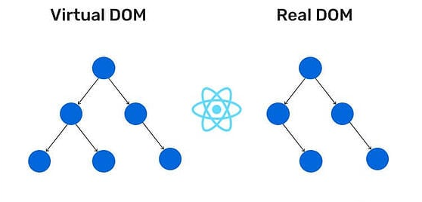
Virtual DOM and Real DOM
DOM stands for Document Object Model.
Real DOM is a structural representation of HTML elements of a web. It can be used to access and change the content of HTML. DOM represents the entire UI of the application.
Virtual DOM is the virtual representation of Real DOM. It is just like a blueprint of a machine, can do the changes in the blueprint but those changes will not directly apply to the machine.
It is represented as a tree data structure.

Slide 7
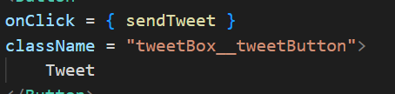
Event in React
Events are the triggered reactions to specific actions like mouse hover, mouse click, key press, etc. Handling these events are like handling events in DOM elements.
Events are named using camel case instead of just using the lowercase.
Events are passed as functions instead of strings.
Example: <Button onPress={lightItUp} />

Slide 8

Arrow Function
Arrow functions allow us to write shorter functions.
Example:
hello = () => {
return "Hello World!";
}
Only works if the function has one statement.
We use arrow functions as functional components, functions within class components, and event handlers.

Slide 9
Scoping
Scoping is determining where variables, functions, and objects are accessible in your code during runtime.
There are two types of scopes in JS:
- Global Scope
- Local or Function Scope

Slide 10
Global Scope: Variables or functions declared in the global namespace have global scope, which means all the variables and functions having global scope can be accessed from anywhere inside the code.
Function Scope: Any variables or functions declared inside a function have local/function scope, which means that all the variables and functions declared inside a function, can be accessed from within the function and not outside of it.

Slide 11
Props in React
Props are short for Properties. It is a React built-in object that stores the value of attributes of a tag and works similarly to HTML attributes. They are read-only components which must be kept pure i.e., immutable.
Props provide a way to pass data from one component to another component. Props are passed to the component in the same way as arguments are passed in a function.

Slide 12
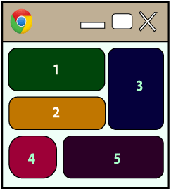
Components in React
Functional Components: These types of components have no state of their own and only contain render methods, and therefore are called stateless components. They may derive data from other components as props (properties).
Class Components: These types of components can hold and manage their own state and have a separate render method to return JSX on the screen. They are called stateful components as they can have a state.

Slide 13
Stateful components:
Contains the knowledge of past, current and possible future changes in state.
Stateless components notify them about the requirement of the state change, then they send down the props to them.
Stateless components:
Contains no knowledge of past, current and possible future state changes.
They receive the props from the Stateful components and treat them as callback functions.

Slide 14


Hooks in React
useState : It is the most important and often used hook. The purpose of this hook to handle reactive data, any data that changes in the application is called state, when any of the data changes, React re-renders the UI.
useEffect : It allows us to implement all the lifecycle hooks from within a single function API.
Lifecycle hooks include - componentWillMount(), componentDidMount(), componentWillUpdate(), componentDidUpdate(), componentWillUnmount()

Slide 15
useRef : This hook allows us to create a mutable object. It is used, when the value keeps changes like in the case of useState hook, but the difference is, it doesn't trigger a re-render when the value changes.
useCallback : is one of the react hooks used to prevent functions declared within the body of function components from being recreated on every render.
useMemo : This hook will help you to optimize computational cost or improve performance. It mostly used when we're needed to make expensive calculations.

Slide 16
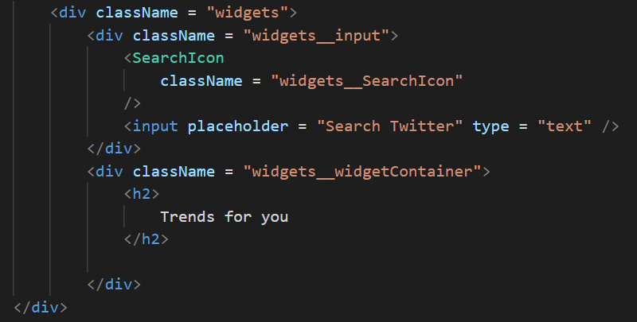
HTML
HTML stands for Hyper Text Markup Language. It is a language of World Wide Web. It is a standard text formatting language which is used to create and display pages on the Web. It makes the text more interactive and dynamic. It can turn text into images, tables, links.

Slide 17
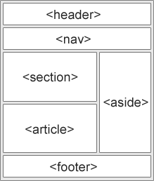
HTML Layout
HTML layout specifies a way in which the web page is arranged.
<header>: It is used to define a header for a document or a section.
<nav>: It is used to define a container for navigation links
<section>: It is used to define a section in a document
<article>: It is used to define an independent, self-contained article
<aside>: It is used to define content aside from the content (like a sidebar)
<footer>: It is used to define a footer for a document or a section

Slide 18
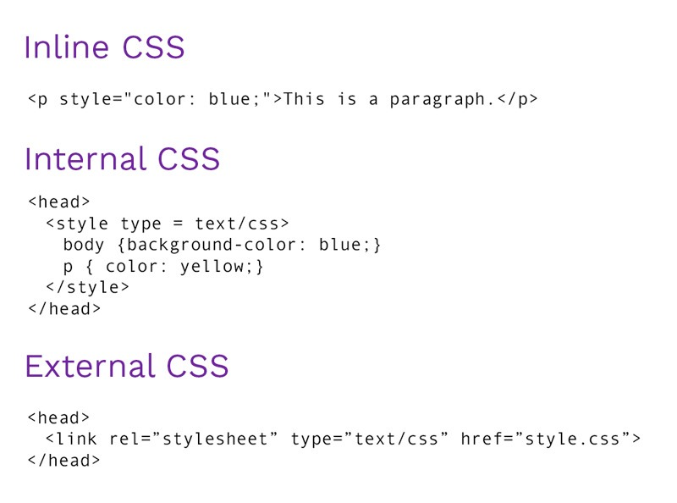
CSS
CSS stands for Cascading Style Sheet. It is a popular styling language which is used with HTML to design websites. It can also be used with any XML documents including XML, etc.
There are three methods to integrate CSS on web pages.
- Inline method : It is used to insert style sheets in HTML document
- Embedded/Internal method : It is used to add a unique style to a single document
- Linked/Imported/External method : It is used when you want to make changes on multiple pages.

Slide 19
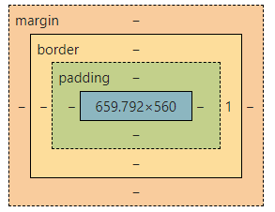
CSS Box model
Margin - It removes the area around the border. It is transparent.
Border - It represents the area around the padding
Padding - It removes the area around the content. It is transparent.
Content - It represents the content like text, images, etc.

Slide 20

!important
What is the important in CSS?
The !important rule in CSS is used to add more importance to a property/value than normal.
Example:
a {
color: blue !important;
background-color: orange !important;
}

Slide 21

Thank You !

