Slide 1

Git & GitHub
- Naf

Slide 2
By: Nafees Chand
Intern/Trainee
Graduated from Manipal Academy of Higher Education

Slide 3
Objectives
Understand Git and GitHub
Understand the Workflow
Git Commands
What is Git Head and Master
How to add files to GitHub

Slide 4

Git and GitHub

Slide 5
What is Git?
Git is a popular version control system.
Users can make any changes without internet access.
It was created by Linus Torvalds in 2005 and has been maintained by Junio Hamano since then.
What is Version Control?
Version control is a system that records changes to a file or set of files over time so that you can recall specific versions later. So ideally, we can place any file in the computer on version control.
A system that keeps records of your changes.
Allows for collaborative development.
Allows you to know who made changes and when.
Allows you to revert any changes and go back to a previous state.

Slide 6

Git isn’t the only version control system.
There are 2 other well known VCS :

Slide 7
GitHub
Largest web-based git repository hosting service.
Allows for code collaboration with anyone online.
Adds extra functionality on top of git
○ UI, documentation, bug tracking, feature requests, pull requests, etc.
Founded in 2008

Slide 8
Git Workflow

Slide 9
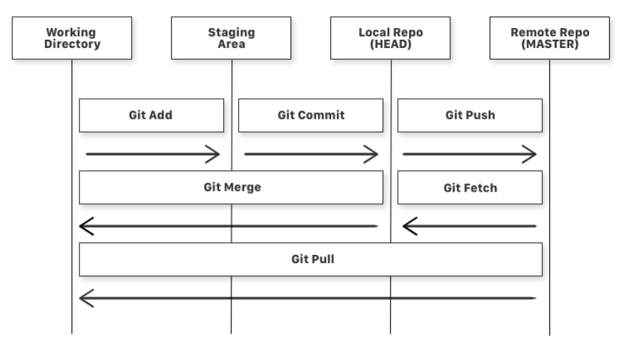
Git Workflow
What is a Repository?
A repository or repo is nothing but a collection of source code.
What is a Branch?
Branches allow you to develop features, fix bugs, or safely experiment with new ideas in a contained area of your repository.
There are four fundamental elements in the Git Workflow.
Working Directory: Consists of files that you are currently working on.
Staging Area: Staging area is files that are going to be a part of the next commit, which lets git know what changes in the file are going to occur for the next commit.
Local Repository: It is a Git repository that is stored on your computer.
Remote Repository: They are hosted on a server that is accessible for all team members, most likely on the internet or on a local network.
Three states
It can be staged. Which means the files with the updated changes are marked to be committed to the local repository but not yet committed.
It can be modified. Which means the files with the updated changes are not yet stored in the local repository.
It can be committed. Which means that the changes you made to your file are safely stored in the local repository.

Slide 10
Git Commands

Slide 11
COMMANDS
git add is a command used to add a file that is in the working directory to the staging area.
git commit is a command used to add all files that are staged to the local repository.
git push is a command used to add all committed files in the local repository to the remote repository. So, in the remote repository, all files and changes will be visible to anyone with access to the remote repository.
git fetch is a command used to get files from the remote repository to the local repository but not into the working directory.
git merge is a command used to get the files from the local repository into the working directory.
git pull is command used to get files from the remote repository directly into the working directory. It is equivalent to a git fetch and a git merge.

Slide 12
Git Head and Master

Slide 13
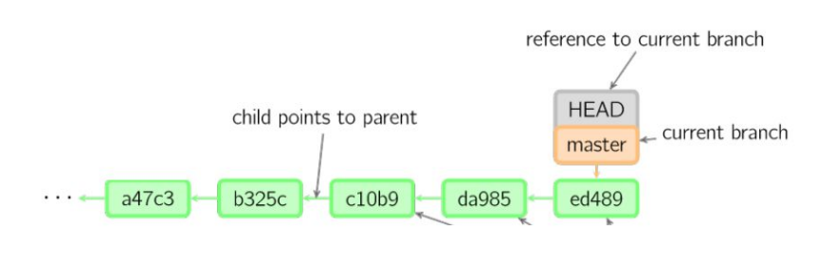
GIT Head and Master
MASTER
The main branch in a project is called the master branch.
The one where all changes eventually get merged back into is called master. This is the official working version of your project, and the one you see when you visit the project repository at github.com/”yourname”/”projectname”.
HEAD
Head is the reference to the most recent commit in the current branch. This means Head is just like a pointer that keeps track of the latest commit in your current branch.

Slide 14
Adding files to GitHub

Slide 15
Adding files to GitHub
Step 1: ls
Lists all the files in the current directory.
Step 2: cd
Changes the directory.
Step 3: git init
This command initializes the git in the given path. You can see the .git hidden files after this command gets executed.
Step 4: git remote add origin
gitLink denotes the place where your code is stored in the remote repository.
Step 5: git add
Adds all the files in the local directory to the remote repository.
Step 6: git commit -m "First commit"
It establishes a connection with local repository.
Step 7: git push origin master
It establishes a connection with a remote repository and upload your source code or files to GitHub.

Slide 16
THANK YOU !

