Slide 1
WELCOME

Slide 2
Project Title:
KryptoSuperman

Slide 3
Presented by
Nafeeul Alam Walee
Registration No: L1A-C-11-0-22
Batch Id: L1A-C-11-0
District: Khulna
Course Registered: Android

Slide 4
Description:
KryptoSuperman is a 2D platform game made by libgdx. The game concepts is taken from the game called “FlappyBird”.
Key Points:
Superman is surrounded by kryptonite pillars and spikes.
Player must avoid these kryptonites and survive as long as possible.

Slide 5
In-game Features
  Splash Screen
  Menu State
  Play State
  Game Over State
  Audio
  Animation
  Survival Scores

Slide 6


STATE 1– Splash State

Slide 7
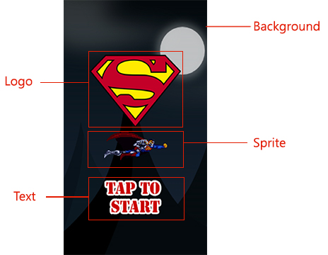
STATE 2 – Menu State

Slide 8
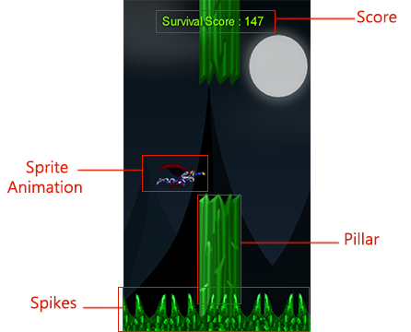
STATE 3 – Play State

Slide 9
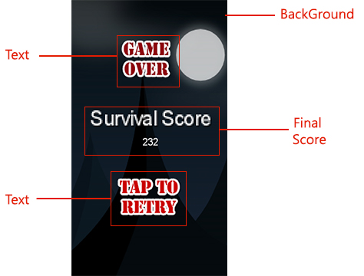
STATE 4 – Game Over State

Slide 10
State Manager
Game State Manager
Stack of states
Set State
Push State
Pop State

Slide 11
THE ARCHITECTURE OF THE APPLICATION
App Start
Score Update
Splash State
Music On
Menu State
Play State
Music Off
Exit
Continue
State
Final Score

Slide 12



