Slide 1
ADVANCED IOT AND DATA-DRIVEN SOLUTIONS FOR OPTIMIZING VEHICLE LIFECYCLE MANAGEMENT AND MAINTANANCE
Research Project Presentation
24-25J-172

Slide 2
Content
Background
Research Problem
Objectives
Overall System Diagrams

Slide 3
Background
The automotive industry is evolving with IoT and AI technologies.
Accurate vehicle tracking remains a critical challenge.
Predictive maintenance is needed to reduce downtime.
Personalized vehicle advice can enhance user satisfaction.
Effective parts recommendations require better data analysis.

Slide 4
Project Introduction
Enhance vehicle lifecycle management using IoT and AI.
Implement real-time GPS tracking for accurate vehicle monitoring.
Utilize predictive maintenance models to reduce downtime.
Provide personalized advice and parts recommendations using AI and NLP.

Slide 5
Main Objective
Enhance vehicle lifecycle management by using IoT and AI technologies to optimize usage, reduce downtime, and provide personalized advice and parts recommendations.

Slide 6
Sub Objectives
Accurately track and log vehicle travel (map)
diagnostics Schedule predictive maintenance
Integrated chatbot NN for vehicle advice
Provide personalized automobile part recommendation

Slide 7
Research Questions
How can we accurately track and log the total lifetime travel of vehicles using IoT technology?
How can predictive maintenance be effectively scheduled using real-time sensor data and time series analysis?
How can we provide real-time, personalized vehicle advice through a neural network-based chatbot?
How can customer reviews be leveraged to provide personalized and reliable recommendations for automobile parts?

Slide 8
Literature Review
The integration of IoT and data-driven technologies is reshaping the automotive industry, particularly in the realm of vehicle lifecycle management and maintenance. This literature review explores the key areas of IoT-enabled vehicle tracking, predictive maintenance, neural network-based vehicle advisory systems, and personalized automobile part recommendations.

Slide 9
Conclusion
The reviewed literature underscores the transformative potential of IoT and data-driven solutions in vehicle lifecycle management. By integrating real-time data analytics, predictive maintenance, AI-driven advisory systems, and personalized recommendations, the automotive industry can achieve greater efficiency, reduced operational costs, and enhanced customer satisfaction. Future research should continue to explore the optimization of these technologies to further advance vehicle lifecycle management and maintenance.

Slide 10
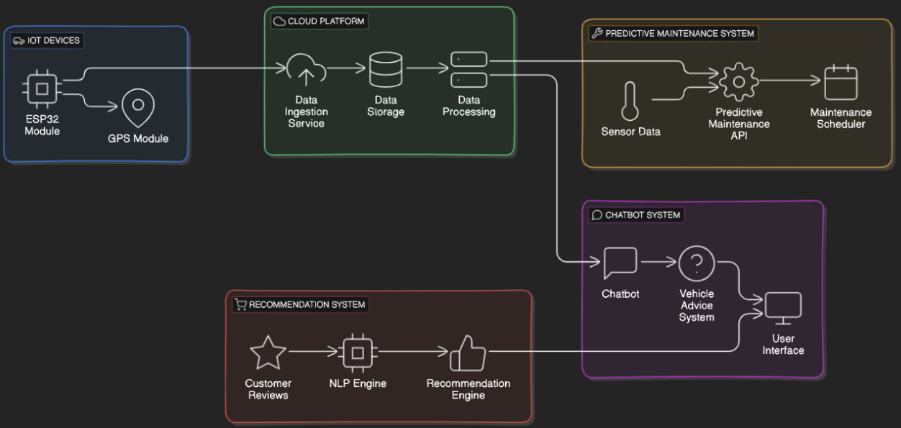
SYSTEM DIAGRAM

Slide 11
ACCURATELY TRACK AND LOG VEHICLE TRAVEL ON A MAP
Nafeel S.M – IT21173554

Slide 12

RESEARCH PROBLEM
How can we utilize IoT technology to accurately track and log the complete travel history of vehicles on a map?

Slide 13
OBJECTIVE
The primary objective of this function is to develop a comprehensive and cost-effective vehicle tracking system utilizing ESP32 modules for real-time GPS monitoring.
aims to enhance personal vehicle security.
contributing to improved transportation efficiency.

Slide 14
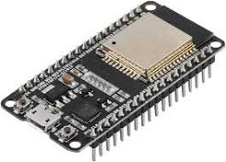


INTRODUCTION
Accurate vehicle tracking is essential for applications personal vehicle monitoring.
Aspects
Select and procure ESP32
Develop firmware
Establish a communication protocol
Set up a cloud platform
Analyze and visualize travel patterns

Slide 15
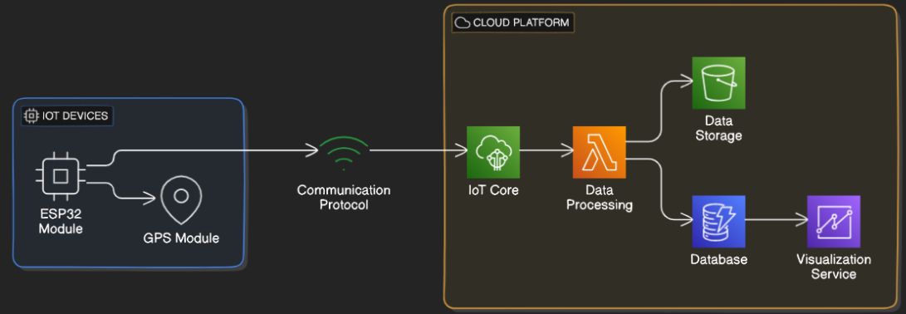
System Diagram

Slide 16
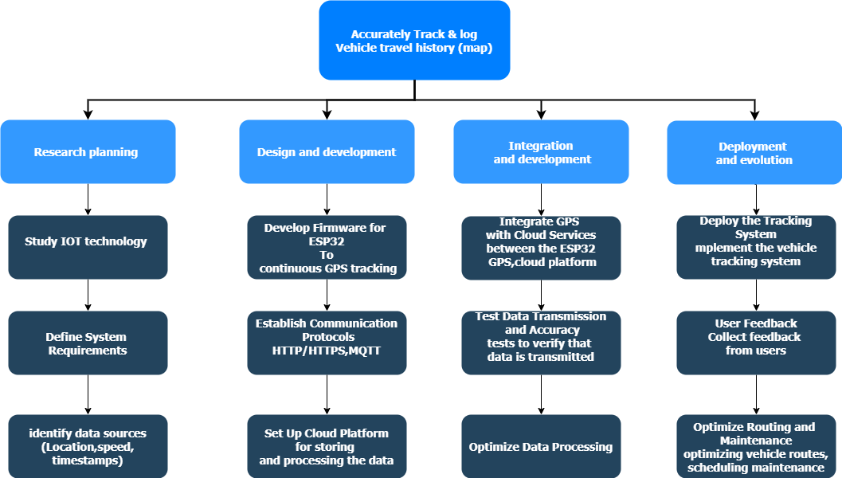
Work Breakdown Structure

Slide 17
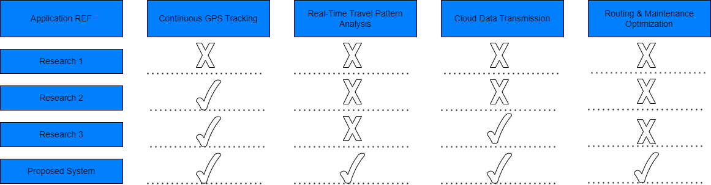
Research Gap​

Slide 18
Diagnostics Schedule predictive maintenance
Shukri H.M- IT21263926

Slide 19
Research Problem
How can predictive maintenance be effectively scheduled using real-time sensor data and time series analysis?

Slide 20
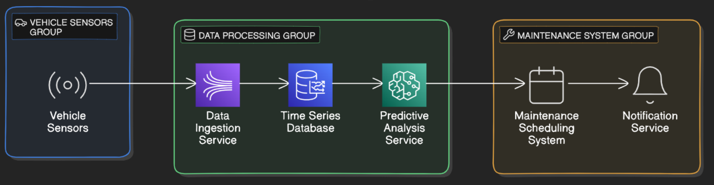
System Diagram

Slide 21
Integrated chatbot NN for vehicle advice
Ahlaan M.I- IT2129

Slide 22
RESEARCH Problem
How can we provide real-time, personalized vehicle advice through a neural network-based chatbot?

Slide 23
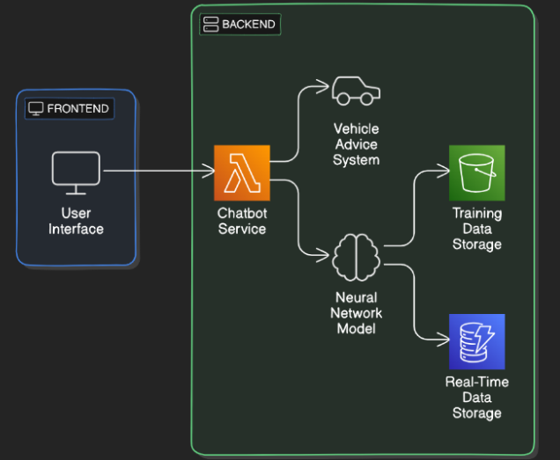
System Diagram

Slide 24
Provide personalized automobile part recommendation

Slide 25
RESEARCH Problem
How can customer reviews be leveraged to provide personalized and reliable recommendations for automobile parts?

Slide 26
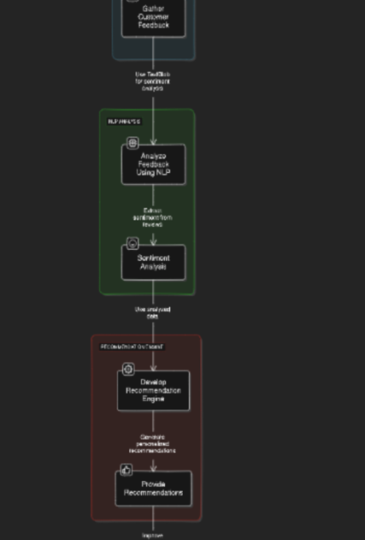
System Diagram

