Slide 1
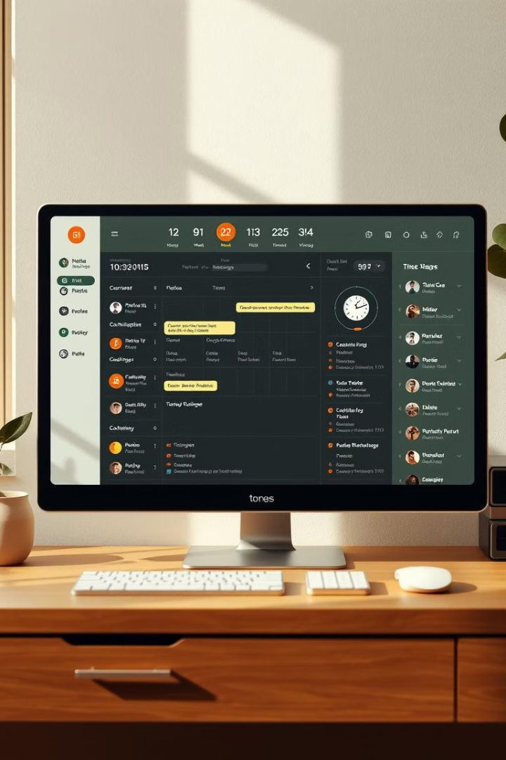

Virtual Assistant for Time Management
Introducing a Python-based desktop interface that optimizes your daily schedule.
Smart, intuitive, and built to maximize your productivity with ease.

Slide 2





Meet Our Project Team
KALLURU LAHARI
SHAIK NAFEESA
AP223110011633
AP23110011550
PURNANAND KUMAR SAH
JAY BARDHAN GOHIWAR
AP23110011551
AP23110011675

Slide 3
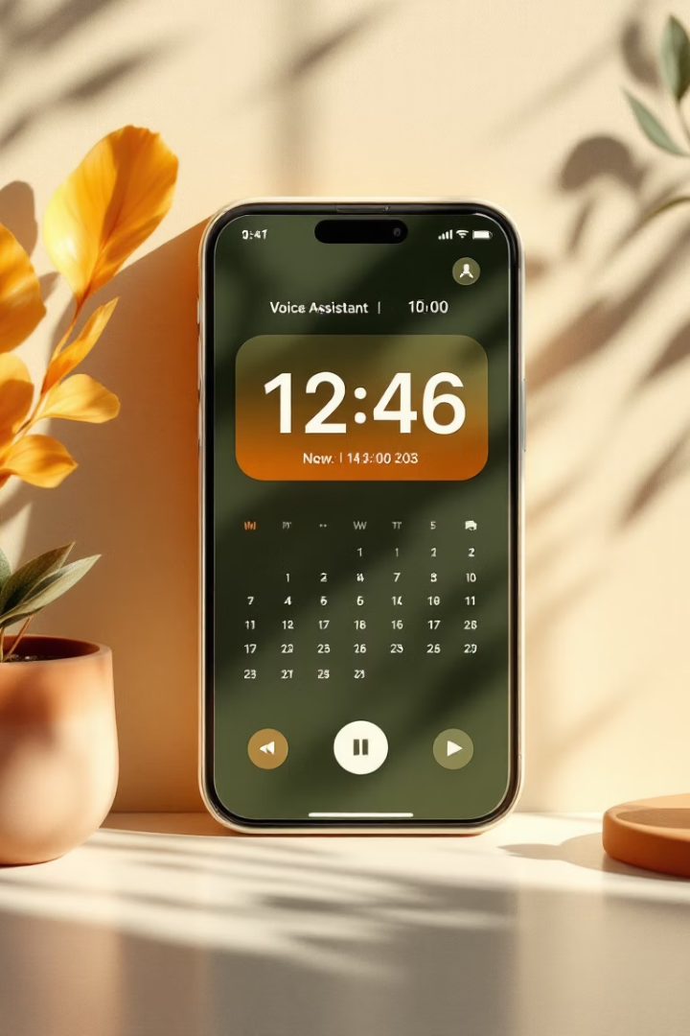
Our Objective
To develop a voice-enabled time management assistant that allows users to efficiently schedule tasks, intelligently avoid overlaps with class routines, and provide personalized suggestions for optimal time slots based on availability and task duration.

Slide 4








Smart Scheduling Technology
Add/Edit/Delete Tasks
Easily manage tasks anytime with simple controls.
Set Class Routine
Integrate your classes to avoid conflicts effortlessly.
Smart Time Slot Suggestion
Get optimal free slot recommendations automatically.
Voice Command Support
Schedule tasks hands-free using intuitive voice commands.
Block Past-Time Entries
Prevent adding tasks for elapsed time periods.
Prevent Task Overlap
Avoid scheduling conflicts with built-in safeguards.
View Productivity Dashboard
Monitor your efficiency and progress visually.

Slide 5





Technology Stack Overview
Core Programming
User Interface
Data Management
Voice & Scheduling
Python powers the interface with clean, maintainable code.
Tkinter builds a simple, responsive desktop GUI for ease of use.
Pandas handles task data efficiently for processing and analysis.
SpeechRecognition enables voice commands; datetime and regex manage scheduling logic.

Slide 6
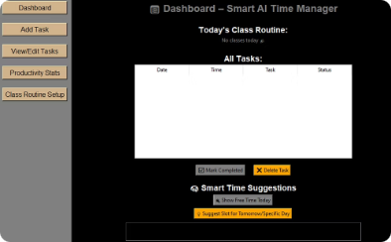
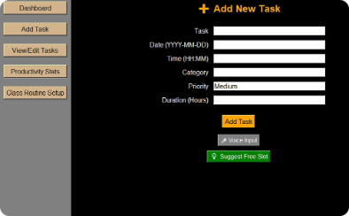
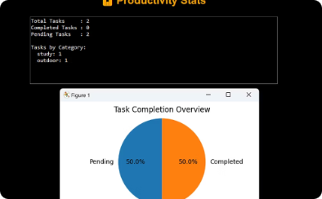
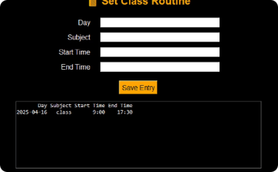
Smart Scheduling Technology UI Preview
Dashboard View
Add Task Form
Productivity Stats
Class routine set-up
Visual summary of tasks, progress graphs, and daily scheduling insights.
Simple input fields streamline task creation with clear scheduling options.
Visual insights into completed vs. pending tasks help users track progress and stay motivated.
Smartly blocks class hours to avoid scheduling conflicts.

Slide 7




Smart Scheduling Technology
Analyze Availability
Scans calendar to identify free time between commitments.
Prioritize Tasks
Ranks tasks based on urgency and duration requirements.
Suggest Time Slots
Recommends best-fit windows to maximize efficiency.

Slide 8






Boosting Productivity
Stay Organized
Maintains clear, conflict-free daily plans for steady progress.
Save Time
Reduces manual scheduling by automating task placement.
Increase Efficiency
Helps users focus on priorities and avoid wasted time.

Slide 9




Conclusion
The Virtual Assistant simplifies daily planning with automation and smart logic.
It combines voice input features to make scheduling effortless and hands-free.
Ideal for students and professionals aiming to manage their time effectively and boost productivity.
Automation
Smart Logic
Voice Input
Automatically suggests optimal time slots and manages task conflicts.
Prioritizes tasks based on urgency and individual routines.
Enables hands-free task management for seamless scheduling.

Slide 10
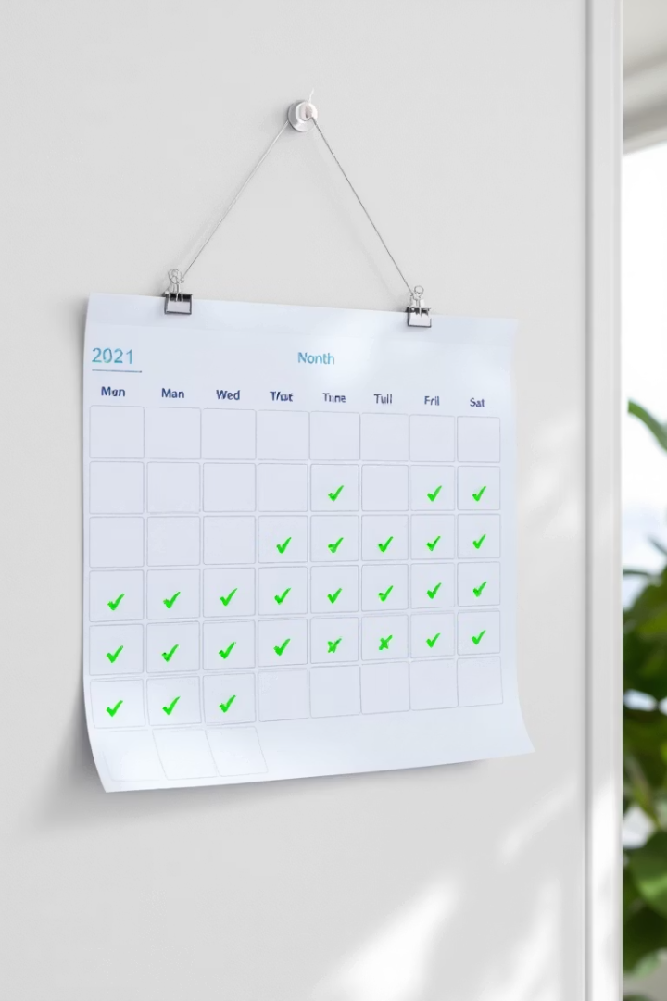



Thank You
Any questions? We're here to help you manage time smartly.
Contact with Us
Next Steps
Stay Productive
lahari_kalluru@srmap.edu.in
Explore smart scheduling to optimize your daily routine.
Use our tools to boost efficiency and balance commitments.
nafeesa_shaik@srmap.edu.in
purnanandkumar_sah@srmap.edu.in
jaybardhan_gohiwar@srmap.edu.in

