Slide 1

BUS GUARD AI : ACCIDENT DETECTION AND TRACKING SYSTEM
NAFEESA K T
MES24MCA-2037
Department of Computer Applications
MES College of Engineering, Kuttippuram
20/08/2025

Slide 2
PRODUCT OWNER Ms. FEBIN AZIZ ASSISTANT PROFESSOR DEPARTMENT OF COMPUTER APPLICATIONS MES COLLEGE OF ENGINEERING, KUTTIPPURAM

Slide 3
TABLE OF CONTENTS
Introduction
Objective
Existing System
Proposed System
Motivation
Functionalities
Module Description
Developing Environment
Sprint Backlog
Product Backlog
User Story
Project Plans
Data Flow Diagrams
ER Diagram

Slide 4
BUS GUARD AI : ACCIDENT DETECTION AND TRACKING SYSTEM
Innovative system for safe school transport.
Combines GPS tracking + AI accident detection.
Detects collisions using sensors/cameras.
Sends instant alerts to parents & school admins.
Offers real-time tracking, delay updates, ETA.
Provides parent mobile app & admin web dashboard.
Built with HTML,Bootstrap,CSS,JavaScript and Dart , Python, TensorFlow, OpenCV, Firebase/MySQL, Google Maps API, Twilio.
Improves emergency response, trust, and communication.

Slide 5
OBJECTIVES
Enhance student safety with AI accident detection and GPS tracking.
Provide real-time alerts and updates to parents and school authorities.
Improve transparency with live bus route monitoring and delay notifications.
Enable quicker emergency response by detecting collisions.
Bridge communication gaps between schools, parents, and transport services.
Ensure reliability and scalability with modern technologies.

Slide 6
EXISTING SYSTEM
Relies only on real-time GPS location.
Cannot detect emergencies like accidents.
No AI-based anomaly detection (e.g., collisions).
Lacks instant alerts for parents and administrators.
Limited to basic route and delay updates.
Weak communication between schools, parents, and transport services.
No integrated mobile app or web dashboard.

Slide 7
PROPOSED SYSTEM
Combines AI algorithms with GPS for tracking and accident detection
Detects collisions using sensors/cameras
Sends instant alerts to parents and administrators during emergencies
Provides live bus route monitoring with delay notifications
Bridges communication gaps between schools, parents, and transport services
Improves safety, trust, and emergency response in student transport

Slide 8
MOTIVATIONS
Addresses limitations of traditional bus trackers that lack emergency detection.
Improves safety by providing real-time accident detection and alerts.
Enhances communication with instant updates for parents and school authorities.
Meets the growing demand for reliable student transportation safety measures.
Bridges the gap between transport services, schools, and parents.
Responds to the need for operational transparency and trust.
Supports better schedule management with delay and ETA notifications.

Slide 9
FUNCTIONALITIES
Real-Time GPS Tracking Tracks bus location continuously and provides live updates.
AI Accident Detection Identifies accidents using sensors/cameras and triggers alerts instantly.
Instant Alerts & Notifications Sends emergency and delay notifications to parents and school admins.
Estimated Time of Arrival (ETA) Updates Provides accurate arrival predictions for parents and admins.

Slide 10
FUNCTIONALITIES
Mobile App for Parents Enables parents to view live tracking, receive alerts, and access incident history.
Web Dashboard for Admins Offers centralized monitoring, incident management, and report generation.
Communication Bridge Seamlessly connects transport services, schools, and parents for better coordination.
Data Storage & Analytics Maintains records of routes, incidents, and performance metrics for analysis.

Slide 11
MODULE DESCRIPTION
MODULES
Admin
Parent
Bus Staff

Slide 12
MODULE DESCRIPTION
SMART BUS MONITORING
Login
Manage Bus
Manage Bus staff
View parent
Route manage
Stop manage
Allocate child to bus
View Notification
View Status
View Accident

Slide 13
MODULE DESCRIPTION
2. PARENT
Registration
Login
Child manage
View notification
View status
Track bus
View accident

Slide 14
MODULE DESCRIPTION
3. Bus Staff
Login
View allocated route
Update location
Update status
Update notification
Accident detection

Slide 15
DEVELOPING ENVIRONMENT
Operating System: Not specified, adaptable to various OS.
Front End: HTML,Bootstrap,CSS,JavaScript and Dart
Back End: Python for backend APIs.
Database: Firebase or MySQL for data management.
Framework: TensorFlow and OpenCV for AI components.
IDE: Not specified, compatible with common IDEs (e.g., VS Code).
APIs: Google Maps API for GPS integration, Twilio for SMS alerts.

Slide 16
SPRINT BACKLOG
Backlog tem | Status And Completion Date | Original Estimation in Hours | Day 1 hrs | Day 2 hrs | Day 3 hrs | Day 4 hrs | Day 5 hrs | Day 6 hrs | Day 7 hrs | Day 8 hrs | Day 9 hrs | Day 10 hrs
SPRINT1
Mobile App UI (Parent) | 18/07/2025 | 7 | 1 | 1 | 1 | 1 | 1 | 1 | 1 | 0 | 0 | 0
Basic Notifications | 22/07/2025 | 7 | 1 | 1 | 1 | 1 | 1 | 1 | 1 | 0 | 0 | 0
SPRINT 2
Data collection | 15/08/2025 | 7 | 1 | 1 | 1 | 1 | 1 | 1 | 1 | 0 | 0 | 0
Database Setup | 20/08/2025 | 7 | 1 | 1 | 1 | 1 | 1 | 1 | 1 | 0 | 0 | 0

Slide 17
SPRINT BACKLOG
Backlog tem | Status And Completion Date | Original Estimation in Hours | Day 1 hrs | Day 2 hrs | Day 3 hrs | Day 4 hrs | Day 5 hrs | Day 6 hrs | Day 7 hrs | Day 8 hrs | Day 9 hrs | Day 10 hrs
SPRINT3
AI Accident Detection | 10/09/2025 | 7 | 1 | 1 | 1 | 1 | 1 | 1 | 1 | 0 | 0 | 0
Emergency Alerts | 15/09/2025 | 7 | 1 | 1 | 1 | 1 | 1 | 1 | 1 | 0 | 0 | 0
SPRINT 4
GPS Integration | 30/09/2025 | 7 | 1 | 1 | 1 | 1 | 1 | 1 | 1 | 0 | 0 | 0
SMS / Push Alerts | 05/10/2025 | 7 | 1 | 1 | 1 | 1 | 1 | 1 | 1 | 0 | 0 | 0
TOTAL |  | 56 | 8 | 8 | 8 | 8 | 8 | 8 | 8 | 0 | 0 | 0

Slide 18
PRODUCT BACKLOG
ID | NAME | PRIORITY <high/medium/low> | ESTIMATE (Hours) | STATUS <Planned/In progress/Completed>
1 | User Registration & Login | High | 8 | In Progress
2 | Real-time GPS Tracking | High | 20 | In Progress
3 | AI Accident Detection | High | 25 | In Progress
4 | Emergency Alert System | High | 15 | In Progress

Slide 19
PRODUCT BACKLOG
ID | NAME | PRIORITY <high/medium/low> | ESTIMATE (Hours) | STATUS <Planned/In progress/Completed>
5 | Delay & ETA Module | Medium | 12 | In Progress
6 | Parent Mobile App | High | 20 | In Progress
7 | Admin Web Dashboard | High | 18 | In Progress
8 | Communication Bridge | Medium | 15 | In Progress

Slide 20
USER STORY
User Story ID | As a type of User | I want to <Perform some task> | So that i can <Achieve Some Goal>
1 | Parent / Admin | Register and Login | Securely access the system
2 | Parent | Track bus in real-time | Know the bus location anytime
3 | System (AI) | Detect accidents | Trigger alerts immediately
4 | Parent | Receive emergency alerts | Ensure child’s safety during accidents

Slide 21
USER STORY
User Story ID | As a type of User | I want to <Perform some task> | So that i can <Achieve Some Goal>
5 | Parent | Get ETA and delay notifications | Manage schedule effectively
6 | Parent | Use mobile app | Receive live tracking and updates
7 | Admin | Use web dashboard | Monitor buses and incidents
8 | Admin & Parent | Use communication bridge | Coordinate effectively between school, transport, and parents

Slide 22
PROJECT PLAN
User StoryID | Task Name | Start Date | End Date | Days | Status
1 | SPRINT 1 | 20/09/2025 | 28/09/2025 | 7 | In Progress
2 |  | 04/10/2025 | 10/10/2025 | 7 | In Progress
3 | SPRINT 2 | 11/10/2025 | 17/10/2025 | 7 | In Progress
4 |  | 18/10/2025 | 25/10/2025 | 7 | In Progress

Slide 23
PROJECT PLAN
User StoryID | Task Name | Start Date | End Date | Days | Status
5 | SPRINT 3 | 01/11/2025 | 07/11/2025 | 7 | In Progress
6 |  | 08/11/2025 | 14/11/2025 | 7 | In Progress
7 | SPRINT 4 | 15/11/2025 | 21/11/2025 | 7 | In Progress
8 |  | 22/11/2025 | 28/11/2025 | 7 | In Progress

Slide 24
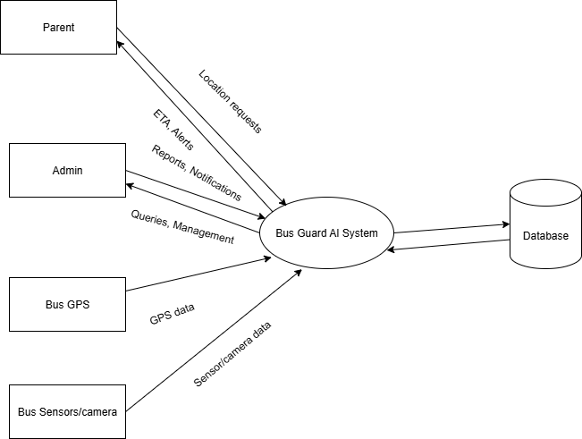
DATA FLOW DIAGRAM
LEVEL 0

Slide 25
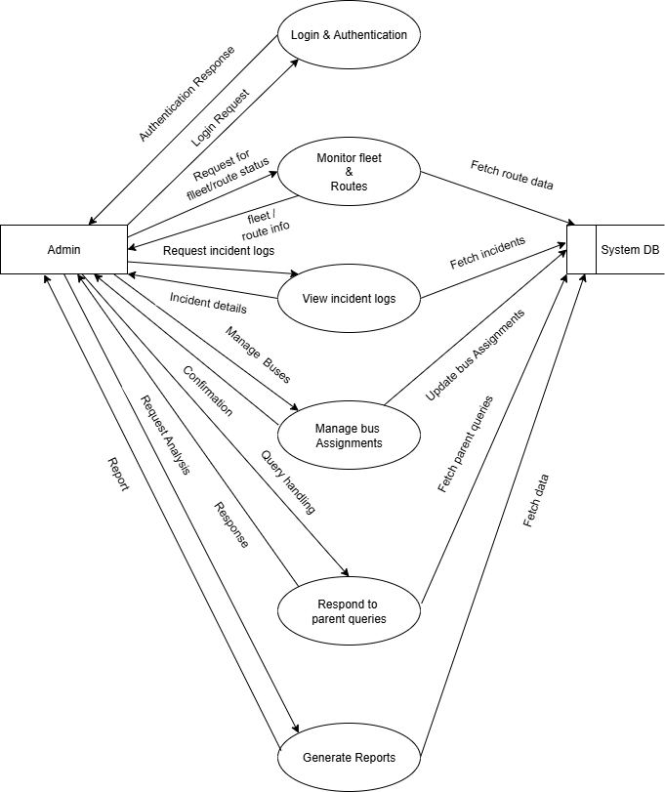
DATA FLOW DIAGRAM
LEVEL 1

Slide 26
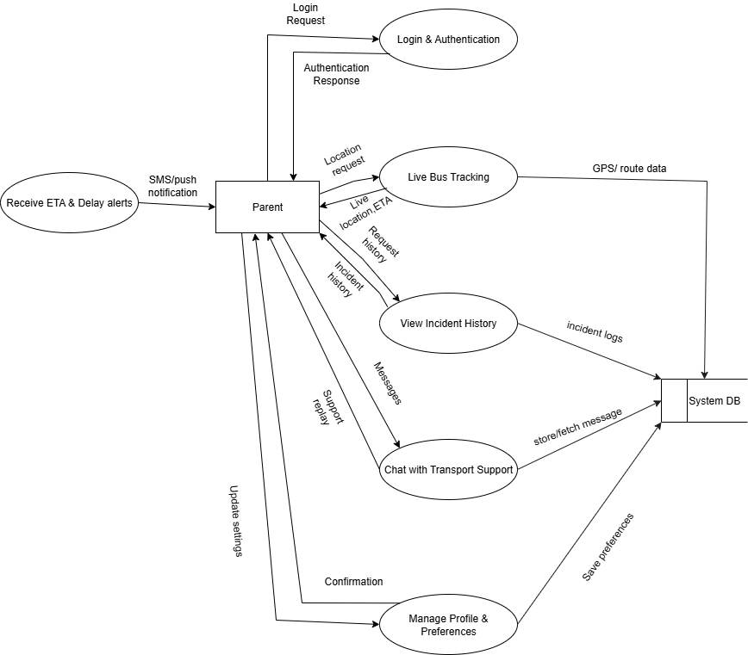
DATA FLOW DIAGRAM
Level 2

Slide 27
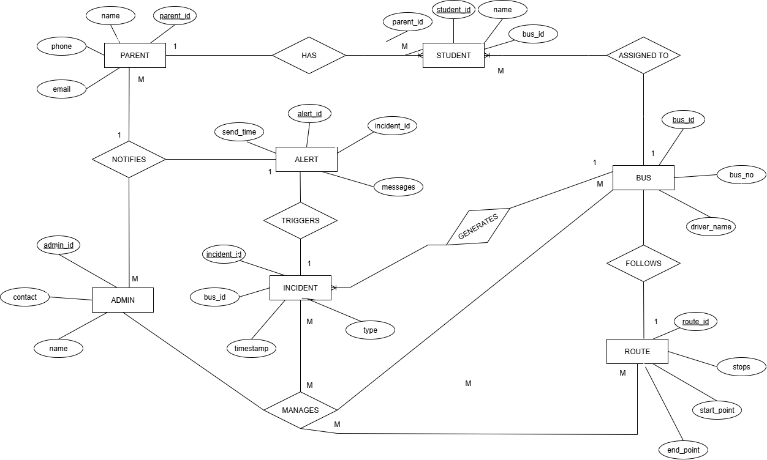
ER DIAGRAM

Slide 28
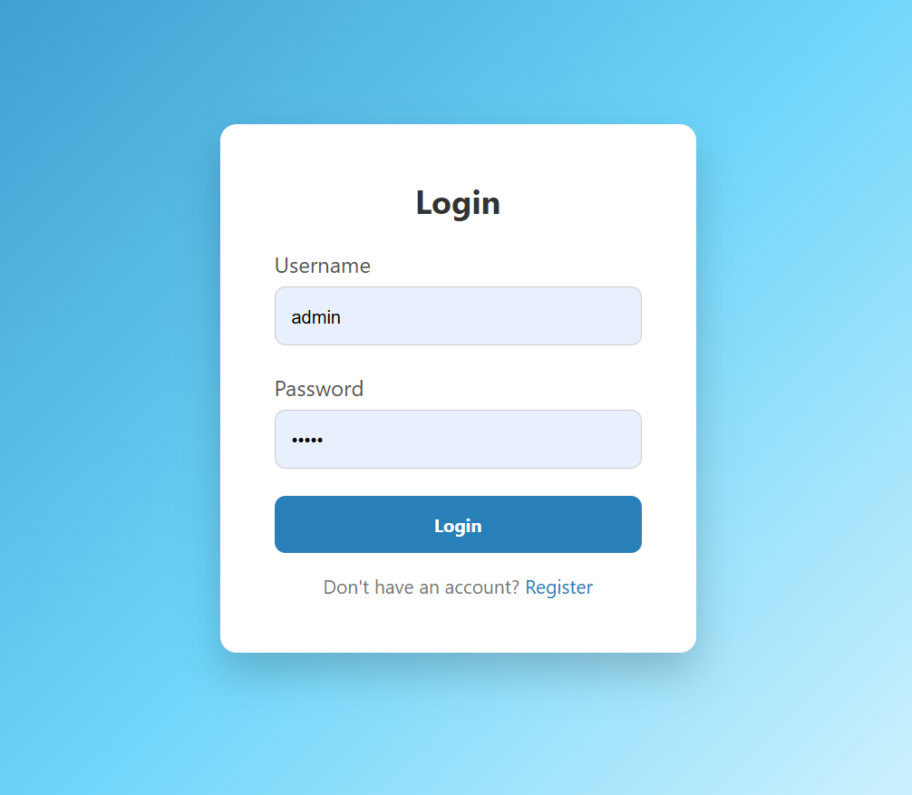
LOGIN

Slide 29
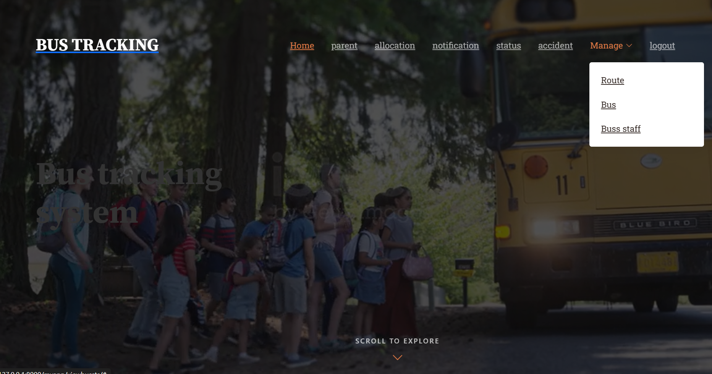
INTERFACE

Slide 30
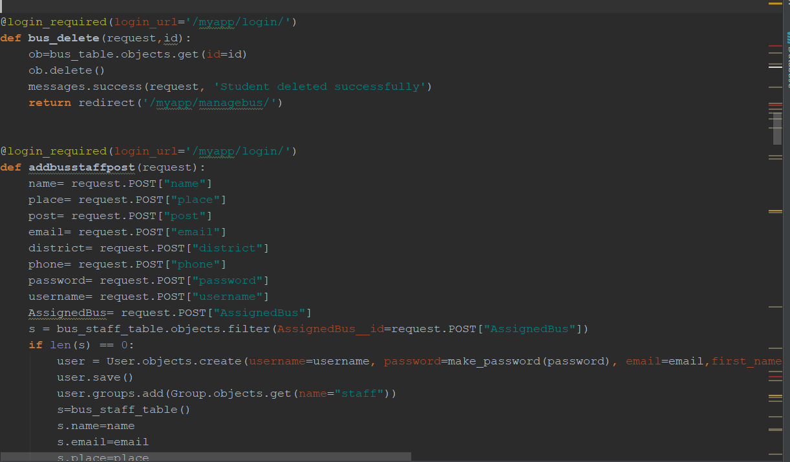
FUCTIONALITIES

Slide 31
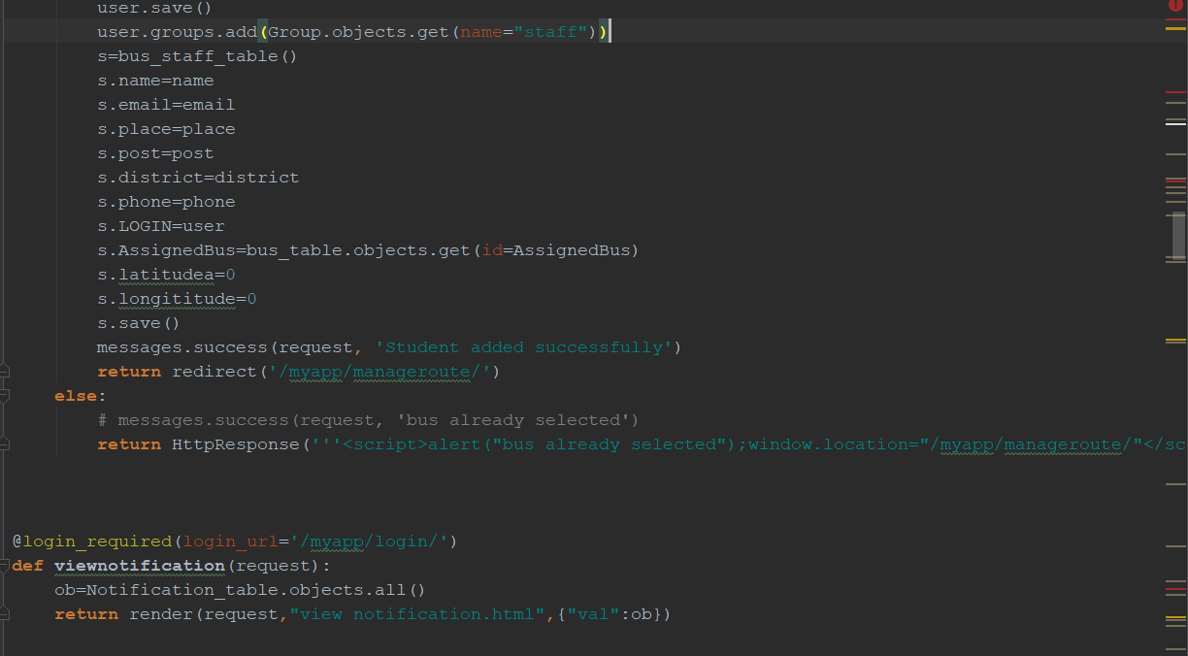
FUNCTIONALITIES

Slide 32
THANK YOU

