Slide 1
Utilization of Blockchain to Enchance
E-voting Security
Presented By:
Name: MD. Navid Razzaque
Roll: 1707013
CSE 4000: Thesis
Department of Computer Science and Engineering
Khulna University of Engineering & Technology,
Khulna, Bangladesh.
Supervised By:
Dr. Kazi Md. Rokibul Alam
Professor
Department of Computer Science and Engineering
Khulna University of Engineering & Technology,
Khulna, Bangladesh.

Slide 2
Outline of the Presentation
Introduction
Related Works
Objectives
Proposed Methodology
Experimental Analyses
Conclusions
References
2

Slide 3
Introduction
Conventional voting system consumes a lot of time and effort. But it still does not guarantee that the vote is fairly counted or not.
E-voting systems have emerged as a promising alternative. But it also presents significant security challenges including the possibility of fraud, tampering and hacking.
Decentralized systems would perform much better in this scenario.
3

Slide 4
Introduction (Contd.)
Blockchain could be used here to eliminate these challenges.
Due to its distributive property and cryptography structure, it is really less susceptible to hacking.
It also ensures the data kept inside the network will be safe from being tampered or manipulated.
4

Slide 5
Related Works
Many blockchain based approaches have been proposed to eliminate the shortcomings of the e-voting systems. Let us discuss some of them.
Ali et al. [1] method:
Merit:
Advanced level operations of an Election were able to be performed.
Gave voters an extra control over the system by including vote verification.
Demerit:
Implemented for small scaled networks.
The users in the network were forced to download and store all of the networks’ elements to run the process.
5

Slide 6
Related Works (Contd.)
Su et al. [2] method:
Merit:
Included encrypted voting, digital signatures in voting process.
Demerit:
Lacked performance speed due to process of encryptions in the system.
Hsiao et al. [3] method:
Merit:
Included homomorphic encryption while casting votes.
Demerit:
Implemented with several smart contracts which made the system computationally expensive.
6

Slide 7
Gap in the Research
Some major shortcomings of the previous research works are as follows:
Conduction of whole process with the help of a single authority which made the initialization of each phases centralized.
Usage of multiple smart contracts which made the system computationally expensive.
Implemented using customized networks which required additional storage.
7

Slide 8
Objectives
To implement an Ethereum based blockchain system to conduct elections in high scaled networks.
To develop a multi-authority based administration system.
To include additional cryptography in the system to increase the layer of security even more.
To develop the whole system in an efficient way to reduce the computational cost.
8

Slide 9
Contributions
Exclusion of single authority based e-voting system which removes the partiality and also gains the trust of the voters.
Inclusion of multi-authority permission based system with El Gamal encryption.
Implementation of the whole system through a single optimized smart contract to reduce the computational cost.
9

Slide 10
Proposed Methodology
Our proposed method for implementing the system is divided into three phases :
Pre-Election Phase
Election Phase
Post-Election Phase
A smart contract will be deployed by one of the authorities in the system.
After required activities and permissions, a certain person can initiate the process.
10

Slide 11
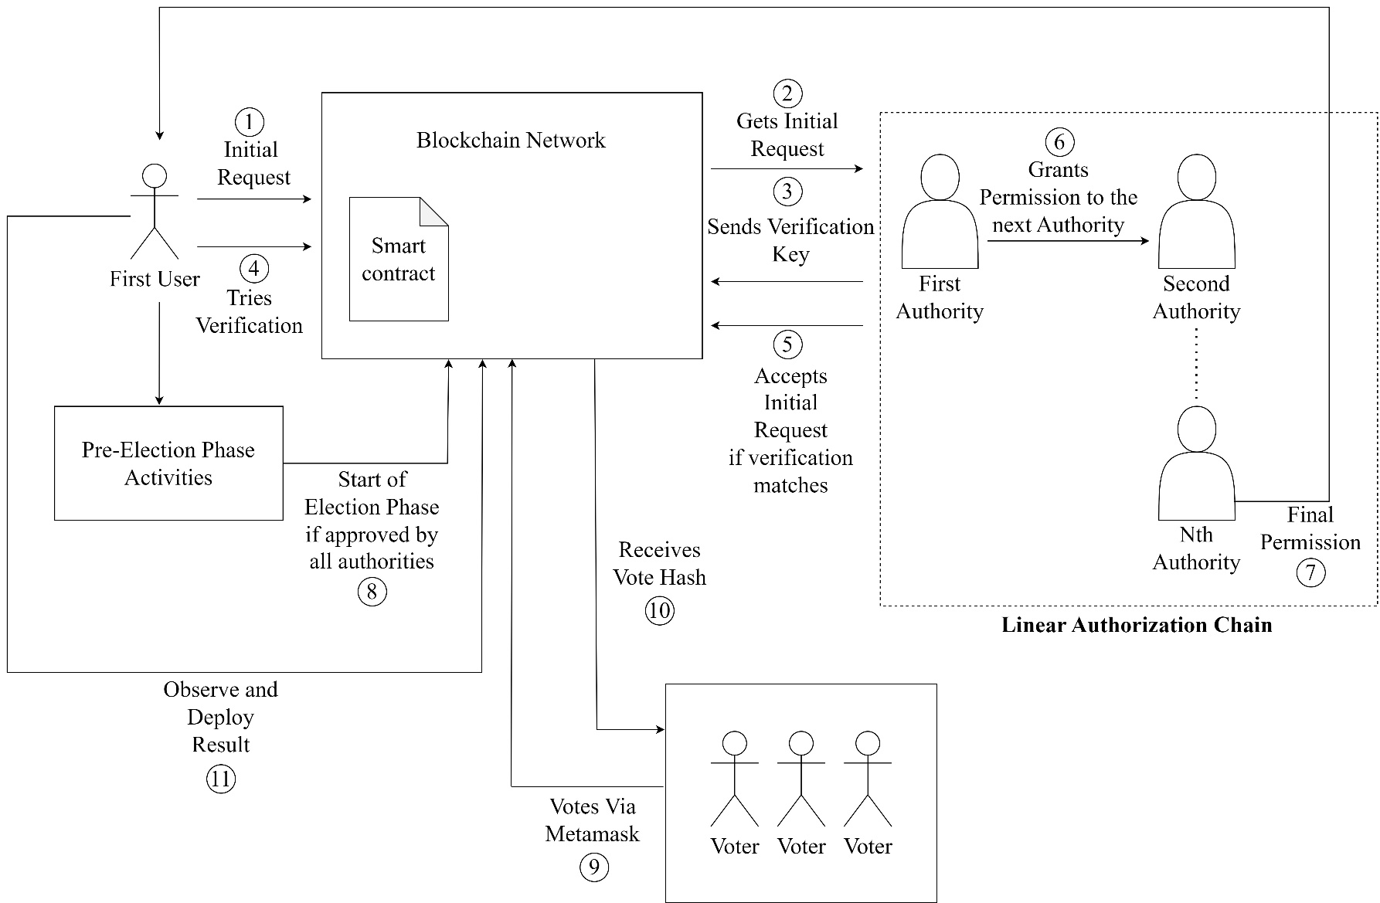
Proposed Methodology
11
Figure 1: An Overview of our proposed System’s Architecture

Slide 12
Proposed Methodology : Pre-Election phase
All of the activities during this phase will be conducted by a certain person.
In order to do that the person needs to go through a linear authorization chain to get required permissions to access.
That person will initially request for access which will be checked and approved by the first authority.
12

Slide 13
Proposed Methodology : Pre-Election phase
The first authority would then transfer the ownership to the second authority for approval and this process will go on till it reaches the last authority.
The first authority will also pass a token to the next authority in an encrypted way with the help of ElGamal encryption.
The second authority will have to decrypt the cipher-texts and match the decrypted token with the passed token to achieve the ownership.
13

Slide 14
Proposed Methodology : Pre-Election phase
No
No
Yes
Verify
Request
Passes
Permission
More
Persons?
Authorized
By All?
Yes
Request?
Yes
Valid?
Yes
No
First Authority
No
Access
Denied
The Requested
Person gets access
Figure 2: Flowchart of Linear Authorization Chain for Permission Management
14

Slide 15
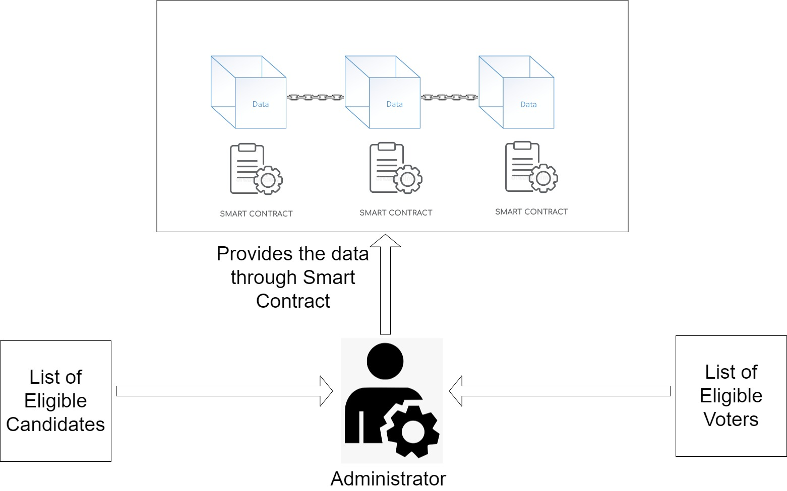
Proposed Methodology : Pre-Election phase
Figure 3: Block Diagram of Pre-Election Phase
15

Slide 16
Proposed Methodology : Election phase
The Ethereum blockchain can be interacted using the Metamask wallet which the eligible voters will be using.
Each of the voters will cast their vote by providing desired candidate index and a secret number. These inputs will be used to generate a hash value for each of the votes.
A fee will be required to conduct the operations in the Ethereum blockchain which will be cut from the Metamask wallet.
16

Slide 17
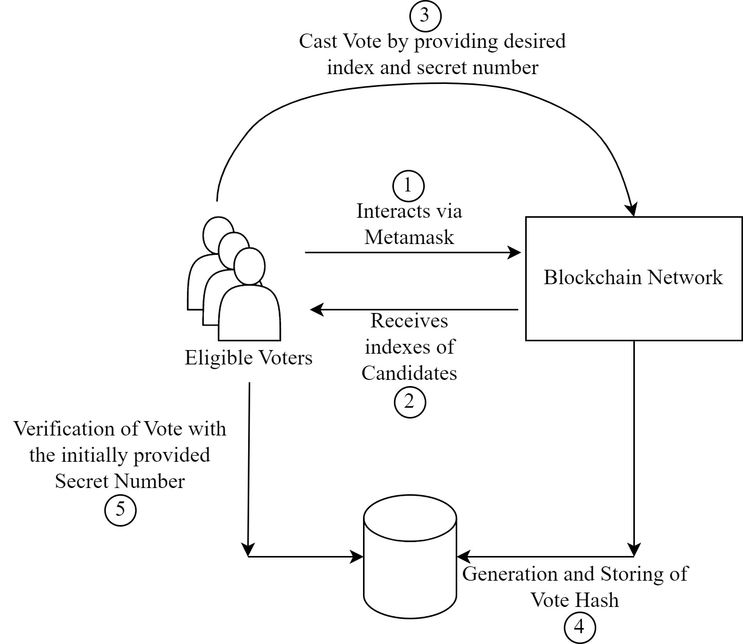
Proposed Methodology : Election phase
Figure 4: Block Diagram of Election phase
17

Slide 18
Proposed Methodology : Post-Election phase
The election will get finished once the event reaches its time limit.
The voters will be able to see the result.
Due to unusual events, the administrator might also finish the event early with the approval of other authorities in the system.
18

Slide 19
Experimental Analyses
Experimental Setup:
Intel(R) Core(TM) i7-6500U CPU @ 2.50GHz
Operating system Windows 10 - 64 bit, 16 GB RAM
Remix IDE v0.29.2
Solidity 0.8.0 or above, python 3.9
Metamask Wallet
Ganache v2.5.4 for simulation
19

Slide 20
Experimental Analyses (Contd.)
Trust Distribution :
Table 1: An Example of First Authority opening request access for the user
Function | Value to Store
openRequestAccess() | 0x4B20993Bc481177ec7E8f571ceCaE8A9e22C02db, 16262
Table 2: The input value of the user to get approval of initial request
Function | Value to Insert
RequestAccess() | 16262
20

Slide 21
Experimental Analyses (Contd.)
Trust Distribution :
Table 3: First Authority granting permission to Second Authority through encryption
Function | transferOwnership()
Address | 0xAb8483F64d9C6d1EcF9b849Ae677dD3315835cb2
Token | 15
Cipher-Text 1 (C1) | 2187
Cipher-Text 2 (C2) | 33495
21

Slide 22
Experimental Analyses (Contd.)
Figure 5: Average Estimated Time for Linear Authorization Chain with respect to No. of Authority
22

Slide 23
Experimental Analyses (Contd.)
Figure 6: Comparison of Decryption Time among ElGamal, RSA and Paillier [6]
23

Slide 24
Limitations and Future works
Limitations:
The total completion time of our system increases with the number of authority in our system.
To reduce the computation cost (Gas Cost) of our smart contract, we completed the encryption and decryption outside the contract.
Future Works:
Linearity of time with number of authority can be reduced so that overall time for the system to complete can be faster.
The prototype of our model has been proved to be functional. So this could be implemented in a real time environment.
24

Slide 25
Conclusions
The main contribution of our method is to include a multi-authority based decision system with ElGamal encryption.
Checking of multiple authorities in start of each major check-points greatly increases the amount of security.
The proposed method consists of a single smart contract only which reduces the chance of blockchain network being complex.
Allow a way for the voters to verify their vote.
25

Slide 26
References
Yavuz, Emre, Ali Kaan Koç, Umut Can Çabuk, and Gökhan Dalkılıç. "Towards secure e-voting using ethereum blockchain." In 2018 6th International Symposium on Digital Forensic and Security (ISDFS), pp. 1-7. IEEE, 2018.
He, O., and Zhongmin Su, “A new practical secure e-voting scheme.” na, 1998
Hsiao, Jen-Ho, Raylin Tso, Chien-Ming Chen, and Mu-En Wu. "Decentralized E-voting systems based on the blockchain technology." In Advances in Computer Science and Ubiquitous Computing: CSA-CUTE 17, pp. 305-309. Springer Singapore, 2018.
Guasch, Sandra, and Paz Morillo, "How to challenge and cast your e-vote." In Financial Cryptography and Data Security: 20th International Conference, FC 2016, Christ Church, Barbados, February 22–26, 2016, Revised Selected Papers 20, pp. 130-145. Springer Berlin Heidelberg, 2017.
Braghin, Chiara, Stelvio Cimato, Ernesto Damiani, and Michael Baronchelli, "Designing smart-contract based auctions." In Security with Intelligent Computing and Big-data Services: Proceedings of the Second International Conference on Security with Intelligent Computing and Big Data Services (SICBS-2018) 2, pp. 54-64. Springer International Publishing, 2020.
26

Slide 27
References (Contd.)
"Comparison of RSA, ElGamal and Paillier — Researchgate", Researchgate,2012, [online] Available: https://www.researchgate.net/figure/Comparison-of-Encrypted-File-Size-by-RSA-ElGamal-and-Paillier_fig5_275338264
"Blockchain — A Short Explanation with Pictures", Hackernoon,2019, [online] Available: https://hackernoon.com/blockchain-a-short-and-simple-explanation-with-pictures-d60d652f207f
"Solidity — Solidity 0.8.18 documentation", Investopedia, 2023, [online] Available: https://docs.soliditylang.org/en/v0.8.18/
"Ganache — TruffleSuite documentation for ganache", Trufflesuite,2022, [online] Available: https://docs.soliditylang.org/en/v0.8.18
"Metamask — Wikipedia Overview for ganache", Wikipedia,2022, [online] Available: https://en.wikipedia.org/wiki/MetaMask
https://lifemathmoney.com/ethereum-gas-and-how-it-works-explained-in-simple-terms/
"What is SHA-256 Algorithm — Simplilearn", Simplilearn, 2022, [online] Available: https://www.simplilearn.com/tutorials/cyber-security-tutorial/sha-256-algorithm
27

Slide 28
THANK YOU

