Slide 1
Software Engineering Project 2 (Web Programming)
Course teacher: Asif Khan Shakir
Lecturer, Dept. of SWE
Daffodil International University

Slide 2
Group K
Group members are…
Name: Md. Nafiul Islam ID:132-35-497
Name: Dewan Imtiaz Been Emran ID:132-35-492

Slide 3


Slide 4
Objective of the project
Rental House Management System will be web based system. The house rental agency manages property for rent in Dhaka. Clients who wish to rent a property will register with the agency. They will provide personal details and information about the property type that they want. Landlords will also register with the agency, providing their property details and personal details require for rent. Registered client will be able to see the available properties from the agency site. If any property match with his requirement, the client will inform the agency and the agency will manage the letting contract between the client and landlord. After the completion of the contract, the agency will get the commission from the landlord.

Slide 5
Users
Agency
Owner
Client

Slide 6
Raw requirement
The house rental agency manages property for rent and properties are registered with the agency.
House owners register their properties providing their details and information about the property.
Clients who wish to rent a property will register with the agency and they can see the available properties from the agency site.
Agency will provide personal details and other information about property to clients.
The clients will inform the agency if any property match with their requirement.
Agency will manage the letting contract between the client and house owner and after the completion of the contract agency will get the commission from house owner.

Slide 7
Scope of the project
The project scope defines the description of the work that is required in delivering the rental house or house for sell which will be provided by this system. The following are the scopes of work during the course of the project:
Study and understand the requirement of this project.
Construct Software Requirement Specification document of the system.
Construct Software Design Document of the system.

Slide 8
Dependencies and Risks
All users must have web access in order to use the system. Web security will be more concern of the project. Database design will be also a great challenge due to prevention of Sql Injection. Guest users and anonymous aren’t allowed to enter in the database will be the main challenge. Run of the project mainly depends on hardware of the server. Also user should have enough knowledge about internet browsing and can use such a device by which he/she may access.

Slide 9
Platform/technology use
HTML
CSS
PHP(Laravel)
MySql

Slide 10
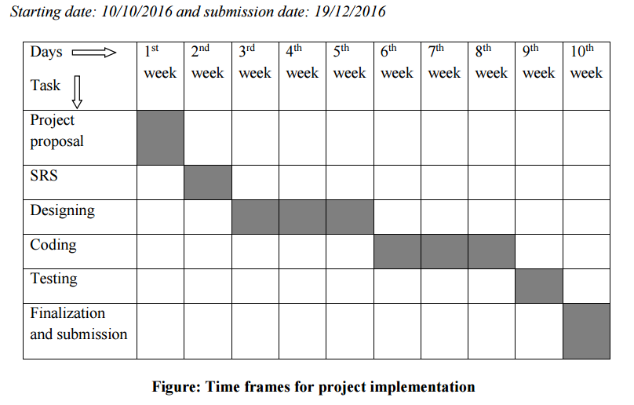

Slide 11
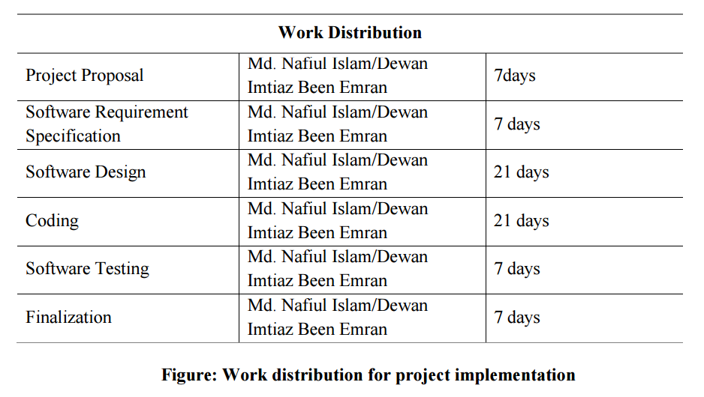

Slide 12


