Slide 1


Student Details
Name – Nafisa rehmani
SkillsBUILD EMAIL ID – Nafisa.08rehmani@gmail.com
COLLEGE NAME – SRM UNIVERSITY AP
COLLEGE STATE – ANDHRA PRADESH
INTERNSHIP DOMAIN – data analytics
Internship start and end date – 3rd June to 25th July [03.06.204 – 25.07.2024]

Slide 2
PROJECT TITLE/Problem Statement
PROJECT TITLE: Data Analytics on CarDekho Dataset
PROBLEM STATEMENT:
To analyze the CarDekho dataset to understand key factors influencing car prices, market trends, and consumer preferences. This analysis aims to provide insights that can help consumers make informed buying decisions and assist businesses in strategic planning.

Slide 3
AGENDA
Visualization of Results: Presentation of key data insights through charts, graphs, and other visual tools to effectively communicate findings.
Conclusion and Recommendations: Conclusions drawn from the analysis, along with actionable recommendations for consumers, businesses, or other stakeholders based on the data insights.
Future Work and Extensions: Discussion of potential areas for further research or analysis, such as integrating additional datasets, exploring more complex modeling techniques, or enhancing the dataset with new features.
Introduction to CarDekho Dataset: Overview of the dataset, including the source, the types of data it contains, and the context of its collection.
Data Cleaning and Preprocessing: Description of the steps taken to prepare the data for analysis, such as handling missing values, normalizing data, and ensuring data quality.
Exploratory Data Analysis (EDA): Examination of the dataset to discover initial patterns, anomalies, and relationships using statistical summaries and graphical representations.
Key Findings and Insights: Summary of the most significant discoveries from the data, including trends and correlations that provide valuable information.

Slide 4
PROJECT OVERVIEW
Purpose: To analyze the CarDekho dataset to derive meaningful insights about car prices, features, and market trends.
Scope: Includes data cleaning, EDA, and visualization. Focus on identifying factors that significantly influence car prices.
Objectives:
Determine the most critical features affecting car prices.
Understand consumer preferences based on various attributes like fuel type, brand, etc.
Provide actionable insights for consumers and businesses.

Slide 5
WHO ARE THE END USERS of this project?
Consumers: Individuals looking to purchase cars, seeking data-driven insights to make informed decisions.
Car Dealers and Businesses: To understand market trends, consumer preferences, and competitive analysis.
Data Analysts and Researchers: Interested in exploring automotive data for research and analytical purposes.

Slide 6
YOUR SOLUTION AND ITS VALUE PROPOSITION
Solution: Detailed analysis and visualization of the CarDekho dataset.
Value Proposition:
Helps consumers identify the best deals based on budget and preferences.
Assists dealers in understanding market demand and setting competitive prices.
Provides businesses with insights for strategic decision-making and marketing.

Slide 7
How did you customize the project and make it your own
Customization:
Focused on key factors like brand, model, year of manufacture, fuel type, and transmission type.
Unique Aspects:
Developed unique visualizations to highlight trends.
Implemented feature selection techniques to identify the most influential factors on pricing.
Used statistical models to predict car prices based on historical data.

Slide 8
MODELLING
Techniques Used:
Data Cleaning and Preprocessing:
Utilized Python libraries like Pandas and NumPy for data manipulation and cleaning.
Addressed missing values, standardized data formats, and normalized data where necessary.
Exploratory Data Analysis (EDA) and Visualization:
Used Matplotlib and Seaborn to create visualizations, such as histograms, scatter plots, and box plots, to explore data distributions and relationships.
Feature Selection and Correlation Analysis:
Applied statistical methods to identify significant features that impact car prices.
Conducted correlation analysis to understand the relationships between variables.
Predictive Modeling:
Implemented linear regression models to predict car prices based on the selected features.
Evaluated model performance using metrics like R-squared and Mean Absolute Error (MAE).
Frameworks:
Jupyter Notebook: For interactive data exploration, analysis, and documentation.
Scikit-Learn: Used for building and evaluating predictive models.
Google Colab: The project was developed and executed on Google Colab, providing a cloud-based environment with GPU support for enhanced computational efficiency..

Slide 9
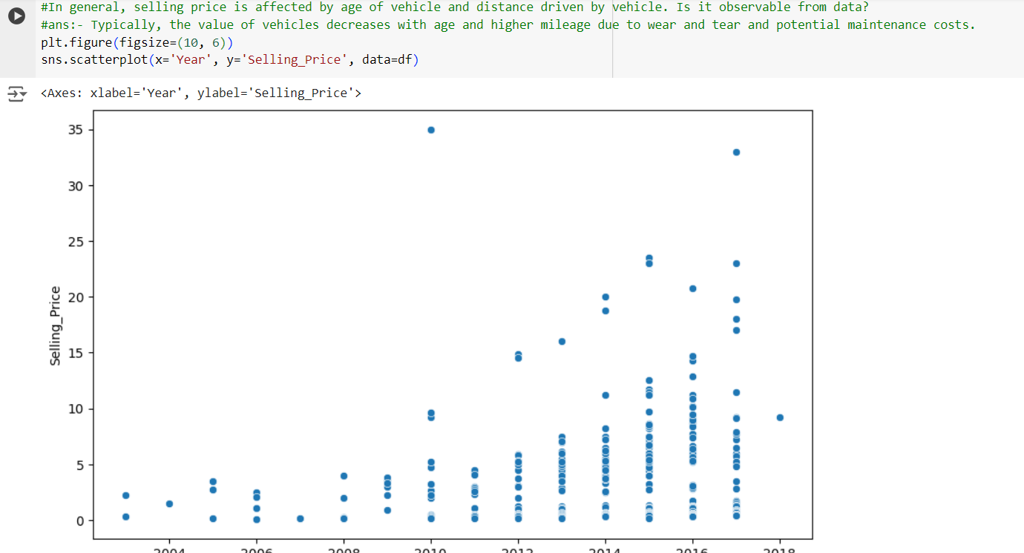
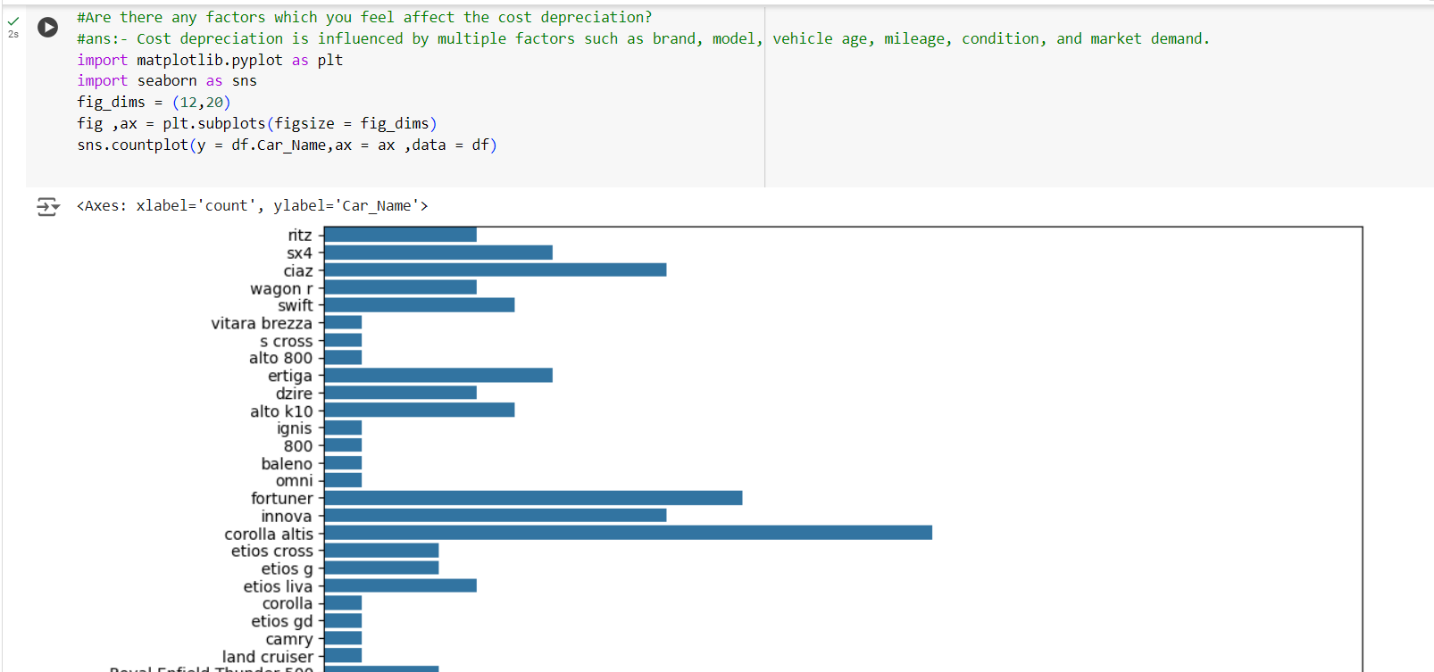
Results
Key Findings:
Identified the top features influencing car prices (e.g., brand, year, fuel type).
Discovered consumer preferences vary significantly by region.
Found a strong correlation between car age and depreciation.
Visualizations

Slide 10
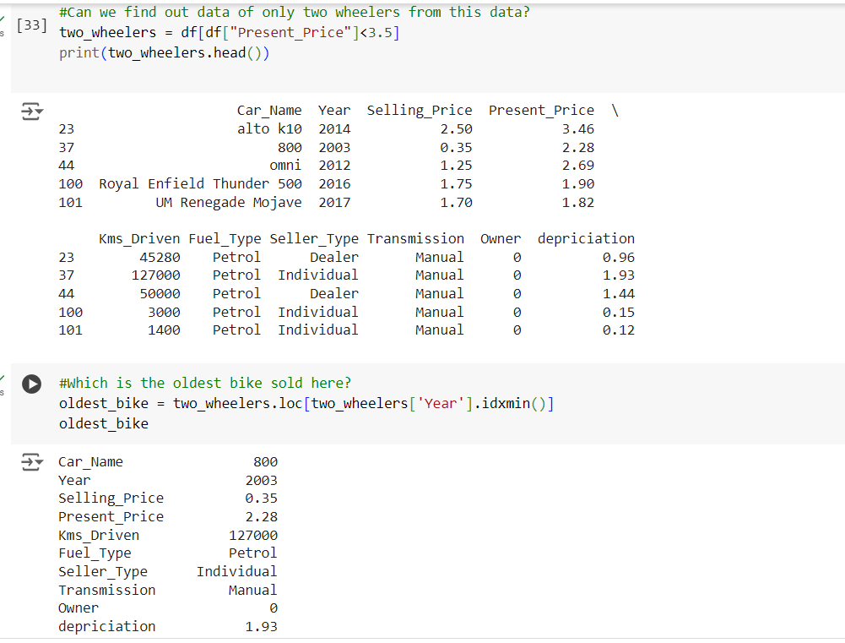
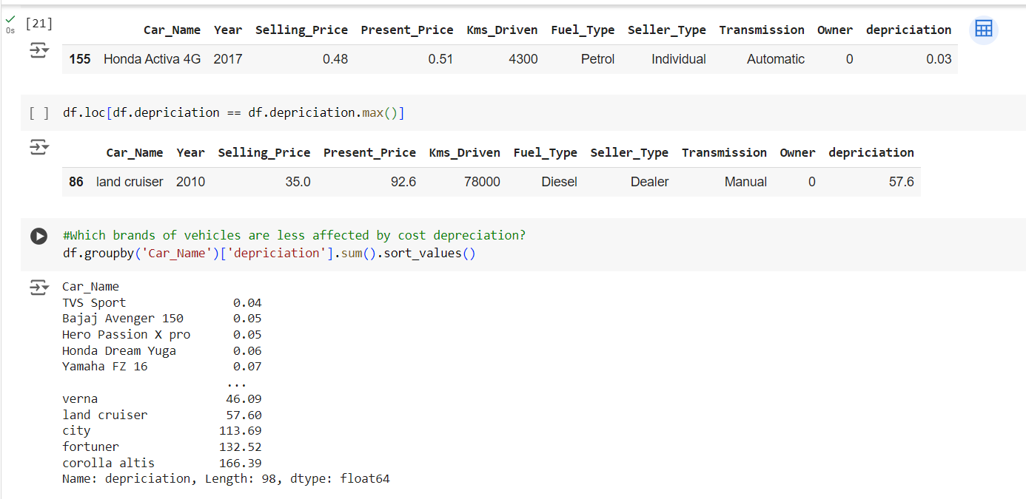
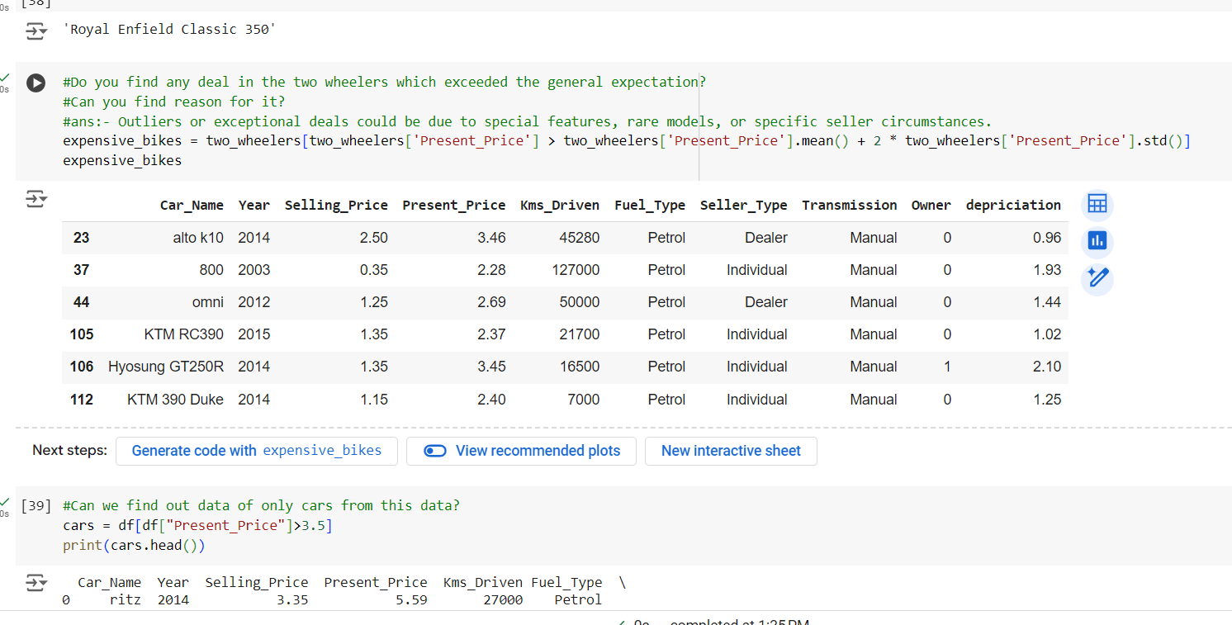
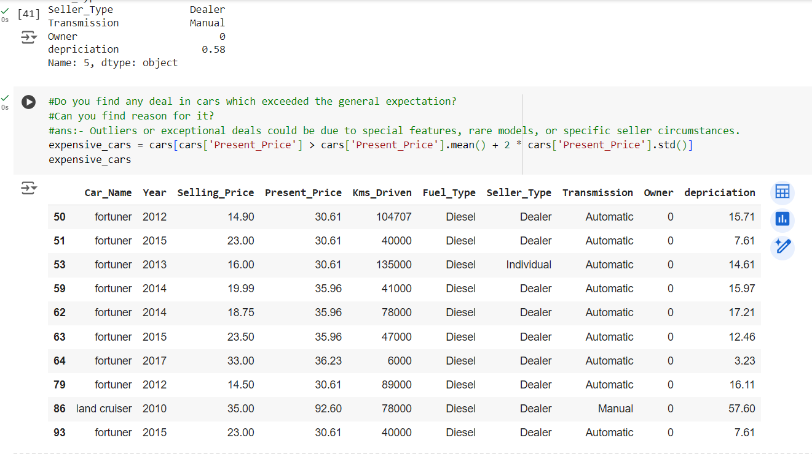
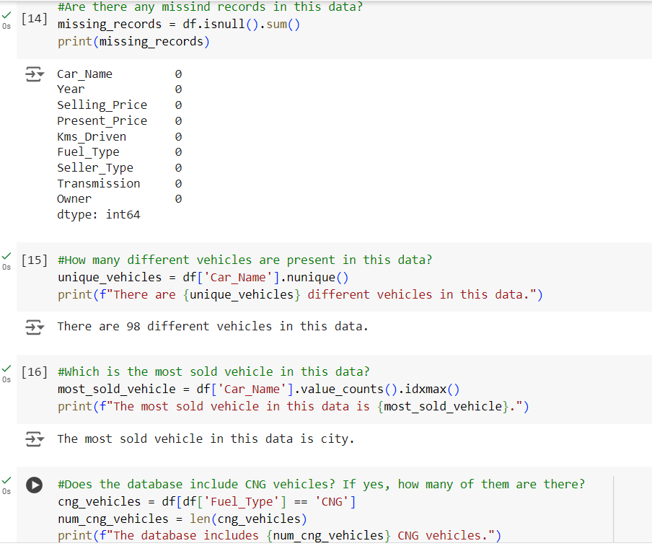
Results

Slide 11
links
Project Links:
File Link: DA-Analytics-File
Colab Link: Nafisa-DA-Colab
GitHub Repository Link: DA-Nafisa
References:
Youtube
Chatgpt
Amazon Web Services (AWS)
Coursera
Geeksforgeeks
Simplilearn

