Slide 1
CSE 308 Software Engineering and Information System Design Sessional
Automation of
BCB’s
Game Development Committee
Group No: 01
Group Members:1005091
1005111
1005113
1005115
1005120
User Interface

Slide 2
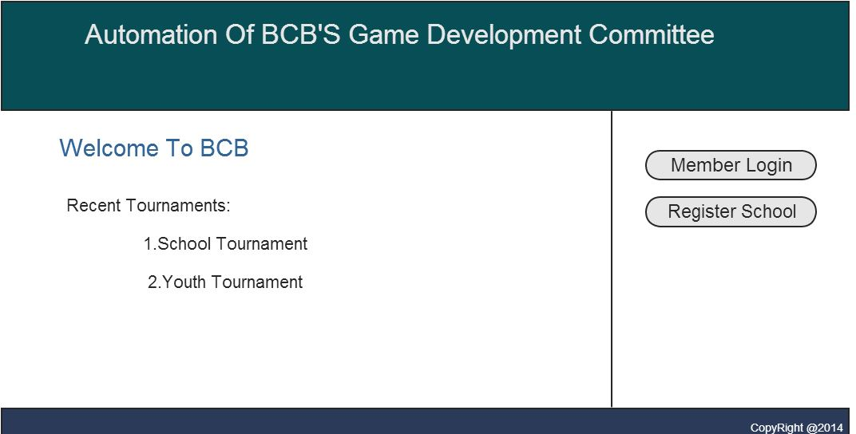
Home:

Slide 3
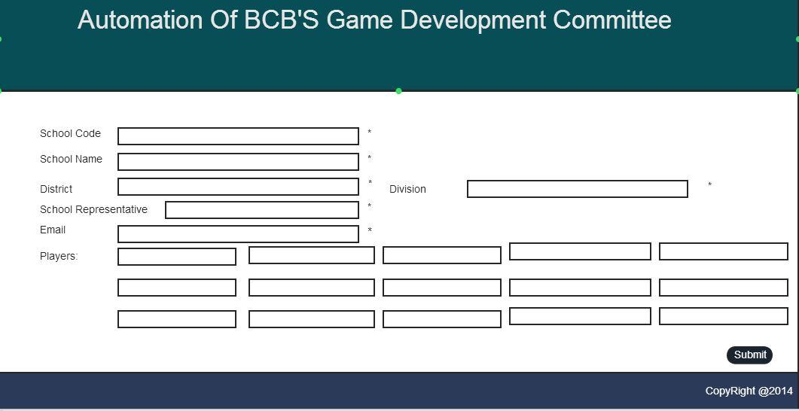
School Registration Form:

Slide 4
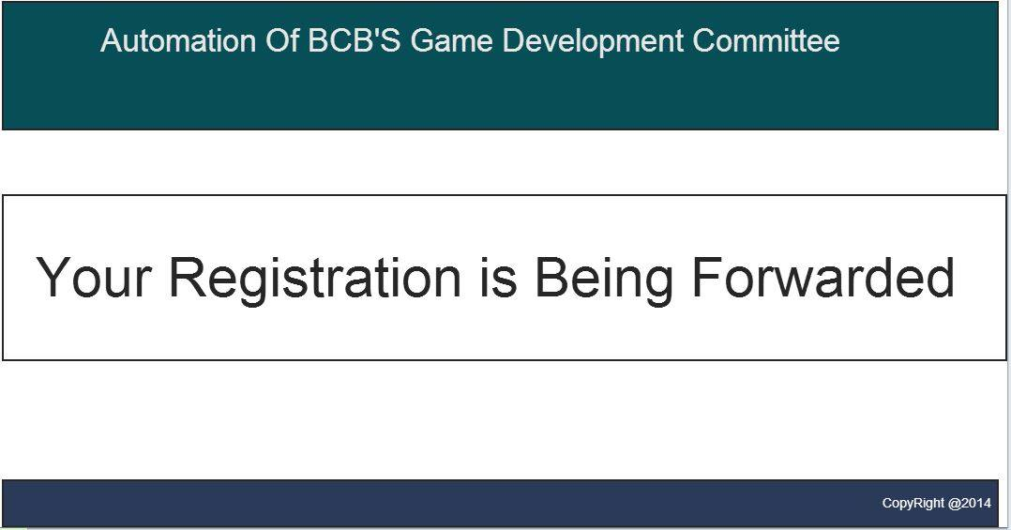
After Registration:

Slide 5
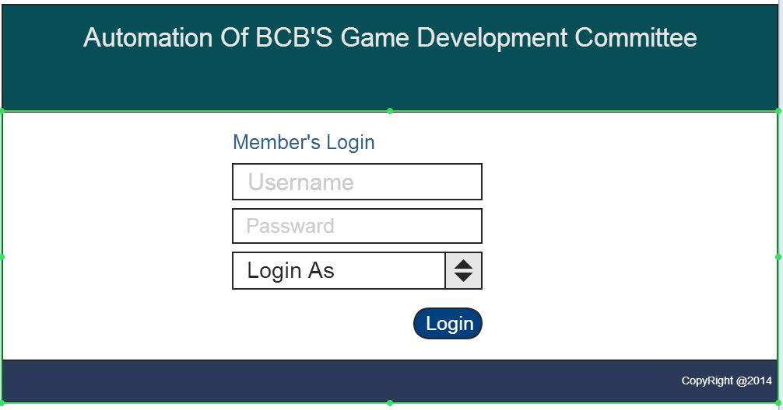
Login page:

Slide 6
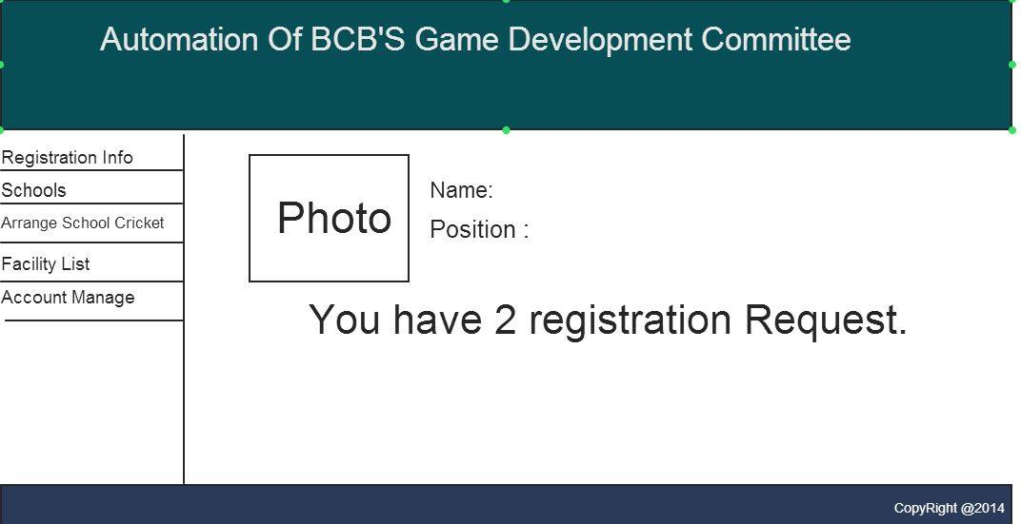
School Cricket Administrator’s Homepage:

Slide 7
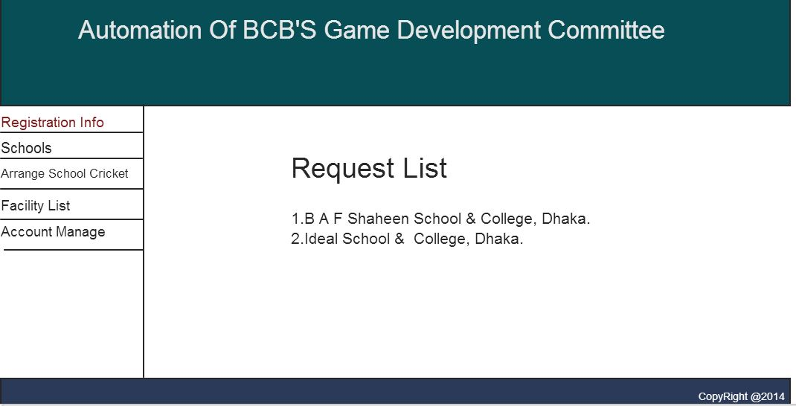
School registration requests:

Slide 8
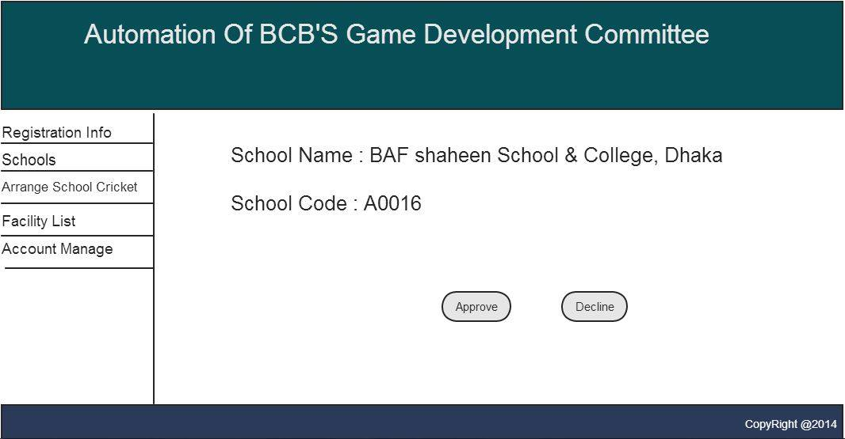
Registration Info:

Slide 9
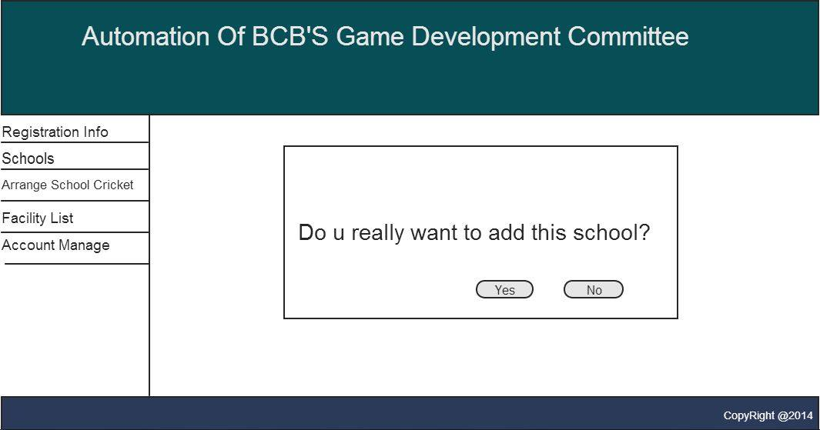
Approve:

Slide 10
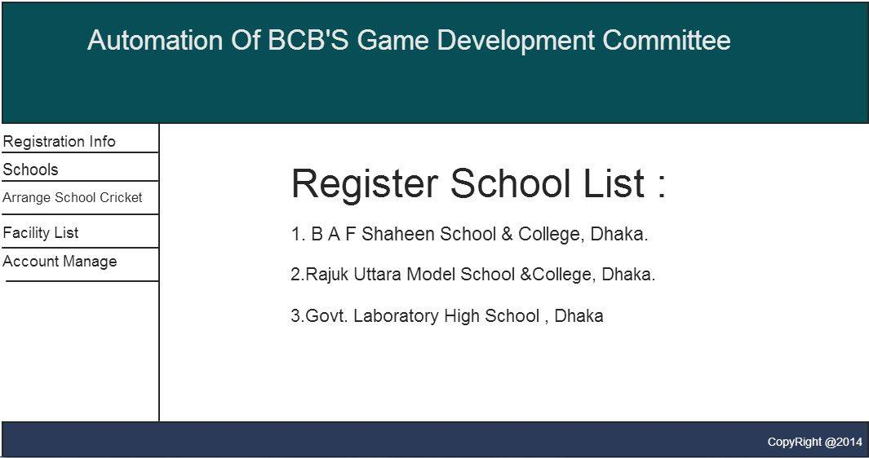
Registered Schools:

Slide 11
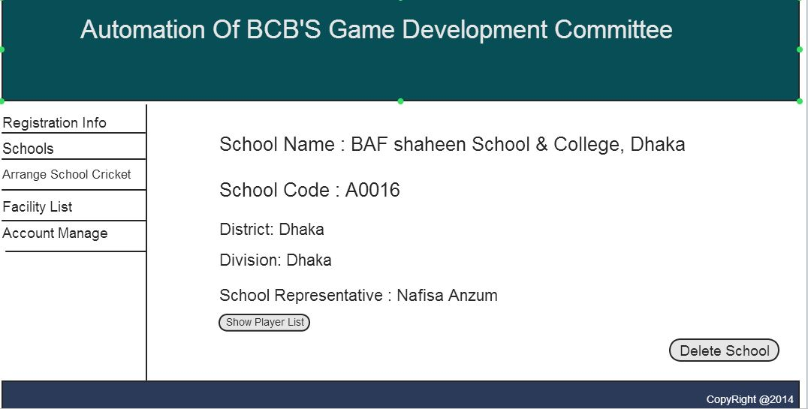
School Info:

Slide 12
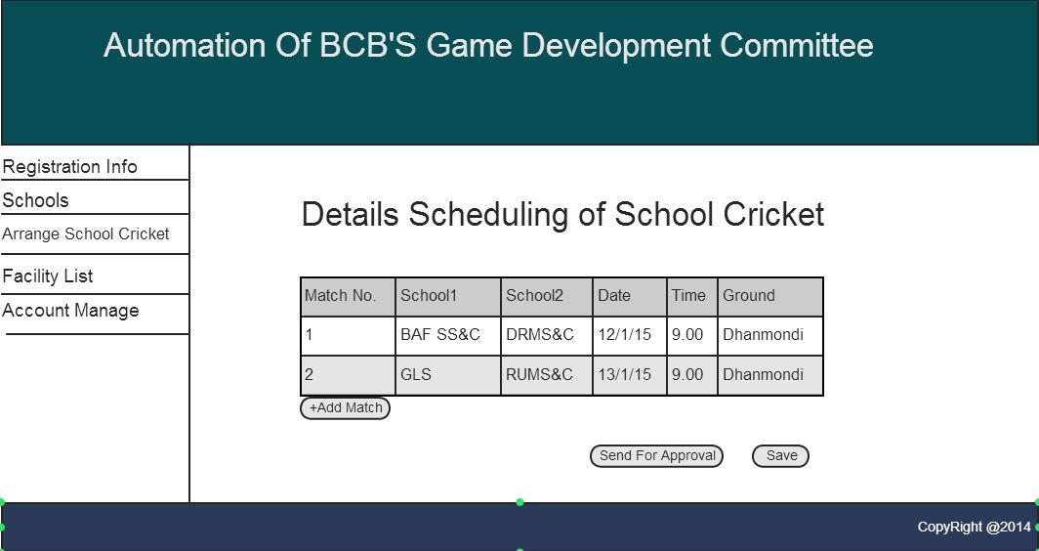
School Cricket Tournament Scheduling:

Slide 13
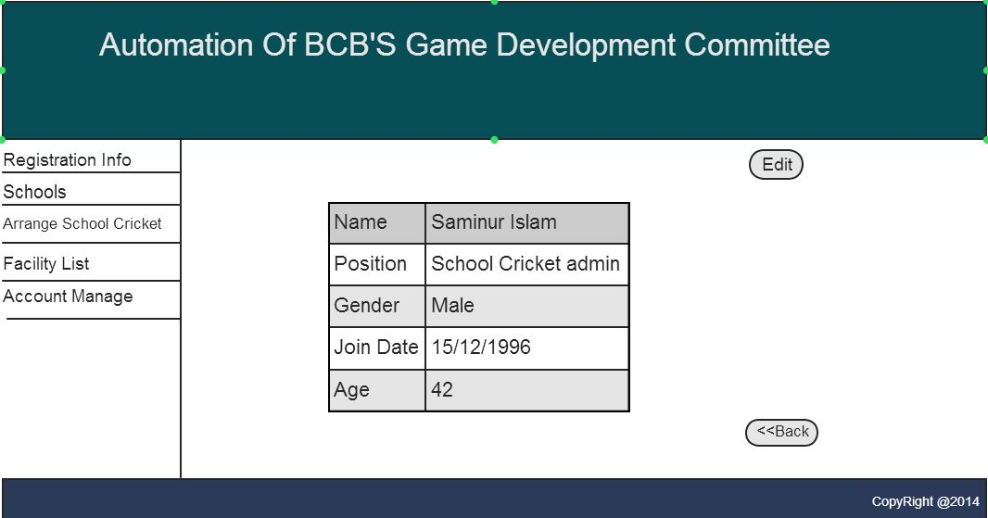
Personal Account settings:

Slide 14
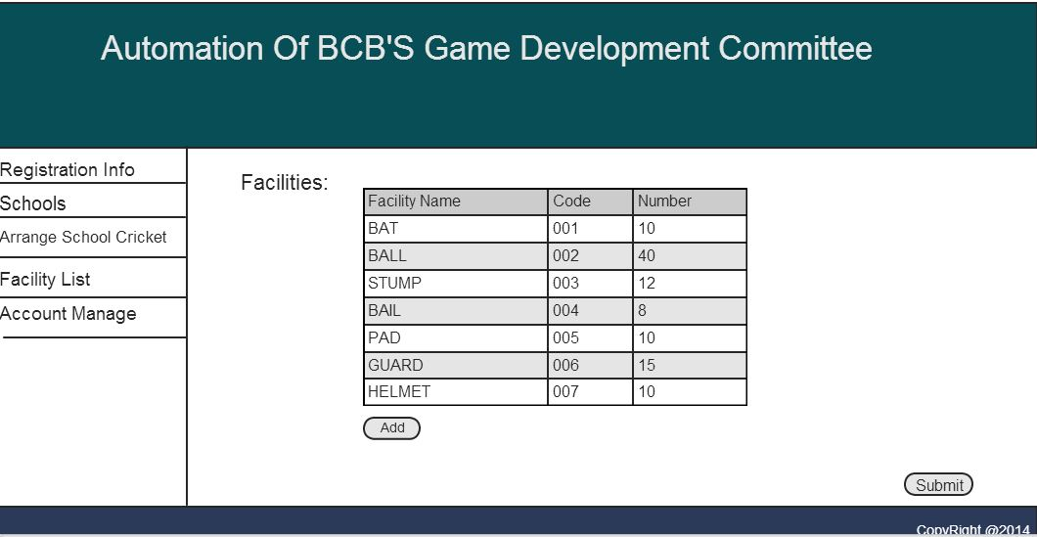
Lists facilities:

Slide 15
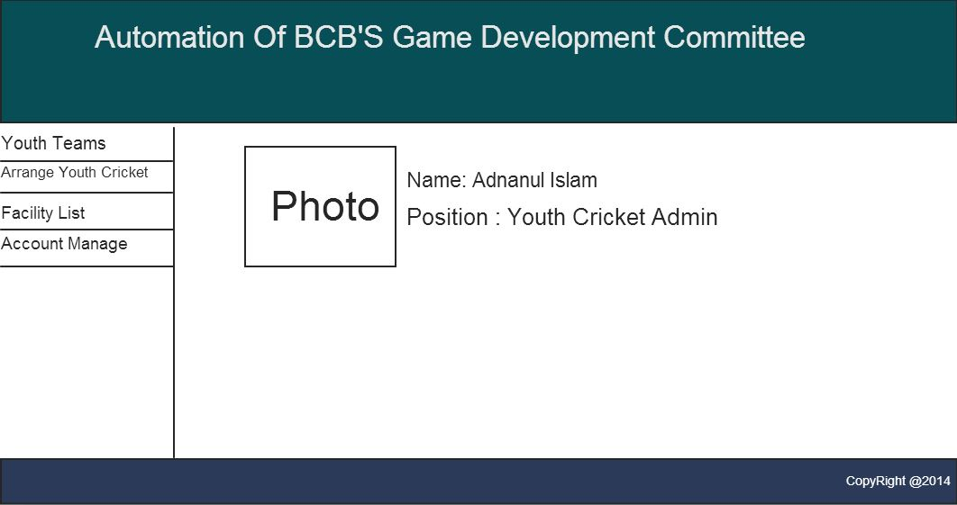
Youth Cricket Admin homepage:

Slide 16
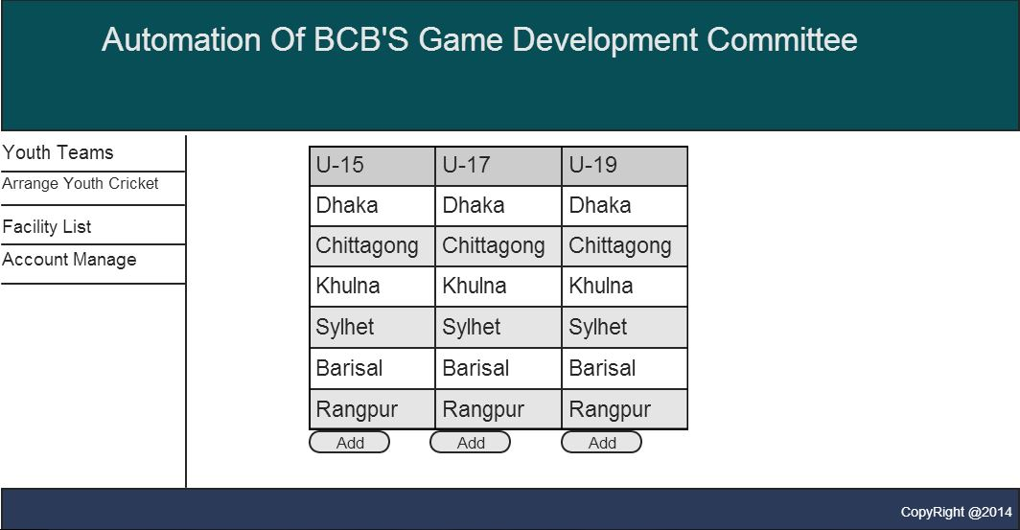
Youth Teams

Slide 17
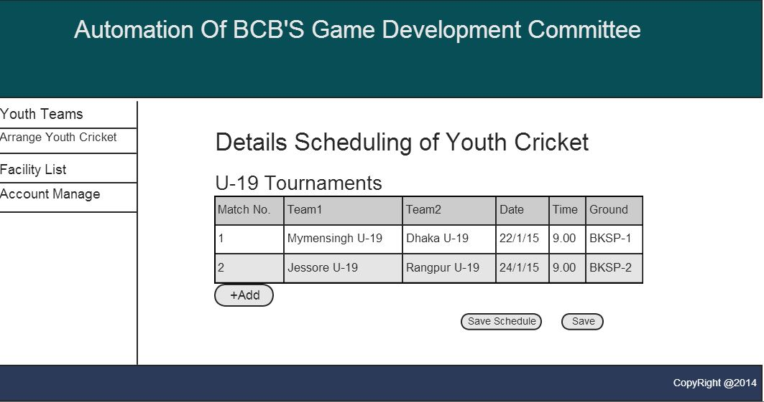
Team Details:

Slide 18
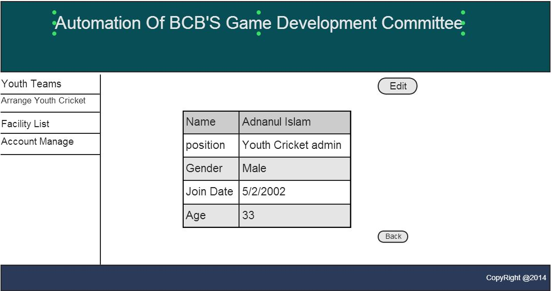
Account settings of Youth cricket admin:

Slide 19
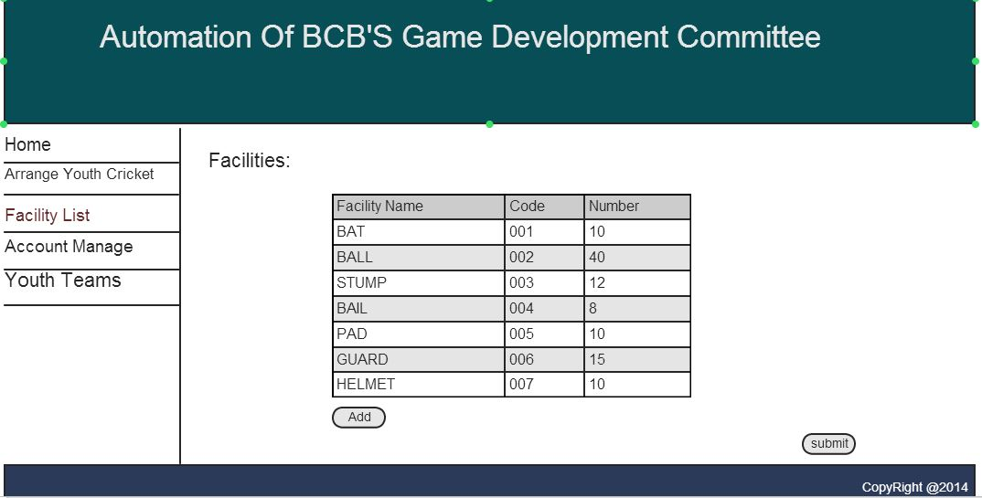
Listed facilities:

Slide 20
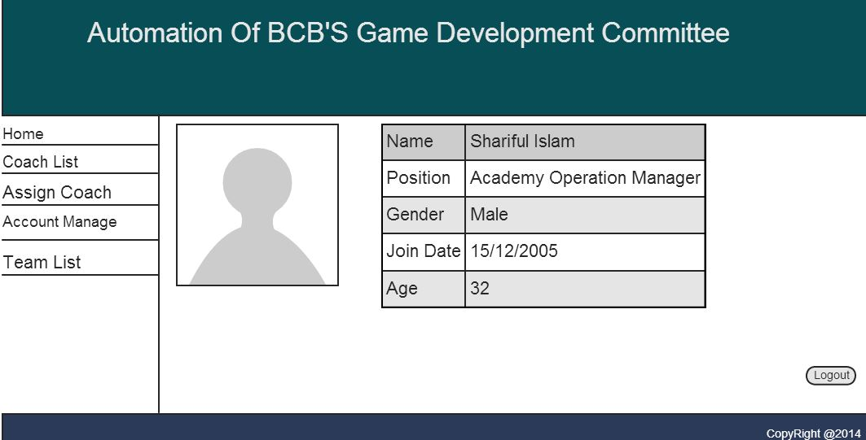
Homepage of Academy Operations manager:

Slide 21
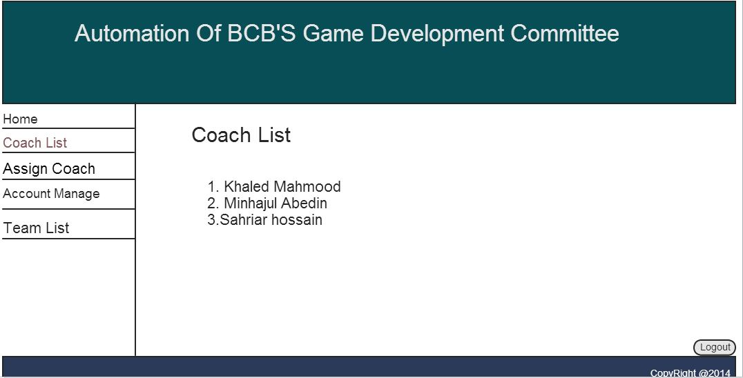
Coach list:

Slide 22
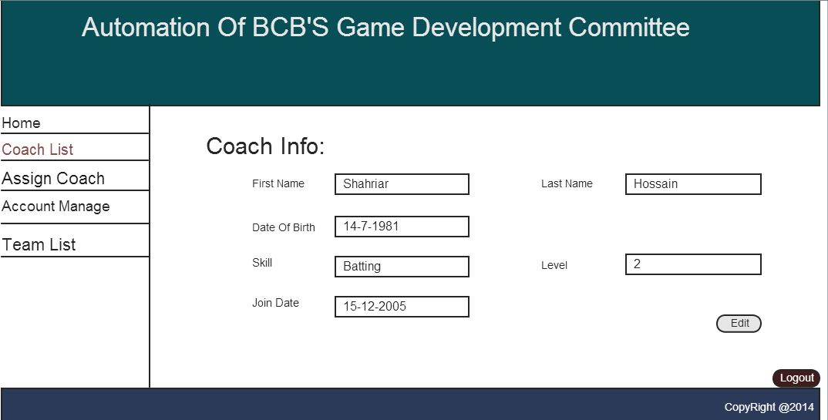
Coach info:

Slide 23
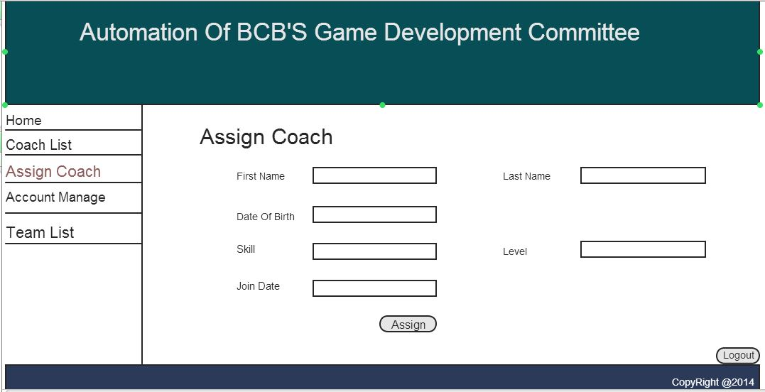
Assign coach:

Slide 24
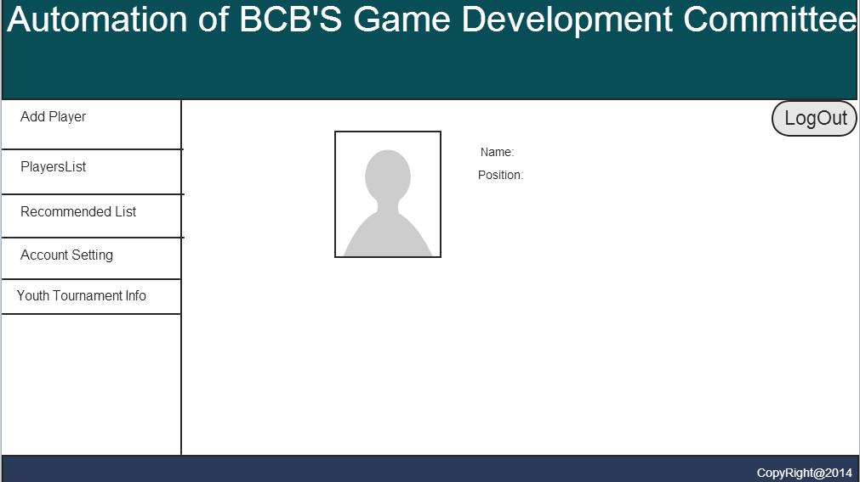
Homepage of divisional coach:

Slide 25
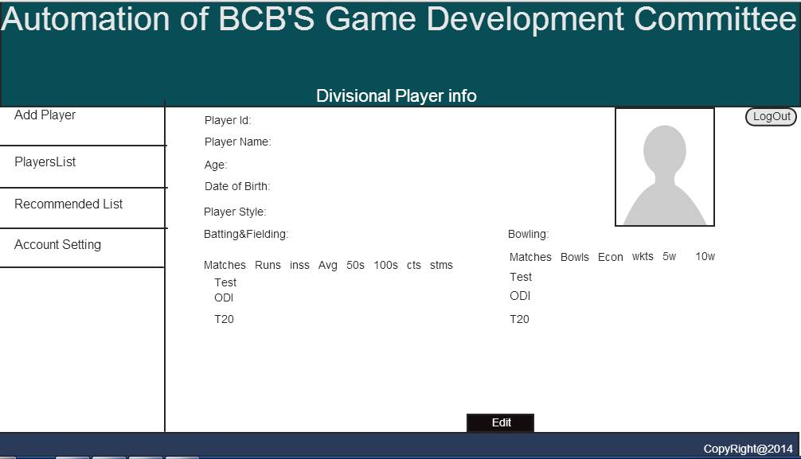
Divisional player info:

Slide 26
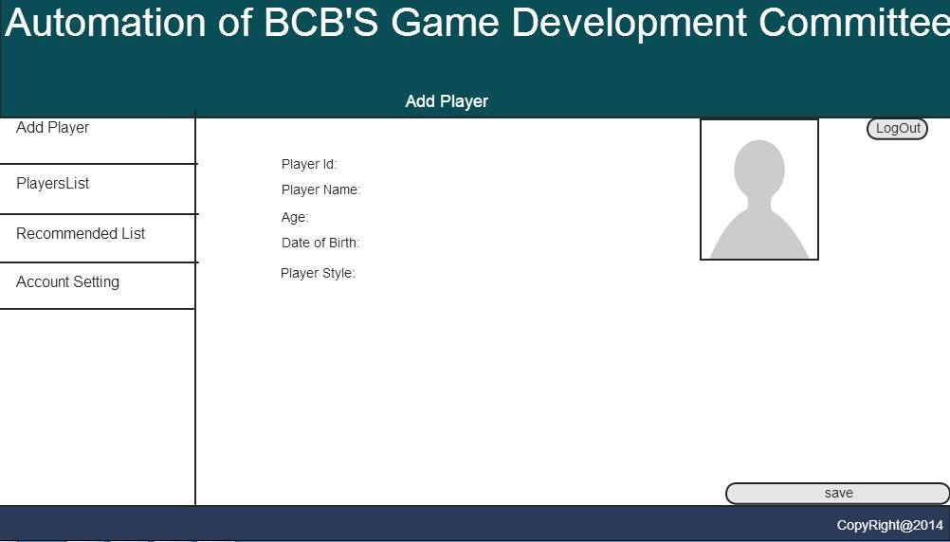
Add player:

Slide 27
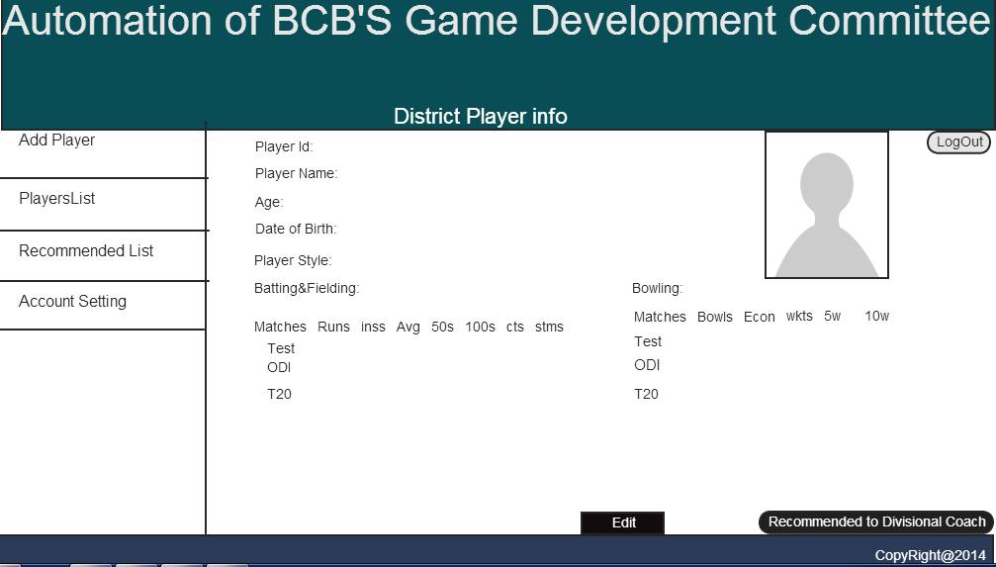
District player info:

Slide 28
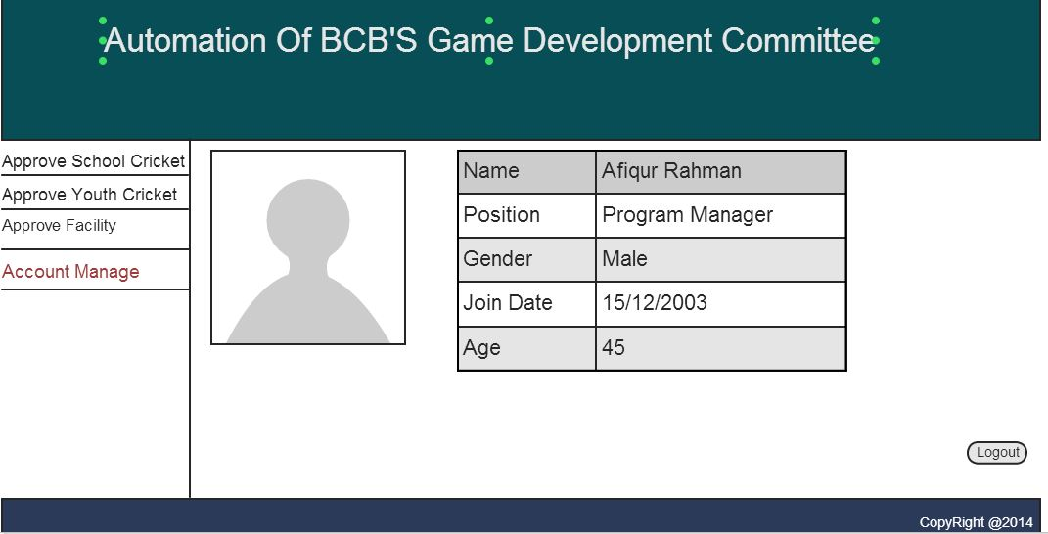
Homepage of program manager:

Slide 29
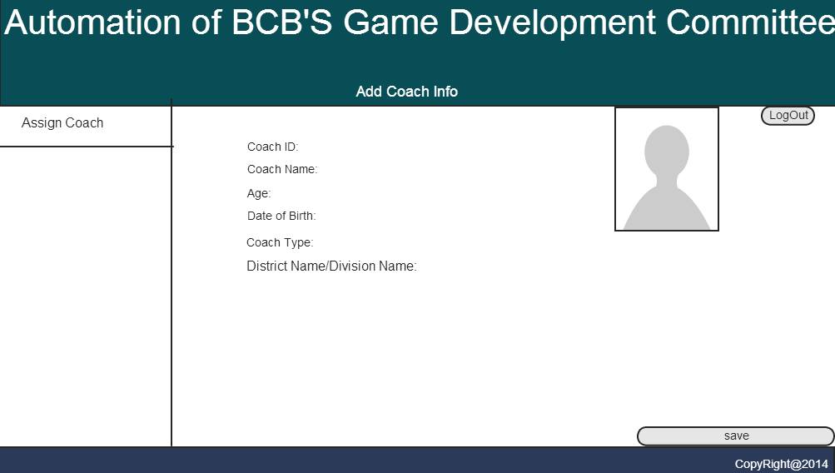
Assign coach:

Slide 30
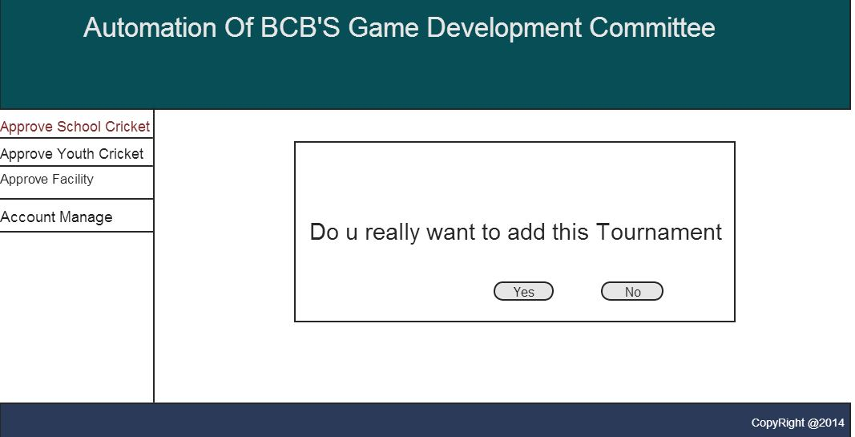
Tournament approve:

Slide 31
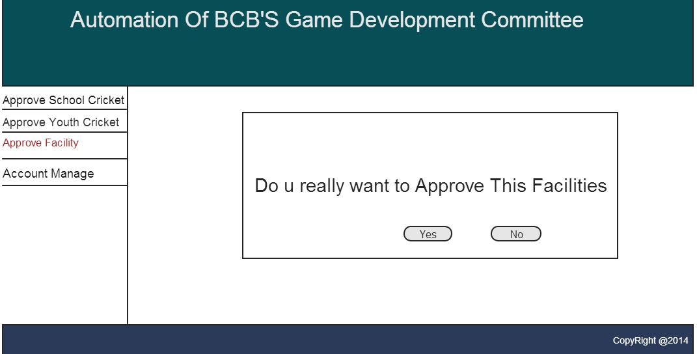
Facilities approval:

