Slide 1

Coal Mining Safety Monitoring and Alerting System

Slide 2
Coal Mining Safety Monitoring and Alerting System
Group - 02
Md SaaD Ibne Jamal - 201714036
Nafisa Tabassum - 201714042
Sabrina Afrin - 201714051
Tausif Al Zubayer - 201714064

Slide 3
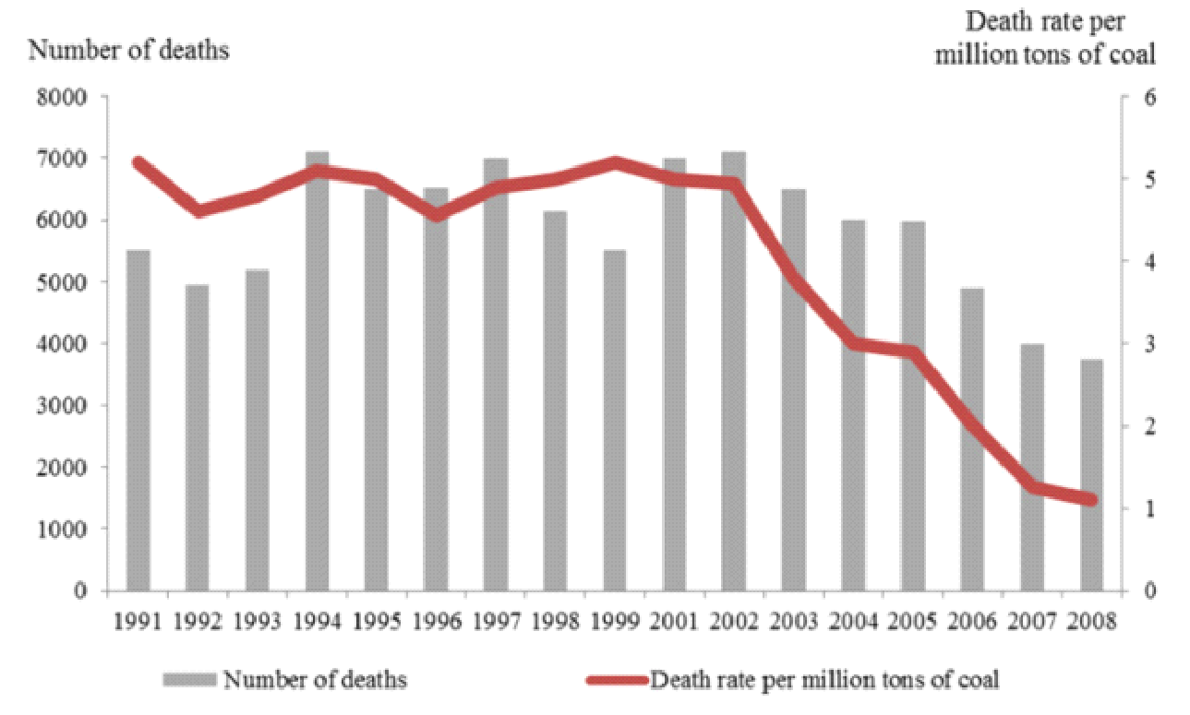
Introduction
Hazardous and often accidents take place
Rate of accidents increasing day by day

Slide 4
Information Gathering
Required information type
Source of information
Approaches for information gathering

Slide 5
What kind of information is required?
Weather of mine (Information-1)
Death rate in coal mine (Information-2)
Forecast of natural calamities (Information-3)
Cause of accidents (Information-4)
Previous accidental incidents (Information-5)

Slide 6
Source of Information
PME Department
Literature review of existing system
Coal mining statistics

Slide 7
Approaches adopted for information gathering
Questionaries (Method-1)
Literature review (Method-2)

Slide 8
Analysis on the gathered information
We gathered Information through Questionnaires (Method-1). Following questions were asked to our Source-1 (PME Dept):
1. Do you have all the records of coal mine situation? (I- 1,2)
2. Do you have any backup of data? (I- 1)
3. What will you do if they are lost or destroyed? (I- 1, 2, 3)
4. How internal data is collected? (I- 1)

Slide 9
Analysis on gathered information
Outcome:
1. Collecting data of mine environment previous data is difficult. (Outcome- 1)
2. Situation changes by time. (Outcome- 2)
3. No backup and restoration process is there. (Outcome- 3)
Rate existing system | Very Poor | Poor | Good | Fair | Excellent
 | 1 | 2 | 3 | 4 | 5

Slide 10
Analysis on the gathered information
We gathered Information through review (Method-2). Following data has been collected from source-2, 3:
1. What are the reasons of accidents? (I-4)
2. When does accident occure frequently? (I- 3)
3. What is the death rate inside mine? (I- 2)
4. Which age person die most? (I- 2)

Slide 11
Analysis on gathered information
Outcome:
1. Natural calamity has an effect in accidental events. (Outcome- 4)
2. People in 20-30 years die most. (Outcome- 5)
3. Rate of death is so high. (Outcome- 6)
Rate existing system | Very Poor | Poor | Good | Fair | Excellent
 | 1 | 2 | 3 | 4 | 5

Slide 12
Analysis on gathered information
What is the rating of current system from source point of view?
Source | Very poor | Poor | Good | Fair | Excellent
PME department | ✓1 | 2 | 3 | 4 | 5
Literature review | 1 | 2 | ✓3 | 4 | 5
Coal mining statistics | 1 | 2 | ✓3 | 4 | 5
So, The current system operability is poor!!!

Slide 13
Information Gathering Matrix
Information | Info - 1 | Info -2 | Info-3 | Info-4 | Info-5
Method | 1 | 1, 2 | 1, 2 | 2 | 2
Source | 1 | 1, 2, 3 | 1, 3 | 2, 3 | 2, 3
Outcomes | 1, 2 | 5, 6 | 2, 4 | 4 | 1, 6

Slide 14
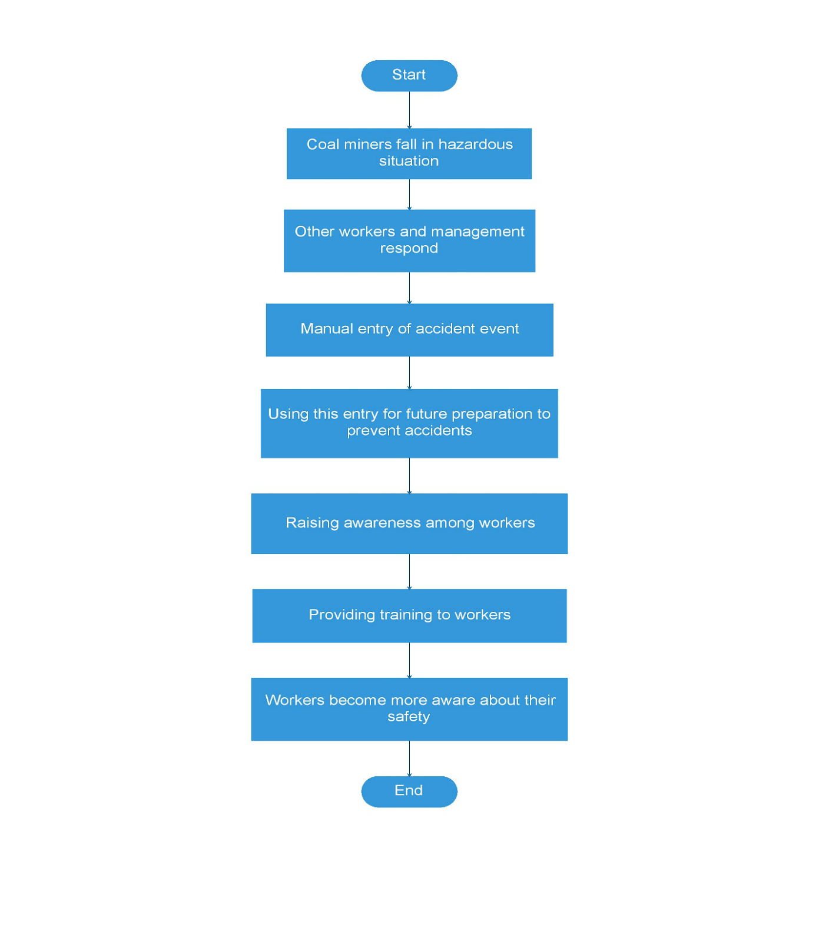
Presenting the Existing System
The existing system does not provide any special advantage to the workers because it does not incorporate any technological innovations.

Slide 15
Feasibility Analysis
Proposed candidate system
The recommended proposals are solely concerned with the safety of the miners. Both consists of alerting systems for hazardous situations. Our proposed candidate systems are
Wireless Sensors system
Fuzzy Neural Network system

Slide 16
Candidate system-1
Candidate system | Features | Process flow
Wireless Sensors | Based on Internet of Things. Wireless sensors are used to collect data and determine the amount of harmful gases A fall detector sensor to detect if a coal miner falls accidentally and a limit switch as a helmet removal sensor to detect whether a worker is currently wearing his helmet. | A number of sensors, hardware and connector will be installed in the several places of mine. Each and every moment these sensors read data from surrounding environment and send to base station.

Slide 17
Candidate system-1
Candidate system | Features | Process flow
Wireless Sensors | If a dangerous environment is detected, this will be stored on cloud and transmitted wirelessly to the base station. We can also report event using outlier detection algorithm and track the position of workers using localization algorithm. | A controller in the base station will process all the data and generate a warning signal if find something accidental After the warning, authority will take safety measurement.

Slide 18
Candidate system-2
Candidate system | Features | Process flow
Fuzzy Neural Network | Fuzzy theory and neural network will be combined to develop an intelligent fuzzy neural network system. If the intelligent fuzzy theory will be combined with neural network then we will get intelligent fuzzy sensor system which will sense the surrounding environment. | A system with AI and Fuzzy Logic will be implemented here. Some information of previously occurred accidents will be given to this system. Some sensors will be installed in the mine and send data to the base station

Slide 19
Candidate system-2
Candidate system | Features | Process flow
Fuzzy Neural Network | Based on some input samples or datasets, it can calculate if the amount of gas in the air is hazardous or not, if the temperature is OK and wind speed etc. | In the base station, Using AI and Fuzzy logic, the system will process current situation data and compare with previous data. Then if possibility of accident, system will generate a warning signal.

Slide 20
Hardware and Software Requirement of Candidate System
Candidate Systems | Hardware | Software
Wireless Sensor | Gas sensor | A real time monitoring system
 | Fall detection accelerometer | Different types of algorithm implementation for event detection and location detection
 | Helmet removal sensor(limit switch)
 | Microcontroller
 | Different types of nodes such as SNs, RNs and MNs

Slide 21
Hardware and Software Requirement of Candidate System
Candidate Systems | Hardware | Software
Fuzzy Neural Network | Computer System | Cloud database
 |  | Neural network
 |  | Training dataset

Slide 22
Characteristics of Candidate System
Characteristics | Wireless Sensor | Fuzzy Neural Network
Technical Feasibility | Various sensors will read data from surrounding environment Data collected by the sensors from environment will be processed by a controller. | Data of previous accidents, previously taken measurement, situation before hazards will be given to the system. Using advanced technology, such as Artificial Intelligence, Data Mining, Neural Network etc all these information will be analyzed and a warning as possibility of hazard will be generated.

Slide 23
Characteristics of Candidate System
Characteristics | Wireless Sensor | Fuzzy Neural Network
Technical Feasibility | Analyzing these information, sufficient steps will be taken to ensure the safety. There will be different types of sophisticated algorithms for event detection and worker’s location detection. | According to the warning, necessary steps will be taken to ensure the safety of workers and minimize the loss.

Slide 24
Characteristics of Candidate System
Characteristics | Wireless Sensor | Fuzzy Neural Network
Economic Feasibility | This system requires a lot of hardware to be implemented. So hardware cost is more. | Hardware cost will be less because we are implementing neural network which is purely software based. As advanced technologies are used, sophisticated software system will be required.

Slide 25
Characteristics of Candidate System
Characteristics | Wireless Sensor | Fuzzy Neural Network
Economic Feasibility | As we aren’t using any advanced technology here, sophisticated software cost will be less. | This system’s maintenance cost is high because of advanced technology and technically more efficient people is required.

Slide 26
Candidate Qualitative Evaluation Matrix
Criteria |  | Candidate System 1 | Candidate System 2
Performance | System accuracy | Excellent | Good
 | Scalability | Excellent | Excellent
 | Response time | Excellent | Very good
 | User friendliness | Very good | Good
 | Complexity | Good | Very good
Cost | System development | Good | Very good
 | User training | Very good | Very good
 | Maintenance | Good | Very good
 | Payback | Excellent | Excellent

Slide 27
Weighted Candidate Evaluation Matrix
Evaluation Criteria | Weighting Factor | Candidate System 1 (Wireless Sensor) |  | Candidate System 2 (Fuzzy Neural Network)
 |  | Rating | Score | Rating | Score
Performance
System accuracy | 5 | 5 | 25 | 3 | 15
Scalability | 4 | 5 | 20 | 5 | 20
Response time | 5 | 5 | 25 | 4 | 20
User friendliness | 5 | 4 | 20 | 3 | 15
Complexity | 3 | 3 | 9 | 4 | 12
Costs

Slide 28
Weighted Candidate Evaluation Matrix
Evaluation Criteria | Weighting Factor | Candidate System 1 (Wireless Sensor) |  | Candidate System 2 (Fuzzy Neural Network)
 |  | Rating | Score | Rating | Score
Performance
User training | 4 | 4 | 16 | 4 | 16
Maintenance | 4 | 3 | 12 | 3 | 12
Payback | 4 | 5 | 20 | 5 | 20
Total |  |  | 162 |  | 150

Slide 29
Selection of the Best Candidate System
The system with the highest total score is judged the best system. According to our analysis, the wireless sensor network is the best system for ensuring coal mining safety. System accuracy and response time are the criterions that have the greatest effect on the total score.

Slide 30
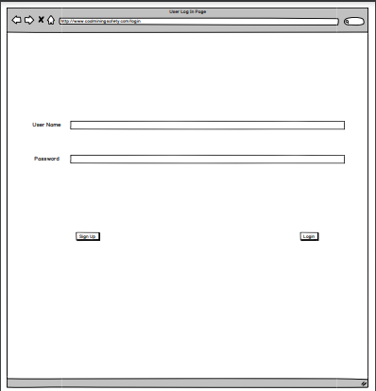
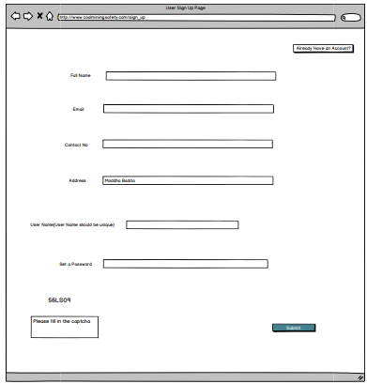
Snapshots of UI:
Log in and Account information

Slide 31
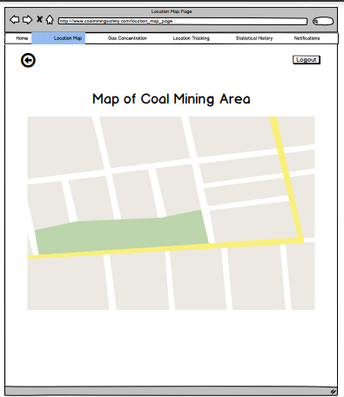
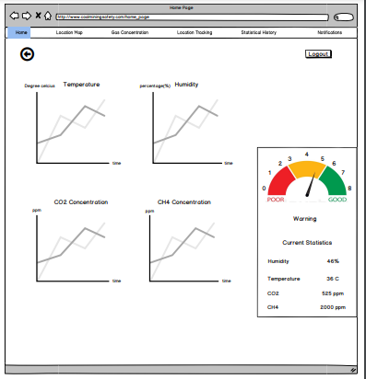
Map Homepage

Slide 32
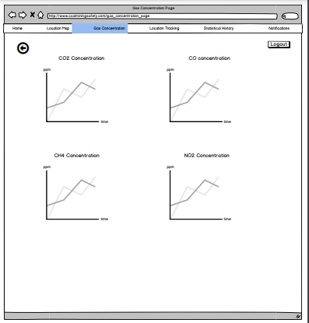
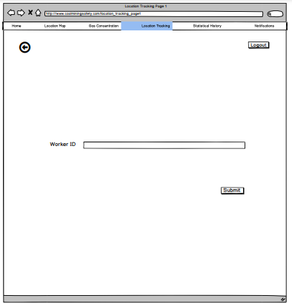
Gas State Worker Tracking

Slide 33
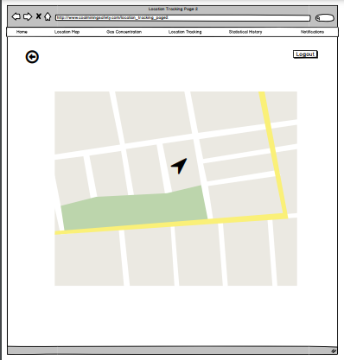
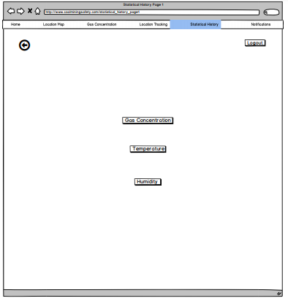
Worker Location History of Location

Slide 34
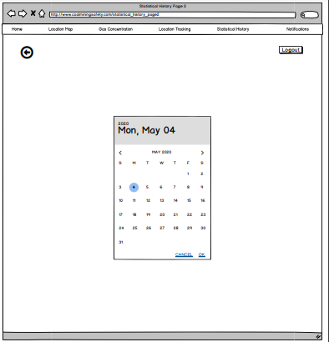
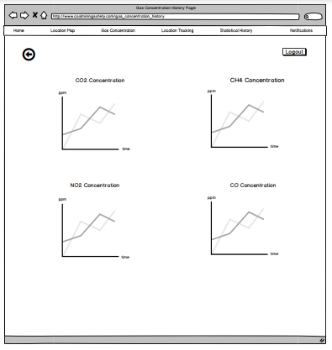
Accident History State History

Slide 35
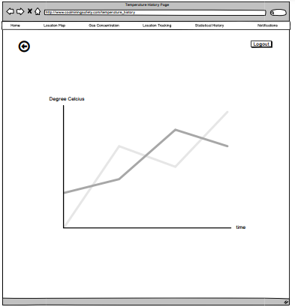
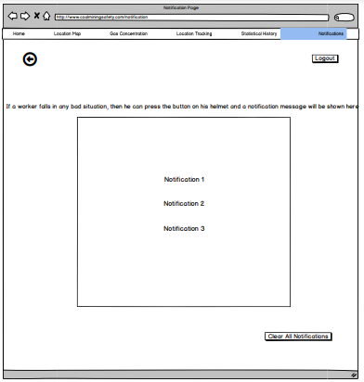
State in percentage Notification

Slide 36
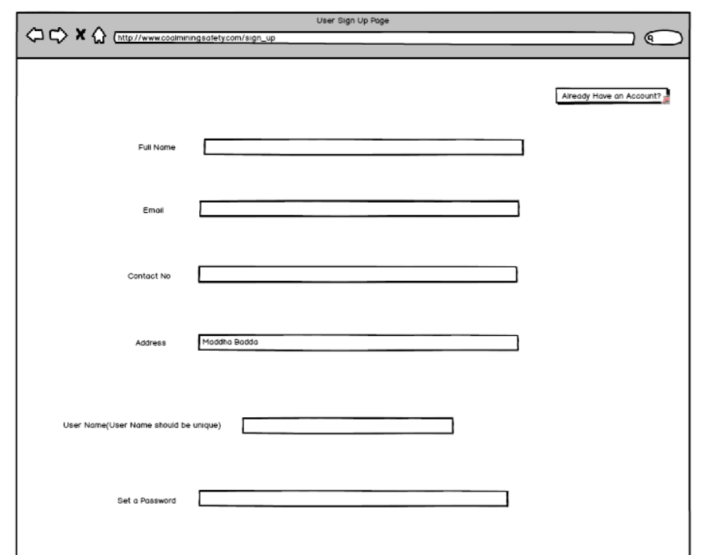
Heuristic Evaluation from Opposite Group

Slide 37
Heuristic Evaluation from Opposite Group
Problem No. | Problem | No. of violated heuristics | Severity Score
1 | The input bars are not properly aligned. | H1 | 2
H1 = Visibility of system status

Slide 38
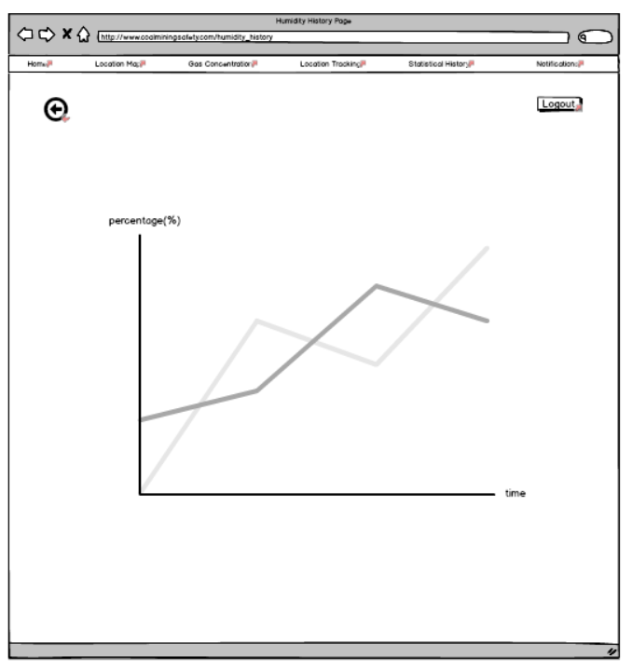
Heuristic Evaluation from Opposite Group

Slide 39
Heuristic Evaluation from Opposite Group
Problem No. | Problem | No. of violated heuristics | Severity Score
2 | The design of the website is not user friendly. | H4 | 2
H4 = Consistency and standards

Slide 40
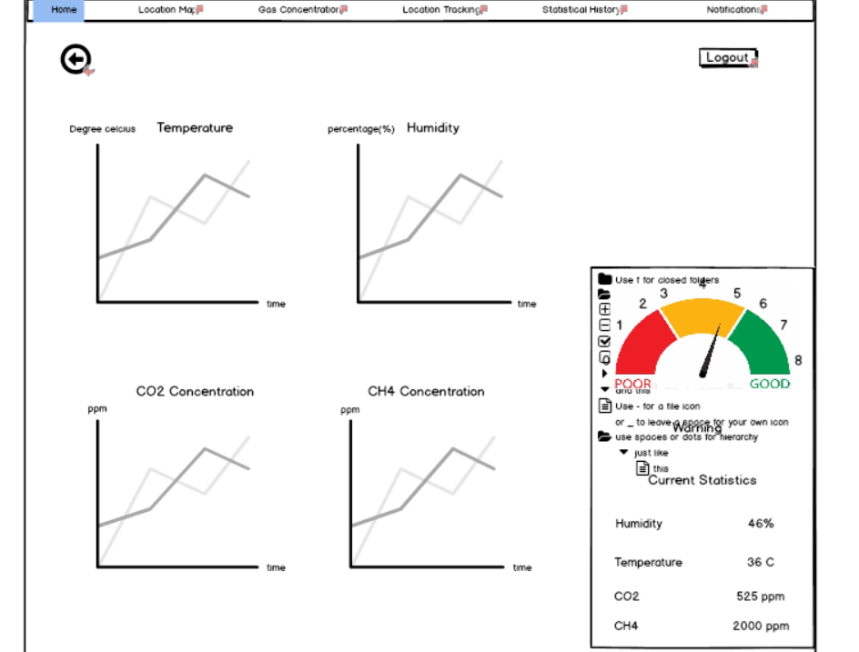
Heuristic Evaluation from Opposite Group

Slide 41
Heuristic Evaluation from Opposite Group
Problem No. | Problem | No. of violated heuristics | Severity Score
3 | The visual chart seems very hard to understand and the text of the chart overlaps. | H8 | 3
H8 = Aesthetic and minimalist design

