Slide 1

Smart Home Delivery Box
EEE404: Robotics and Automation Laboratory
Group 2 (G2)
1806131 | 1806174 | 1806191
1806160 | 1806188 | 1806195

Slide 2
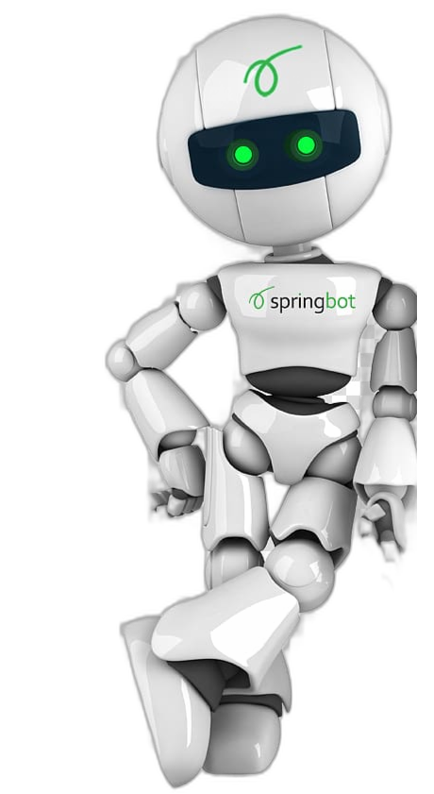
OBJECTIVE
Integral in various fields, including manufacturing, healthcare, and logistics to simplify and enhance processes across industries.
1
Amalgamation of AI, ML, and robotics streamlines processes and enhances decision-making capabilities, leads to smarter, data-driven solutions
2
3
Fosters innovation, improves resource utilization, and creates a more interconnected world
4
Mitigates the complexities of daily life, making tasks not just easier but also more fulfilling.

Slide 3
TABLE OF CONTENTS
01
04
02
05
06
03
Introduction
Implementation
Methodology
Costing
Circuit Diagram
Sustainability

Slide 4
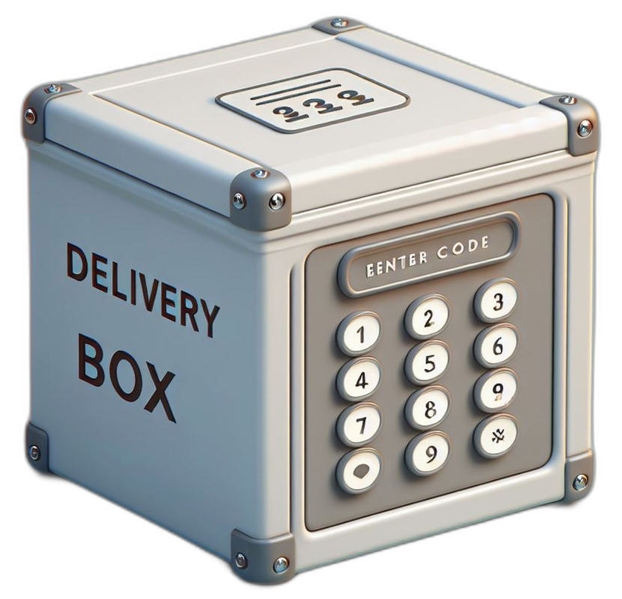
INTRODUCTION
Our smart delivery system changes how parcels are handled, using advanced technology for security and ease. Real-time updates and easy access control help users protect their packages. This shows how modern automation makes deliveries smarter and simpler for everyone.

Slide 5
KEY FEATURES
Delivery Notifications
1
2
Unauthorized Opening
Sending notifications to the user about the delivery status
Alerting the user if the delivery box is opened without authorization
OTP-Based Unlocking
4
3
OTP Generation
Using a one-time password (OTP) for secure access
Generating OTP within ESP32 and sending it to the delivery man via the owner.
Load Sensor
5
6
Manual Control
Utilizing a load sensor to ensure that the delivery box is not empty
Manual oppening system in case of emergencies

Slide 6
METHODOLOGY
1
Delivery man arrives and calls the owner
Owner generates OTP using Telegram and sends it to the delivery man
2
Delivery man unlocks the delivery box entering the OTP using keypad
3
Delivery man locks the box after putting in the parcel
4
Owner gets notification on the parcel weight
5
After returning, Owner generates OTP to unlock the box and retrieves parcel
6

Slide 7
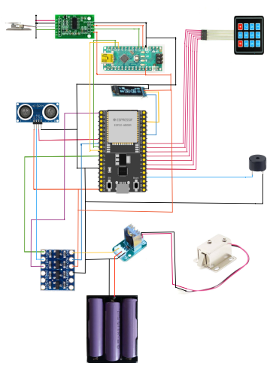
CIRCUIT DIAGRAM
Keypad
Door Lock
Buzzer
Arduino Nano
ESP32
Lock Driver
3.7V Li-ion Battery
OLED
HX7111
Amplifier
Voltage Level Converter
Sonar Sensor
Load Sensor

Slide 8
KEY COMPONENTS
ESP32
1
2
Load Sensor
WiFi capable microcontroller
Sensitive weight detector
Door Lock
4
3
Sonar Sensor
12V super secure lock
Detector of lid state/
5
Keypad
Input OTP

Slide 9
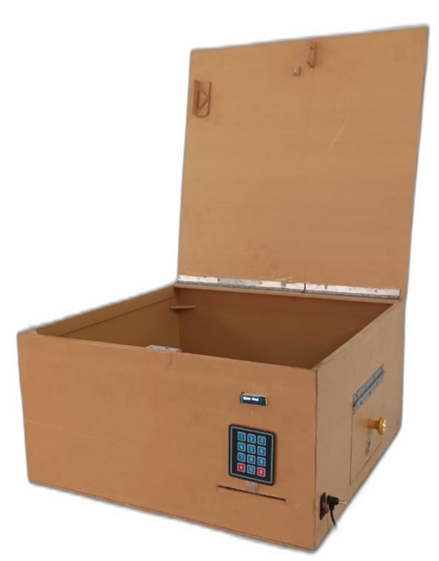
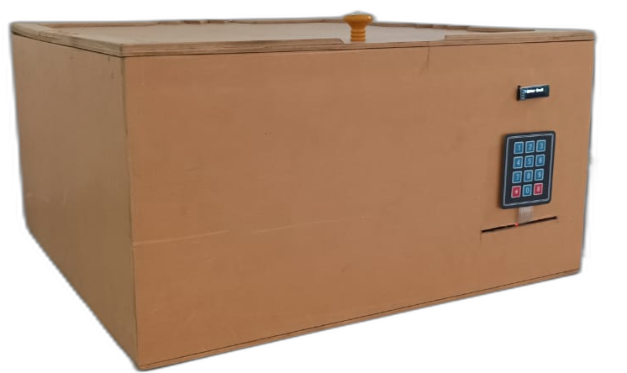
IMPLEMENTATION

Slide 10
TRADE OFF AND COMPARISON
ESP32 is used as it has more pins than ESP8266
Worked with a PVC board box for the time being.
Keypad has been used instead of push buttons
Small display for cost efficiency

Slide 11

DRAWBACKS AND SOLUTIONS
Power Backup
Solution: Adapter with ESP shield
Power failure
Solution: Manual unlock
Unauthorized Entry
Solution: Alarm

Slide 12
COST ANALYSIS
Components | Cost | Components | Cost (BDT)
ESP32 | 690 | Adapter 5V | 300
12V Lock | 750 | Arduino nano | 450
Load Sensor (15 kg) | 380 | OLED Display | 320
Manual lock | 200 | Li-ion Battery 3.7V(3x) | 210
Keypad (4x3) | 50 | Sonar | 90
Box | 3000 | Voltage Level Converter | 65
Total Cost: 6505 BDT

Slide 13

SUSTAINABILITY
Energy Efficient
Time
Efficient
Durable Build Quality
Enhanced Security

Slide 14
DEMONSTRATION

Slide 15
FUTURE PROSPECT
Incorporation with parcel delivery services
1
2
Hazardous object detection
Visual feedback
3
Backup power
4
5
Preciser load sensor

Slide 16
THANK YOU

