Slide 1


Paper Title:
"Machine & Deep Learning Algorithms for Bengali
Cyberbullying Detection"
University:
Department of Computer Science and Engineering,
Ahsanullah University of Science & Technology.
Group Members:
Misbahul Sheikh (20200204039)
Naushin Mamun (20200204010)
Nafisa Tasnim Neha (20200204020)
Date: 24/09/2024
Notes:
https://pixabay.com/en/achievement-agreement-business-3481967/

Slide 2
Outline
Introduction
03
Literature Review
04
Dataset Analysis
05
Methodology
06-07
Result Analysis
08
Conclusion And Future Works
09
References
10
Notes:
https://pixabay.com/en/books-science-shelf-library-book-408220/

Slide 3

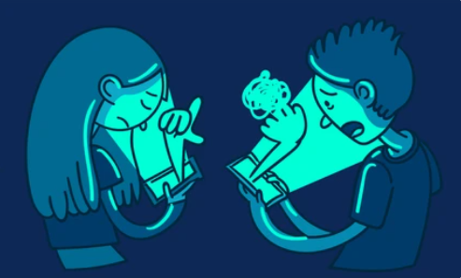

Introduction
Bullying causes harm through physical, verbal, emotional, and social aggression.
It’s a anonymous psychological harassment via technology, making it hard to control.
Increased internet use in Bangladesh has escalated online harassment of women, especially on Facebook.
Machine learning, deep learning, and Transformer models effectively detect cyberbullying in various languages, including Bengali.

Slide 4
Literature Review
Paper no. | Dataset | Models | Result (Accuracy)
1 | Formspring.me, labeled via Amazon Mechanical Turk | C4.5, Instance-based Learner | 78.5% with C4.5
2 | Not specified | Neural Network, SVM | Neural Network: 92.8%, SVM: 90.3%
3 | Social media (Bengali data) | TF-IDF + Naive Bayes, SVM, Random Forest, XGBoost, BERT | BERT: 90%, SVM: 79%, Naive Bayes: 76%
4 | Tweets | SVM, Naive Bayes | SVM: 71.25%, Naive Bayes: 52.70%
5 | Twitter (sentiment analysis) | VADER, BERT, 5 other ML algorithms | BERT: 92%
6 | Bengali comments from social media, blogs, newspapers | Recurrent Neural Networks (RNN), other ML algorithms | RNN: 82.20%
Fig1: Literature Review

Slide 5

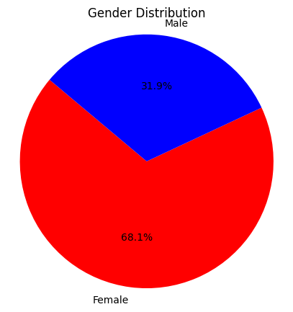
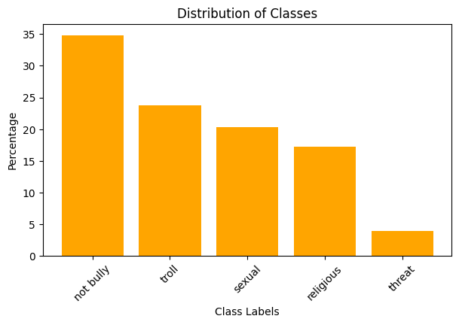
Dataset Analysis
Not bully – 34.86 %
Troll – 23.73 %
Sexual – 20.29 %
Religious – 17.22 %
Threat – 3.85 %
Fig2: Gender Comment Distribution
Fig3: Distribution of Classes
5
Notes:
https://pixabay.com/en/office-neo-urban-apple-trend-1500461/

Slide 6

Methodology
Preprocessing
Tokenization
Removing
1. Digits
2. Web links
3. Punctuation
4. Symbols
5. Non-Bengali letters
6. Stop words
Lemmatization
Feature extraction
TF-IDF
UNI-gram
BI-gram
TRI-gram
Word2Vec
GloVe
FastText
Class conversion
Dataset
ML Models
KNN
LR
RF
Performance
Accuracy
Precision
Recall
F1-score
LSTM
CNN
Bangla-Bert
Comparison
Graph
Fig4: Total Workflow
6
Notes:
https://pixabay.com/en/office-neo-urban-apple-trend-1500461/

Slide 7

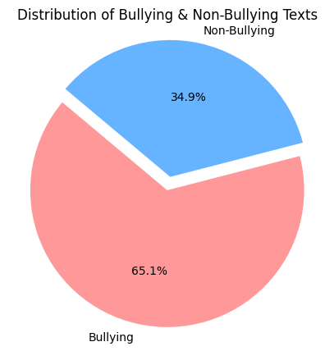
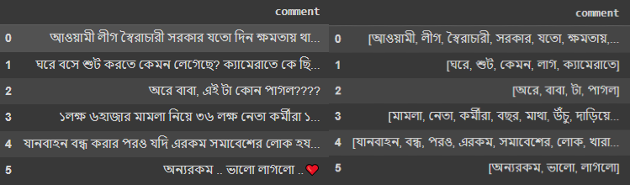
Methodology
Fig5: After Preprocessing Text
Fig6: After Converting Multi Class to Binary Class
7
Notes:
https://pixabay.com/en/office-neo-urban-apple-trend-1500461/

Slide 8
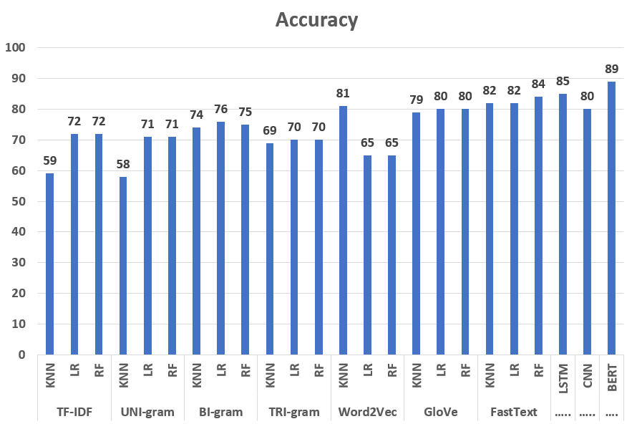
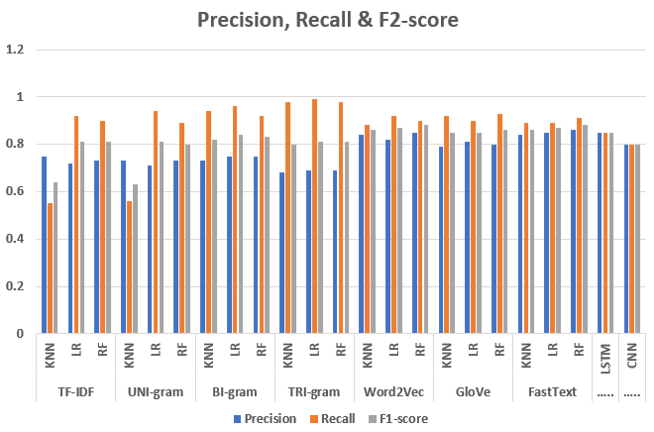
Result Analysis
Bangla-BERT worked best compared to other algorithms and achieved an accuracy of 89%.
RF with the FastText embedding technique performed better with an accuracy of 84%.
LSTM gives better results than CNN and other ML models with an accuracy of 85%.
BI-gram and TRI-gram techniques provide almost the same results.
Notes:
https://pixabay.com/en/thumbs-up-okay-good-well-done-2056022/

Slide 9
Conclusion And Future Works
Bangla-BERT model achieved 89% accuracy in Bengali cyberbullying detection.
Random Forest with FastText and LSTM models also performed well.
Sampling techniques would be helpful in getting better results for this kind of imbalanced dataset.
Explore additional state-of-the-art transformer models.
Develop real-time detection and integrate multilingual capabilities with user feedback.
Notes:
https://pixabay.com/en/thumbs-up-okay-good-well-done-2056022/

Slide 10
References
[1] K. Reynolds, A. Kontostathis, and L. Edwards, “Using machine learning to detect cyberbullying,” in Proceedings - 10th International Conference on Machine Learning and Applications, ICMLA 2011, 2011, vol. 2, pp. 241–244, doi: 10.1109/ICMLA.2011.152.
[2] J. Hani, M. Nashaat, M. Ahmed, Z. Emad, E. Amer, and A. Mohammed, “Social media cyberbullying detection using machine learning,” Int. J. Adv. Comput. Sci. Appl., vol. 10, no. 5, pp. 703–707, 2019, doi: 10.14569/ijacsa.2019.0100587.
[3] Subrata Saha, Md. Shamimul Islam, Md. Mahbub Alam, Md. Motinur Rahman, Md. Ziaul Hasan Majumder, Md. Shah Alam and M. Khalid Hossain, “Bengali Cyberbullying Detection in Social Media Using Machine Learning Algorithms,” 2023 5th International Conference on Sustainable Technologies for Industry 5.0 (STI), 979-8-3503-9431-3/23/$31.00 ©2023 IEEE, DOI: 10.1109/STI59863.2023.10464740.
[4] R. R. Dalvi et al., “Detecting A Twitter Cyberbullying Using Machine Learning,” Proc. Int. Conf. Intell. Comput. Control Syst. ICICCS 2020, pp. 297–301, May 2020, doi: 10.1109/ICICCS48265.2020.9120893.
[5] S. Saha, M. I. H. Showrov, M. M. Rahman, and M. Z. H. Majumder, “VADER vs. BERT: A Comparative Performance Analysis for Sentiment on Coronavirus Outbreak,” 2023, pp. 371–385, doi: 10.1007/978-3-031-34619-4 30/COVER.
[6] E. A. Emon, S. Rahman, J. Banarjee, A. K. Das, and T. Mittra, “A Deep Learning Approach to Detect Abusive Bengali Text,” Jun. 2019, doi: 10.1109/ICSCC.2019.8843606.
Notes:
https://pixabay.com/en/thumbs-up-okay-good-well-done-2056022/

Slide 11

Thank you..
11
Notes:
https://pixabay.com/en/question-mark-labyrinth-lost-maze-2648236/

Slide 12


Questions
Do you have any questions?
Please ask..
12
Notes:
https://pixabay.com/en/question-mark-labyrinth-lost-maze-2648236/

