Slide 1
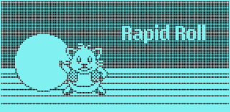
Rapid Roll Game
Presented to:
Lecturer Mohammad Rahman
Presenting by:
Nafisa Tasnim Neha
ID : 20200204020
Md. Ashiquzzaman Joy
ID : 20200204024
Md. Shiful Islam Fahad
ID : 20200204025
Inspired By :
Rapid Roll Game Of Nokia-1600

Slide 2
Main Menu
Play
Instructions
High Scores
Credit
Music
Exit

Slide 3
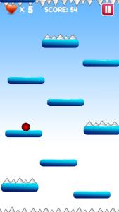
Play
This will start the game.
Player has to avoid obstacles .
Highest scores will be recorded.

Slide 4
INSTRUCTIONS
Any option will be activated by single clicking the left button of your mouse on it .
For moving the ball left, press the left arrow from your keyboard .
For moving the ball right, press right arrow from your keyboard .
If the ball collides with spike on or fall on the spike, player will lose a life .
If the ball can touch the heart sign, player will earn a life .

Slide 5

HIGH SCORES
High score window and Background
5 high scores and player names will be displayed in descending order

Slide 6
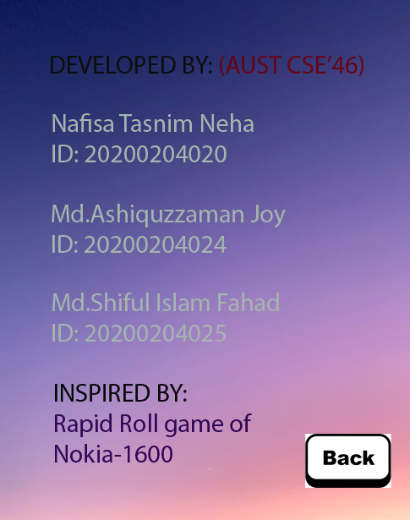
CREDIT

Slide 7
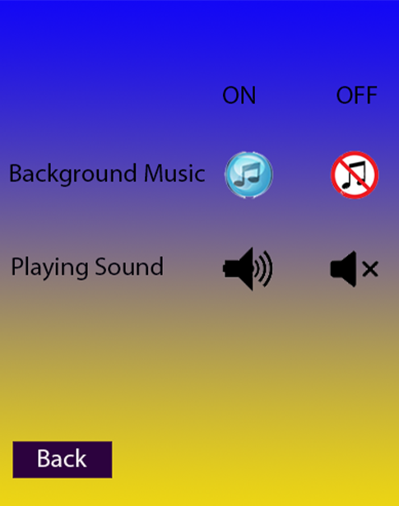
MUSIC
According to the user’s preference user can turn off background music and in game sound.

Slide 8
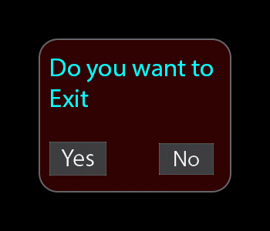
EXIT
A confirmation window will be shown upon clicking the exit button.

Slide 9

Back button
This will take players to the main menu.

Slide 10

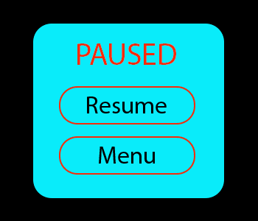
Game pause
Clicking on this button will pause the game.

Slide 11

Level contents
Hearts will give extra chances to the players.
Player has to hit the heart in order to gain it.

Slide 12
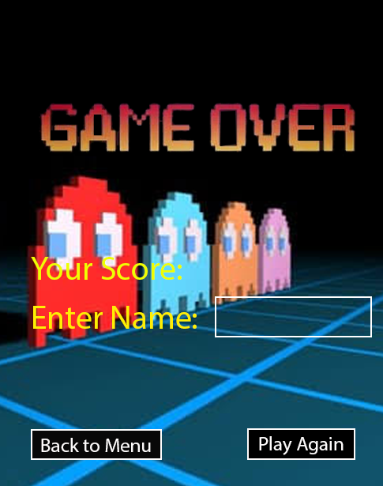
Game over
After hitting an obstacle game over window will open .
player score and player name will be shown.

Slide 13
Thank you

