Slide 1

Title: Regression Analysis of Rainy Weather Dataset:
Using Different Machine & Deep Learning Models
Date: 25th September, Wednesday, 2024
Team Members:
Name: Misbahul Sheikh
ID: 20200204039
Name: Naushin Mamun
ID: 20200204010
Name: Nafisa Tasnim Neha
ID: 20200204020

Slide 2

Abstract
Motivation
Literature Review
Methodology
Data Collection
Data Processing
Feature Extraction
Data Splitting
Result Analysis
References
Table of Content

Slide 3

Abstract
Regression analysis on rainy weather data using machine learning and deep learning models.
Predict continuous variables related to rainfall.
Models were thoroughly trained and validated for robustness.
Deep learning models worked best for predicting rainfall
1

Slide 4


Motivation
Predicting rainfall is important for farming, water management, and disaster planning.
Traditional methods aren't always accurate.
Machine learning and deep learning can improve predictions.
The paper compares different models to make weather forecasts better.
The goal is to help make better decisions using advanced methods.
2

Slide 5

Literature Review
Paper 01
Paper 02
Paper 03
Paper 04
Models Used:
Linear Regression
Result:
R² = 0.946
MAE = 0.123
Models Used:
Multiple Linear Regression Result:
R² = 0.823
MAE = 0.08
MSE = 0.23
RMSE = 0.20
Paper 03
Models Used:
Statistical forecasting model
Result:
RMSE = 8.13
Heidke Skill Score = 0.37
Correlation = 0.74
BIAS = - 0.85%
Hit Score = 58%
Models Used:
Multiple Linear Regression
Lasso Regression
XGBoost
Random Forest
Result based on R²:
MLR = 0.9950
Lasso Regression = 0.9910
XGBoost = 0.9819
RFR = 0.9737
3

Slide 6
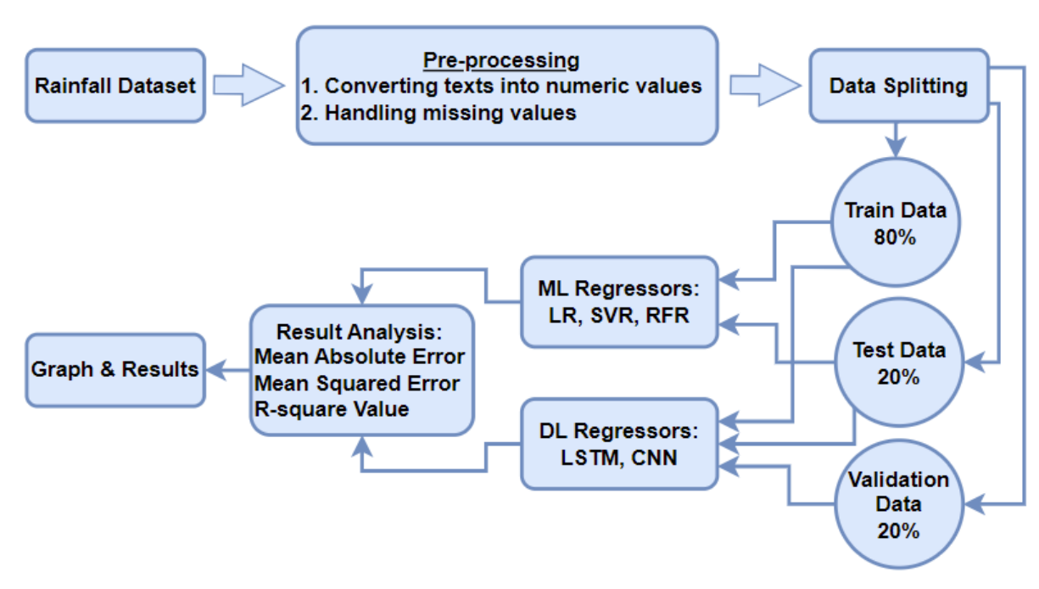
Methodology
Fig 1. Total Workflow
4

Slide 7


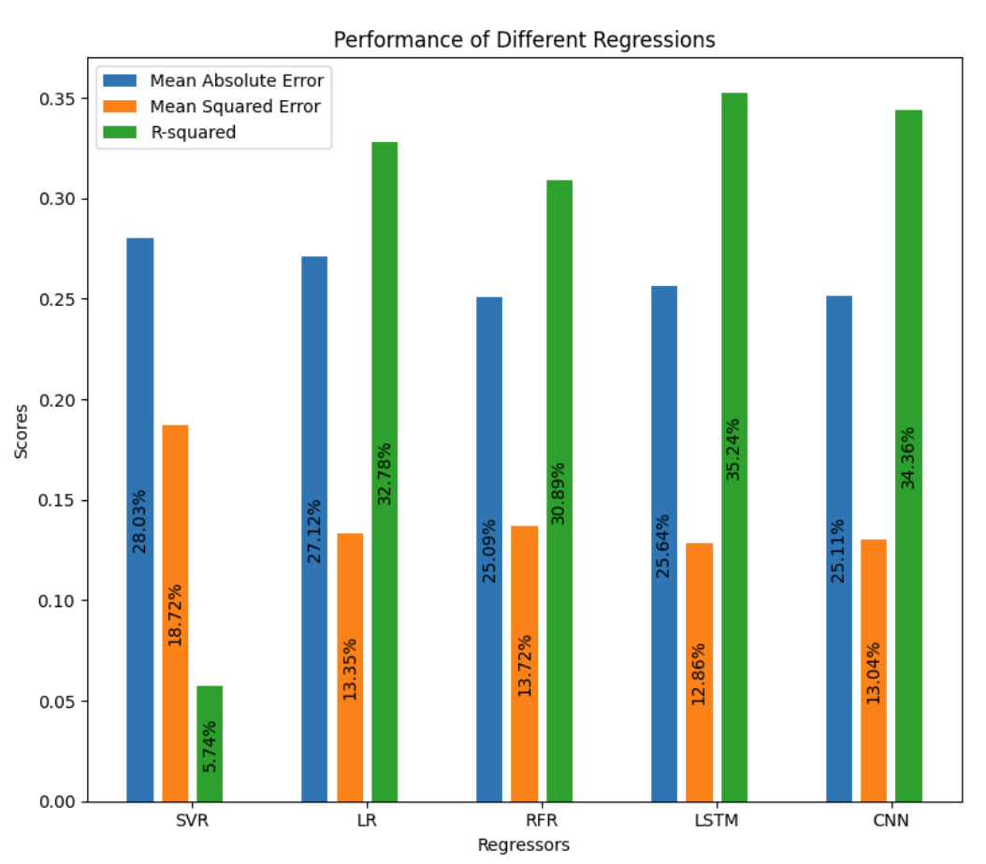
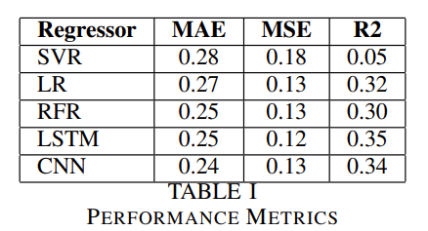
Result Analysis
Fig 2. Result Table
Fig 3. Result in Bar Chart
5

Slide 8


.
Conclusion
LSTM and CNN models gave the best results for predicting rainfall, with lower errors and higher accuracy.
LSTM had a slightly better performance than CNN.
Traditional models like SVR and LR didn't perform as well, with SVR being the least accurate.
Random Forest Regression was good but not as strong as the deep learning models.
Overall, deep learning models were the most effective for weather prediction.
6

Slide 9

References
[1] J.Refonaa, M.Lakshmi, Raza Abbas, Mohammad Raziullha, “Rainfall Prediction using Regression Model,” 2019 International Journal of Recent Technology and Engineering (IJRTE), ISSN: 2277-3878, Volume-8, Issue-2S3.
[2] MAI Navid, NH Niloy, “Multiple Linear Regressions for Predicting Rainfall for Bangladesh,” 2018 Communications. Vol. 6, No. 1, 2018, pp. 1-4. doi: 10.11648/j.com.20180601.11.
[3] Santosh Singh, Vishal Pandey, Abhishek Singh, “Rainfall Prediction Using Machine Learning,” Thakur College of Science & Commerce, Thakur Village, Kandivali East, Mumbai 400101, Maharashtra, India. 2024 IJCRT, Volume 12, Issue 3 March 2024, ISSN: 2320-2882.
[4] MD MIZANUR RAHMAN, RAFIUDDIN, MD MAHBUB ALAM, “Seasonal forecasting of Bangladesh summer monsoon rainfall using simple multiple regression model,” 2013 SpringerLink, Volume 122, pages 551–558, (2013).
7

Slide 10

Thank You!
8

