Slide 1
RYAN'S PROBLEM, EXPLAINED
Why his images broke
and how we fixed it
A 5-minute walkthrough
Nafiseh Mollaei · github.com/Nafiseh17086/cellpose-sam-automation

Slide 2
01 — The message
What Ryan sent us
“
My images are huge — around 30,000 by 31,000 pixels each. And the 5 files I'm working with have slightly different sizes. This breaks my code.
— Ryan, in the lab Slack
Two problems hiding in one sentence. Let's unpack them.

Slide 3
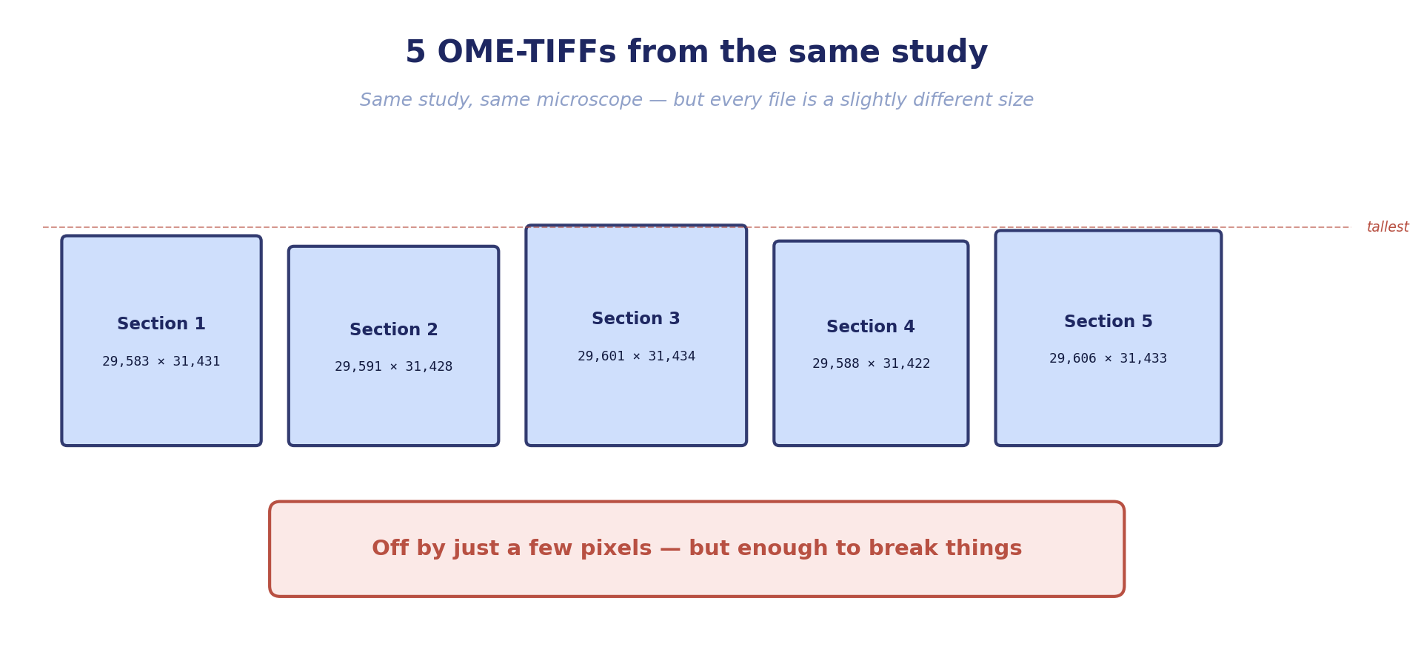
02 — Problem 1
Slightly different sizes
Think of 5 photos of the same painting, each taken with a slightly shaky camera. Same painting, slightly different photos.

Slide 4
02b — Why it matters
When does the size mismatch break things?
✓ Doesn't matter when...
✗ Does matter when...
Segmenting each image one at a time
Stacking sections into a 3D model
Counting cells in each section
Comparing pixel-by-pixel across slices
Measuring intensity per cell
Batch-loading them as one tensor
Making per-image reports
Anywhere np.stack() is called
Each image is processed independently —
the sizes never have to agree.
These all require all the images to share
exactly the same dimensions.
Good news: most of what we want to do is on the left.

Slide 5
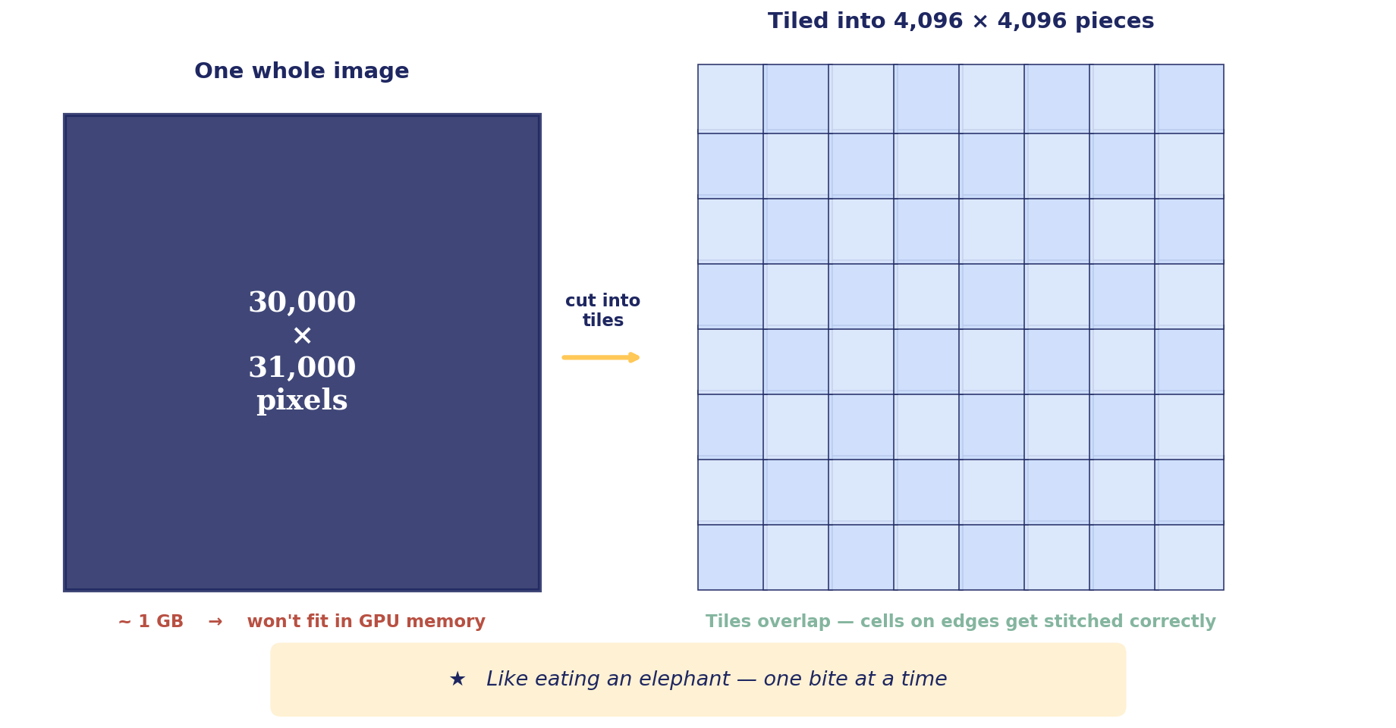
03 — Problem 2
The images are too big for the computer
1 image = 30,000 × 31,000 pixels × 2 bytes per pixel = ~ 1 GB
Loaded whole, processed by the GPU, with intermediate calculations… it balloons to ~11 GB. Most GPUs can't hold that.

Slide 6
04 — The fix
Three steps — like eating an elephant
1
2
3
Look first
Cut & process
Pad (if needed)
Show me what's in each file:
sizes, channels, names.
Break each image into small tiles.
Segment each tile. Stitch back.
Add black borders so all images
match the biggest one.
inspect
segment
pad
All three live in one script: scripts/large_image_segment.py

Slide 7
Step 1
Look first → inspect
The command
Example output
python large_image_segment.py inspect ome_tiffs/
section_1.ome.tif
shape: (5, 29583, 31431)
channels: 5
What it does
names: DAPI, CD3, CD8, CD20, CD68
Reads the headers of every file in the folder. Tells you: how big is each one, how many channels (DAPI, CD3, CD8, etc.), what each channel is called, and — most importantly — whether the sizes match.
section_2.ome.tif
shape: (5, 29591, 31428)
channels: 5
...
Why first?
So you don't run a 3-hour job on the wrong channel.
WARNING: 5 different shapes
-> run `pad` after segmenting

Slide 8
Step 2
Cut & process → segment
We never load the whole image at once. Instead: cut it into 4,096-pixel tiles, segment each tile, then stitch the masks back together.
Memory-mapped
Overlapping tiles
Native resolution
Pages from disk on demand
Cells on edges stitch back
Nothing is downsampled

Slide 9
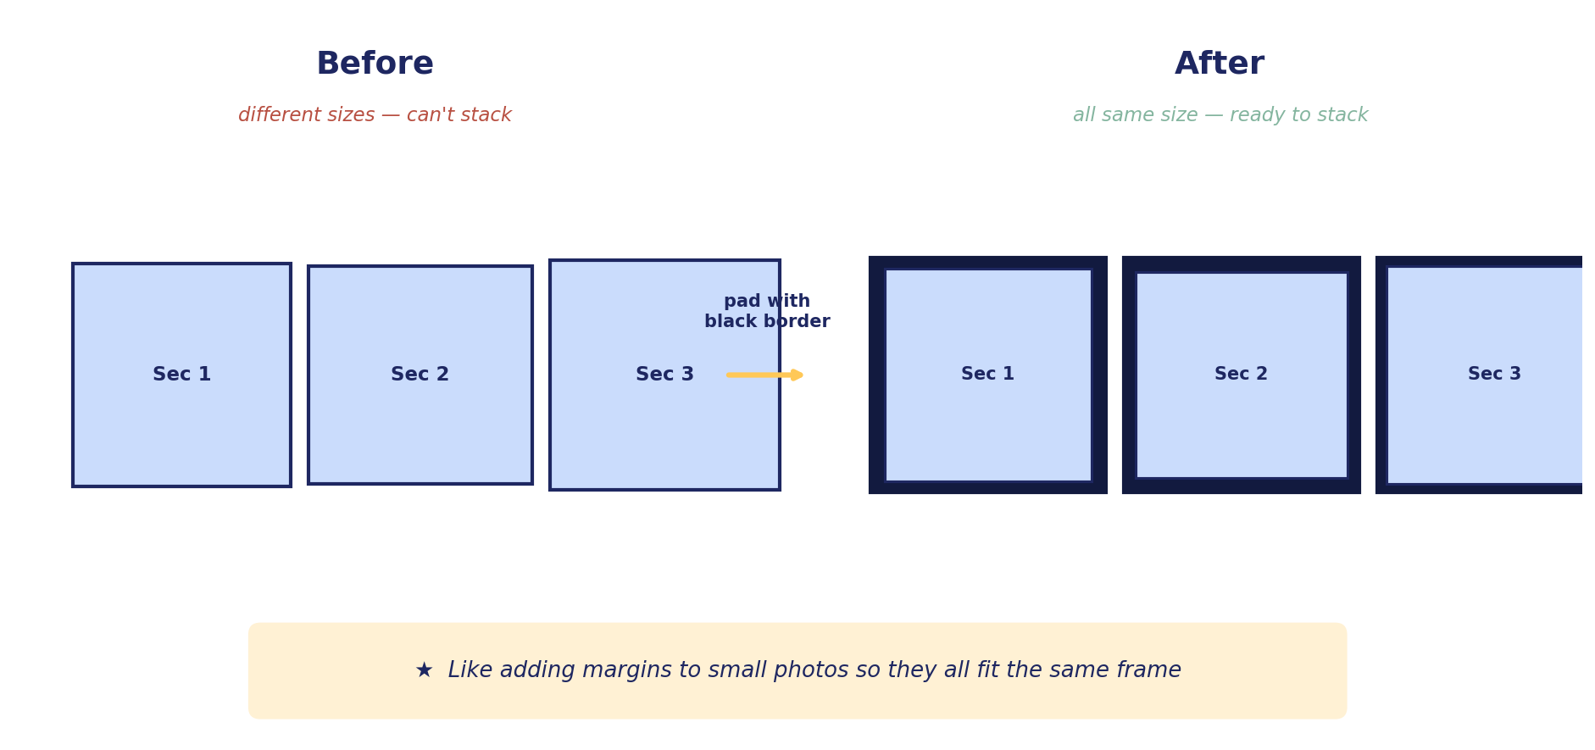
Step 3
Pad if needed → pad
Only do this if you want to stack the slices for a 3D model. Adds a black border around the smaller images so they all match.
One caveat: padding makes the sizes match — it does NOT actually align the tissue across slices. For real 3D reconstruction we'd use pystackreg or VALIS.

Slide 10
THE TAKEAWAY
In one paragraph
Ryan's 5 OME-TIFFs are huge (~30,000 × 31,000 pixels each) and slightly different sizes. The size difference doesn't matter for per-image segmentation — but the size is too big for the GPU to handle whole. I added a script that cuts each image into tiles, segments them, and stitches the results back. If we later need to stack the sections into 3D, a second tool pads them to the same dimensions.
WHAT'S CHANGED
WHAT'S NEXT
Same model. Same defaults.
Different I/O strategy.
Run inspect on Ryan's folder,
confirm the DAPI channel,
launch overnight batch.
github.com/Nafiseh17086/cellpose-sam-automation

