Slide 1

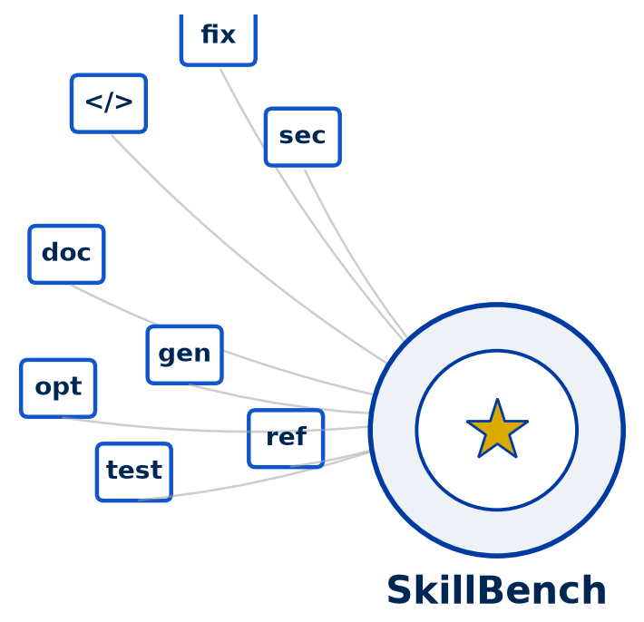
RESEARCH PROPOSAL · SOFTWARE ENGINEERING
AIGovernanceBench
Benchmarking and recommending AI coding skills across codebase complexity, time, and cost
Study 1 · AIGovernanceBench Study 2 · The Ambiguity Tax
Nafiz Imtiaz Khan | Department of Computer Science, UC Davis

Slide 2
PART I
AIGovernanceBench
Benchmarking and recommending AI coding skills across complexity, time, and cost

Slide 3

Motivation: The Skill Explosion
AN OPEN STANDARD
Coding agents now plug in on-demand “skills” — Claude Agent Skills opened this as a public, cross-platform standard
EXPLOSIVE GROWTH
Hundreds of skills already exist, with more shipping every week
NO DATA TO CHOOSE ON
Picking one is a blind guess: no evidence on what performs best, for which repo, at what cost

Slide 4
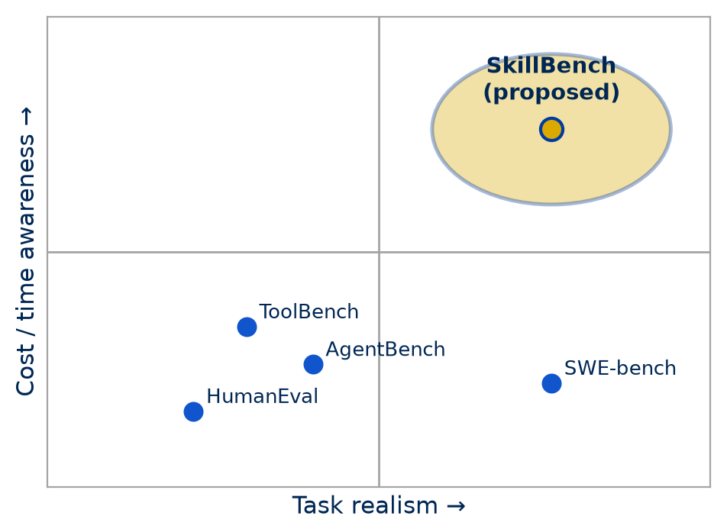
The Gap: No “SWE-bench” for Skills
WRONG UNIT OF EVALUATION
SWE-bench / SWE-bench Pro benchmark whole agents on issue resolution — not individual skills
CATALOGS DO NOT SCALE
Tool-selection accuracy collapses as catalogs grow — 50K+ tokens of tool definitions before a task even starts
COST GOES UNMEASURED
Token cost varies up to 30× on the identical task — and more cost ≠ more accuracy

Slide 5
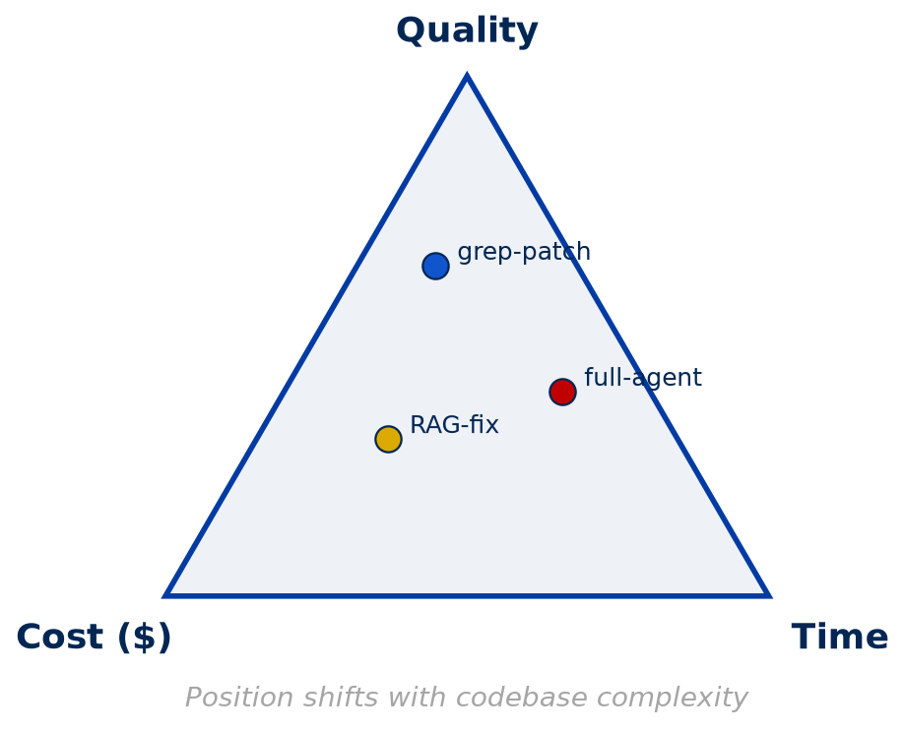
Core Idea: Every Skill Trades Quality, Time, Cost
NO SKILL DOMINATES
The right pick depends on codebase complexity
GREP-AND-PATCH
Cheap and fast — fails on deep refactors
FULL AUTONOMOUS AGENT
Higher quality — 10–100× the tokens
SKILLBENCH MEASURES IT
the tradeoff directly, per skill and per complexity tier

Slide 6
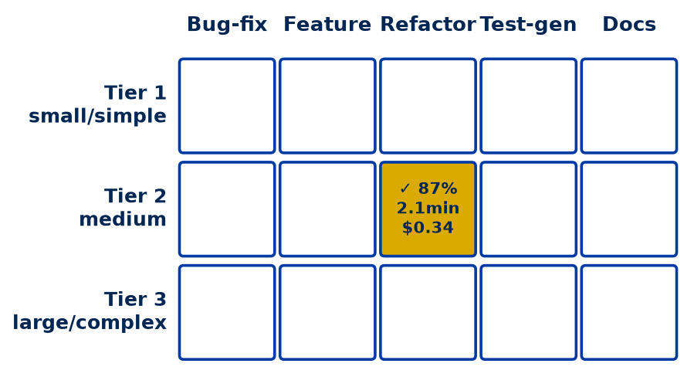
AIGovernanceBench: A Task Matrix, Not a Leaderboard
Three axes — codebase complexity tier × task type × skill. Every run logs success, wall-clock time, $ cost, and token count.
Bug-fix
Feature
Refactor
Test-gen
Docs
Tier 1
small / simple
Tier 2
medium
✓ 87%
2.1 min · $0.34
Tier 3
large / complex
Every cell is a measured run for one skill, task type and complexity tier, logging success, wall-clock time, $ cost and token count. No single row wins outright.

Slide 7
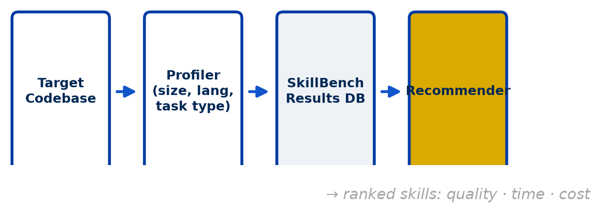
From Benchmark to Recommendation
Profile the target codebase, match it against AIGovernanceBench results, and return ranked skills — not just a single winner.
TARGET
CODEBASE
the repo you
want to improve
PROFILER
size · language
task type
SKILLBENCH
RESULTS DB
quality · time · $
per complexity tier
RECOMMENDER
matches profile
to results
RANKED SKILLS
quality · time · cost
not a single winner
The benchmark feeds the recommender. What a user gets back is a ranked list for their own codebase.

Slide 8
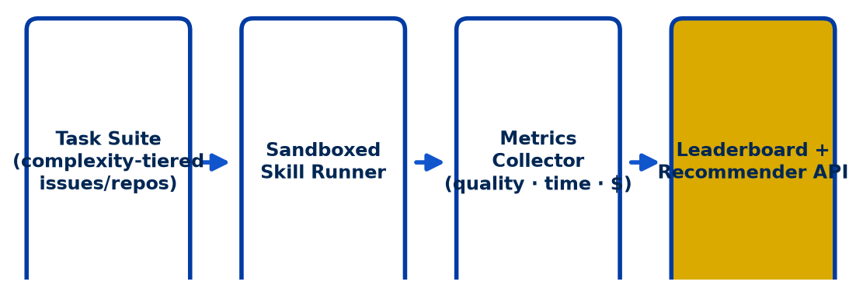
System Architecture
Each (skill, task) pair runs in an isolated sandbox; a metrics collector logs quality, time, and $ cost into the leaderboard and recommender API.
TASK SUITE
complexity-tiered
issues and repos
SANDBOXED
SKILL RUNNER
one isolated run per
(skill, task) pair
METRICS
COLLECTOR
quality · time · $
logged per run
LEADERBOARD +
RECOMMENDER API
public results,
queryable
Every run is isolated, so cost and quality can be attributed to that skill alone. Study 2 reuses the same instrumentation.

Slide 9
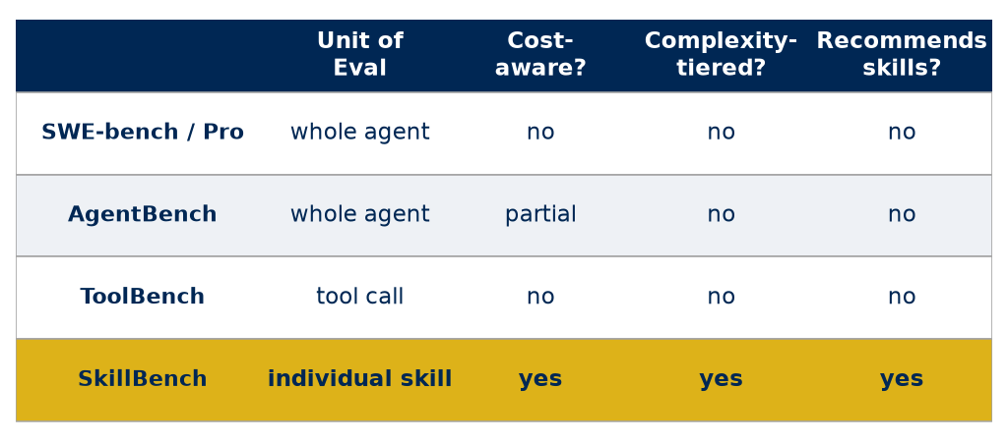
How AIGovernanceBench Differs
Existing agent benchmarks score whole systems once — none isolate the skill, tier by complexity, or recommend.
Unit of
evaluation
Cost-
aware?
Complexity-
tiered?
Recommends
skills?
SWE-bench / Pro
whole agent
no
no
no
AgentBench
whole agent
partial
no
no
ToolBench
tool call
no
no
no
AIGovernanceBench
individual skill
yes
yes
yes
AIGovernanceBench is the only one that evaluates the skill itself, and the only one that turns its results into a recommendation.

Slide 10
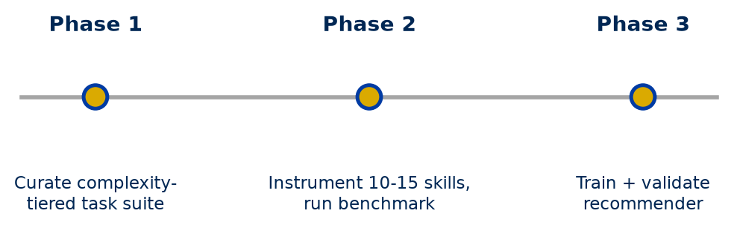
Study 1 · Roadmap
PHASE 1
Curate complexity-tiered task suite
issues and repos
across 3 tiers
PHASE 2
Instrument 10–15 skills, run benchmark
isolated sandbox runs
quality · time · $ logged
PHASE 3
Train and validate the recommender
profile → ranked skills
held-out validation
Exit criterion: a public leaderboard, plus a recommender that beats a “most popular skill” baseline on held-out repositories.

Slide 11
Two Studies, One Question
Both ask what a natural-language instruction costs to execute. One varies the skill, the other varies its clarity.
STUDY 1 · SKILLBENCH
Varies: which skill is installed
Measures: quality · time · $ per task
Unit: the SKILL
Answers: which skill should I install?
STUDY 2 · THE AMBIGUITY TAX
Varies: how clear the instruction is
Measures: tokens · latency · $ per success
Unit: the INSTRUCTION
Answers: what does vagueness cost me?
SHARED SUBSTRATE
Run on verifiable tasks → log tokens, wall-clock time and cost per run → score against executable ground truth
Agent skills are instructions too. A skill written ambiguously pays exactly the cost Study 2 measures, which makes the ambiguity tax a skill-quality metric.

Slide 12
PART II
Problem Statement & Literature Review
Ambiguity, inference cost, and verifiable tasks: five anchor papers

Slide 13
Problem Statement
Real instructions are often ambiguous, and the model has to answer anyway. We only count part of what that costs.
A REAL REQUIREMENT
“Return items
filtered by
the threshold”
THE MODEL CANNOT ASK
Forced determinism: it must
collapse many readings into
one executable answer
items > threshold
THE AGENT PICKS ONE
Nothing in the output
says which reading
it chose.
items ≤ threshold
THE THREE CONSEQUENCES
WRONG CODE
Pass@1 collapses — up to −67 points
DIVERGENT CODE
the same prompt yields incompatible programs
WASTED COMPUTE
extra tokens and latency, paid even when it succeeds
MEASURED by prior work
MEASURED by prior work
NEVER MEASURED
Prior work has established that ambiguity makes models wrong. It has not asked what ambiguity costs. If that cost is paid even on successful runs, accuracy-based benchmarks understate the harm.

Slide 14
The Landscape: Three Literatures That Never Meet
Each of these fields covers part of the hypothesis. None covers all of it.
A · AMBIGUITY → CORRECTNESS
Injects ambiguity into verifiable tasks,
reports pass rates only
B · LENGTH → CORRECTNESS
Studies reasoning length and overthinking,
varies difficulty, not clarity
C · INFERENCE ECONOMICS
Prices cost per correct answer,
treats the prompt as fixed
Orchid · When Prompts Go Wrong · HumanEvalComm
Su et al. (2025)
Cost-of-Pass (ICLR 2026)
THE INTERSECTION: NOBODY WORKS HERE
Ambiguity controlled + verifiable tasks + token, latency and cost measured
Five papers meet all three criteria used here: executable ground truth, a controlled clear-vs-unclear contrast, and public data or code.

Slide 15
Orchid: The First Benchmark Built Around Ambiguity
Yang et al. · East China Normal University · arXiv:2604.21505 (Apr 2026)
SOURCE
HumanEval+
BigCodeBench
THREE-AGENT PIPELINE (DeepSeek-V3)
HUMAN
CURATION
246 person-hrs
ORCHID
Apache-2.0
Injection
writes the
ambiguity
Judge
checks plausibility
& intent
Explain
documents each
reading
1 clear requirement
+ unit tests
LEXICAL
one word, two senses
SYNTACTIC
unclear reference
SEMANTIC
phrase reads two ways
VAGUENESS
detail omitted
1,304
tasks
5,216
ambiguous variants
4
ambiguity types
6
LLMs evaluated
5
samples per task
Metrics: Pass@k, Conflict Rate (functional divergence across samples), and Ambiguity Recognition on four levels: unaware → detection → localization → tackling.
huggingface.co/datasets/SII-YDD/Orchid · Orchid-HEval 164 · Orchid-BCB 164 · Orchid-BCB-Expand 976

Slide 16
Orchid: What It Found, and What It Left Out
Six models · temperature 0.8 · max length 1,024 tokens
−7.22 pp
mean Pass@1 drop
−31.10 pp
worst-case drop
14% → 28%
GPT-4 conflict rate
≈50%
recognition precision
<23%
can localize it
WHAT ORCHID RECORDS
✓ Pass@k on real unit tests
✓ Functional divergence across samples
✓ Whether the model notices the ambiguity
✓ Requirement token length & perplexity
WHAT IT NEVER RECORDS
✗ Output / completion tokens
✗ Wall-clock latency
✗ Cost per successful solution
✗ Any cost conditional on succeeding
USEFUL FOR OUR DESIGN: ambiguous requirements are SHORTER (−0.6% to −2.6% input tokens) but carry more uncertainty (+4.5% to +17.8% perplexity)
So if output length goes up, a longer prompt cannot be the explanation.
Doing well on clear requirements does not predict stability under ambiguity: GPT-4 loses 28+ points on Orchid-BCB, Qwen2.5-Coder about 8.

Slide 17
When Prompts Go Wrong: Defective Task Descriptions
Larbi et al. · University of Luxembourg & UCL · arXiv:2507.20439 (Jul 2025)
AMBIGUOUS
replace precise terms with general ones
HumanEval
+ MBPP
164 + 974 tasks
GPT-4
MUTATION
guided by explicit
mutation rules
EXPERT
VALIDATION
5 researchers
DEFECT
DATASET
CONTRADICTORY
add a conflicting constraint
INCOMPLETE
omit a parameter or edge case
85%
rated natural by reviewers
93%
contain a valid defect instance
4 models
at 6–7B and 32–34B scale
512
max sequence length (tokens)
METRICS
MCC (can the model tell clear from unclear?) · Pass@1 · Successful Execution Rate · Runnable but Incorrect Rate
Items that failed validation were repaired by hand, so each one is a realistic instance of its defect class.

Slide 18
When Prompts Go Wrong: Code That Runs and Is Wrong
GPT-4 on HumanEval, by task-description condition
PASS@1 · correctness collapses
Original
73.8
SER
95 – 98%
unchanged
across all
conditions
Incomplete
45.1
Ambiguous
34.8
Contradictory
6.7
RUNNABLE BUT INCORRECT · the code still runs
Original
24.4
MCC
−0.1 to 0.55
models cannot
tell clear from
unclear
Incomplete
53.7
Ambiguous
64.6
Contradictory
89.0
Models do not refuse these prompts. They return code that runs and gives the wrong answer: execution stays near-perfect while correctness collapses. Larger models help only slightly. No token, latency or cost figure is reported.

Slide 19
HumanEvalComm: Do Models Ask Before They Answer?
Wu & Fard · University of British Columbia · ACM TOSEM 2025 · arXiv:2406.00215
ASKS A CLARIFYING QUESTION
fewer than 40% of responses
OUTCOME
Pass@1 −35% to −52%
Test Pass Rate −17% to −35%
Incompleteness draws the most
questions, and still the worst code
762 modified
problems
ambiguity · inconsistency
incompleteness + combos
CODE LLM
GENERATES CODE ANYWAY
over 60% of responses
INTERVENTION: “Okanagan”, a multi-round clarification agent
Communication Rate +58 pts · Good Question Rate +38 pts → Pass@1 +8 pts · Test Pass Rate +7 pts
A large change in behaviour buys a modest accuracy gain. The extra turns and tokens are never priced, so whether clarification pays for itself is still open.

Slide 20
Underthinking vs Overthinking: The Confound
Su, Healey, Nakov & Cardie · Cornell, Adobe Research, MBZUAI · arXiv:2505.00127
Accuracy is NON-MONOTONIC in reasoning length
INCORRECT ANSWERS ARE LONGER
MATH: >6,000 tokens vs <3,000
PEAK
rising
falling
MODELS MISJUDGE DIFFICULTY
overthink easy · underthink hard
lower
lowest
very short responses
short
optimal length
long
excessively long
reasoning length →
This is the main rival explanation for any token increase we find. Length already tracks difficulty and impending failure, so the design has to hold the task constant and condition on success. Otherwise we would just rediscover this result.

Slide 21
Cost-of-Pass: The Metric We Adopt, and Invert
Erol, El, Suzgun, Yüksekgönül & Zou · Stanford University · ICLR 2026 · arXiv:2504.13359
C(p) expected cost of one attempt
v(m, p)
expected spend per
CORRECT solution
THEY VARY: model · task
the prompt is held FIXED
=
R(p) probability of a correct answer
WE INVERT IT. Ambiguity Tax: AT(m, p) = v(m, p ambiguous) / v(m, p clear)
hold the model and the task fixed · vary only the clarity of the requirement
Their findings: lightweight models win basic quantitative tasks and reasoning models win complex ones. Frontier cost has roughly halved every few months. Self-refinement and majority voting rarely justify their spend. Code at github.com/mhamzaerol/Cost-of-Pass.

Slide 22
Synthesis: What Is Measured, and What Is Not
Rows are the five anchor papers. Columns are the quantities the hypothesis needs.
Clarity
controlled
Verifiable
tasks
Correctness
Output
tokens
Latency
Cost per
success
Orchid (2026)
✓
✓
✓
✗
✗
✗
When Prompts Go Wrong (2025)
✓
✓
✓
✗
✗
✗
HumanEvalComm (TOSEM 2025)
✓
✓
✓
✗
✗
✗
Su et al., Under/Overthinking (2025)
✗
✓
✓
✓
✗
✗
Cost-of-Pass (ICLR 2026)
✗
✓
✓
✓
✓
✓
THIS STUDY
✓
✓
✓
✓
✓
✓
Ambiguity research stops at correctness, and efficiency research never varies clarity. The cost of ambiguity has not been measured.

Slide 23
PART III
Concrete Research Plan
Pricing ambiguity: the inference tax paid even when the model succeeds

Slide 24
Reframing the Hypothesis
AS ORIGINALLY STATED
“LLMs perform badly when instructions
are ambiguous — more tokens, more time,
sometimes outright failure.”
The failure half is already settled across
2,000+ verifiable tasks and a dozen models.
AS REVISED
Ambiguity imposes a measurable inference
tax, extra output tokens and latency,
paid even on the runs the model gets RIGHT,
and therefore invisible to every
accuracy-based benchmark in the field.
AT(m, p) = v(m, p ambiguous) / v(m, p clear)
the Ambiguity Tax, where v is cost-of-pass (Erol et al., ICLR 2026)
AT > 1
ambiguity costs extra even on success; the hypothesis holds
AT ≈ 1
ambiguity is free when the model succeeds, a useful negative result
Falsifiable in both directions. A null result would contradict the overthinking literature.

Slide 25
The Proposed Research Plan
Four research questions, each with a falsifiable hypothesis and a decisive measurement.
DECISIVE MEASUREMENT
RQ1
Does ambiguity cost more even when the model SUCCEEDS?
H1 · AT > 1: output tokens and latency rise on passing runs
Δ tokens | success
RQ2
Which TYPE of ambiguity is most expensive?
H2 · vagueness and semantic cost more than lexical and syntactic
AT per type
RQ3
Does REASONING MODE amplify or absorb the tax?
H3 · reasoning models pay more, because they deliberate over the ambiguity
AT × reasoning on/off
RQ4
Does the effect REPLICATE across construction methods and models?
H4 · direction stable, magnitude varies by model family
Orchid vs HumanEvalComm
One instrumented sweep answers all four, because the same runs produce correctness, tokens, latency and cost. No question needs its own experiment.

Slide 26
What Makes This Novel
N1
CROSSES TWO LITERATURES
Ambiguity benchmarks report pass rates only, and efficiency work never varies clarity. The gap in the table is a real one, not one drawn to fit.
N2
MEASURES ONLY THE RUNS THAT SUCCEED
Prior work mixes the cost of ambiguity with the cost of failing. Looking only at runs that pass all unit tests separates the two.
N3
THE INPUT-LENGTH CONFOUND IS ALREADY RULED OUT
Orchid's own data: ambiguous prompts are 0.6–2.6% shorter with 4.5–17.8% higher perplexity. That is a control we did not have to build.
N4
PRICES EACH AMBIGUITY TYPE
Lexical, syntactic, semantic and vagueness are costed separately, so the result says which kind to fix rather than giving one aggregate number.
N5
EXACT TOKEN ACCOUNTING
Local open-weight models report true token counts and generation time per call, so the numbers do not depend on provider billing.

Slide 27
Methodology
One task, five phrasings, identical tests. Only the clarity changes.
STIMULI
Orchid: 1 clear +
4 typed variants
per task
MODELS
qwen3:14b, llama3:8b
via Ollama
+ 1–2 frontier API
HARNESS
k ≥ 5 samples
sandboxed unit-test
execution
PER-CALL LOG
prompt tokens
output tokens
duration · pass/fail
ANALYSIS
mixed-effects
regression
(1|task) + (1|model)
PRIMARY OUTCOMES
Δ output tokens | success
Δ latency | success
Ambiguity Tax (cost-of-pass ratio)
SECONDARY / REPLICATION
Pass@1, as a replication check on prior work
Conflict rate across samples
HumanEvalComm as an independent set
log(output_tokens) ~ ambiguity_type × reasoning_mode + input_tokens + difficulty + (1 | task) + (1 | model)
same specification for latency; logistic form for correctness
1,304 Orchid tasks × 5 conditions are available. The 164-task Orchid-HEval subset carries the pilot.

Slide 28
Controlling the Confounds
Each rival explanation is ruled out by a design choice.
THREAT
CONTROL
Longer prompts cause longer outputs
Orchid's ambiguous prompts are shorter, and input tokens also enter as a covariate
Difficulty, not ambiguity, drives length
Paired within-task design: the underlying problem is identical
Cost rises only because the model is failing
Condition on runs passing all unit tests; failures analysed separately
Clarification turns inflate tokens by definition
Separate asking from silently reasoning longer, and report both
Ambiguity is an artefact of one construction method
Replicate on HumanEvalComm, which was built by hand rather than by LLM injection

Slide 29
Phases and Deliverables
0 · INSTRUMENT
1 · PILOT
2 · FULL SWEEP
3 · REPLICATION
4 · ANALYSIS
week 1
Ollama harness:
tokens, duration,
test outcome
weeks 2–3
Orchid-HEval
164 × 5 × 2 models
k = 5
weeks 4–7
all 1,304 tasks
+ frontier models
reasoning on/off
weeks 8–9
HumanEvalComm
762 variants
same harness
weeks 10–12
mixed-effects
models; release
harness + logs
EXIT CRITERION
One task runs end to end
Ambiguity Tax with CIs
Per-type cost profile
Effect reproduces
Paper + artefact
ALREADY IN PLACE
Orchid, HumanEvalComm and HumanEval are downloaded and schema-verified. Token accounting is confirmed on local models. The five anchor papers are read.
Pre-register the hypothesis, the conditional-on-success rule, and the primary regression before Phase 2.

Slide 30
Whom It Benefits
Four groups, each with a decision that needs a price on ambiguity.
SOFTWARE TEAMS & REQUIREMENTS ENGINEERS
Attaches a number to requirement clarity.
“Vague tickets cost 1.4× per merged fix” justifies
spec-quality investment in a way a pass-rate delta
does not. The per-type profile says which
kind of vagueness to fix first.
MODEL BUILDERS & INFERENCE PROVIDERS
Isolates cost-under-uncertainty as a failure mode
distinct from overthinking on hard problems.
A model that silently burns tokens on an under-
specified prompt is wasting compute, and
today pays no benchmark penalty for it.
They decide: how much to invest in writing specs.
They decide: what to optimise and reward.
THE EVALUATION COMMUNITY
Accuracy-only benchmarks systematically understate
the harm of ambiguity, because the runs that succeed
still cost more. Argues for reporting cost alongside
correctness as standard practice.
AGENT & SKILL ECOSYSTEM (this project)
Agent skills and governance files ARE instructions.
An ambiguity tax is directly a skill-quality metric,
linking this study to the AIGovernanceBench recommender
and the AIGovernanceBench analyzer.
They decide: what a robustness benchmark must report.
They decide: which skills to install and trust.
The harness is a means to an end. What the study delivers is a cost figure for ambiguity.

Slide 31
Next Steps (Superseded by Part IV)
1
BUILD THE HARNESS
Orchid loader · sandboxed test execution · per-call logging of prompt_eval_count, eval_count and eval_duration through the Ollama API. Roughly one file.
2
RUN THE PILOT CELL
Orchid-HEval × 2 local models × 5 conditions × k=5 ≈ 8,200 calls. Enough to see whether the tax exists before committing to the full sweep.
3
DECIDE THE API BUDGET
Cost-of-pass needs published per-token prices; local models give tokens and time but not dollars.
4
PRE-REGISTER
Freeze the hypothesis, the conditional-on-success rule and the primary regression before the full run; report deviations.
Contact: Nafiz Imtiaz Khan · nikhan@ucdavis.edu

Slide 32
PART IV
What the Experiments Found
7,354 generations · two models · 164 tasks · two A100s

Slide 33
What We Ran
Four experiments. The task, signature and unit tests never change; only the wording does.
PILOT
20 tasks · 8b
2,438 runs
SKILL ARMS
4 arms · 8b
1,943 runs
CONTRADICTION
5 arms · 8b
981 runs
FULL RUN
164 tasks · 14b
3,935 runs
EVERY RUN IS GRADED BY EXECUTING THE CODE AGAINST REAL UNIT TESTS
5 wordings
clear + lexical, semantic,
syntactic, vagueness
5 samples
temperature 0.8,
per prompt
2 models
qwen3:8b and
qwen3:14b
4 outcomes
pass, tokens,
seconds, thinking share
Pairing is the whole design: the same task appears in every condition, so a cost difference cannot be blamed on one condition getting a harder problem.
WHAT CHANGED AT SCALE
THE PILOTS WERE UNDERPOWERED
The key test rested on 8-14 paired tasks,
because a task counts only if the model
solved it under BOTH wordings.
THE FULL RUN FIXED THAT
164 tasks gives 98-105 paired tasks
per comparison, roughly 8x the pilot,
and the answer changed sign.

Slide 34
Hypothesis Scorecard
Eight predictions. Two hold, one is directional, three fail, one is unresolved.
H1
Ambiguity lowers the pass rate
HOLDS
all 4 types on 14b; only 2 on 8b
H2
Ambiguity raises cost per correct answer
HOLDS
tax 1.05-1.34 on 14b, up to 1.71 on 8b
H3
It costs extra even when it succeeds
DIRECTIONAL
3 of 4 positive at n~100, none survive correction
H4
Wall-clock time tracks tokens
HOLDS
r = 0.989 over 3,935 runs
H5
The extra cost sits in the reasoning block
NOT SHOWN
reasoning is 95-97% regardless of wording
H6
Bigger rewrites cost more
UNRESOLVED
right direction at scale, but test is between-task
H7
A wrong skill hurts more than a right one helps
FAILS
neutral filler hurt MORE than the wrong skill
H8
Wrong skills hurt most when the task is unclear
FAILS
no interaction; ambiguity swamps the arms
The accuracy and cost story is solid. The claim that would have made this novel is still unproven, and the skill hypothesis is dead.

Slide 35
Result 1: Every Kind of Ambiguity Costs Money
164 tasks, qwen3:14b, 3,935 runs, no skills loaded.
SHARE OF ATTEMPTS THAT PASS ALL UNIT TESTS
TAX
clear wording
72%
1.00
baseline
Syntactic
68%
1.05
-4 points
Semantic
64%
1.18
-8 points
Lexical
61%
1.30
-10 points
Vagueness
56%
1.34
-16 points
COST PER CORRECT ANSWER
tokens per attempt ÷ share that work
Vagueness: 1.34x the bill for the same function.
THE PROMPTS ARE NOT LONGER
Ambiguous prompts average 100-105 input tokens;
clear ones 105. Length cannot explain the cost.
Published work reports a ~7-point average drop. Splitting by type shows why that understates it: the damage runs from 4 to 16 points.

Slide 36
Result 2: Which Ambiguity Hurts Depends on the Model
The same 5 wordings, two models. The damage profile moves.
qwen3:8b (485 runs, 20 tasks)
qwen3:14b (3,935 runs, 164 tasks)
clear
0.63
0.72
Syntactic
0.62
0.68
Semantic
0.48
0.64
Lexical
0.58
0.61
Vagueness
0.34
0.56
ON 8b: ONE VILLAIN
Vagueness costs 28 points. Lexical and
Syntactic are harmless. Tax 1.71 vs ~1.0.
ON 14b: EVERY TYPE BITES
Higher baseline (0.72 vs 0.63), yet Lexical
goes from harmless to a 1.30 tax.
A stronger model is better at the task and MORE sensitive to a single ambiguous word. Type profiles do not transfer across models.

Slide 37
Result 3: The Novel Claim, Now Properly Powered
Do successful runs still cost more? Only tasks solved under BOTH wordings count.
THE PILOTS
8-14 paired tasks · all deltas NEGATIVE
THE FULL RUN
98-105 paired tasks · 3 of 4 POSITIVE
EXTRA TOKENS ON THE AMBIGUOUS VERSION, SUCCESSFUL RUNS ONLY
wording
median delta
n tasks
raw p
after correction
Lexical
+48
102
0.048
0.192
Vagueness
+42
98
0.079
0.237
Semantic
+24
105
0.172
0.344
Syntactic
-1
105
0.675
0.675
THE SIGN IS NOW STABLE
Pilots said cheaper. At 8x the sample, dearer.
BUT THE EFFECT IS SMALL
+48 tokens on ~1,700 is under 3%.
Honest verdict: directionally consistent, too small to establish here. Proving it needs 4-8x more paired tasks.

Slide 38
Result 4: You Are Paying for Thinking, Not for Answers
Holds in every condition, on both models. The most robust number in the study.
REASONING
8,325 characters
ONE TYPICAL RESPONSE, DRAWN TO SCALE — the gold sliver is the answer (454 chars)
REASONING SHARE BY WORDING — FLAT ACROSS THE BOARD
94.8%
clear
95.8%
Lexical
95.3%
Semantic
95.3%
Syntactic
95.4%
Vagueness
SO H5 IS NOT SHOWN
Ambiguity does not shift
the reasoning balance.
BOTH MODELS AGREE
8b: 97%. 14b: 95%.
Not a quirk of one model.
TOKENS = TIME
r = 0.989 between tokens
and seconds (H4).
95% of every bill is reasoning the user never sees. One run reached 16,313 output tokens for a single short function.

Slide 39
Result 5: Loaded Skills — Neutral Filler Did the Most Damage
We tried irrelevant skills, then skills that directly contradict the task. Neither behaved as predicted.
PASS RATE vs NO SKILL LOADED, CLEAR WORDING (paired across 20 tasks)
no skill
baseline
—
neutral filler
-0.210
p = 0.006
halt-and-ask skill
-0.195
p = 0.011
planning skill
-0.085
p = 0.241
coding skill
-0.030
p = 0.499
PREDICTED
wrong skill breaks the task,
model stops and asks
OBSERVED
0 of 489 runs ever asked,
even when told to wait
THE REAL PATTERN
irrelevant prose hurts most;
coding directives hurt least
It is not misalignment and not contradiction. Any irrelevant material in the system prompt degrades the work, and only when the output format is loose enough to let it.

Slide 40
A Side Finding: The Benchmark Itself Has Bugs
Found while validating the harness, in a published, peer-reviewed dataset.
3 SWAPPED PROBLEMS
Task 24's "ambiguous" version is actually
task 25's problem. 25 holds 26's. 26 holds 24's.
They are graded against the original tests, so
they can never pass: guaranteed failures with
nothing to do with ambiguity.
27 NON-EDITS
27 "ambiguous" prompts are character-for-
character identical to the clear one.
The injection did nothing, which drags the
measured effect toward zero.
Both are excluded automatically, and the counts print at the start of every run.
Anyone benchmarking on this dataset without the exclusions is measuring dataset bugs alongside ambiguity. This is worth reporting on its own.
Detection is mechanical: does the variant still define the same function the tests call?
A first pass flagged 19 — helper functions defined before the target. Checking every def, not the first, gives exactly 3.

Slide 41
Where This Goes Next
Four of eight hypotheses failed or stalled. That changes the plan, not the project.
1
Add a non-reasoning model
95% of spend is reasoning. qwen3:30b-instruct emits 89 tokens where these emit 2,400. Under an hour to run.
2
Take H3 to a bigger task set
The sign is stable and the effect is ~3%. Orchid-BCB-Expand's 976 rows would give the power to settle it.
3
Re-test dose-response within task
The direction is finally right at scale, but the comparison is still between different tasks.
4
Publish the dataset defects
3 rotated variants and 27 no-op injections, with a detection method. Stands alone.
THE RESULT THAT IS READY TO WRITE UP
Ambiguity costs 4-16 points of pass rate and up to 1.34x the tokens per correct answer, it replicates across
two models and 6,400 runs, and which TYPE hurts depends on the model.

