Slide 1
INTEGERATED DESIGN PROJECT

Slide 2
GROUP-05
AHM ZOBYER 201714013
FARZANA FARUK JHUMU 201714023
MASRUR HASAN MAHIN 201714027
MD. ARIFUL ISLAM TAREK 201714030
NAFIZ IMTIAZ KHAN 201714043
SUMAIYA NUHA MUSTAFINA 201714059

Slide 3
PROJECT IDEAS
PUBLIC TRANSPORT SUPPORT AND MANAGEMENT SYSTEM
INTERPRETED SIGN LANGUAGE EXECUTION AND COMMUNICATION WITH THE DISABLED PERSON
DRIVER DROWSINESS DETECTION
SMART SPECTACLE FOR BLIND

Slide 4
MIST AUTOMATED STUDENT ATTENDANCE SYSTEM

Slide 5
AIM
THE VISION OF THE PROJECT IS TO MAKE AN EFFICIENT ATTENDANCE SYSTEM USING FINGERPRINT SENSOR.

Slide 6
MOTIVATION
Behind The Idea
Proxy System
Late Coming
Wasting class time
Proper Idea about ones attendance
Difficulties regarding the application submission

Slide 7
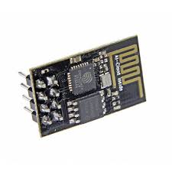
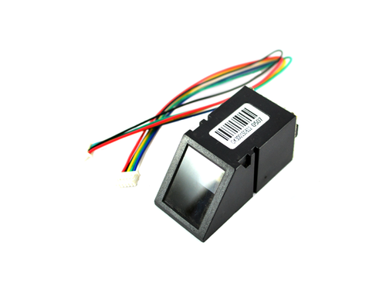
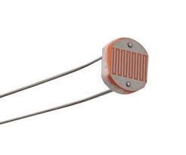
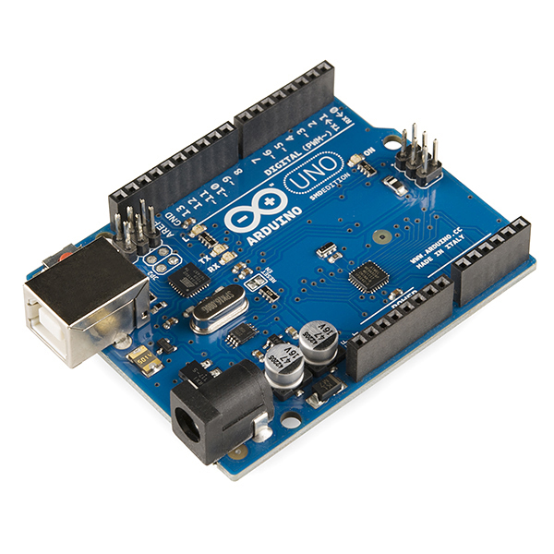
HARDWARES
Fig:fingerprint Scanner
Fig:Wi-fi Module
Fig:LDR Sensor
FigArduino Uno

Slide 8
Weekly Plan For Frontend:
Week | Work Plan
2 | Developing front end skeleton of Admin Dashboard using html
3 | Add CSS and bootstrap to the html code of Admin Dashboard,
4 | Add JavaScript to the Admin Dashboard
5 | Developing front end skeleton of Teacher Dashboard using html
6 | Add CSS and bootstrap to the html code of Teacher Dashboard
7 | Add JavaScript to the Teacher Dashboard

Slide 9
Weekly Plan For Frontend:
Week | Work Plan
8 | Developing front end skeleton of Student Dashboard using html
9 | Add CSS and bootstrap to the html code of Admin Dashboard
10 | Add JavaScript to the Admin Dashboard
11 | Integrate Firebase with Admin Dashboard
12 | Integrate Firebase with Teach er and Student Dashboard

Slide 10
Required Tools
Sublime Text
Bootstrap
JavaScript
GitHub
Firebase
Chrome Developer Tools

Slide 11

Required Tools
Sublime Text
It will be used as code editor

Slide 12

Required Tools
Bootstrap
CSS Framework
Will be used for styling

Slide 13

Required Tools
GitHub
Will be used for developing the project concurrently

Slide 14

Required Tools
Firebase
Will be used as Database

Slide 15

Required Tools
JavaScript
Will be used for calculating,
Manipulating, and validating data

Slide 16

Required Tools
Chrome Developer Tools
Will be used to show the site in browser and debugging more easily

Slide 17
QUESTION AND ANSWER SESSION

Slide 18
THANKS!

