Slide 1
INTEGERATED DESIGN PROJECT(II)

Slide 2
GROUP-05
AHM ZOBYER 201714013
FARZANA FARUK JHUMU 201714023
MASRUR HASAN MAHIN 201714027
MD. ARIFUL ISLAM TAREK 201714030
NAFIZ IMTIAZ KHAN 201714043
SUMAIYA NUHA MUSTAFINA 201714059

Slide 3
MIST AUTOMATED STUDENT ATTENDANCE SYSTEM

Slide 4
AIM
THE VISION OF THE PROJECT IS TO MAKE AN EFFICIENT ATTENDANCE SYSTEM USING FINGERPRINT SENSOR.

Slide 5
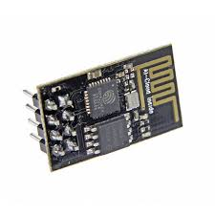
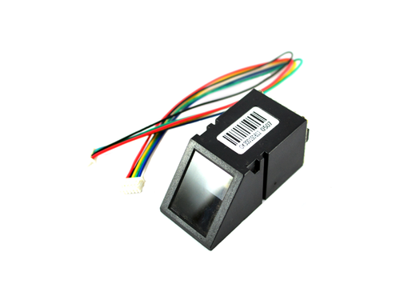
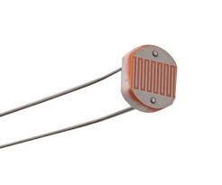
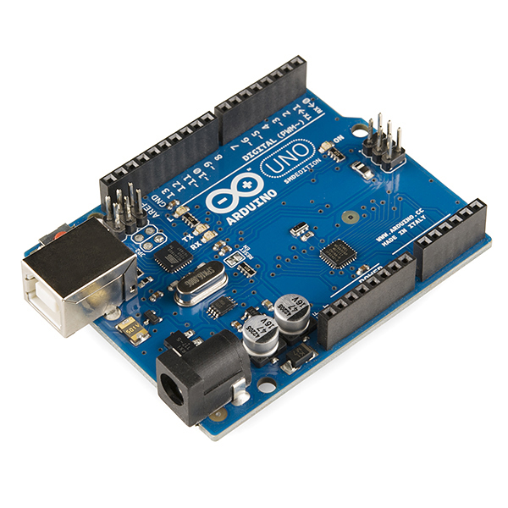
HARDWARES
Fig: Fingerprint Scanner
Fig: Wi-Fi Module
Fig: LDR Sensor
Fig: Arduino Uno

Slide 6
Week wise Plan For HW Implementation:
Project Timeline
Week | Project Target | Details
1 | N/A | Project Presentation
2 | Project Timeline Presentation | System Architecture design and finalizing what are the sensors that will be used in the project
3 | Purchasing Hardware Tools And getting started with arduino | Purchasing the hardware from the market. Interfacing Arduino and Fingerprint Sensor
4 | Implement functionalities | Using adafruit fingerprint sensor library implement the detailed functionalities. Enroll Update Delete

Slide 7
Week wise Plan For HW Implementation:
5 | Interfacing LED display | Interfacing LED display with fingerprint sensor
6 | Installment Of LDR | Interfacing LDR sensor with Arduino
7 | Positioning of Laser | LDR Sensors and Laser light positioning Testing
8 | Wi fi interface | Wi fi module interfacing with arduino
9 | Testing 1 | Integration of LDR with fingerprint sensor and send data to firebase from the sensors
10 | Front end ,Back end Connection | Connecting front end with back end and send data to website
11 | Testing 2 | Fingerprint Scanner Testing with Valid Data Set
12 | Testing 3 | Implement the fingerprint sensor in front of the classroom and take real data
13 | Final Project Submission | Final Project Simulation and present it before the panel
14 | Final modification and update | Doing the modification suggested by the panel

Slide 9
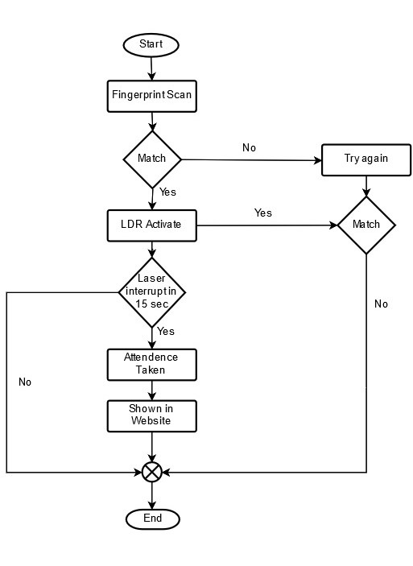
System Workflow

Slide 10
QUESTION AND ANSWER SESSION

Slide 11
THANKS!

