Slide 1
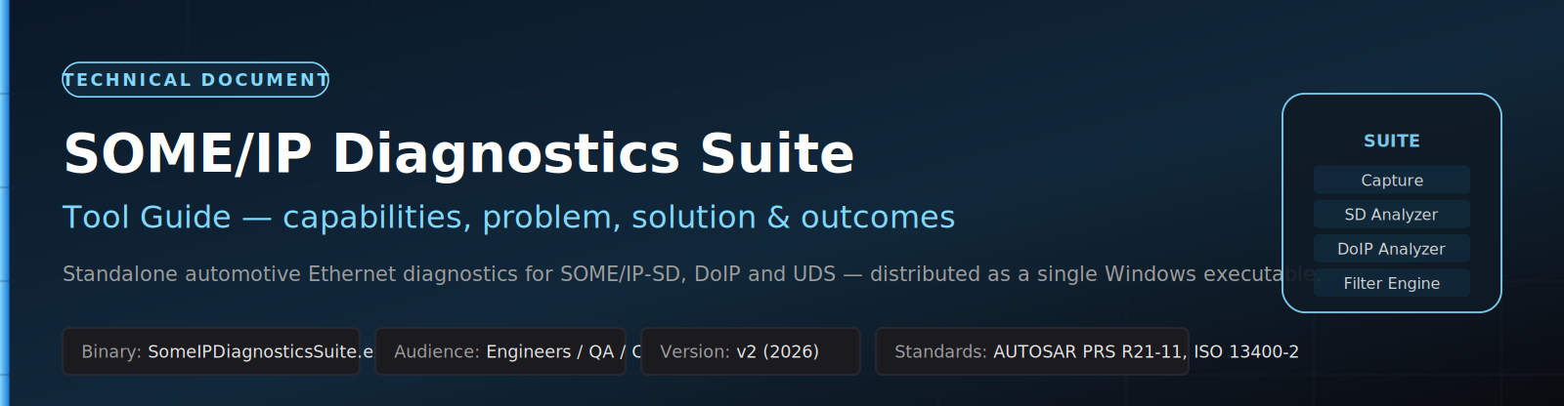
PROJECT OVERVIEW
SOME/IP
Diagnostics
Suite
Standalone in-vehicle Ethernet diagnostics
A single Windows executable that turns a packet
capture into an actionable AUTOSAR / DoIP report —
ready for engineers, QA, CI and shareable artefacts.
BINARY
VERSION
STANDARDS
SomeIPDiagnosticsSuite.exe
v2 (2026)
AUTOSAR PRS R21-11 · ISO 13400-2
Presented to: Engineering, QA & CI Stakeholders
Date: 2026

Slide 2
SOME/IP DIAGNOSTICS SUITE
Agenda
What we will cover in the next ~20 minutes
01
The Problem
06
CLI & CI
Why diagnosing SOME/IP & DoIP today is painful
From engineer's laptop to the build pipeline
02
The Solution
07
Test data & outputs
What SomeIPDiagnosticsSuite.exe delivers
Reproducible verification on every machine
03
Capabilities
08
Outcomes
Seven tabs, two CLI sub-commands
What changes for the team
04
Architecture
09
Roadmap & Q&A
End-to-end data flow
Where we go next
05
GUI walkthrough
Capture, SD Analyzer, DoIP Analyzer
SOME/IP Diagnostics Suite · Project Overview Deck · v2 (2026)
2 / 17

Slide 3
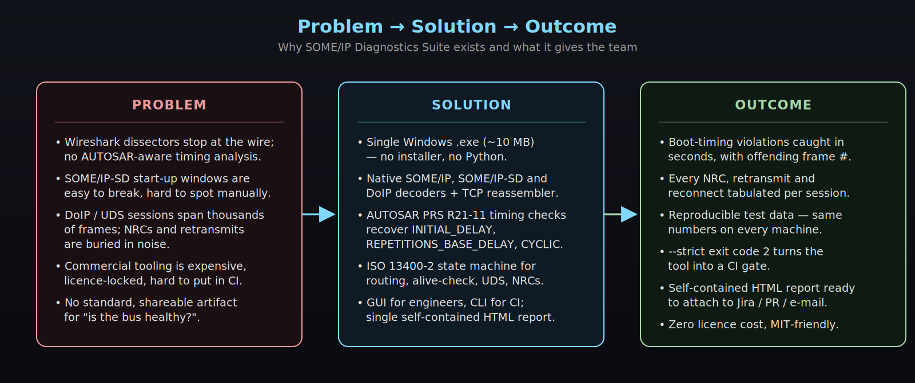
SOME/IP DIAGNOSTICS SUITE
The Problem
Diagnosing SOME/IP-SD and DoIP today is slow, manual and expensive
Pain points today
▸ Wireshark dissectors decode frames but cannot validate AUTOSAR-SD start-up timing.
▸ Subtle boot-time drift (~ hundreds of ms) silently blocks service discovery.
▸ DoIP / UDS sessions span thousands of frames — NRCs and retransmits drown in noise.
▸ Commercial benches are licence-locked and impossible to put on every laptop or CI runner.
▸ No standard, shareable artefact for “is the bus healthy?”.
SOME/IP Diagnostics Suite · Project Overview Deck · v2 (2026)
3 / 17

Slide 4
SOME/IP DIAGNOSTICS SUITE
The Solution
A single, license-free executable — GUI for engineers, CLI for CI
What it is
How it ships
▸ Single Windows executable (~12 MB) — no installer, no Python, no DLLs.
▸ Native SOME/IP, SOME/IP-SD and DoIP decoders + TCP reassembler.
▸ AUTOSAR PRS R21-11 timing audit with offending frame numbers.
▸ ISO 13400-2:2019 state-machine for routing, alive-check, UDS, NRCs.
▸ Self-contained HTML report + compact JSON summary.
▸ CI exit code 2 in --strict mode — ready to fail the build.
Double-click
SomeIPDiagnosticsSuite.exe
→ launches the GUI
Capture info
→ one-line summary
...exe info <pcap>
Full analysis
→ HTML + JSON report
...exe analyze <pcap>
CI gate
→ exit 2 on violation
...exe analyze ... --strict
SOME/IP Diagnostics Suite · Project Overview Deck · v2 (2026)
4 / 17

Slide 5
SOME/IP DIAGNOSTICS SUITE
Capabilities at a Glance
Seven GUI tabs + two CLI sub-commands cover the full workflow
Capture
SD Analyzer
DoIP Analyzer
Filter Engine
Load .pcap / live NIC; layered decode
AUTOSAR PRS R21-11 timing audit
ISO 13400-2 session reconstruction
O(1) hash-lookup rule pipeline
SD Demo
DoIP Demo
Dashboard
Deterministic SOME/IP-SD simulator
Deterministic DoIP simulator
KPIs · throughput · status
CLI sub-commands
SomeIPDiagnosticsSuite.exe info <capture> · analyze <capture> [--report HTML] [--json JSON] [--strict]
SOME/IP Diagnostics Suite · Project Overview Deck · v2 (2026)
5 / 17

Slide 6
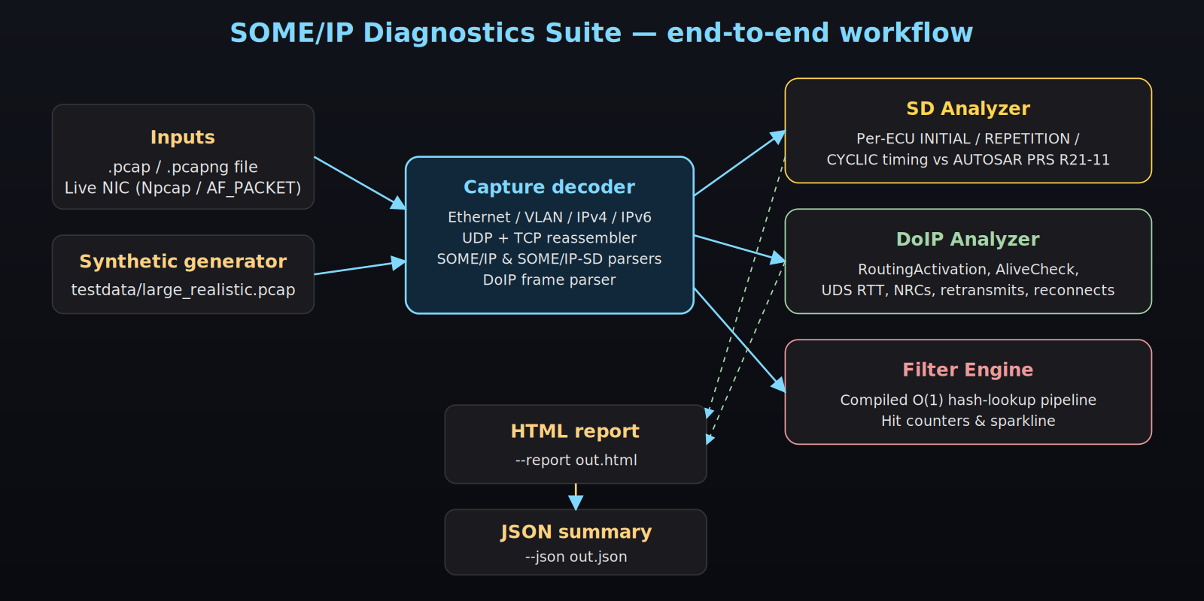
SOME/IP DIAGNOSTICS SUITE
Architecture & Data Flow
Capture → Decoder → Analysers → Report — strictly left-to-right
Decoder & analysers share immutable message objects → GUI never freezes, even on multi-million-frame captures.
SOME/IP Diagnostics Suite · Project Overview Deck · v2 (2026)
6 / 17

Slide 7
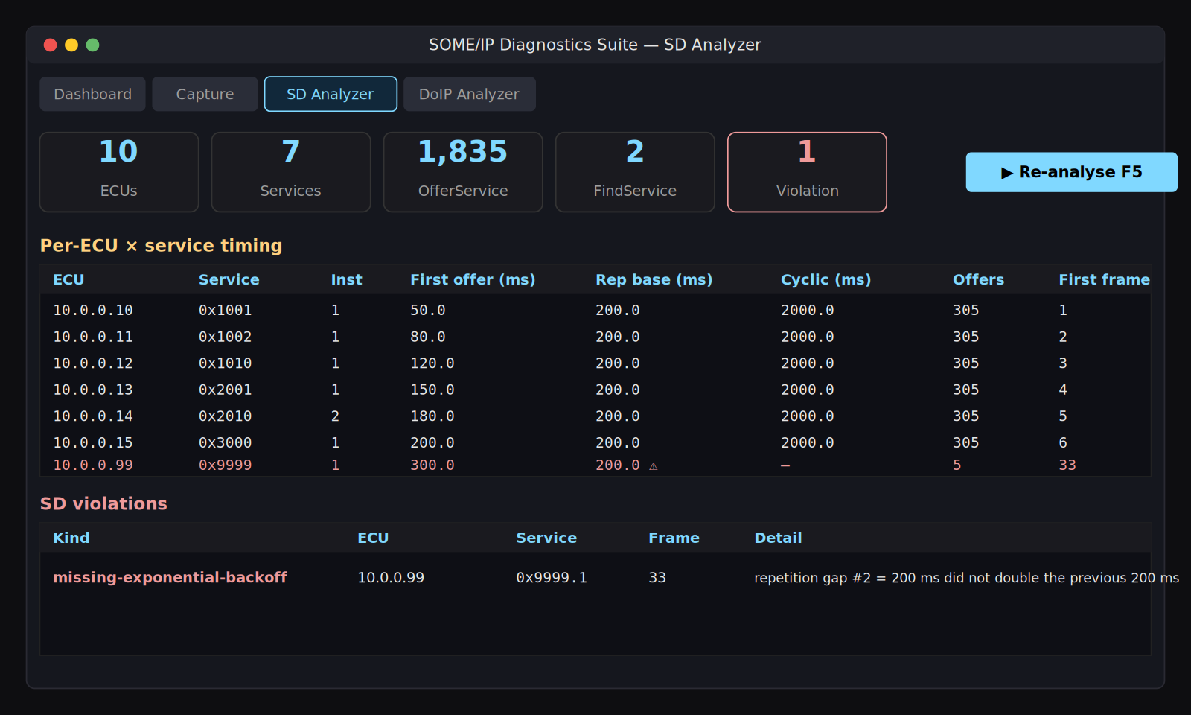
SOME/IP DIAGNOSTICS SUITE
SD Analyzer — AUTOSAR PRS R21-11 timing audit
Recovers boot-up timing from the trace and flags every violation
What it computes
▸ INITIAL_DELAY recovered from first SD packet per ECU.
▸ REPETITIONS_BASE_DELAY measured across the repetition phase.
▸ CYCLIC_OFFER_DELAY measured across sustained offers.
▸ Per-ECU × service KPI table.
Violations flagged
▸ Initial-delay outside the AUTOSAR window.
▸ Missing exponential back-off in the repetition phase.
▸ Cyclic-offer drift beyond tolerance — with exact frame index.
SOME/IP Diagnostics Suite · Project Overview Deck · v2 (2026)
7 / 17

Slide 8
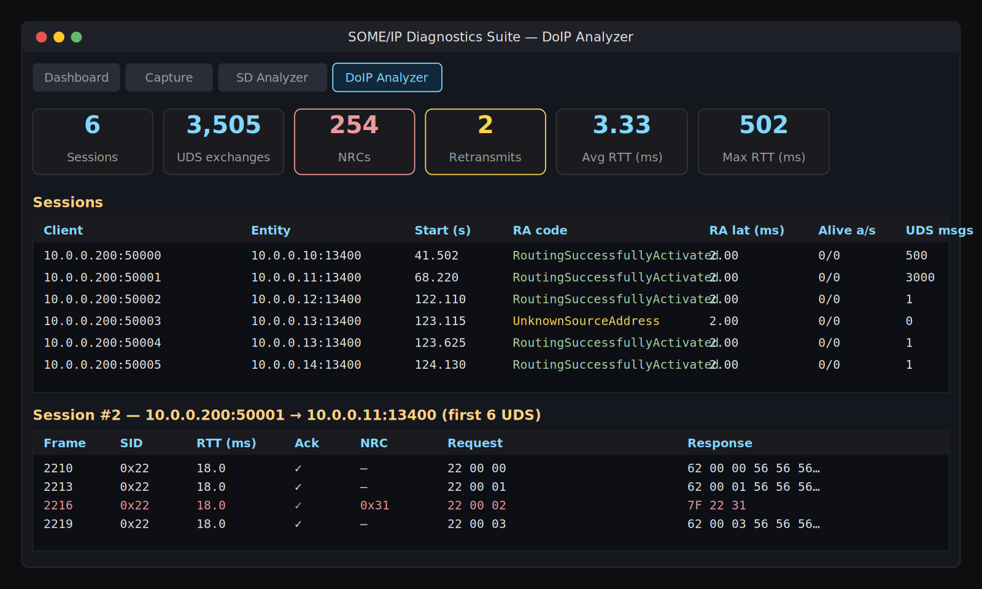
SOME/IP DIAGNOSTICS SUITE
DoIP Analyzer — ISO 13400-2:2019 session reconstruction
Walks the full state machine; surfaces NRCs, retransmits, reconnects
State machine coverage
▸ RoutingActivation outcome + latency (port 13400).
▸ AliveCheck request / response pairing.
▸ DiagnosticMessage / Ack / Positive / Negative responses.
▸ Reconnect detection on the same logical session.
Per-session metrics
▸ UDS exchange count · NRC count · retransmits.
▸ Average / max RTT per session.
▸ Colour-coded UDS table: red = NRC, yellow = retransmit.
SOME/IP Diagnostics Suite · Project Overview Deck · v2 (2026)
8 / 17

Slide 9
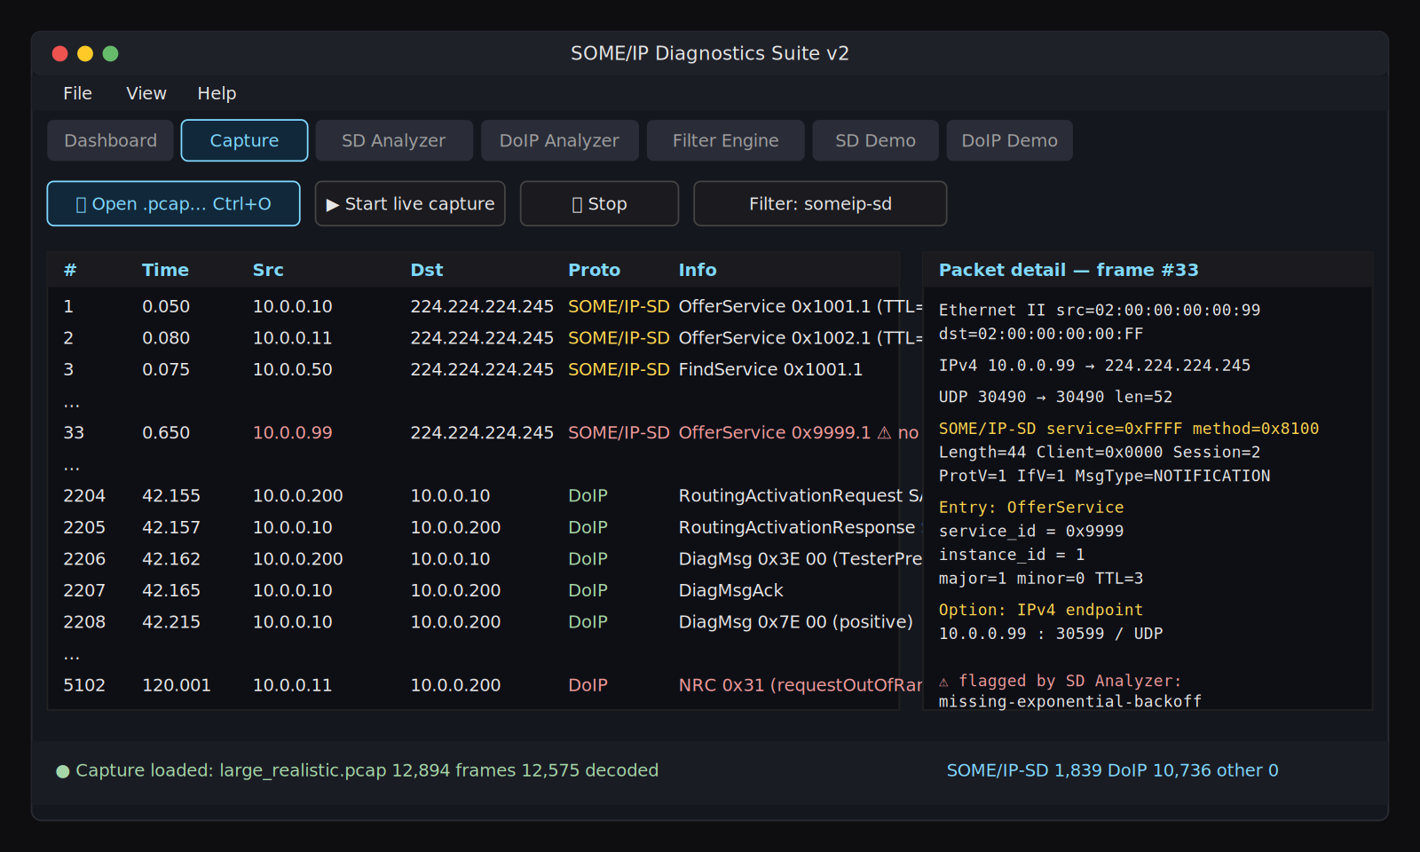
SOME/IP DIAGNOSTICS SUITE
GUI · Capture tab
Open .pcap / .pcapng, browse decoded packets, drill into layers
Key actions
▸ Ctrl + O — open a capture file.
▸ Live capture via Npcap / AF_PACKET.
▸ Click a row → layered decode + hex.
▸ Status bar shows decoded counts.
Highlighted row
The red row is the misbehaving
ECU 10.0.0.99 / service 0x9999 —
the headline finding flagged by
the SD analyser.
SOME/IP Diagnostics Suite · Project Overview Deck · v2 (2026)
9 / 17

Slide 10
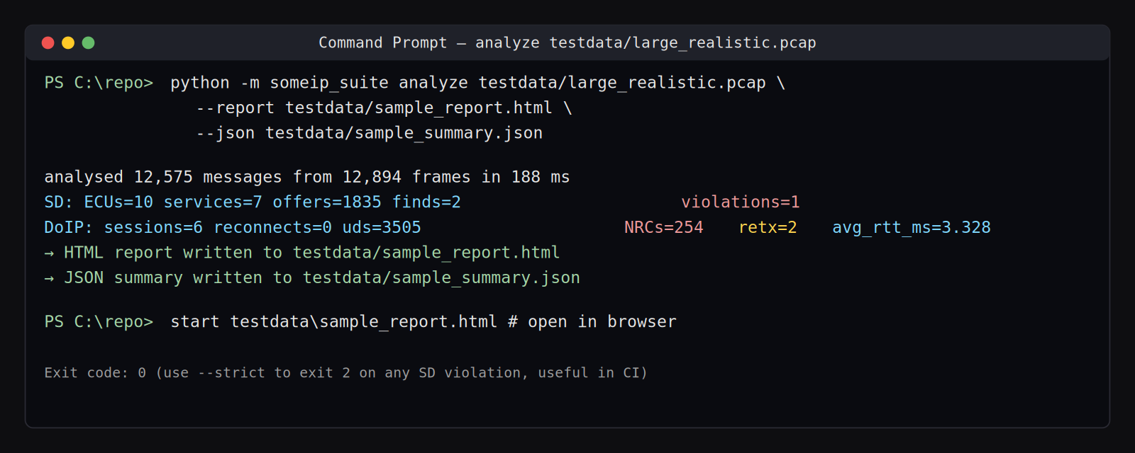
SOME/IP DIAGNOSTICS SUITE
Command-Line Interface
Same binary, scripted from terminals & CI runners
Sub-commands
SomeIPDiagnosticsSuite.exe info <capture>
SomeIPDiagnosticsSuite.exe analyze <capture> \
--report out.html \
--json out.json \
--strict
Flags
--report HTML
Self-contained HTML report (same as GUI export).
--json JSON
Machine-readable summary for CI dashboards.
--strict
Exit code 2 on any SD timing violation.
SOME/IP Diagnostics Suite · Project Overview Deck · v2 (2026)
10 / 17

Slide 11
SOME/IP DIAGNOSTICS SUITE
Bundled Test Data
Deterministic, realistically large capture — reproducible everywhere
1.1 MB
≈13 000
7
5
Capture size
Frames
ECUs (1 faulty)
DoIP sessions
SOME/IP-SD scenarios
DoIP / UDS scenarios
▸ 6 well-behaved ECUs (10.0.0.10 … 10.0.0.15).
▸ 1 misbehaving ECU (10.0.0.99, service 0x9999) — missing exponential back-off.
▸ FindService probes from head-unit 10.0.0.50.
▸ SubscribeEventgroup from consumers 10.0.0.60 / 61.
▸ 500× TesterPresent — RTT statistics.
▸ 3 000× ReadDataByIdentifier with ~8 % NRC 0x31.
▸ RoutineControl with 3× response-pending (NRC 0x78).
▸ RoutingActivation rejected → tester reconnects with valid SA.
▸ RDBI with no ack → application-level retransmit.
SOME/IP Diagnostics Suite · Project Overview Deck · v2 (2026)
11 / 17

Slide 12
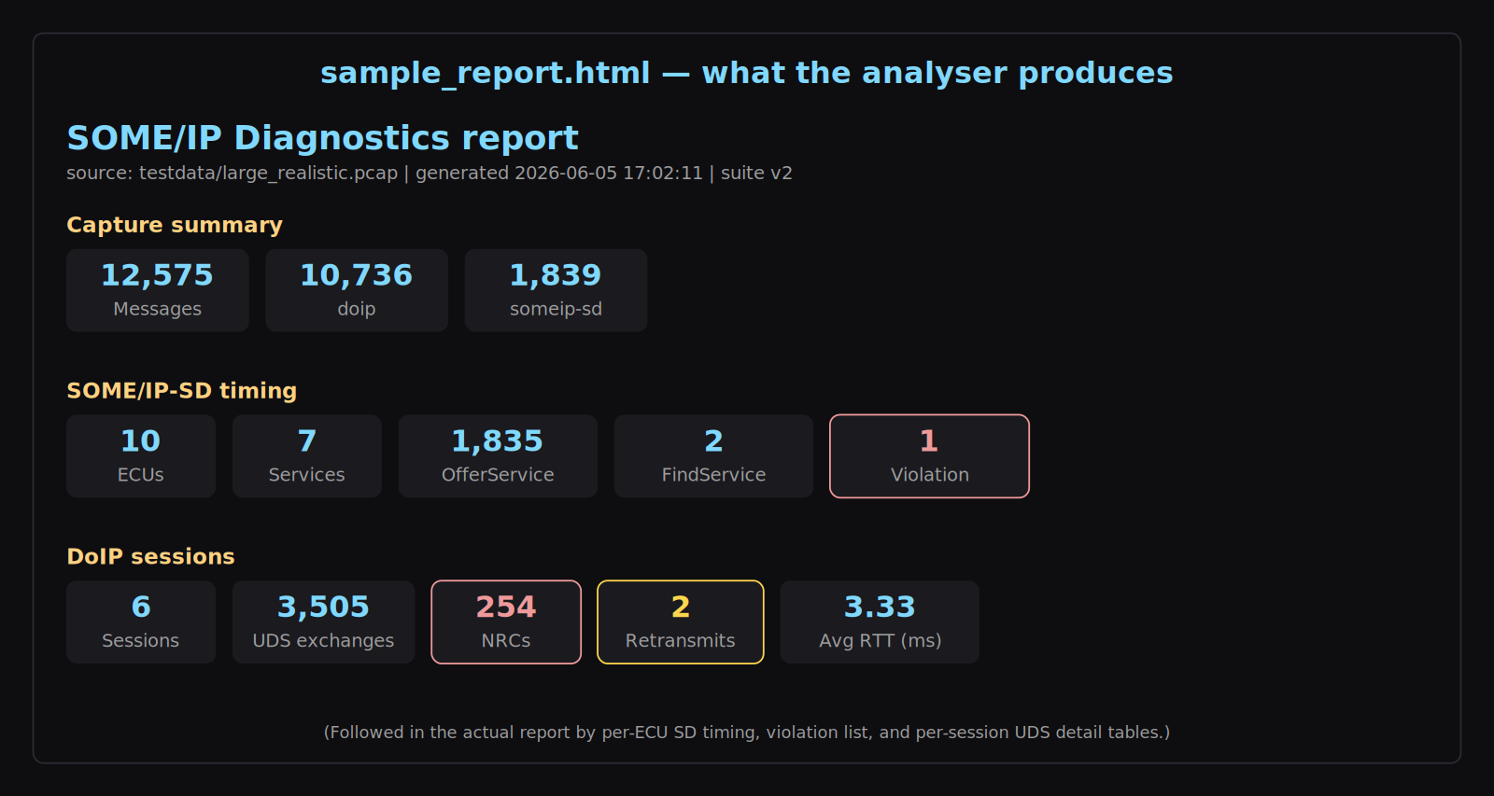
SOME/IP DIAGNOSTICS SUITE
Reviewing the HTML Report
Self-contained file — no JavaScript, safe to e-mail or attach to a PR
Report sections
1
Capture summary
Per-protocol message counts
2
SD KPI strip
Violations are the headline
3
Per-ECU × service
Recovered timing constants
4
SD violations
ECU, service, frame, detail
5
DoIP sessions
Routing, RA latency, RTT
6
Per-session UDS
Red = NRC, yellow = retx
SOME/IP Diagnostics Suite · Project Overview Deck · v2 (2026)
12 / 17

Slide 13
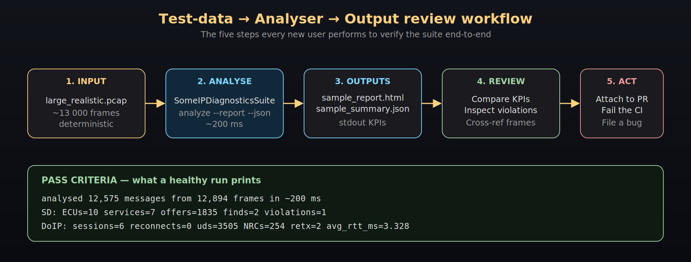
SOME/IP DIAGNOSTICS SUITE
Pass Criteria — Golden Numbers
Deterministic capture ⇒ byte-identical KPIs on every machine
Healthy stdout (always identical):
analysed 12,575 messages from 12,894 frames in ~200 ms
SD: ECUs=10 services=7 offers=1835 finds=2 violations=1
DoIP: sessions=6 reconnects=0 uds=3505 NRCs=254 retx=2 avg_rtt_ms=3.328
SOME/IP Diagnostics Suite · Project Overview Deck · v2 (2026)
13 / 17

Slide 14
SOME/IP DIAGNOSTICS SUITE
Continuous Integration
From a developer's desk to every pull request
Step 1
Example: GitHub Actions
Run — Invoke SomeIPDiagnosticsSuite.exe analyze with --strict
- name: SOME/IP diagnostics
run: |
SomeIPDiagnosticsSuite.exe analyze \
captures/run.pcap \
--report report.html \
--json summary.json \
--strict
- name: Upload diagnostics
if: always()
uses: actions/upload-artifact@v4
with:
name: someip-report
path: |
report.html
summary.json
Step 2
Gate — Exit code 2 fails the job on any SD timing violation
Step 3
Publish — Upload report.html + summary.json as artefacts
Step 4
Trend — Feed JSON KPIs into Grafana / Splunk / Excel dashboards
SOME/IP Diagnostics Suite · Project Overview Deck · v2 (2026)
14 / 17

Slide 15
SOME/IP DIAGNOSTICS SUITE
Outcomes & Business Value
What changes for engineers, QA and management
⏱
Faster triage
🛡
Better quality
🔁
Reproducibility
Boot timing violations caught in seconds with offending frame number.
Every NRC, retransmit and reconnect tabulated per session.
Deterministic test data → identical KPIs on every machine.
🚦
CI confidence
📎
Shareable artefact
💰
Zero licensing
--strict turns the tool into a build gate, no licence cost.
Single self-contained HTML report — attach to Jira / PR / e-mail.
MIT-friendly, pure stdlib — runs on every laptop and runner.
SOME/IP Diagnostics Suite · Project Overview Deck · v2 (2026)
15 / 17

Slide 16
SOME/IP DIAGNOSTICS SUITE
Roadmap
What landed in v2 — and what is next
v1
Foundations
v2
Real diagnostics
Next
Where we go
▸ Tkinter GUI scaffolding.
▸ Synthetic SOME/IP-SD generator.
▸ DoIP demo + filter engine prototype.
▸ Real .pcap / .pcapng ingestion.
▸ AUTOSAR PRS R21-11 violation engine.
▸ ISO 13400-2 session reconstructor.
▸ CLI sub-commands + --strict.
▸ Single-file Windows .exe + CI workflow.
▸ Deterministic test data + golden report.
▸ PCAPng nanosecond timestamps.
▸ SOME/IP-TP (segmentation) decoder.
▸ Per-VLAN filtering & IPv6 hardening.
▸ Trend dashboard template (Grafana).
▸ Optional Linux & macOS binaries.
SOME/IP Diagnostics Suite · Project Overview Deck · v2 (2026)
16 / 17

Slide 17
THANK YOU
Questions & Discussion
SOME/IP Diagnostics Suite — turning Ethernet captures into actionable, shareable evidence.
Where to go next
Binary
SomeIPDiagnosticsSuite.exe (repo root)
Tool Guide
docs/TOOL_GUIDE.md — capabilities, problem, solution, outcomes
Test Data
docs/TEST_DATA_GUIDE.md — using the bundled pcap & reading the report
User Guide
docs/USER_GUIDE.md — install, GUI tour, CLI, troubleshooting
Test data
testdata/large_realistic.pcap · sample_report.html · sample_summary.json
Repository: github.com/Nag12211221/Some-IP-Stand-alone

