Slide 1
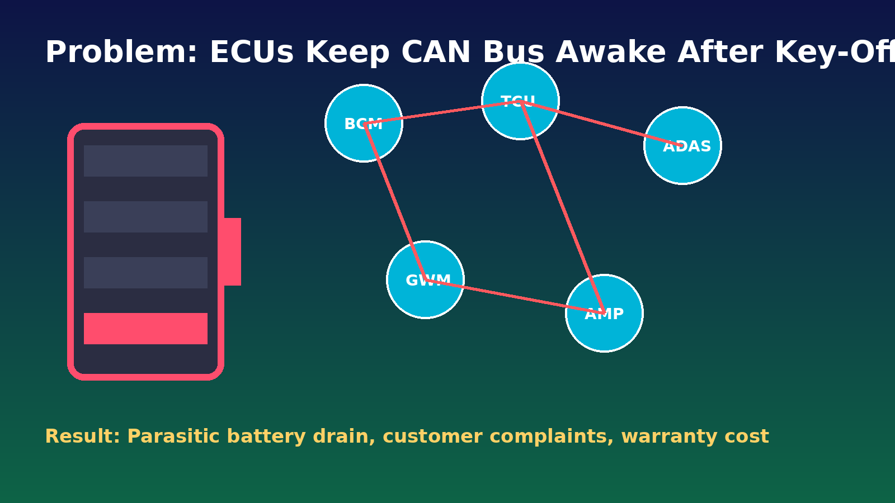
🔋 Key-Off Load / NM Wake Diagnostic Tool

Slide 2
1) What is the Problem?
• Some ECUs fail to enter sleep mode after key-off
• CAN Network Management messages continue unnecessarily
• Bus stays awake and causes parasitic battery drain
• Teams spend hours manually scanning logs
• Field impact: dead battery complaints and warranty claims

Slide 3
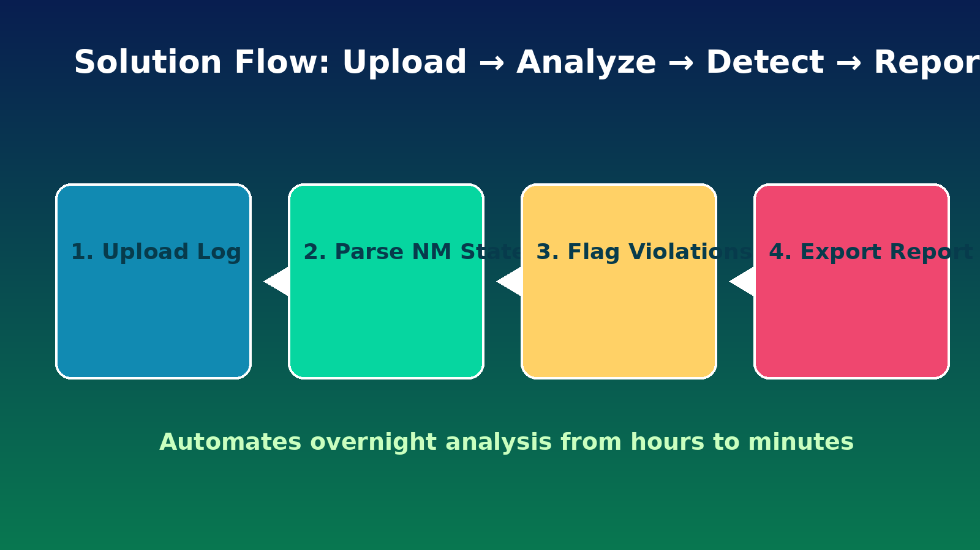
2) What Solution Do We Offer?
A browser-based diagnostic tool that automatically identifies ECUs causing key-off battery drain.

Slide 4
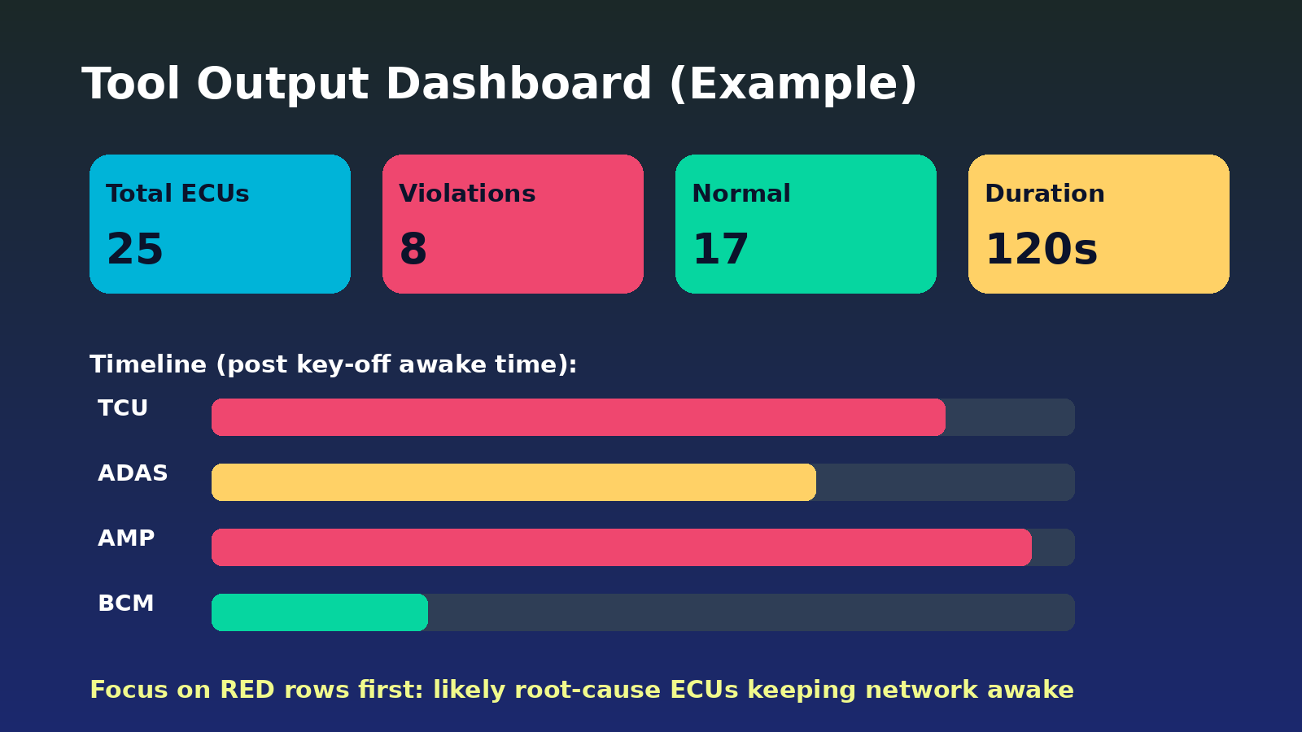
3) Tools for Fellow Engineers
• KeyOffLoad_Diagnostic_Tool.html (no install, works offline)
• test_data/ with complex scenarios (normal, violations, stress)
• OUTPUT_ANALYSIS_GUIDE.md (how to read and triage output)
• Export options: CSV / JSON / Print report for issue tracking
• Existing KeyOffLoad_Presentation.pptx for technical review

Slide 5
4) Presentation Showcase
• Open Expo One-Pager for quick audience overview
• Run live demo using stress-test dataset (50 ECUs)
• Show timeline + violations to explain root-cause detection
• Share downloadable HTML tool and PPT with attendees
• Key message: "Hours of manual analysis reduced to minutes"

