Slide 1
KLA PROBLEM STATEMENT · HACKATHON 2026 · GRAND FINALE
Grand Finale Update: SEM+Cellular Domain
Adaptation & Throughput Optimization
Fine-tuned on a new, more diverse dataset (incl. novel cellular content) with zero forgetting, plus a verified 1.95× throughput gain at zero quality cost.
Team Anaavarana · A Trail to Unveil

Slide 2
SLIDE 2
New Dataset — More Diverse Than Anticipated
A new dataset (1,197 images, filename indicated “excluded” — reasoning unconfirmed by KLA at submission time) was provided for the Grand Finale round.
Re-clustered from scratch
Genuinely novel content found
Noise statistics matched Phase 2
K=6 (Phase 2's scheme) proved too coarse. Iterated K=6 → K=10 → targeted re-splits on 3 residually-mixed clusters, arriving at 13 verified categories — each confirmed by eye, not trusted on the algorithm's word alone.
Two categories (cellular_single_process, cellular_branching) show biological/cellular SEM morphology — never present in any prior training data. A real domain expansion, not just new samples of old categories.
Correlation 0.869 vs Phase 2's 0.864; magnitude ~0.101 vs ~0.100. Same underlying multiplicative-noise generation process, confirming Phase 2's calibration approach remained valid.
Built a leak-free, 10%-per-category stratified split (1,083 train / 114 val) across all 13 categories, matching Phase 2's methodology exactly.
2

Slide 3
SLIDE 3
Training Strategy — Tested Empirically, Not Assumed
Six approaches tested and measured honestly on the leak-free, full-resolution 114-image validation set:
Approach
PSNR
SSIM
From-scratch (1,083 images, no pretrain)
23.439 dB
0.6057
lost
Old Phase 2 model, untouched (never trained on this data)
23.664 dB
0.6239
baseline
Fine-tuned from Phase 2 checkpoint (lr=5e-5) — DEPLOYED
23.697 dB
0.6238
win
Fine-tuned + rotation only
23.682 dB
0.6246
close
Fine-tuned + rotation + synthetic degradation (lr=5e-5)
23.631 dB
0.6235
lost
Fine-tuned + rotation + synthetic degradation (lr=1e-4)
23.649 dB
0.6242
lost
Fine-tuning beat the untouched old model on 12/13 categories. Adding Phase 2's proven augmentations ON TOP of fine-tuning underperformed at two learning rates — isolated to synthetic-data pool dilution diminishing the focused, low-LR fine-tune signal (not augmentation broadly: rotation alone came close). Not adopted for the final checkpoint.
3

Slide 4
SLIDE 4
Forgetting Check — Fine-Tuning Safety Verification
Fine-tuning risks improving on new data while quietly losing prior capability. Verified directly against both earlier domains:
Domain
Old Phase 2 Model
Finale Fine-Tuned Model
Change
Phase 1 (natural photos, cross-domain)
27.610 dB
27.736 dB
+0.126 dB
Phase 2 (original SEM training domain)
23.664 dB
23.611 dB
−0.053 dB
Finale (new SEM + cellular, target domain)
23.664 dB*
23.697 dB
+0.033 dB
*old model's score on finale data, shown for reference
Verdict: no meaningful forgetting.
Phase 1 generalization improved. The Phase 2 dip (−0.053 dB) is smaller than the run-to-run noise observed repeatedly throughout this project. The model gained new-domain capability while essentially fully retaining prior capability — a well-behaved fine-tune, not a trade-off.
4

Slide 5
SLIDE 5
Throughput Optimization — FP16 Inference, Verified
Half-precision (FP16) inference patched directly into run.py (the actual graded entry point) — not a side benchmark.
FP32 baseline
(batch=8, T4 GPU)
FP16 (deployed)
(batch=8, T4 GPU)
Speedup
Quality cost
4.721 ms/image
2.419 ms/image
1.95×
None
Full-dataset verification (not a sample)
✓
Ran the actual patched run.py end-to-end on all 1,197 images
✓
0 / 1,197 contract violations (shape, dtype, [0,1] range, NaN/Inf) confirmed on FP16 output
✓
PSNR/SSIM identical to FP32 to 3-4 decimal places: 23.697 dB / 0.6238, both precisions
✓
GPU-only: automatically falls back to FP32 on CPU-only environments, verified working correctly
INT8 quantization was tested and rejected: CPU-based, ~62× slower than the verified GPU FP16 result on this hardware.
5

Slide 6
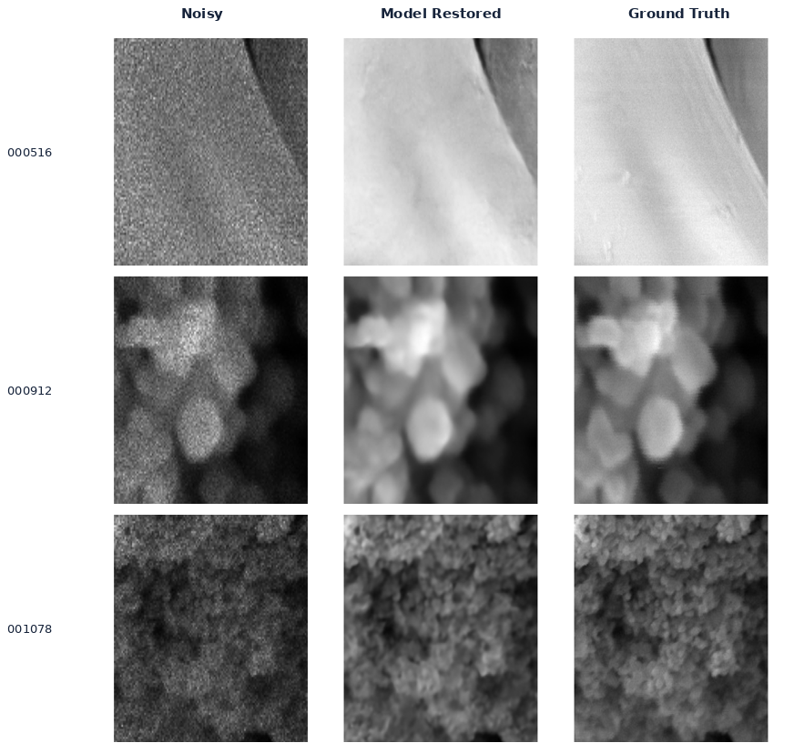
SLIDE 6
Best Restorations — Highest-PSNR Held-Out Examples
Selected by evaluate.py's own PSNR ranking on the finale val set — spanning distinct content types:
6

Slide 7
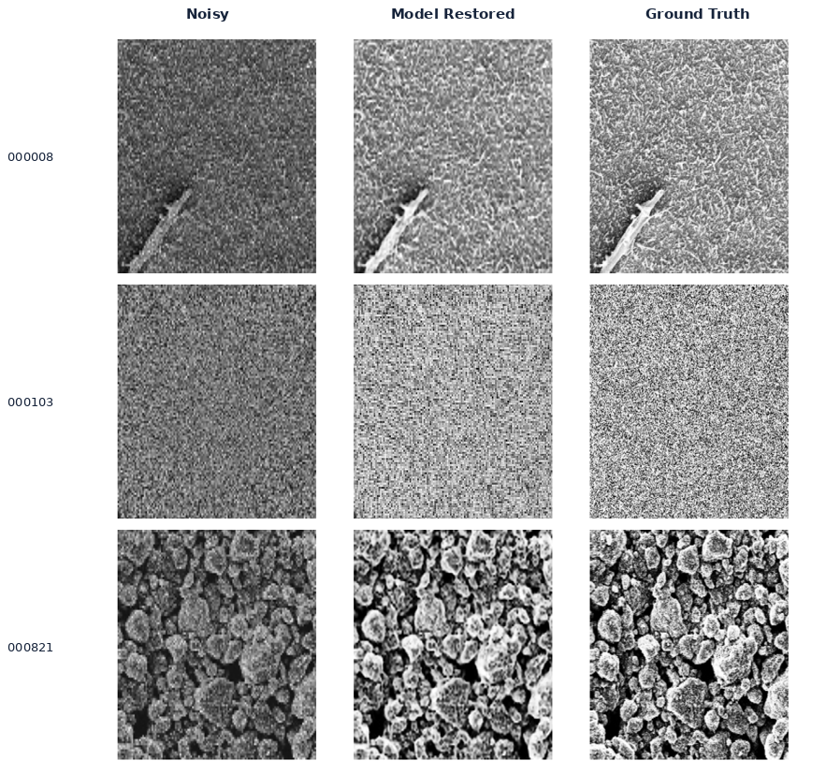
SLIDE 7
Worst Restorations — Honest Failure Analysis
Lowest-PSNR examples, shown without cherry-picking — dominated by near-featureless, low-structure content:
7
Consistent with Phase 2's “stochastic-texture ceiling” finding: near-featureless, high-noise content (row 2) sits at an information-theoretic recovery limit — not a model deficiency.

Slide 8
SLIDE 8
Final Metrics Summary
Deployed checkpoint
weights_finale_finetuned/best.pt → models/best.pt
Val PSNR (leak-free, 114 images)
23.697 dB
Val SSIM
0.6238
Throughput, FP32 (batch=8, T4)
4.721 ms/image
Throughput, FP16 (batch=8, T4) — deployed
2.419 ms/image (1.95× faster)
Contract validity
1,197 / 1,197 clean
Phase 1 cross-domain (forgetting check)
27.736 dB (improved from 27.610 dB)
Phase 2 domain (forgetting check)
23.611 dB (noise-level dip from 23.664 dB)
Categories discovered
13 (incl. 2 novel cellular categories)
Train / Val split
1,083 / 114 (10%-per-category stratified)
Team Anaavarana · A Trail to Unveil

