Slide 1
GRAND FINALE · A DATASET CALLED “EXCLUDED”
A new 1,197-image set, investigated before anything was built on it
Re-ran our clustering pipeline — K=6 (of Phase 2) was too coarse, so we iterated to K=10 and re-split three still-mixed clusters, arriving at 13 categories confirmed by eye.
1,197
13
2 new categories
biological / cellular SEM content — never present in any prior round
images, spec-verified before any training began
verified categories, up from Phase 2's 7
Same discipline as before: 10% held out per category, so the two brand-new cellular categories are represented in validation, not left to chance.
12 · Grand Finale

Slide 2
GRAND FINALE · TESTED, NOT ASSUMED
Don't start over — adapt what already works
Three strategies, measured head-to-head on the same held-out set, across all 13 categories:
From scratch, new data only
Untouched Phase 2 model
Fine-tuned from Phase 2 checkpoint
1,083 images, trained fresh
Never trained on this data — beat the from-scratch model on all 13 categories
Gentle, low learning rate — beat the old model on 12 of 13 categories
23.439 dB
23.664 dB
23.697 dB
1,083 new images alone can't match a model that already learned from 4,310 — fine-tuning wins.
13 · Grand Finale

Slide 3
GRAND FINALE · TWO SAFETY CHECKS
Rejecting augmentation, and ruling out catastrophic forgetting
Augmentation, tried twice, rejected
No catastrophic forgetting
Synthetic-noise augmentation helped in Phase 2 — here it made fine-tuning worse at two learning rates (23.631, 23.649 vs. 23.697). Rotation alone, no synthetic data, came close (23.682): doubling the pool with synthetic images diluted focused exposure to real images during a deliberately gentle fine-tune.
Domain | Old | Fine-tuned
Phase 1 (natural photos) | 27.610 | 27.736
Phase 2 (original SEM domain) | 23.664 | 23.611
A tiny, noise-level dip on old data — the model gained new capability without losing what it already had.
14 · Grand Finale

Slide 4

GRAND FINALE · THROUGHPUT
A 1.95× speedup, verified to cost zero quality
Baseline · run.py, batch-8, T4, FP32
FP16, patched into run.py itself
Speedup
4.721 ms
2.419 ms
1.95×
How
Verified, not assumed
INT8, ruled out
Casts model + batch to FP16 automatically when a GPU is present; CPU-only environments fall back to FP32, since FP16 isn't reliably faster there.
Full 1,197-image run: PSNR/SSIM identical to FP32 to 3–4 decimals (23.697 dB / 0.6238). 0 contract violations across all outputs.
Measured honestly: ran on CPU, ~62× slower than FP16-GPU. Correctly not pursued.
15 · Grand Finale

Slide 5
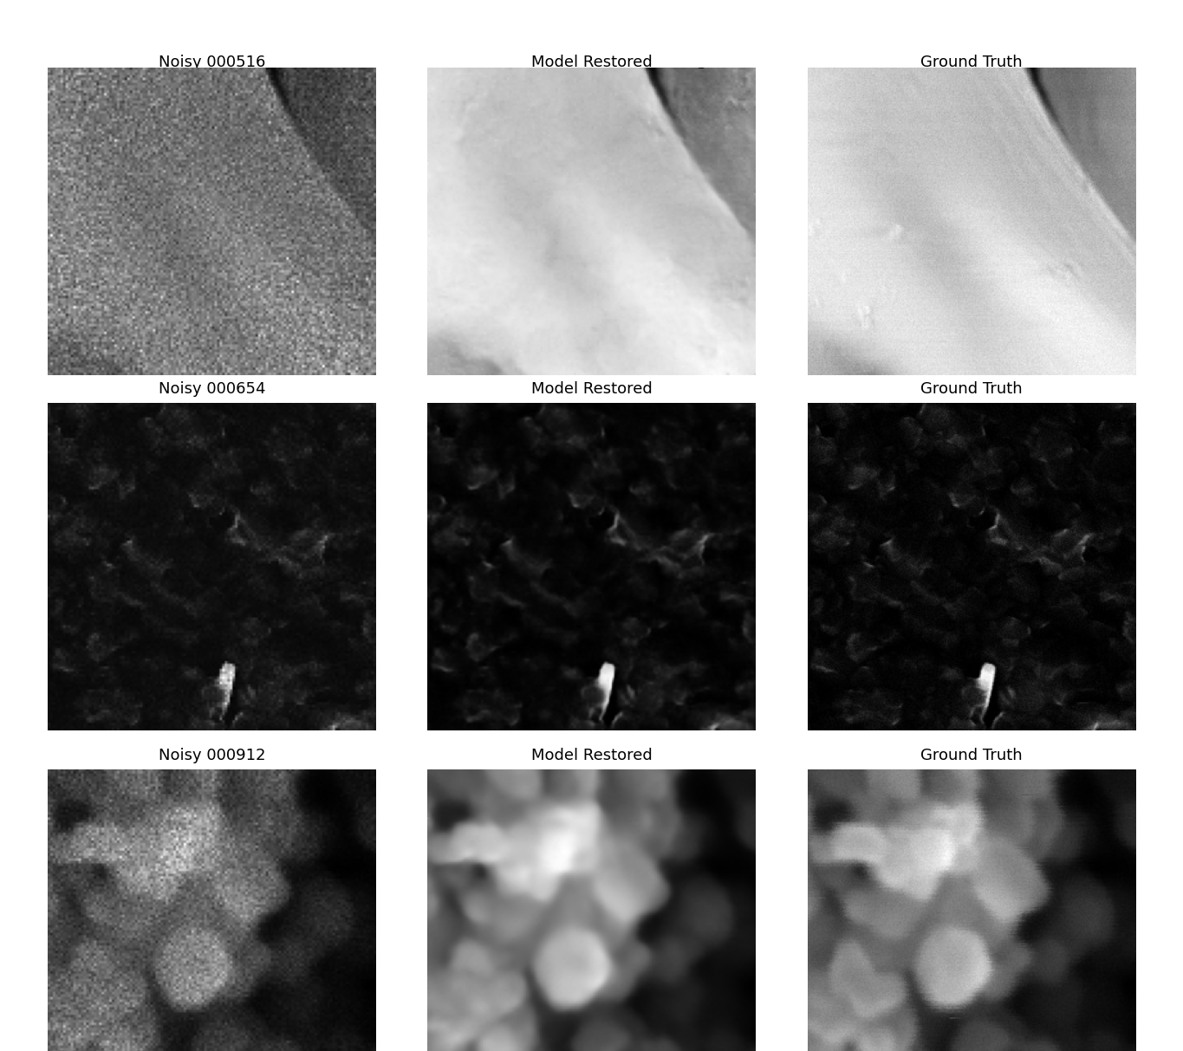
GRAND FINALE · BEST RESTORATIONS
Highest-PSNR cases, on the new 13-category data
The fine-tuned checkpoint on unseen, more diverse content — including morphologies well outside Phase 2's original 7 categories.
17 · Grand Finale

