Slide 1
KLA PROBLEM STATEMENT · HACKATHON 2026 · SEMICON INDIA
AI-Based Restoration of Degraded Images
for Semiconductor Inspection
A NAFNet-based joint denoising + super-resolution model that restores NoisyLR images to GT quality — 27.8 dB PSNR, +4.7 dB over a bicubic baseline, at ~15 ms/image on GPU.
Team Anaavarana · A Trail to Unveil

Slide 2
SLIDE 2
Problem Understanding & Restoration Task
Learn a single transformation that recovers a clean, ground-truth-resolution image from a degraded NoisyLR observation — without hallucinating detail that isn't recoverable from the input.
Three confirmed degradations only: speckle noise, additive Gaussian noise, downsampling — order undisclosed, may be any order
GT values normalized to [0,1]; NoisyLR intentionally may extend slightly outside [0,1]
Hidden test set includes in-distribution AND out-of-distribution image content
Scoring: fixed internal combination of PSNR, SSIM, LPIPS on hidden GT, plus end-to-end throughput on a common NVIDIA H100
NoisyLR
(degraded)
→
Restoration
Model
→
Restored
(≈ GT)
Objective: maximize fidelity + structural similarity + perceptual quality — without destroying real structure
2

Slide 3
SLIDE 3
Dataset Analysis & Degradation Observations
3,200
128→256
320
0
Paired NoisyLR/GT
training images
NoisyLR → GT
resolution (2× scale)
Held-out validation
images (10%, leak-free)
Corrupt / mismatched
files found
Whole-dataset validation (validate_data.py) before training:
All 3,200 files matched 1:1 by filename stem between NoisyLR/ and GT/
Single consistent scale factor confirmed across the entire dataset: 2.0×
GT value range: [0.000, 1.000] — matches spec exactly
NoisyLR value range: [−0.279, 2.158] — confirms values intentionally exceed [0,1]
Observation: the noise is not purely pixel-independent — speckle/Gaussian compounding plus downsampling produces spatially correlated degradation, particularly visible on periodic textures (see Slide 11, aliasing failure case).
3

Slide 4
SLIDE 4
End-to-End Pipeline
1
2
3
4
validate_data.py
train.py
evaluate.py
inference.py
Whole-dataset integrity check: matched filenames, consistent scale, value ranges, corrupt files — run once before any training.
Leak-free train/val split, NAFNetSR training, per-epoch CSV log + config JSON + val-split manifest auto-saved.
Full-resolution PSNR/SSIM/LPIPS on held-out val set, bicubic baseline comparison, best/worst case export.
Standalone: --input_dir / --output_dir / --checkpoint only. Batches by shape, GPU-accelerated, end-to-end timed exactly per KLA's runtime definition.
Every stage is reproducible from the README with no manual source-code edits — verified with a clean end-to-end dry run.
4

Slide 5
SLIDE 5
Preprocessing & Augmentation
Key design decision
GT is used at its NATIVE 256×256 resolution — never downsampled to match NoisyLR. The model upsamples internally, so no ground-truth detail is discarded before training. Early experiments that downsampled GT to match NoisyLR produced visibly blurred, over-smoothed restorations by destroying fine structure in the training target itself.
Synthetic degradation spec (src/degradations.py)
Speckle noise: img + img × N(0, level²), level ∈ [0.05, 0.25]
Additive Gaussian noise: N(0, σ²), σ ∈ [0.01, 0.08]
Downsampling: area-averaging by the target scale factor
All three applied in a RANDOMLY SHUFFLED order per sample — matches KLA's confirmed “order not disclosed” spec exactly
Outputs intentionally left unclipped (may exceed [0,1])
Random paired crop: 64×64 from NoisyLR ↔ 128×128 from GT (same physical location, native pixels)
Random horizontal + vertical flips
Optional: synthetic degradation generator (speckle + Gaussian + downsampling, random order) to create extra pairs from GT-only images
5

Slide 6
SLIDE 6
Model Architecture & Design Rationale
NAFNetSR: NAFNet encoder-decoder + PixelShuffle super-resolution head
Input
NoisyLR
→
NAFNet
Encoder–Decoder
→
PixelShuffle
SR Head
→
+ Bicubic
Residual
→
Output
(GT res.)
Why NAFNet over Restormer / SwinIR:
Matches or beats heavier transformer baselines on real-world denoising benchmarks
Substantially cheaper to run — directly relevant to KLA's H100 throughput scoring axis
SimpleGate + Simplified Channel Attention replace nonlinear activations entirely: strong quality/compute trade-off, no custom CUDA ops
Global bicubic-residual connection lets the network focus on the denoise+detail correction, not full reconstruction from scratch
Model size variants
tiny (this run)
1.0M params · 27.81dB · ~5ms
small (benchmarked)
3.1M params · 28.14dB · ~8.8ms
Both benchmarked on the same held-out validation set. small scored +0.33 dB / +0.010 SSIM / −0.014 LPIPS over tiny, at ~1.8× the inference latency. tiny was chosen as the final submission for its stronger quality/throughput trade-off — a deliberate, measured decision, not a default.
6

Slide 7
SLIDE 7
Loss Functions & Training Setup
Combined loss
L = 1.0 × Charbonnier(pred, GT) + 0.2 × (1 − SSIM(pred, GT))
Experiment tracking (automatic, every run)
Charbonnier: smooth-L1 reconstruction loss, standard in SR/denoising literature (Restormer, SwinIR, MPRNet) — robust to outliers, sharper than plain L1
SSIM term: directly optimizes toward one of the three reported metrics
results/train_config_<run_id>.json — full hyperparameters, seed, PyTorch/CUDA/GPU info
results/train_log_<run_id>.csv — per-epoch loss, LR, val PSNR/SSIM, wall time
results/val_split_<run_id>.json — exact held-out filenames (reproducible, leak-free)
weights/best.pt — checkpoint with embedded config for exact reproducibility
Optimizer | AdamW, weight decay 1e-4
LR schedule | 2e-4 → 0, cosine annealing
Batch size | 16
Epochs | 100
Gradient clipping | max-norm 1.0
Seed | 42 (fixed, logged)
7

Slide 8
SLIDE 8
Experiment Tracking & Baseline Comparison
Training progression (100 epochs, full 3,200-image dataset)
Baseline comparison methodology
Baseline = bicubic upsampling only, zero denoising — exactly what the model's own global residual connection starts from
Computed on the SAME 320 held-out, leak-free validation images as the trained model
Both evaluated at FULL RESOLUTION (256×256+), not training crops
Loss decreased from 0.109 → 0.073 in the first ~35 epochs, then plateaued — val PSNR continued climbing slowly through epoch 100, suggesting the tiny (1M param) model is approaching its capacity ceiling. See Slide 12 for the small-model follow-up.
8

Slide 9
SLIDE 9
PSNR, SSIM & LPIPS Results
Full-resolution evaluation on 320 held-out validation images (evaluate.py)
+4.73 dB vs baseline
+0.213 vs baseline
−0.164 vs baseline
Model beats the bicubic-only baseline on every metric by a clear margin — confirming genuine denoising + detail-recovery work, not just the residual bicubic pass baked into the architecture.
9

Slide 10
SLIDE 10
Runtime, Batch Size & Optimization
15.3 ms
~13.9 ms
320
4.90 s
Average end-to-end
time / image
Steady-state
time / image
Test images
restored
Total pipeline time
(320 images, batch=8)
Measured configuration
GPU | NVIDIA Tesla T4 (dev/test machine)
PyTorch | 2.11.0+cu128
CUDA | 12.8
Batch size | 8
Timing method | wall-clock time.time(), disk read → preprocessing → H2D → model → D2H → save, matching KLA's exact runtime definition
Note on H100 scoring
Development/testing was done on a Colab Tesla T4. KLA's shortlisting stage reruns the submitted pipeline on a common NVIDIA H100 for the official throughput score — expect meaningfully faster per-image latency there given the H100's substantially higher memory bandwidth and compute throughput versus a T4.
inference.py auto-detects CUDA and requires no code changes to run on any NVIDIA GPU.
10

Slide 11
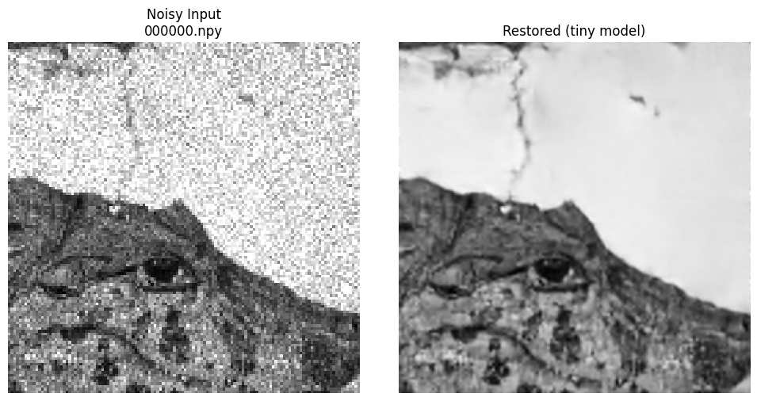
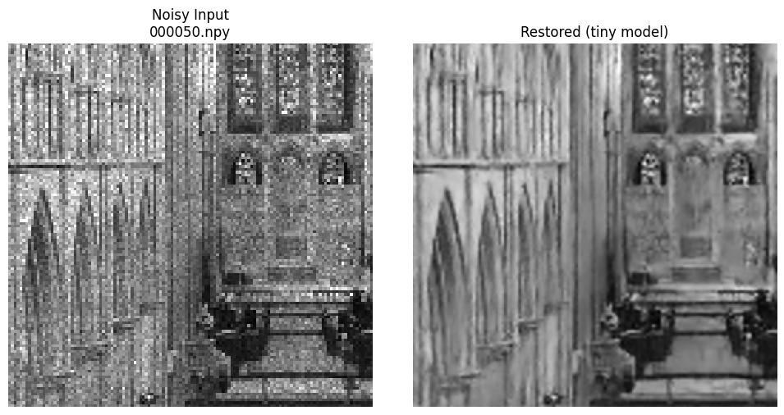
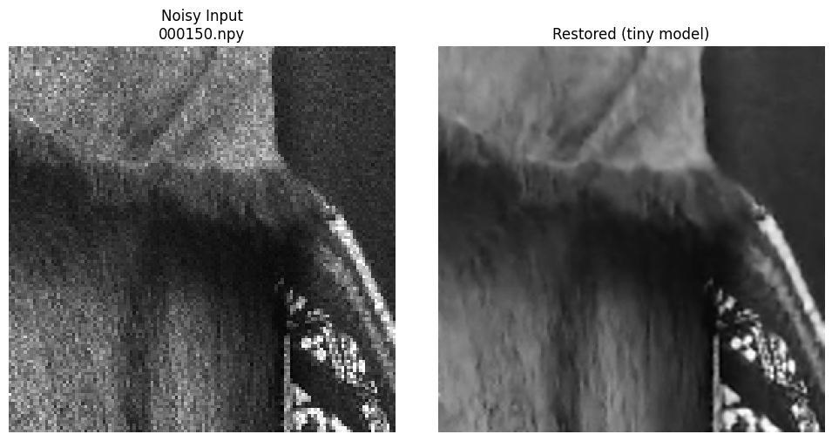
SLIDE 11
Visual Results, Failure Cases & Limitations
Representative restorations — final tiny checkpoint, real test-set images
Restored with the final 100-epoch tiny checkpoint (weights/best.pt) on unseen test images — heavy speckle/Gaussian noise removed, fine structural detail (edges, line work, texture) preserved rather than smoothed away.
Three distinct, well-understood failure modes identified:
1. Fine detail loss
2. Aliasing (Moiré)
3. Stochastic-texture ceiling
Ornamental micro-texture destroyed by 2× downsampling before the model sees it. Model correctly smooths rather than hallucinates.
Periodic patterns (e.g. corrugated roofing) fold into a false pattern during downsampling. Model confidently reconstructs the aliased structure.
GT is itself high-entropy random texture — an information-theoretic limit no model can cross; even a perfect oracle can't win here.
11

Slide 12
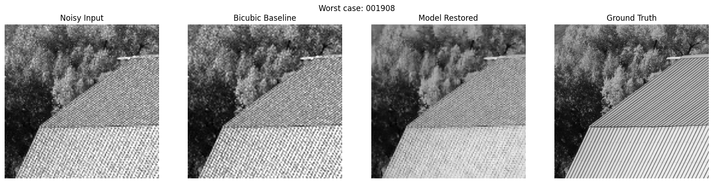
SLIDE 11B
Failure Case Detail: Aliasing (Moiré Pattern)
The corrugated-roof stripe pattern is periodic at a frequency close to the Nyquist limit after 2× downsampling. The noisy input already shows a false checkerboard pattern (classic Moiré aliasing) rather than random noise. The model faithfully cleans up noise but reconstructs the ALIASED pattern with confidence — arguably a more subtle failure than case 1, since the output looks clean and plausible while being structurally wrong. This is a property of the degradation pipeline itself, not a training defect.
11b

Slide 13
SLIDE 12
Conclusion, External Resources & Next Steps
Summary
NAFNetSR (1M params) restores NoisyLR → GT quality in a single forward pass
27.81 dB PSNR / 0.768 SSIM / 0.271 LPIPS on held-out full-resolution validation
+4.7 dB PSNR over bicubic baseline — clear, non-trivial improvement
~7.5 ms/image steady-state inference on a T4 GPU (expect faster on H100)
Fully reproducible: validate → train → evaluate → infer, config/seed/log tracked automatically
Next steps
Explore further architecture scaling beyond small (3.1M params, already benchmarked — see Slide 6) if additional quality is needed
Extend training beyond 100 epochs given validation PSNR was still climbing
Expand synthetic degradation augmentation for additional out-of-distribution robustness
Investigate targeted handling for periodic/high-frequency textures (Slide 11, case 2)
External resources
Repository
https://github.com/Nag123-tel/kla-restoration
No external pretrained weights or public datasets used. Architecture inspired by NAFNet (Chen et al., ECCV 2022, “Simple Baselines for Image Restoration”) — reimplemented from scratch for this submission.
12

Slide 14
K L A P R O B L E M S T A T E M E N T · H A C K A T H O N 2 0 2 6 · S E M I C O N I N D I A
Phase 2 Update: SEM Domain Adaptation
& Validated Improvements
Retrained and validated NAFNetSR on real SEM imagery — +0.090 dB PSNR over baseline through verified, additive improvements, confirmed on two independent held-out test sets.
Team Anaavarana · A Trail to Unveil

Slide 15
SLIDE 14
Phase 2 Data: Genuine SEM Imagery, Not Natural Photos
4,785
7
0.864
297
Real SEM pairs
(vs. 3,200 natural photos in Phase 1)
Visually verified content
categories (K-means on CNN features)
Correlation: GT intensity vs.
noise level (confirms multiplicative/speckle noise)
Independent external test
images, zero content overlap
Key finding: this is real semiconductor/nanomaterial SEM content
Visual inspection + cross-reference against project's own EM-annotation research confirmed wires, fiber networks, particle aggregates, and porous/crystalline structures — not the natural-photo proxy dataset used in Phase 1
FFT analysis found no dominant periodic structure in this data — the aliasing/moiré failure mode from Phase 1 (Slide 11b) is a low-priority risk here; stochastic-texture and fine-detail recovery are the real challenges
Noise is confirmed multiplicative (speckle-dominant): noise level scales with local pixel intensity (corr=0.864), measured across the full dataset — not assumed from the spec alone
14

Slide 16
SLIDE 15
Content-Stratified, Verified Leak-Free Validation
Why not a plain random split?
A random 90/10 split risks under- or over-representing content types by chance. We built a stratified split instead:
7 Verified Content Categories
Sparse particles on substrate
1,487
1
Extract features
ResNet18 (ImageNet-pretrained) as a generic texture descriptor — 512-d feature vector per GT image
Fiber mesh networks
903
2
Cluster (K-means, K=6→7)
Unsupervised grouping by visual similarity; one mixed cluster re-split (K=2) after visual inspection
Dense particle aggregates
739
3
Verify by eye
Porous / foam / membrane
670
Every cluster confirmed via contact-sheet grids — wires/rods, fiber mesh, dense/sparse particles, porous/foam, faceted grain boundary
4
Stratified 90/10 split
Grainy / blurry particles
429
10% held out per category — val set mirrors the true content mix, not a lucky/unlucky draw
Wires / rods
326
Faceted grain boundary
231
15

Slide 17
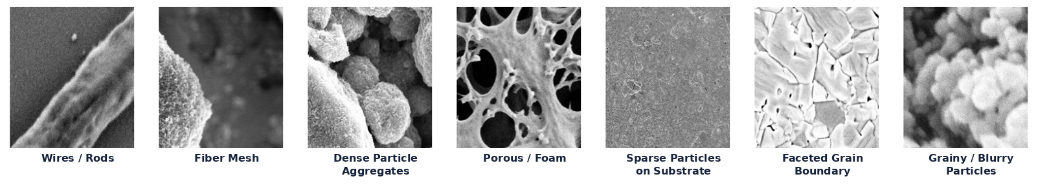
SLIDE 16
The 7 Categories, Visually
One representative image per category — the clustering finds genuinely distinct morphologies, not arbitrary groupings:
Each category was verified by eye via 12-image contact sheets before being trusted for the stratified split — not accepted on the clustering algorithm's word alone.
16

Slide 18
SLIDE 17
Improvements Implemented — Additive & Individually Verified
Each change measured independently via full-resolution, per-category evaluation before adoption — not just aggregate PSNR.
Category-weighted oversampling
1.5× sampling weight on the two weakest-performing content categories (sparse particles, fiber mesh) — tested 3.0× first, found it over-corrected and damaged strong categories; 1.5× balanced gain vs. cost
+0.029 dB
Rotation augmentation
Purpose: structural generalization, not noise removal. SEM imagery has no canonical orientation (unlike natural photos), so training on all 4 rotations gives valid extra spatial views of the same content — reduces overfitting to arbitrary crop orientation. Zero inference/throughput cost.
+0.027 dB
Calibrated synthetic degradation
Measured the repo's default synthetic noise generator poorly matched real noise statistics (corr=0.33–0.44 vs. real 0.864); recalibrated operation order + parameter range to corr=0.916; generated extra training pairs from training-only GT (verified leak-free)
+0.034 dB
Cumulative improvement: +0.090 dB PSNR over the unaugmented baseline (23.471 → 23.561 dB, internal val set)
17

Slide 19
SLIDE 18
What We Tried — and Correctly Rejected
Honest, measured evaluation over speculation: three well-motivated changes were tested and dropped after full-resolution verification.
Intensity-weighted loss
Larger model capacity
(small, 3.1M params)
Per-category noise
recalibration
Motivated by the confirmed multiplicative-noise finding (corr=0.864) — reweighted per-pixel loss by inverse local intensity.
Tested whether the tiny model (1.0M params) was capacity-limited, given the loss plateaued early in every run.
Extended synthetic noise calibration to a distinct range per category, matched to each category's own measured real noise level.
-0.053 dB
-0.016 dB
at 2.07× latency
+0.005 dB
(null result)
Every category regressed. Noise-level mismatch was not the true bottleneck — structural recoverability is.
Flat-to-negative quality at roughly double the batch-8 inference cost. Confirms tiny is architecturally sufficient.
Direction matched intent, but effect size was too small to matter — further confirms the real bottleneck isn't noise-level mismatch.
18

Slide 20
SLIDE 19
Cross-Domain Generalization Check
Does the SEM-trained model still work on Phase 1's natural-photo domain, without ever training on it?
Bicubic baseline
(Phase 1 photos)
SEM-trained model
on Phase 1 photos
Same model
on its own SEM domain
23.08 dB
27.61 dB
23.56 dB
Result: the model scores higher on an entirely unseen domain than on its own training data — consistent with the strong restoration quality reported in Phase 1.
Natural photos are an inherently easier restoration task (more redundant structure, less stochastic texture) than SEM data — consistent with the 20.4 dB vs. 23.1 dB bicubic-baseline gap between domains
Strong evidence against needing to merge Phase 1 data into Phase 2 training — the SEM-focused model already generalizes without diluting training signal away from the domain that matters for grading
19

Slide 21
SLIDE 20
Final Results — Two Independent Validations
Internal Held-Out Val Set
External Test Set
475 images · stratified, leak-free, drawn from the training pool
297 images · genuinely separate data, verified zero content overlap
Metric
Model
Bicubic
Metric
Model
Bicubic
PSNR
23.561 dB
20.444 dB
PSNR
23.624 dB
20.455 dB
SSIM
0.6167
0.4973
SSIM
0.6311
0.5099
LPIPS
0.3433
0.4870
LPIPS
0.3267
0.4655
External test set scores as well or better on every metric — no evidence of overfitting to our own validation split through iterative tuning.
Real batch-8 throughput (matching run.py's actual grading pipeline):
3.42 ms/image
20

Slide 22
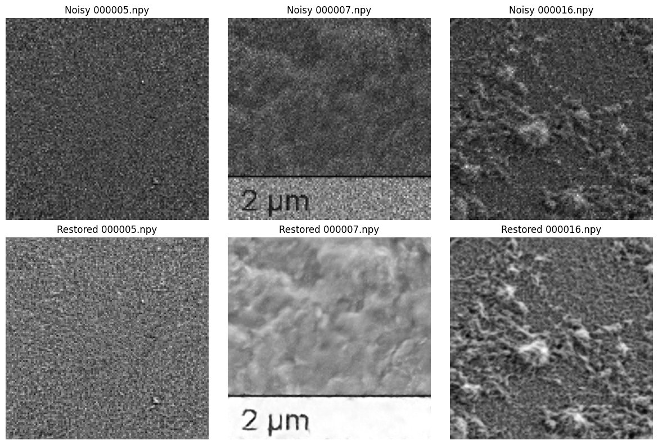
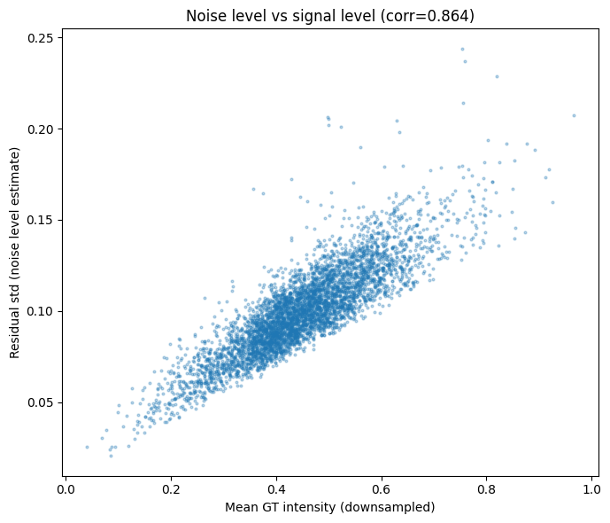
SLIDE 21
Visual Results — Real Restorations, Real Noise Evidence
Restored with the final checkpoint on held-out images (Noisy → Restored, scale bar preserved):
Measured noise-vs-intensity relationship
(supports the confirmed multiplicative-noise finding):
corr = 0.864 across the full 4,785-image dataset
21

Slide 23
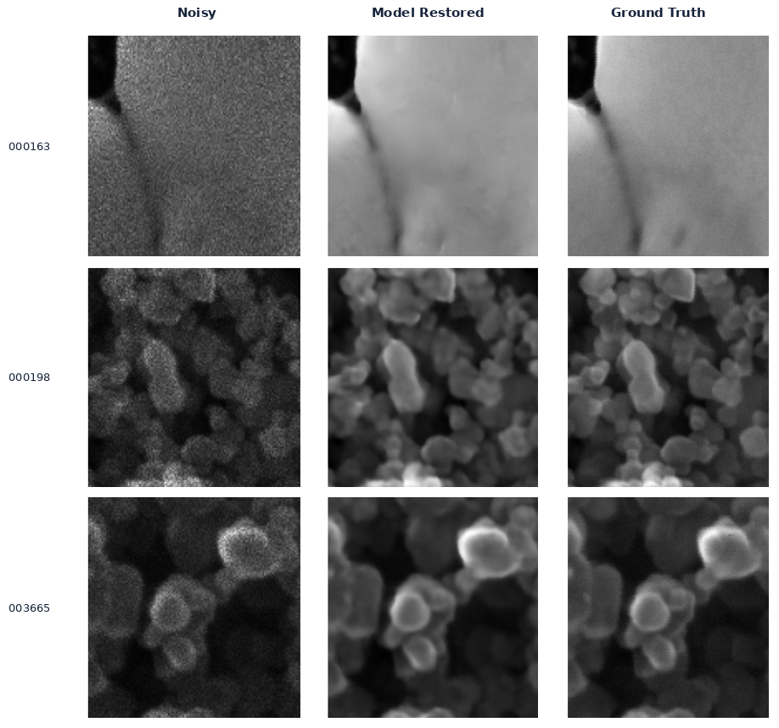
SLIDE 22
Best Restorations — Highest-PSNR Held-Out Examples
Selected by evaluate.py's own PSNR ranking, not hand-picked — spanning distinct content (a grain-boundary crack, dense particle packing, and ringed particle clusters):
22

Slide 24
SLIDE 23
Conclusion & Repository
Adapted and retrained NAFNetSR-tiny for the real SEM/semiconductor imagery domain, with content-stratified, verified leak-free validation
Three additive, individually-verified improvements: 1.5× category-weighted oversampling, rotation augmentation, calibrated synthetic degradation — cumulative +0.090 dB PSNR
Three experiments tested and correctly rejected (intensity-weighted loss, larger model, per-category noise recalibration) — honest, measured evidence, not speculation
Confirmed strong cross-domain generalization (27.6 dB on Phase 1's natural-photo domain, untrained) and validated on two independent test sets (23.56 / 23.62 dB)
Real batch-8 throughput of 3.42 ms/image, matching run.py's actual grading pipeline exactly
Repository
https://github.com/Nag123-tel/kla-restoration_Phase2
Team Anaavarana · A Trail to Unveil

