Slide 1


DriveUs
Made by:
Bakos henriett, Gyura Gabriella, nagy laura

Slide 2
DriveUs
OM kód: 203061/012
E-mail cím: titkar@hengersor.hu
Telefon:
Telefon: +36 30 369 7855
Budapesti Gazdasági Szakképzési Centrum Pestszentlőrinci Technikum
1184 Budapest Hengersor u. 34.
Made by:
Bakos henriett, Gyura Gabriella, nagy laura

Slide 3
DRIVEus
The probelem
The solution
DriveUs
Available for anyone anywhere and anytime
Easy communicaton over the platform
Information pages
Intuitive and easy to use and user-friendly
Only call based reservations
The quality of the cars
No platform for the renting informations

Slide 4
DRIVEus
Functions of the program
Registraton
Login
Profile editing
Search, browse
Making a reservation
Surfing through previous reservations

Slide 5
DRIVEus
The program
Backend – PHP
Node.js
Frontend - PHP
HTML
CSS
JavaScript
Bootstrap
Database – MySQL
PhpMyAdmin

Slide 6
DRIVEus
Backend

Slide 7
DRIVEus
frontend

Slide 8
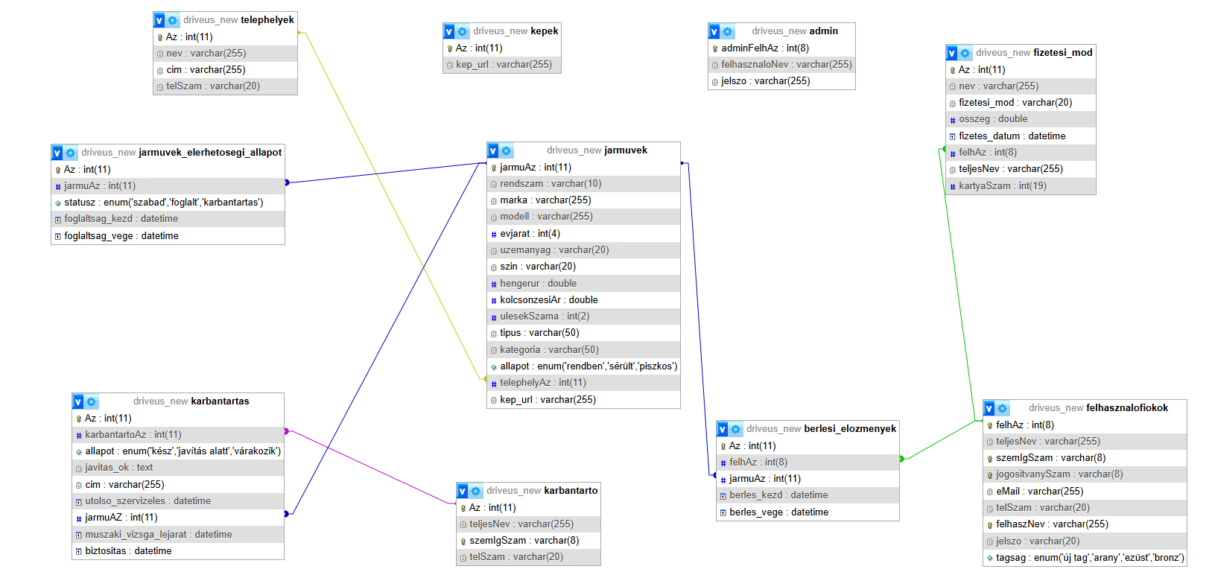
DRIVEus
database

Slide 9
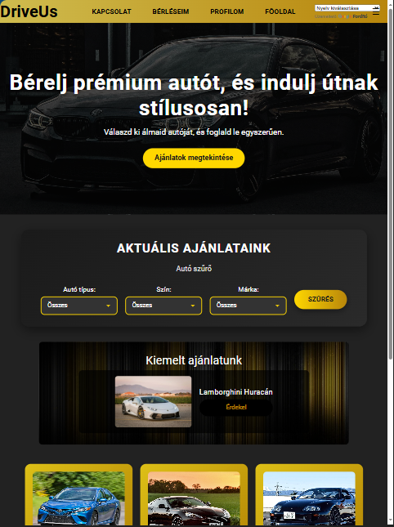
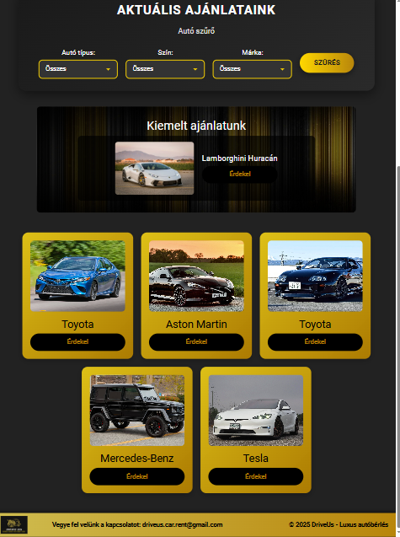
DRIVEus
responsivity

Slide 10
DRIVEus
responsivity

