Slide 1


DriveUs
OM kód: 203061/012
E-mail cím: titkar@hengersor.hu
Telefon:
Telefon: +36 30 369 7855
Budapesti Gazdasági Szakképzési Centrum Pestszentlőrinci Technikum
1184 Budapest Hengersor u. 34.
Made by:
Bakos henriett, Gyura Gabriella, nagy laura

Slide 2
DriveUs
OM kód: 203061/012
E-mail cím: titkar@hengersor.hu
Telefon:
Telefon: +36 30 369 7855
Budapesti Gazdasági Szakképzési Centrum Pestszentlőrinci Technikum
1184 Budapest Hengersor u. 34.
Made by:
Bakos henriett, Gyura Gabriella, nagy laura

Slide 3
DRIVEus
The probelem
The solution
DriveUs
Available for anyone anywhere and anytime
Easy communicaton over the platform
Information pages
Intuitive and easy to use and user-friendly
Only call based reservations
The quality of the cars
No platform for the renting informations

Slide 4
DRIVEus
Functions of the program
Registraton
Login
Profile editing
Search, browse
Making a reservation
Surfing through previous reservations

Slide 5
DRIVEus
The program
Backend – PHP
Node.js
Frontend - PHP
HTML
CSS
JavaScript
Bootstrap
Database – MySQL
PhpMyAdmin

Slide 6
DRIVEus
Backend

Slide 7
DRIVEus
Models

Slide 8
DRIVEus
controllers

Slide 9
DRIVEus
frontend

Slide 10
DRIVEus
database

Slide 11
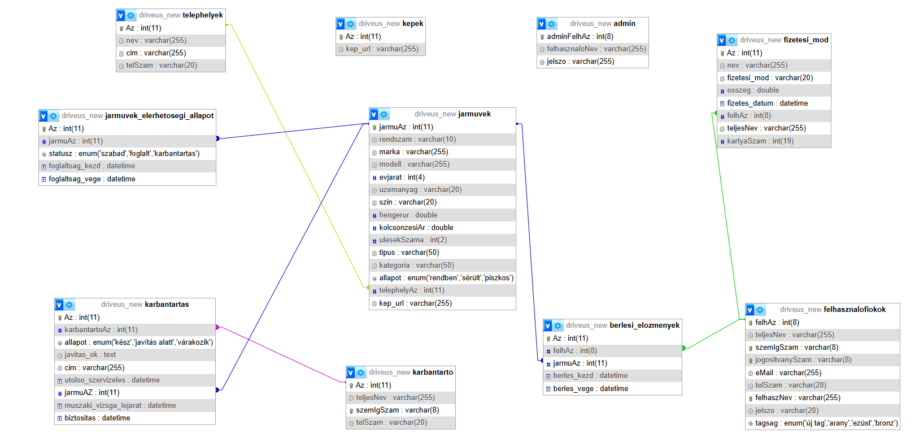
DRIVEus
database

Slide 12

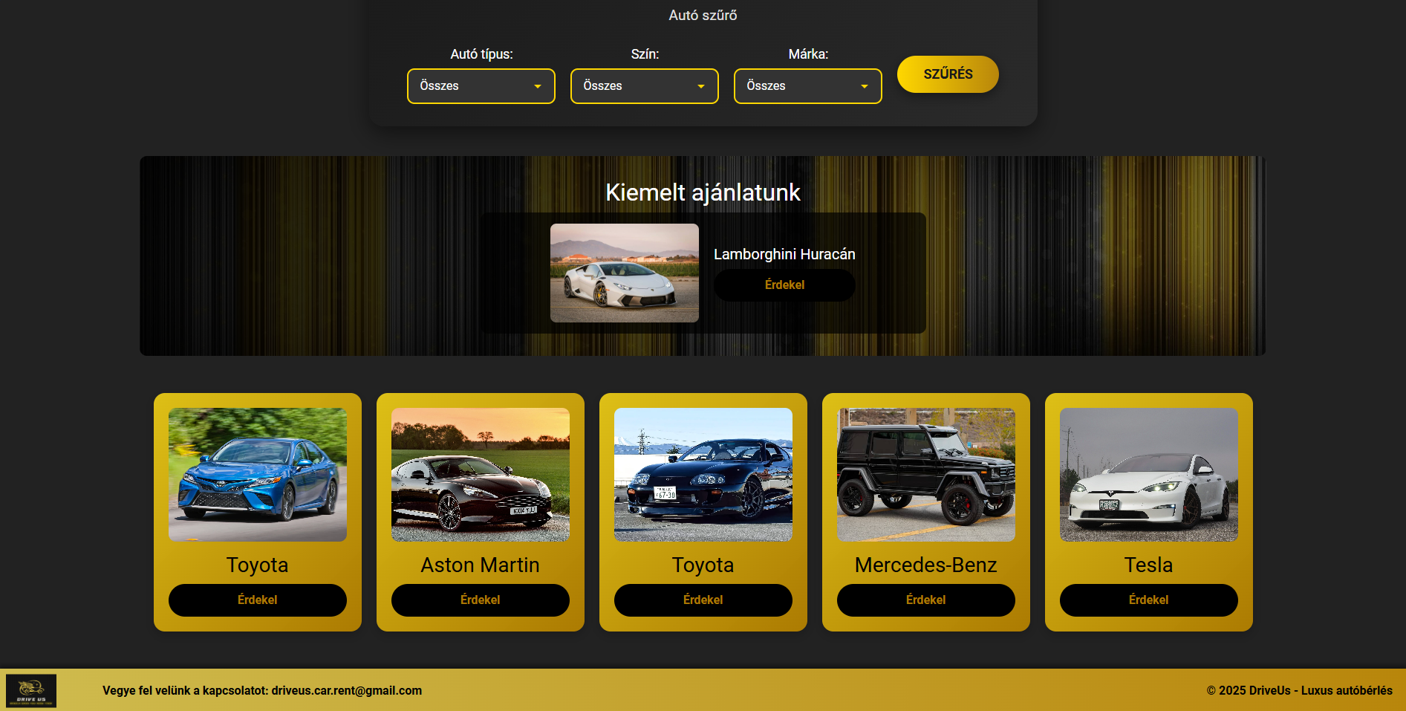
DRIVEus
Without responsivity

Slide 13
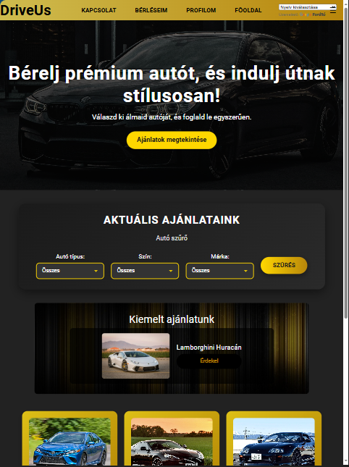
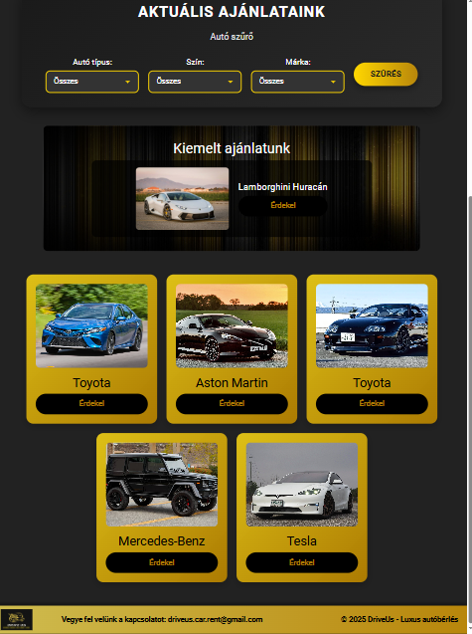
DRIVEus
With responsivity
Optimized for mobile devices
Access from anywhere on any device

Slide 14
DRIVEus
TESTS
Frontend
backend
DriveUs
Available for anyone anywhere and anytime
Easy communicaton over the platform
Information pages
Intuitive and easy to use and user-friendly
Only call based reservations
The quality of the cars
No platform for the renting informations

Slide 15



DRIVEus
Teamwork
GitHub
Google Drive
Microsoft Teams
Trello
Live communication

Slide 16
DRIVEus
TEAMWORK - BACKEND
BAKOS HENRIETT
GYURA GABRIELLA
NAGY LAURA

Slide 17
DRIVEus
TEAMWORK - FRONTEND
BAKOS HENRIETT
GYURA GABRIELLA
NAGY LAURA

Slide 18
DRIVEus
PUBLICATION
GitHub actions

Slide 19
DRIVEus
FUTURE PLANS
Mobile application
Advertisements

