Slide 1

TASK NO -4
Code Refactoring and Bug Fixing
Prepared-by Naga Babu Katarapu
Intern ID :- IN1241118

Slide 2
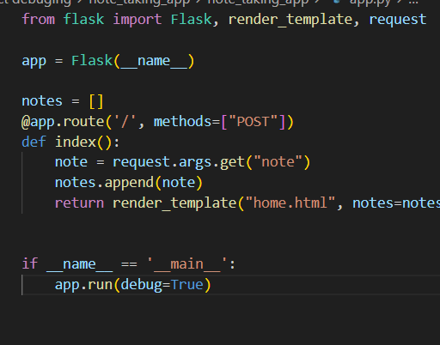
Finding Bugs in the Server
In this Server red borders are Bugs
Method is to be used here POST only.
The post() method is used when you want to send some data to the server.
Data is transfer to HTML form element
In this no form element

Slide 3

Fixing Bugs In Sever code
1). I fix this bug with the help of the “GET” method
2). To read data from HTML form element. request.form.get(“note”)

Slide 4
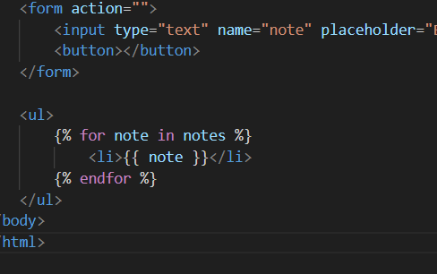
Finding Bugs in HTML code
The highlighted was given action but in that route is missing. and missing post-method.
button tags is empty in this second red line. Here we have to give a button for “add note”.

Slide 5


Fixing Bugs in HTML page
Here fill the method and missing element in action.
Button was fill with “ Add note”

Slide 6
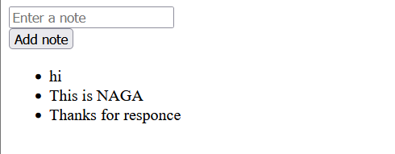
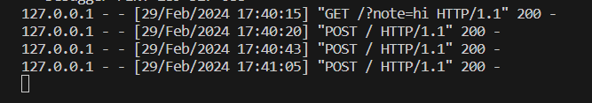
Server Output

Slide 7

THANK YOU

