Slide 1
AI Powered Study Planner
Presented by: Nagalakshmi(24A31A05GX)
Shajida(24A31A05HM)
Varshini(24A31A05HX)
Bhavishyathasri(24A31A05HW)
CSE-E

Slide 2
Objective
To design an AI-based study planning system
To help students manage time effectively
To generate smart and personalized study schedules
To improve productivity and learning efficiency
To support better exam preparation with structured planning
To reduce stress by organizing study tasks systematically

Slide 3
Introduction
AI Powered Study Planner is a smart web application
It helps students organize study schedules easily
Uses AI logic to optimize time and subjects
Provides a simple and interactive dashboard
Helps students stay consistent in their studies

Slide 4
Features
Smart study timetable generation
Daily and weekly planner view
Task creation and management
Progress tracking system
Notes and reminders
Responsive UI design

Slide 5
Working / Logic
User enters subjects, topics, and available time
System analyzes priority and workload
AI generates optimized study schedule
Tasks are stored in local storage
User can edit and update tasks anytime
Progress is tracked automatically

Slide 6
Technology Used
HTML – Structure
CSS – Styling
JavaScript – Functionality
AI Logic (Rule-based system)
Local Storage – Data saving

Slide 7
Modules
Home Dashboard Module
AI Planner Module
Task Management Module
Notes Module
Progress Tracker Module

Slide 8
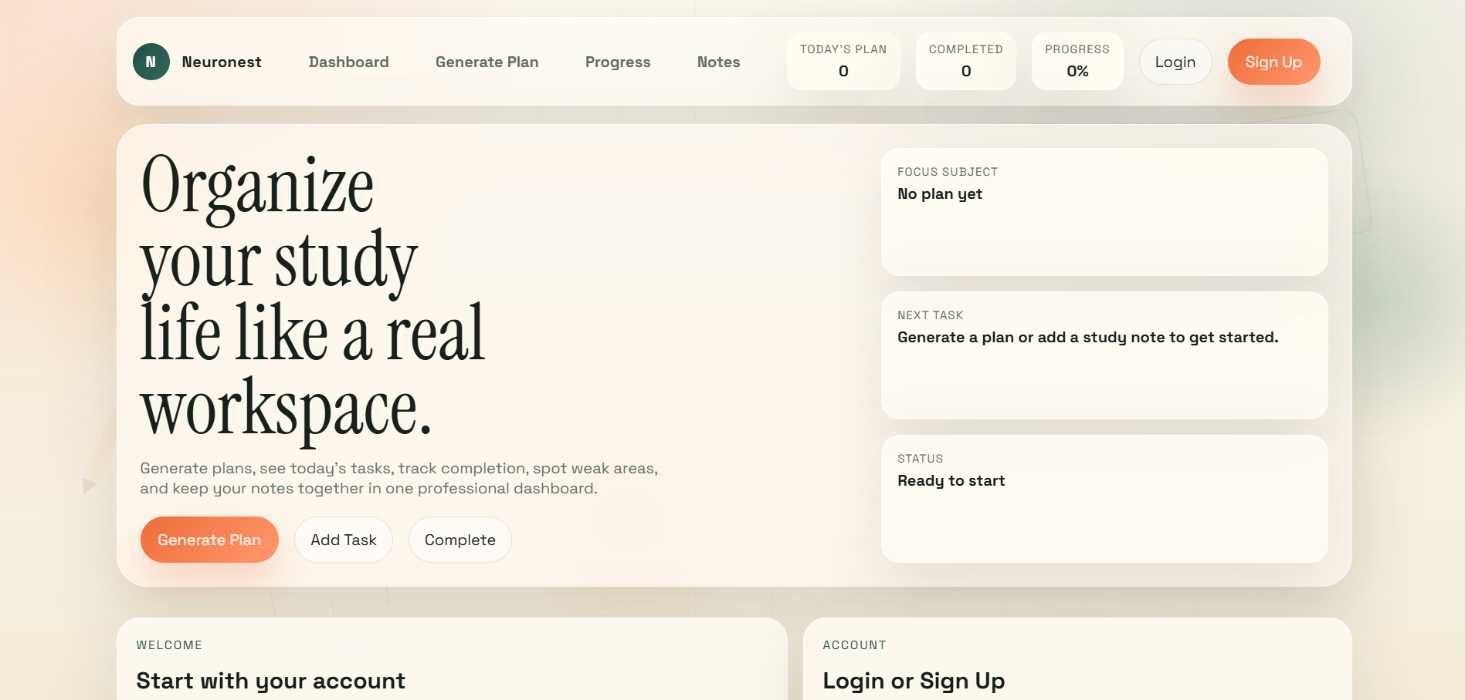
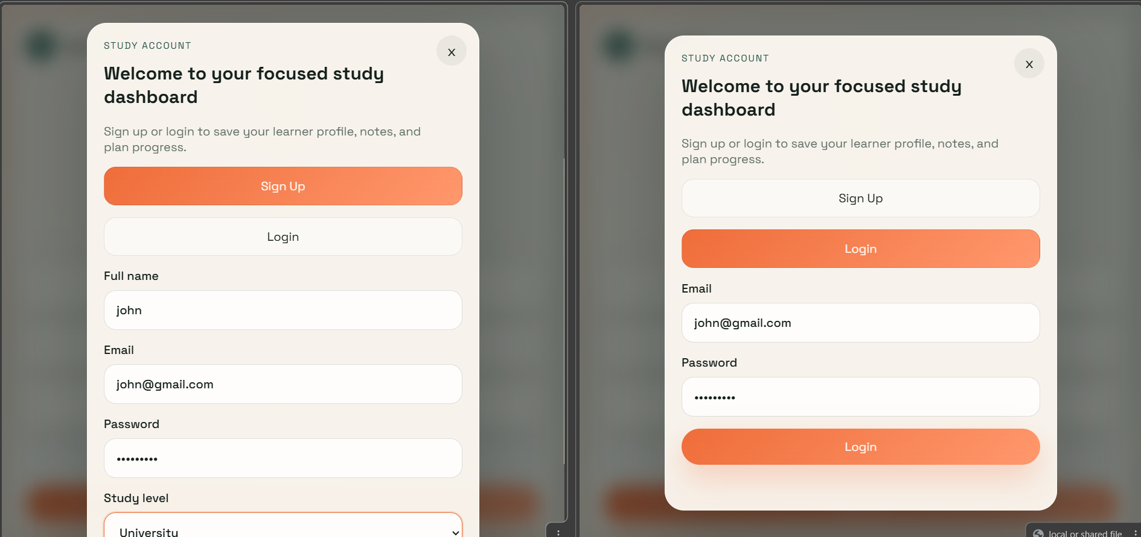
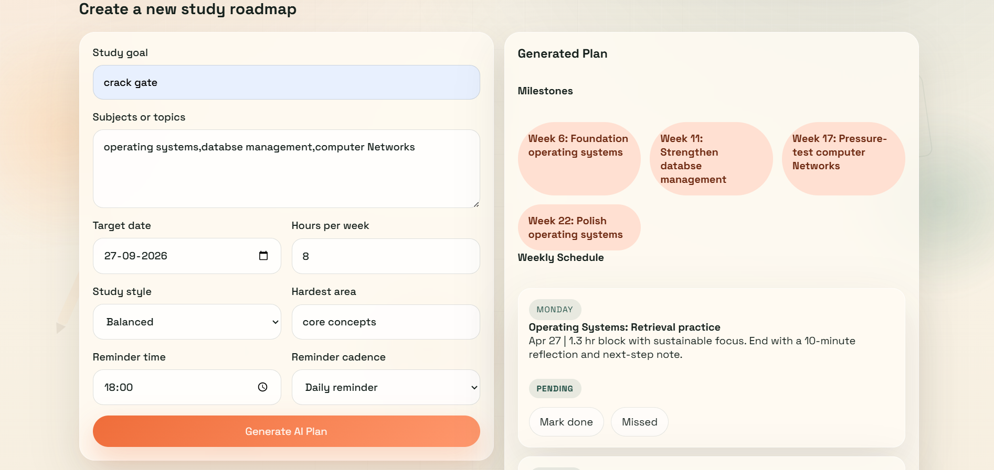
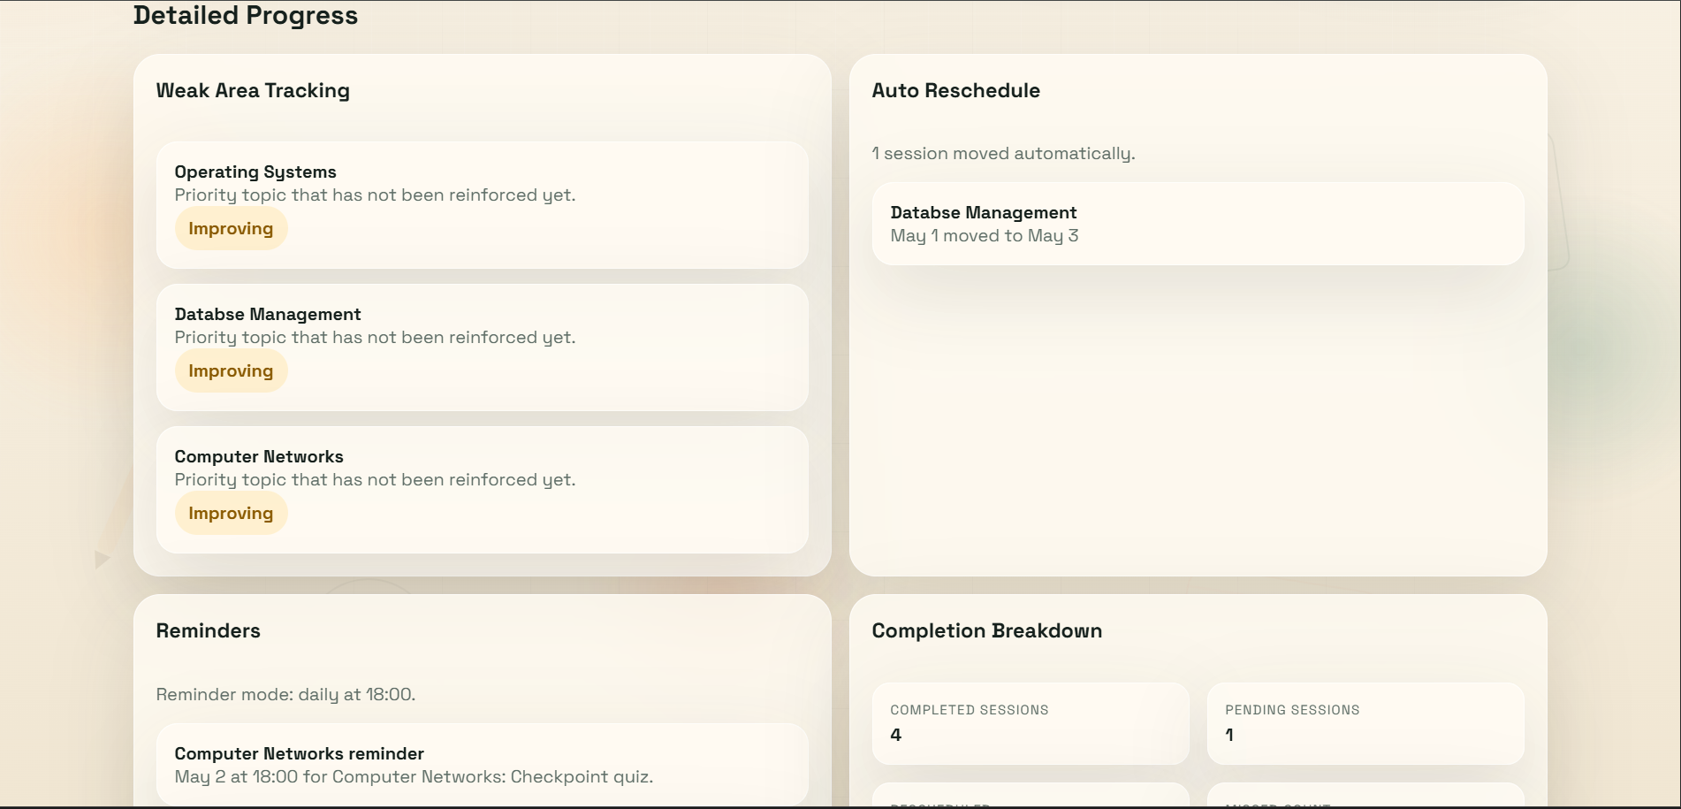
Screenshots
Home Page View Login/Signup
Generate Plan Progress

Slide 9
Advantages
Improves time management
Reduces manual planning effort
Increases productivity
Easy to use for students
Helps in exam preparation
Provides structured learning approach

Slide 10
Limitations
Requires manual input of study data
Limited AI intelligence (rule-based system)
No real-time external integration (like calendar sync)
Depends on user consistency for accuracy
No advanced predictive learning feature

Slide 11
Future Enhancements
Integration with advanced AI models (like ChatGPT API)
Mobile application version
Cloud storage support
Smart notifications and reminders
Performance analytics using graphs
Voice-based study planning system

Slide 12
Conclusion
The AI Powered Study Planner is an efficient system that helps students plan, organize, and track their studies effectively using intelligent scheduling techniques. It improves productivity, reduces confusion, and supports better academic performance.

