Slide 1
SECURE DATA HIDING IN IMAGES USING STEGANOGRAPHY
CAPSTONE PROJECT
Presented By:
Student Name : Naga Hanuman Singamsetty
College Name & Department : Tirumala Engineering College ,
Computer Science and Engineering

Slide 2
OUTLINE
Problem Statement
Technology used
Wow factor
End users
Result
Conclusion
Git-hub Link
Future scope

Slide 3
Problem Statement
With the increasing need for secure communication, traditional encryption methods are often vulnerable to attacks. Steganography provides an alternative approach by concealing data within digital images, making it less detectable. However, challenges such as maintaining image quality, preventing unauthorized access, and ensuring robust security persist. This project aims to develop a steganographic technique that enhances security while preserving image integrity, ensuring reliable data concealment and retrieval.

Slide 4
Technology used
Programming Language: Python
Libraries Used:
OpenCV (cv2) – For reading, modifying, and saving images.
os – For file handling and executing system commands.
string – For character mapping and encryption.
Platform: Python IDE: IDLE (Integrated Development and Learning Environment).
Operating System: Windows.

Slide 5
Wow factors
Enhanced Security: The project uses password-protected decryption to prevent unauthorized access. Invisible Data Embedding: Unlike encryption, which makes data look suspicious, this method hides data within an image, making detection difficult.
Custom Character Encoding: Instead of common steganography tools, this method maps ASCII characters to pixel values, adding an extra security layer.
Preserves Image Quality: The embedded message does not significantly alter the visual appearance of the image.
Lightweight & Fast Processing: The algorithm runs efficiently with minimal computational resources.

Slide 6
End users
Journalists & Activists: To securely communicate sensitive information without attracting attention.
Cybersecurity Professionals: For implementing hidden communication methods in security applications. Government & Law Enforcement: To share confidential data in a covert manner.
General Users: Anyone who wants to send hidden messages securely over digital platforms without relying on traditional encryption methods.

Slide 7
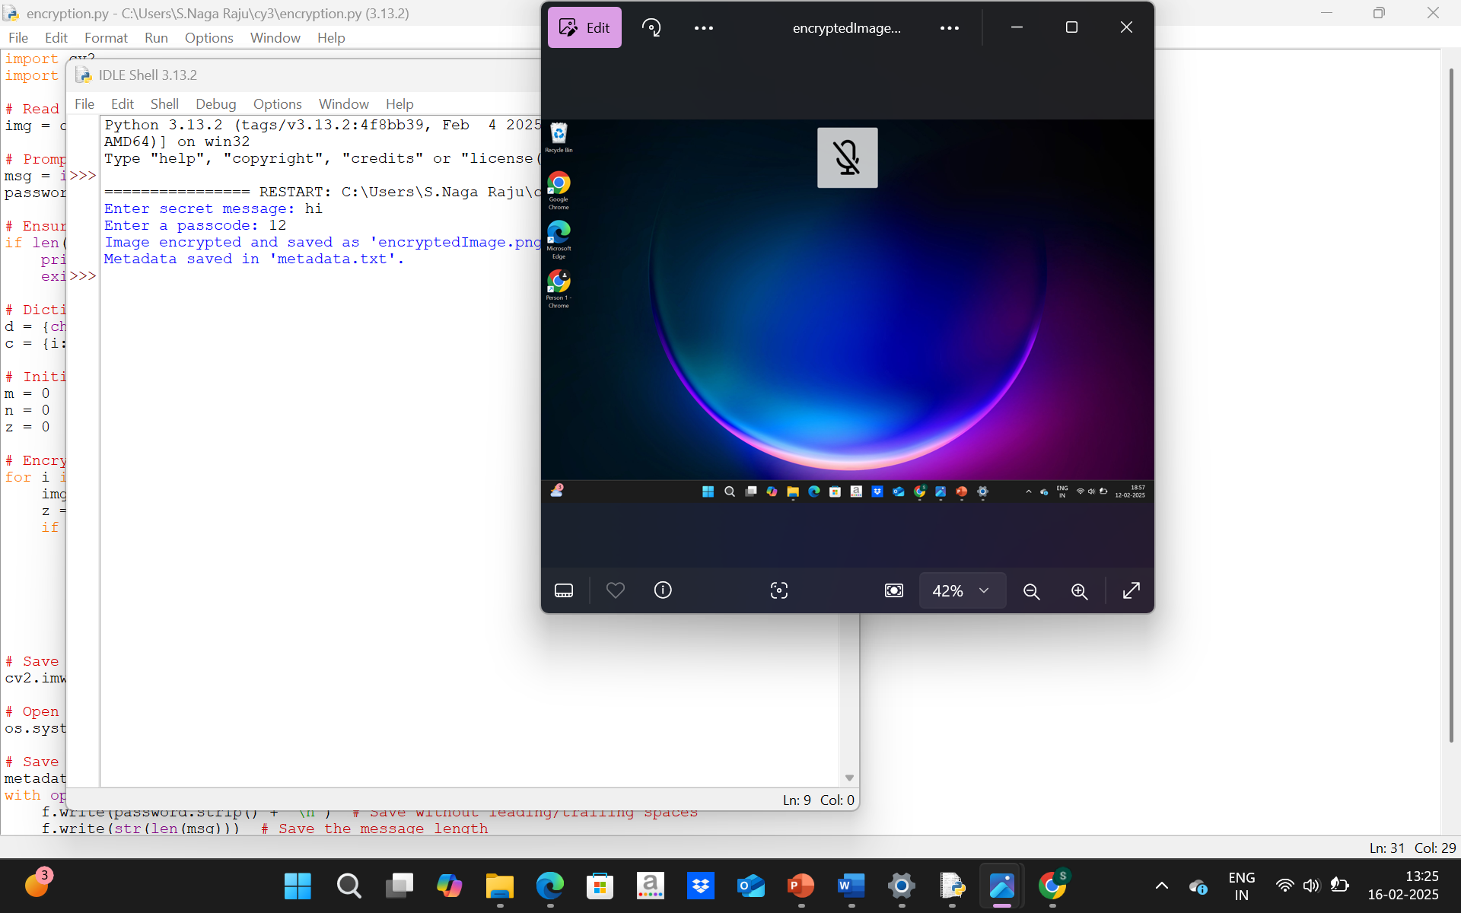
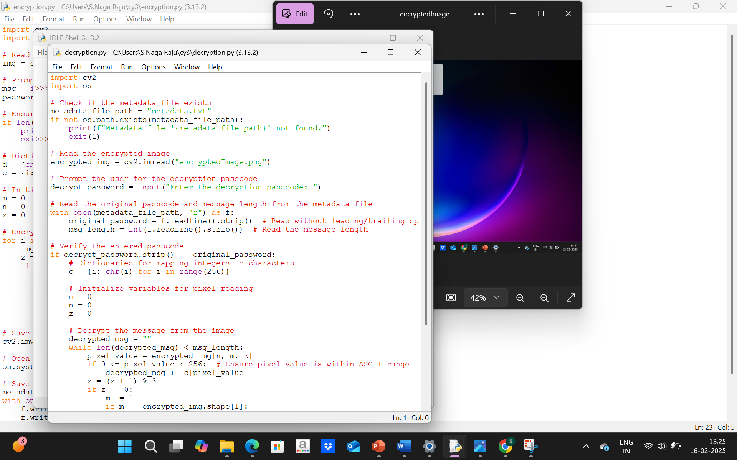
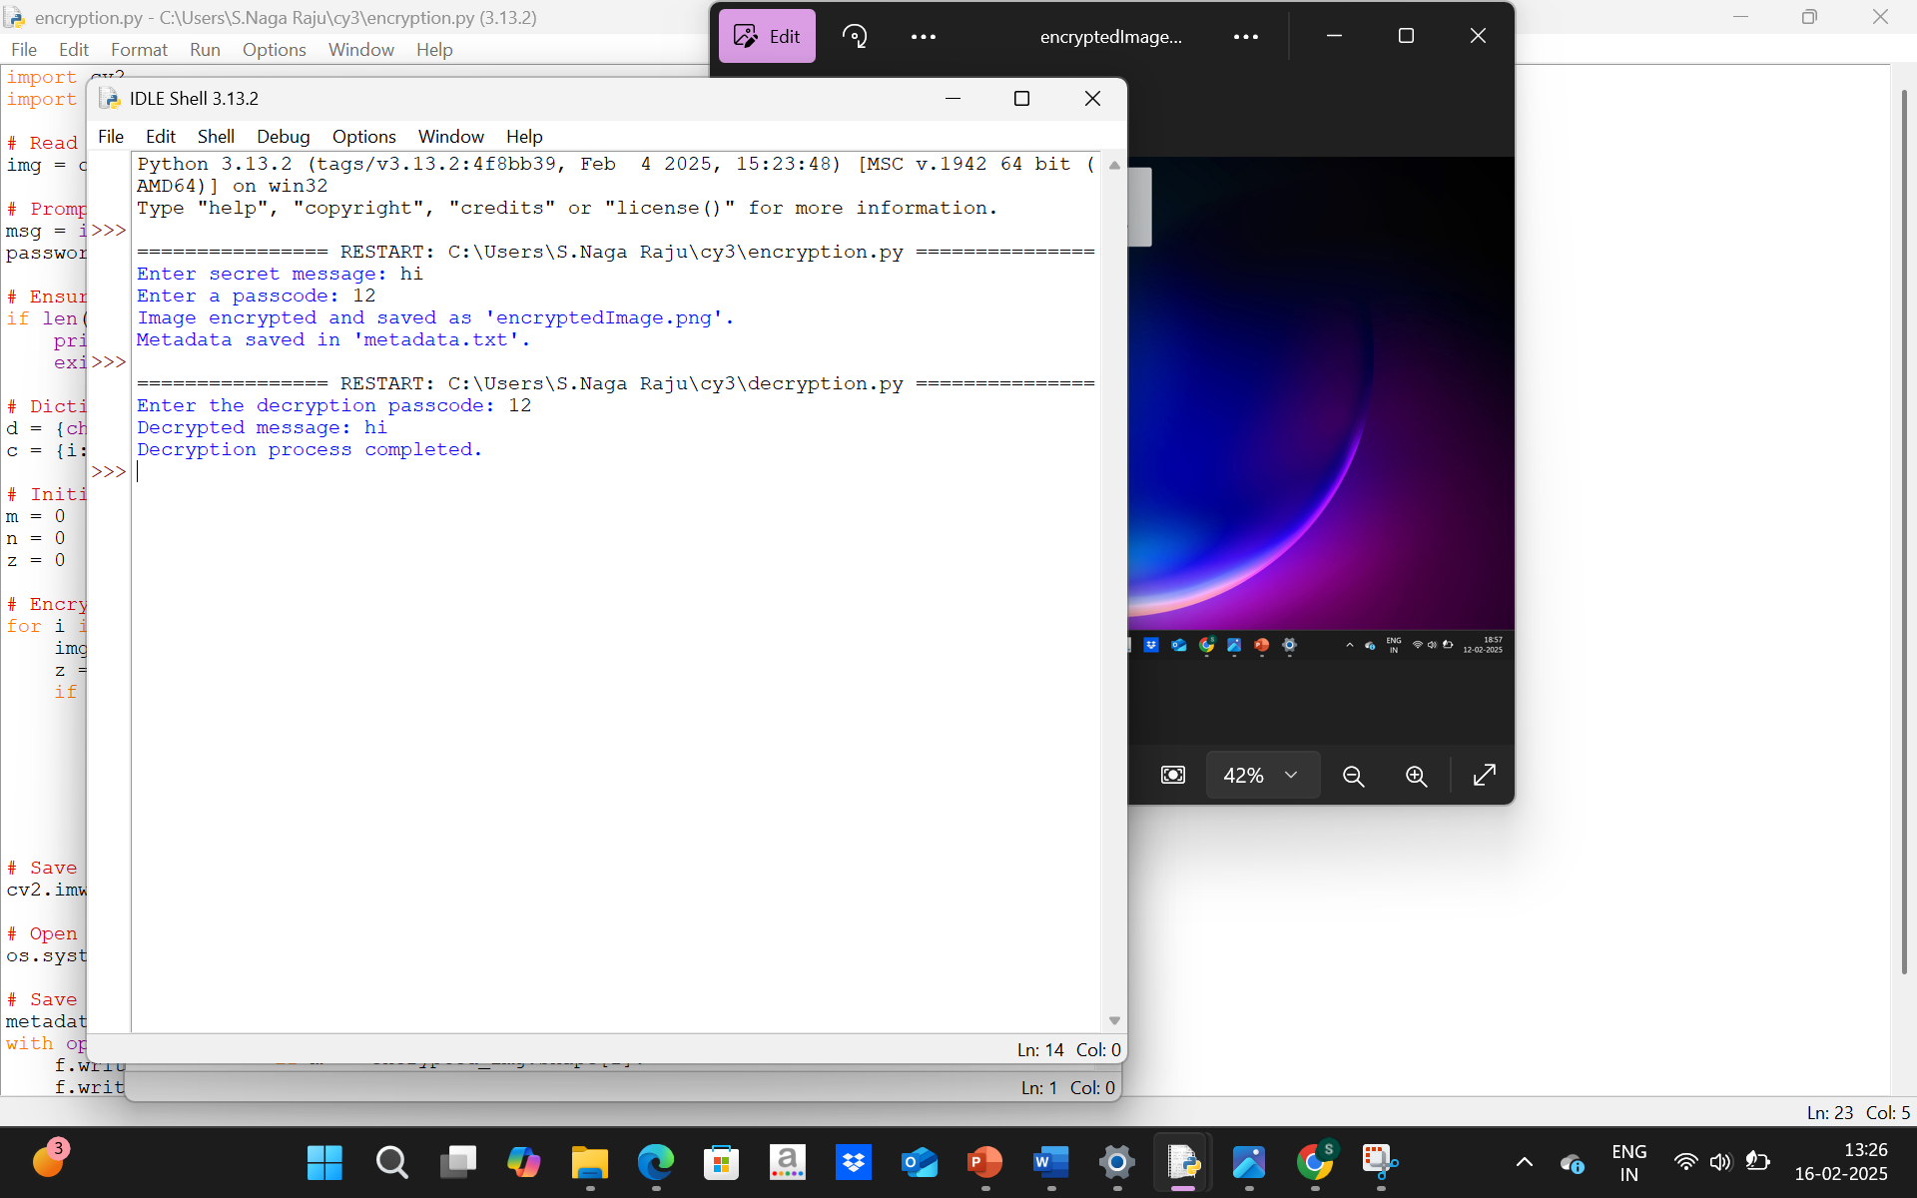
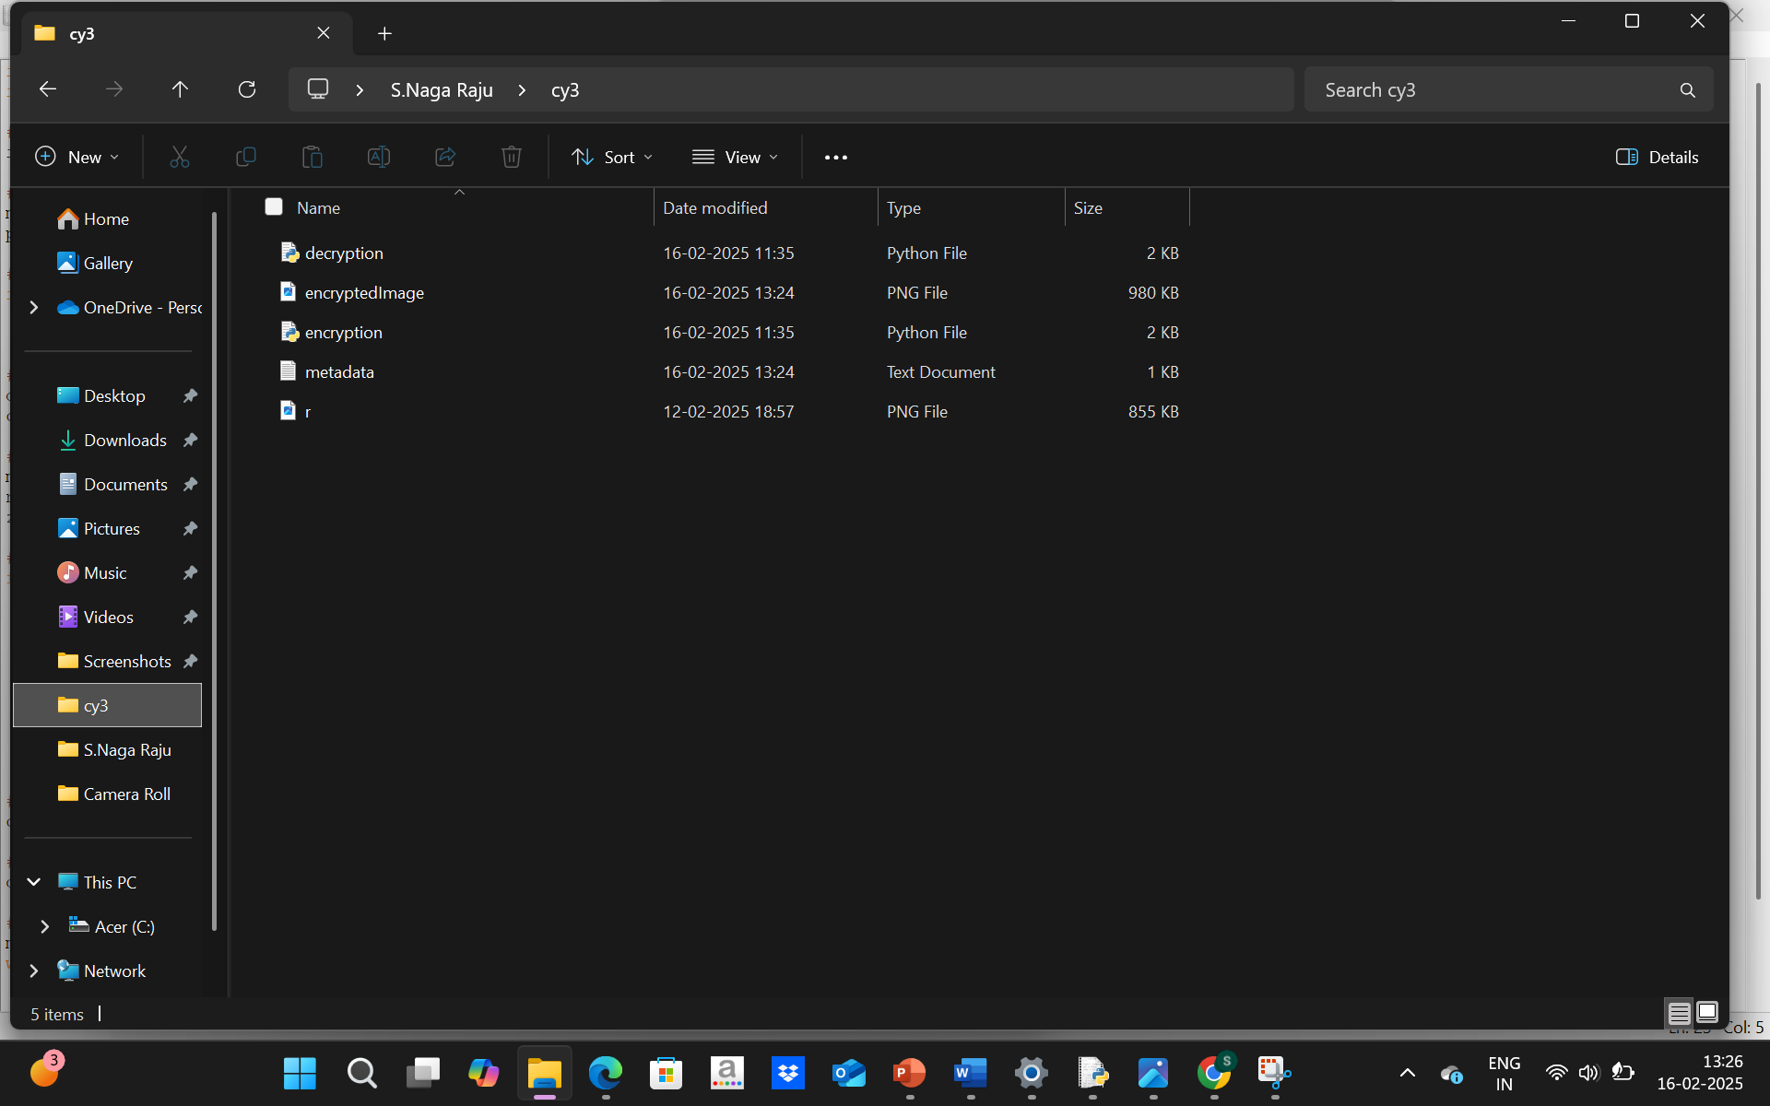
Results

Slide 8
Conclusion
Steganography is an effective method for secure data hiding, making communication safer without raising suspicion. This project successfully implements a password-protected steganographic approach that ensures confidentiality while maintaining the integrity of the cover image. It provides a simple yet robust solution for secure information transfer.

Slide 9
GitHub Link
Link:https://github.com/Naga003/steganography_project.git

Slide 10
Future scope
Increased Storage Capacity: Improve algorithms to store larger messages within an image without compromising quality.
Advanced Encryption Integration: Implement AES or RSA encryption to provide double-layer security before hiding data.
Support for Multiple File Formats: Expand beyond .jpg to include .png, .bmp, and other formats.
Mobile & Web App Development: Create a user-friendly interface for non-technical users to encode and decode messages easily.
AI-Powered Steganalysis Resistance: Strengthen security against AI-based techniques that detect hidden data in images.

Slide 11
THANK YOU

