Slide 1
Mapping data
Chassis ID: 125225

Slide 2
Search
Search for a single chassis ID or engine serial number
Chassis ID:
or
GJ125225
ESN:
Search

Slide 3
CEP Data
Chassis ID: GJ125225
Build Set
Date: 09/28/2015
Hours: ?
CEP Data
ESN: Y094453
Engine Family: FPCRH12.9M01
Model Year: 2015
Breakdown of engine configuration: E4N0C8934945423000
TRANS: EATON ADVANTAGE FAO16810SEP3 10 SPD,W/ HILL START AID, MX ENG ONLY
HP Rating: 455HP / 1650 LB-FT (IDAT chassis found only 455)
Truck Model: T680 Series Conventional
Software Level: PC4__1408P151F (Support Link log files) – Davie4
Machining Assembly: Phase 2
Notes:
Machining Assembly (get information from CEP software) – Phase 2
Contact Gene Nagy
See Sam’s email to know how to get the data

Slide 4
Plant Data
Chassis Build
Date: 10/09/2015
Hours: ?
Plant Data
Chassis ID: GJ125225
Transmission Configuration: TRANS: EATON ADVANTAGE FAO16810SEP3 10 SPD,W/ HILL START AID, MX ENG ONLY
Application: LINEHAUL
Mileage: 674661.50 km ?
Software Engine: ?
After Treatment Software Level: RH Under ?
Rear Axle Ratio: 0293
Notes:
Ask Andrew or Aaron the following:
Transmission Configuration (from iDAT or snowflake)
Software Engine
After Treatment Software Level
Current mileage get from Davie4 (Sam’s email)

Slide 5
Dealer Date
In Service
Date: 03/12/2015
Hours: ?
Dealer Date
Build Date: 09/10/2015
Engine Date: 28/09/2015
Dealer Date: 03/12/2015
Notes:
- Engine Date is care for Engine Inspection
- Dealer Date rule provided by Current Product (reconfirm with them) if the delivery date is different than the service date, shows the delivery date.

Slide 6
SL Case (Sam’s email – Oracle Sw)
Display SL Case (Use the first SL in IDAT)
SL ID: 180611-000565
Disposition: HP Fuel Injector
Attachment and Messages (Same as IDAT – Case Notes and Attachments)
link to SL case
Dealer Story: How do I link Warranty Claim with SL? Dealer Story is in the Warranty
Notes:
Warranty Claim SL Link in iDAT (each case has to be plot in the timeline chart).
How to find if a Warranty Claim has a SL Case?
Waiting for Aileen about how to get the physical attachments files

Slide 7
Claim Info 10/21/2015
Display Claim Info
Claim
Dealer Story
Part Replaced
Cost Associated
Warranty
15296-9196-A875
16118-6708-A875
16133-6775-A875
17123-8799-A875
17187-0182-A875
17236-0431-A875
…
Claim
Date: 10/21/2015
Hours: ?
SL Case
Claim Info
Attachments
Davie Logs
Notes:
Current product asked to export all the fields the Excel file generated in IDAT (confirm with Andrew)

Slide 8
Attachments
Display Attachments
Link to the Dealer Warranty Claims Attachment Viewer application?
Notes:
Dealer Warranty Claims Attachment Viewer application (Not for Engine Inspection – Current Product)

Slide 9
Davie Logs
Display Davie Logs
Link to the Davie log application?
Notes:
Oracle Support Link, IDAT, attachment, d4 report generator (too much logs better use IDAT orSL)

Slide 10
Summary of Claims
Display Summary of Claims
Display all the fields as the Excel file generated in IDAT application (Warranty Tab) ~ 65 fields ?
Notes:
Nice to have

Slide 11
Fault Codes
Display list of Fault codes if they are in the same X and Y axis
Display the P code in the Fault Code event if there is one for the X and Y axis
FC
FC: P0087

Slide 12
Campaign
Display Campaign
Campaign Code:
Status:
Notes:
iDAT Warranty Tab – find campaigns (Ask Andrew)

Slide 13
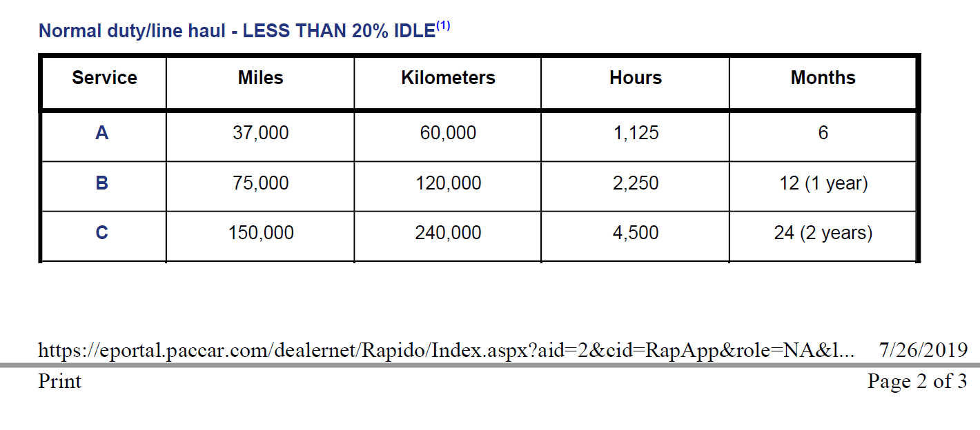
Service Interval
The service interval events will be plot according to the maintenance schedule
Notes:
If we are unable to get information from Service Rapido, can we get information from this poster 2017 Maintenance Intervals?
Do you have an idea who create this poster? Who can I contact? (Ask Andrew) No, engine Inspection

Slide 14
Other options
Print the timeline chart
Export timeline data in different formats
Export to PDF file
Export to Excel File
Export Summary of Claims in Excel File
Configure the X and Y axis in the timeline chart
Notes:
X for day, week and month; Y for miles and hours

Slide 15
Phase 2
List of requirements

Slide 16
List of requirements
Display the vehicle information (combination of Engine Build and Chassis Build) when the timeline chart is loaded.
Produce a report with the selected fields displayed in the timeline chart (PDF or Excel format?)
Search for multiple Chassis ID or Engine Serial Number. Have a list to choose.
Compare the chassis with the rest of population

Slide 17
Next Steps
- Modify the requirements after the meetings if it is needed.
- Confirm with stakeholders if mapped data corresponds with the data requirements.

