Slide 1
Mapping data
Chassis ID: 222666

Slide 2
Search
Search for a single chassis ID or engine serial number
Chassis ID:
or
KJ222666
ESN:
Search

Slide 3
CEP Data
Chassis ID: KJ222666
Build Set
Date: 03/06/2018
Hours: ?
CEP Data
Head Machining
Block Machining
ESN: X006250
Engine Family: JPCRH10.8M01
Model Year: 2018
Breakdown of engine configuration: E40FF1E7C960574400
MX-11 430 430@1600 1650@900 2017 W/ENG BRK
HP Rating: 430HP / torque (like webecat)
Truck Model: T680 Series Conventional
Current Software Level: PC4__1463P181C (Remote Diagnostics)
Last Software Level: ?
Notes:
Machining Assembly (Sam’s Request)
Head Machining
Block Machining

Slide 4
Plant Data
Chassis Build
Date: 03/16/2018
Hours: ?
Plant Data
Chassis ID: KJ222666
Transmission Configuration: TRANS: EATON ADVANTAGE FAO16810SEP3 10 SPD,W/ HILL START AID, MX ENG ONLY
Application: LINEHAUL
Mileage: 193883.88 km ? Current one from Davie4 or RD
After Treatment Software Level: Remote Diagnostics? Ask Brent
Rear Axle Ratio: 0279
Dealer Date: 06/14/2019
Notes:
Ask Andrew or Aaron the following:
Transmission Configuration: FLR ADV AUTOMATED FAO-16810S-EP3 10SPD W/ HSA *USE W/ MX ENGINES
Software Engine
After Treatment Software Level

Slide 5
Claim Info 04/08/2018
Display Claim Info
Claim: 18099-9177-I080
Warranty
Dealer Story: DEALER REIMBURSEMENT FOR PERFORMANCE OF TRUCK PRE-DELIVERY |INSPECTION | |
Claim
Date: 04/08/2018
:
Hours: ?
Part Replaced:
Claim Info
Attachments
Cost Associated
Davie Logs
Parts: 0
Labor: 252
Total: 252
Campaign #: PDI
Linnk to the Bulletin only for Campagin starting with ‘E’
Notes:
Confirm with Andrew or Aaron if he wants the Excel file generated in IDAT instead of seeing the information above
Can I add the campaign in the claim info or should I put it as a link? In what system do you see the campaign status?
When there is campaign, put the label Campaign claim. Found the number in the dealer story
Have a filter for Engine only (Claim Type = ‘MX STD WTY’)
Link for the bulletin: https://eportal.paccar.com/dealer/uskw/en/service/enginebulletins/enginefieldservice/Pages/E241.aspx

Slide 6
Claim Info 12/17/2018
Display Claim Info
Claim: 19011-2089-K085
Warranty
Dealer Story: CEL PULLED UNIT IN HOOKED UP COMPUTER PULLED CODES |TSHOT FC P1495 REGEN INCOMPLETE. BACKED UNIT OUT STARTED |REGEN REGEN COMPLETED NO ISSUES CLEARED CODES |ROAD TEST NO ISSUES
Claim
Date: 12/17/2018
:
Hours: ?
Claim Info
Part Replaced:
Attachments
Davie Logs
Cost Associated
Parts: 0
Labor: 184
Total: 184

Slide 7
Claim Info 03/08/2019
Display Claim Info
Warranty
Claim
Dealer Story
Cost
Parts Replaced
Campaign No
Claim
19072-6185-I080
19074-2161-K085
19074-2159-K085
19150-2240-K085
19074-2160-K085
18KWH: EATON.. CUSTOMER ..
18KWH: EATON..
CUSTOMER ..
CUSTOMER ...
View
View
18KWH
18KWH
Date: 03/08/2019
:
View
View
Hours: ?
View
View
Claim Info
View
View
Attachments
View
View
Davie Logs

Slide 8
Rules for Warranty Period
Basic Warranty Period: 250K miles
End of Basic Warranty : 500 K miles

Slide 9
SL Case (There is no SL for KJ222666)
Display SL Case (Use the first SL in IDAT)
SL ID:
Disposition:
Attachment and Messages (Same as IDAT – Case Notes and Attachments)
link to SL case

Slide 10
Attachments
Display Attachments
Link to the Dealer Warranty Claims Attachment Viewer application?
Notes:
Dealer Warranty Claims Attachment Viewer application (Not for Engine Inspection – Current Product)

Slide 11
Davie Logs
Display Davie Logs
Link to the Davie log application?
Notes:
Oracle Support Link, IDAT, attachment, d4 report generator (too much logs better use IDAT orSL)

Slide 12
Summary of Claims
Display Summary of Claims
Display all the fields as the Excel file generated in IDAT application (Warranty Tab) ~ 65 fields ?
Notes:
Nice to have

Slide 13
Fault Codes
Display list of Fault codes if they are in the same X and Y axis
Display the P code in the Fault Code event if there is one for the X and Y axis
FC
FC: P0087
Notes:
Ask Andrew and Aaron to show me the FC (Remote Diagnostics?)

Slide 14
Campaign
Display Campaign
Campaign Code:
Status:

Slide 15
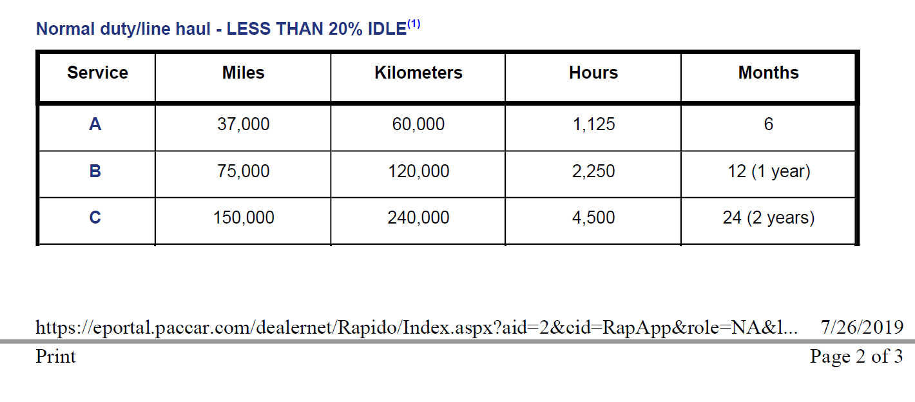
Service Interval
The service interval events will be plot according to the maintenance schedule
Notes:
Not access to Service Rapido

Slide 16
Scenarios
A chassis can have multiple engines
When the miles for the claim is 99 or 1 or 1000, the claim needs to be reviewed
Notes:
X for day, week and month; Y for miles and hours

Slide 17
Other options
Print the timeline chart
Export timeline data in different formats
Export to PDF file
Export to Excel File
Export Summary of Claims in Excel File
Configure the X and Y axis in the timeline chart
Notes:
X for day, week and month; Y for miles and hours

