Slide 1
Mapping data
Chassis ID: 376611

Slide 2
Search
Search for a single chassis ID or engine serial number
Chassis ID:
or
KJ376611
ESN:
Search

Slide 3
CEP Data
Chassis ID: KJ376611
Build Set
Date: 12/10/2018
Hours: ?
CEP Data
Head Machining
Block Machining
ESN: Y187007
Engine Family: JPCRH12.9M01
Model Year: 2018
Breakdown of engine configuration: E4X7E5D7B356614300
MX-13 455 455@1600 1650@900 2017 W/ENG BRK ?
HP Rating: 455HP
Truck Model: T680 Series Conventional
Software Level: PC4__1463P181C ?
Notes:
Should be Engine build date or Build date?
Confirm with Andrew and Aaron about Breakdown of engine configuration and Software Level
Machining Assembly (Sam’s Request)
Head Machining
Block Machining

Slide 4
Plant Data
Chassis Build
Date: 12/18/2018
Hours: ?
Plant Data
Chassis ID: KJ376611
Transmission Configuration: TRANS: PACCAR PO16F112C 12 SPD 1650 LBFT, W/ HILL START AID
Application: REGIONAL HAUL
Mileage: 32311.00 km ? Current one from Davie4
Software Engine: ?
After Treatment Software Level: Unknow?
Rear Axle Ratio: 0267
Notes:
Ask Andrew or Aaron the following:
Transmission Configuration: FLR ADV AUTOMATED FAO-16810S-EP3 10SPD W/ HSA *USE W/ MX ENGINES
Software Engine
After Treatment Software Level

Slide 5
Dealer Date
In Service
Date: 01/18/2019
Hours: ?
Dealer Date
Build Date: 12/18/2018
Engine Date: 12/10/2018
Dealer Date: 01/18/2019
Notes:
- Engine Date is care for Engine Inspection
- Dealer Date rule provided by Current Product (reconfirm with them) if the delivery date is different than the service date, shows the delivery date.

Slide 6
Claim Info 01/03/2019
Display Claim Info
Claim: 19003-9712-S054
Warranty
Dealer Story: DEALER REIMBURSEMENT FOR PERFORMANCE OF TRUCK PRE-DELIVERY |INSPECTION | |
Claim
Date: 01/03/2019
:
Hours: ?
Part Replaced:
Claim Info
Attachments
Davie Logs
Cost Associated
Parts: 0
Labor: 280
Total: 280
Campaign #: PDI?
Notes:
Confirm with Andrew or Aaron if he wants the Excel file generated in IDAT instead of seeing the information above
For Warranty Claim is using the report date. Is it Ok?
Can I add the campaign in the claim info or should I put it as a link? In what system do you see the campaign status?

Slide 7
Claim Info 04/05/2019
Display Claim Info
Warranty
Claim
Dealer Story
Cost
Parts Replaced
Campaign No
Claim
19115-6619-I080
19115-6621-I080
19115-6620-I080
19162-6899-I080
E209: TURBO SPE.
.CEL ON & LOW..
CHECK TRANS LIG..
TRANS WILL NOT..
View
View
PDI
E209
Date: 04/15/2019
View
View
Hours: ?
View
View
Claim Info
View
View
Attachments
Davie Logs

Slide 8
SL Case
Display SL Case (Use the first SL in IDAT)
SL ID:190411-001136
SL Case
Date: 4/11/2019
Disposition: Turbo Charger Assembly
Hours: ?
SL Case
Messages:
Sam Devalal Posted: 4/15/2019 4:58:45 AM Hooked up to unit after test drive no codes in PCI
…..
Attachments:
File Name
Type
Date
2636791_@CKJ376611_@Detailed view_@D20190415_074552.pdf
Application/pdf
2019-04-15 04:58:45
2636413_ups newlog.pdf
Application/pdf
2019-04-13 05:33:14
2636408_1XKYAP8X5KJ376611_N13299_@Regenerate ..
Text/plain
2019-04-13 05:02:52
More..

Slide 9
Attachments (No yet – Working on getting access)
Warranty
Claim
Date: 01/03/2019
:
Hours: ?
Claim Info
Attachments
Davie Logs
Link to the Dealer Warranty Claims Attachment Viewer application?
Notes:
Dealer Warranty Claims Attachment Viewer application (Not for Engine Inspection – Current Product)

Slide 10
Davie Logs
?
Display Davie Logs
Warranty
Claim
Date: 01/03/2019
:
Hours: ?
Claim Info
Attachments
Davie Logs
Link to the Davie log application?
Notes:
There is no SL for this Warranty Claim date. Is there Davie Logs?

Slide 11
Summary of Claims
Display Summary of Claims
Display all the fields as the Excel file generated in IDAT application (Warranty Tab) ~ 65 fields ?
Notes:
Nice to have

Slide 12
Fault Codes
Display list of Fault codes if they are in the same X and Y axis
Display the P code in the Fault Code event if there is one for the X and Y axis
FC
FC: P0087
Notes:
Ask Andrew and Aaron to show me the FC (Remote Diagnostics?)

Slide 13
Campaign
Display Campaign
Campaign Code:
Status:

Slide 14
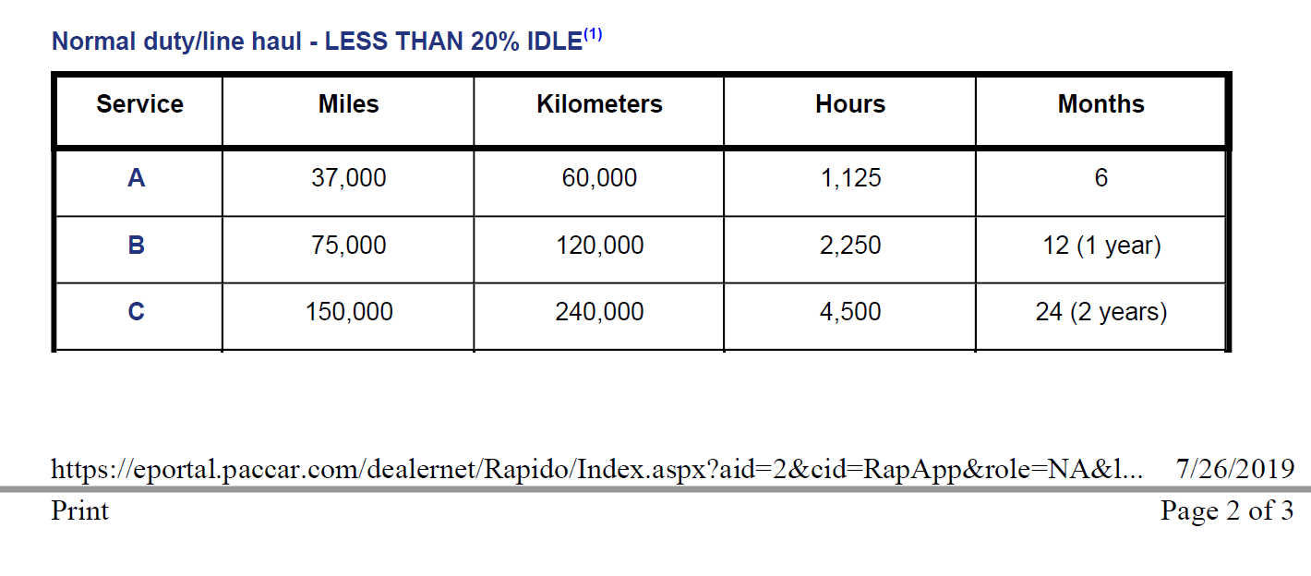
Service Interval
The service interval events will be plot according to the maintenance schedule
Notes:
Not access to Service Rapido

Slide 15
Other options
Print the timeline chart
Export timeline data in different formats
Export to PDF file
Export to Excel File
Export Summary of Claims in Excel File
Configure the X and Y axis in the timeline chart
Notes:
X for day, week and month; Y for miles and hours

