Slide 1
Player Classification Using Random Forest Machine Learning Model
-NAGA BHAGAVAN

Slide 2

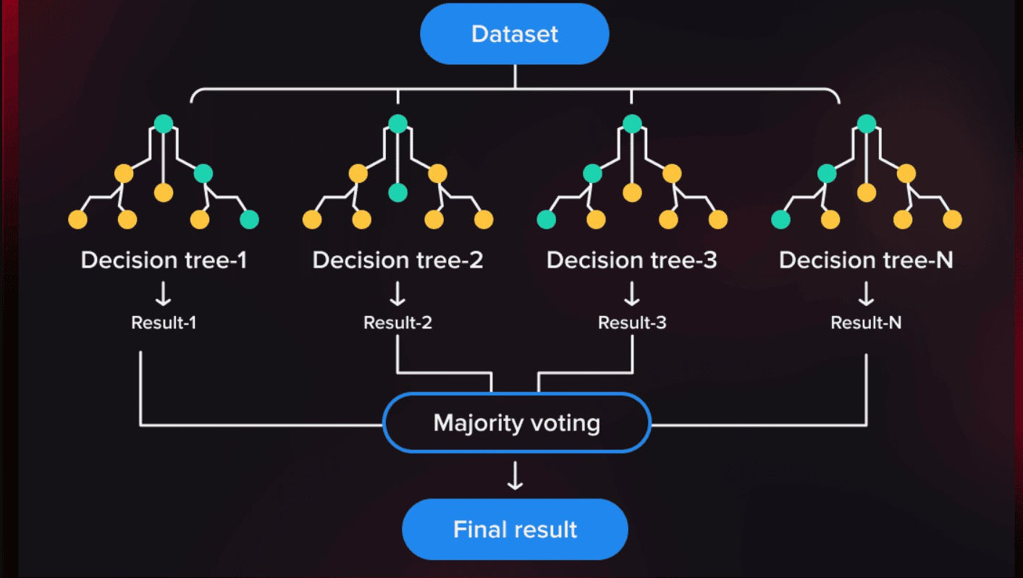
Introduction :
In this presentation, we will explore the use of machine learning model for player classification. We will discuss the process of feature selection, model training, and evaluation. Let's dive into the world of sports analytics and machine learning.
Problem Statement: Classify cricket players into four categories ('Best', 'Good', 'Average', and 'Bowler') based on their batting statistics.
Approach: Use a Random Forest Classifier from scikit-learn to train a model on the given dataset.

Slide 3



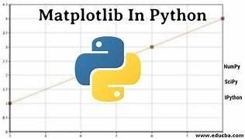

Tools and libraries used:

Slide 4
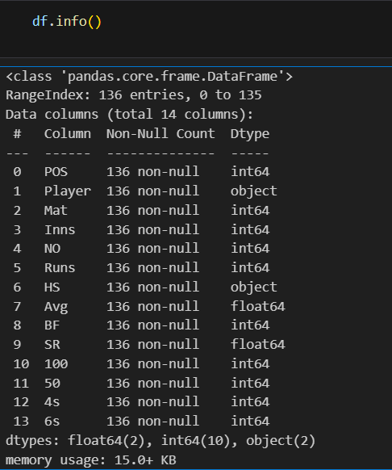
Data Set Info :

Slide 5
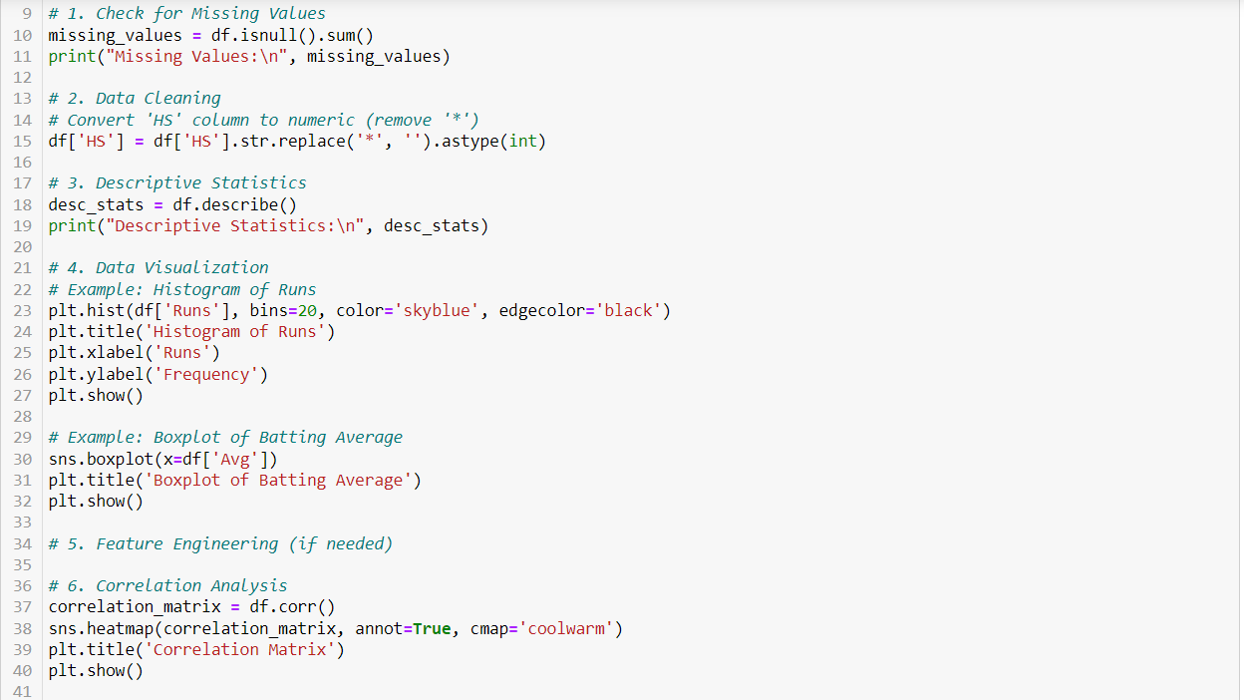
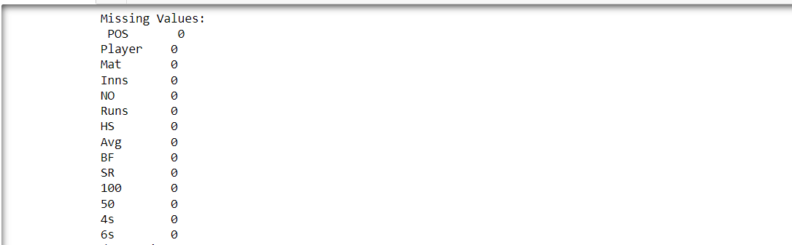
Data Preprocessing :
Data preprocessing involved identifying and removing outliers, ensuring data integrity and reliability for subsequent analyses.
Apply the function to the DataFrame and create a new column 'Category'.

Slide 6
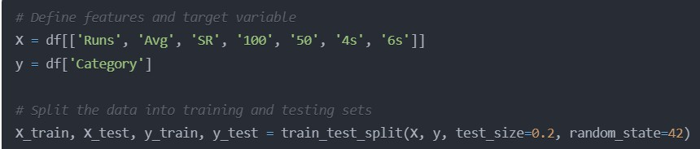
Feature Selection and Data Splitting :
Define the features (X) and the target variable (y). Split the data into training and testing sets using train_test_split from scikit-learn.

Slide 7
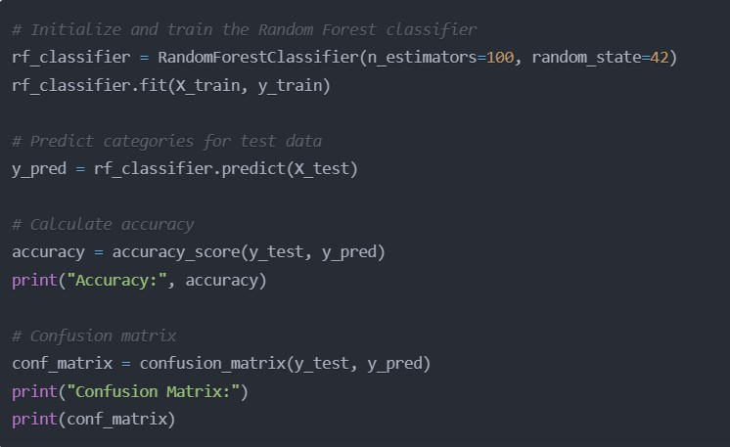
Model Training and Evaluation
Initialize a Random Forest Classifier with 100 estimators (decision trees).
Train the classifier using the training data.Make predictions on the test data.
Calculate the accuracy of the model using accuracy_score from scikit-learn.
Calculate and print the confusion using confusion_matrix from scikit-learn.
matrix

Slide 8
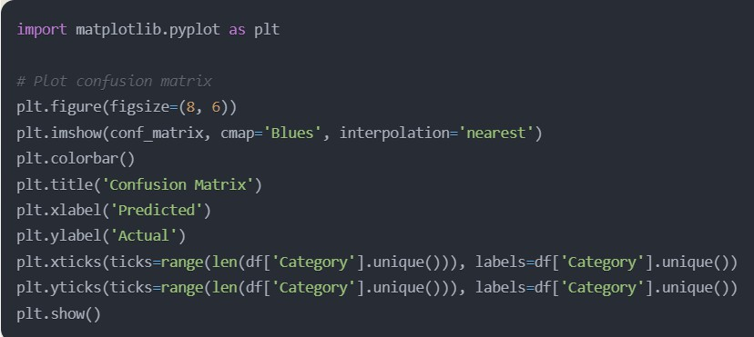
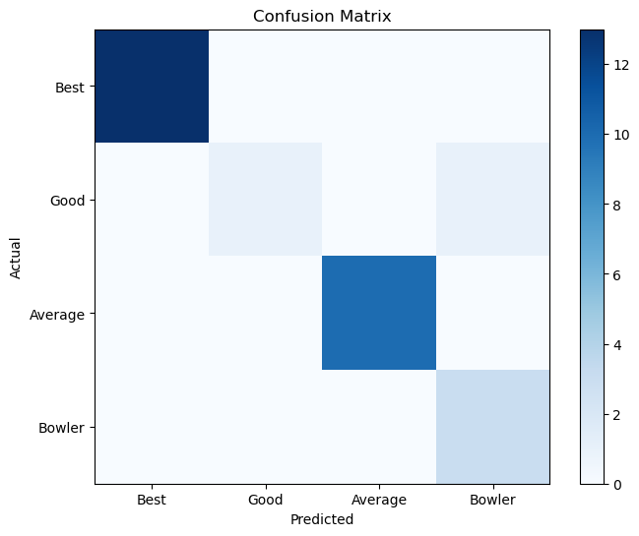
Confusion Matrix Visualization
Import the matplotlib.pyplot library for visualization.Plot the confusion matrix as a heatmap using plt.imshow.
Customize the plot with labels, title, and color map.Display the plot using plt.show().

Slide 9
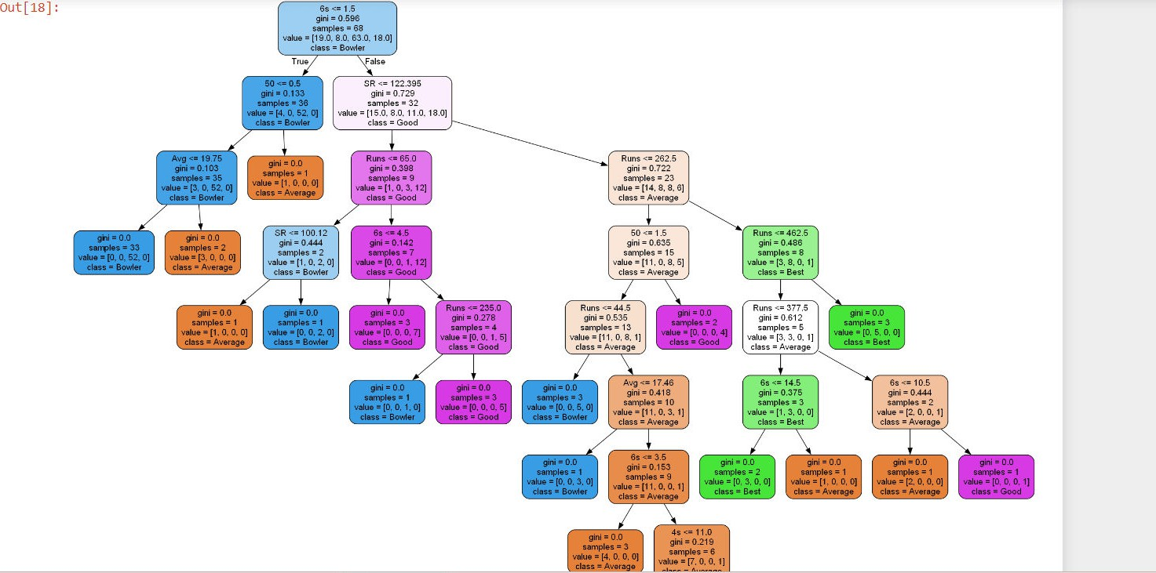
Decision Tree Visualization
Import the necessary libraries for decision tree visualization.Extract a specific decision tree from the Random Forest model.
Export the decision tree to a .dot file
using export_graphviz from scikit-learn.Convert the .dot file to a .png image using pydot.Display the decision tree image using Image from IPython.display.

Slide 10
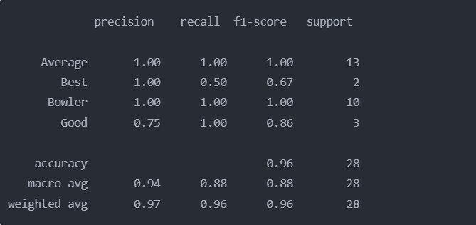
Classification Report
Present the classification report generated by the model.Explain the different metrics (precision, recall, f1-score, support) for each class.
Discuss the overall accuracy and the macro and weighted averages.

Slide 11
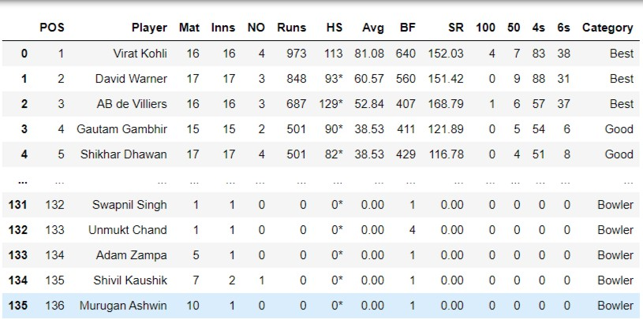
Conclusion
The Random Forest model accurately classified players into 'Best', 'Good', and 'Bowler' categories primarily based on their batting averages, with high averages indicating better batters and low averages representing bowlers.

Slide 12
THANK YOU

