Slide 1

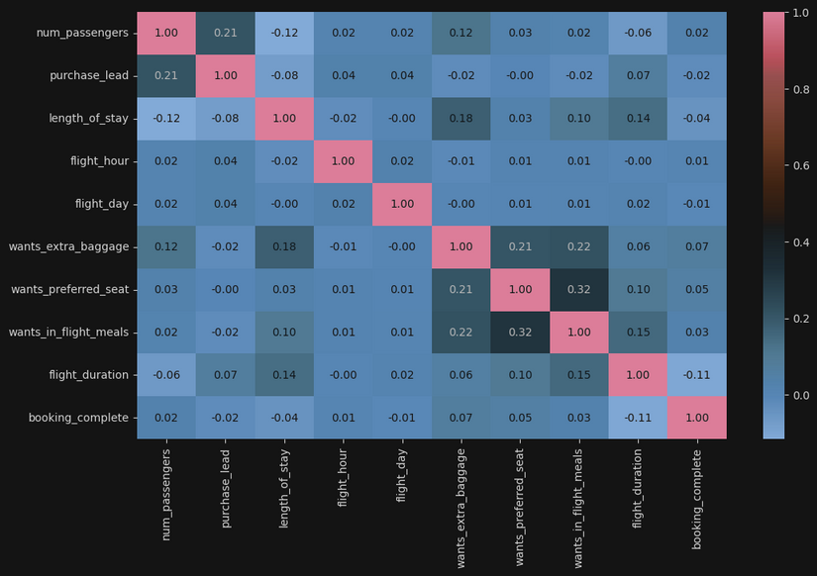
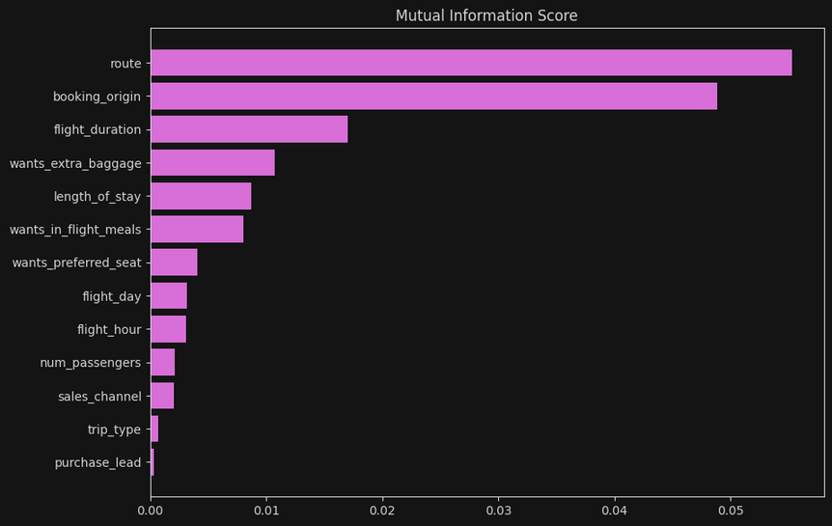
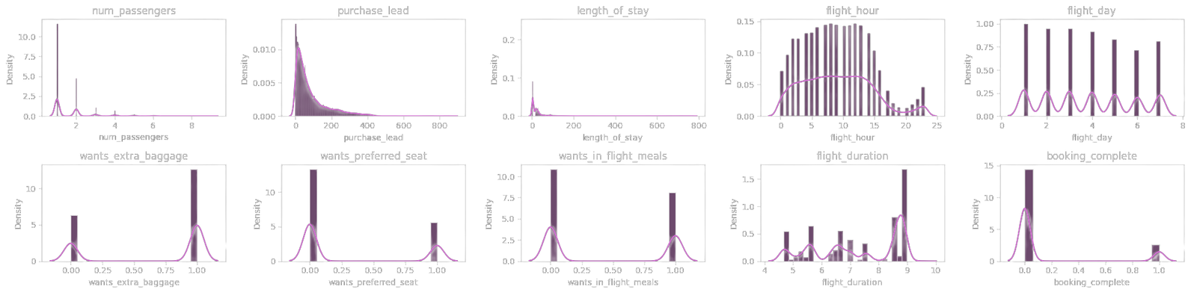
Top 5 Features which influence customer behaviour:
route
booking_origin
flight duration
wants_extra_baggage
length_stay
Accuracy From RandomForest: 85.39
AUC Score: 0.57

