Slide 1
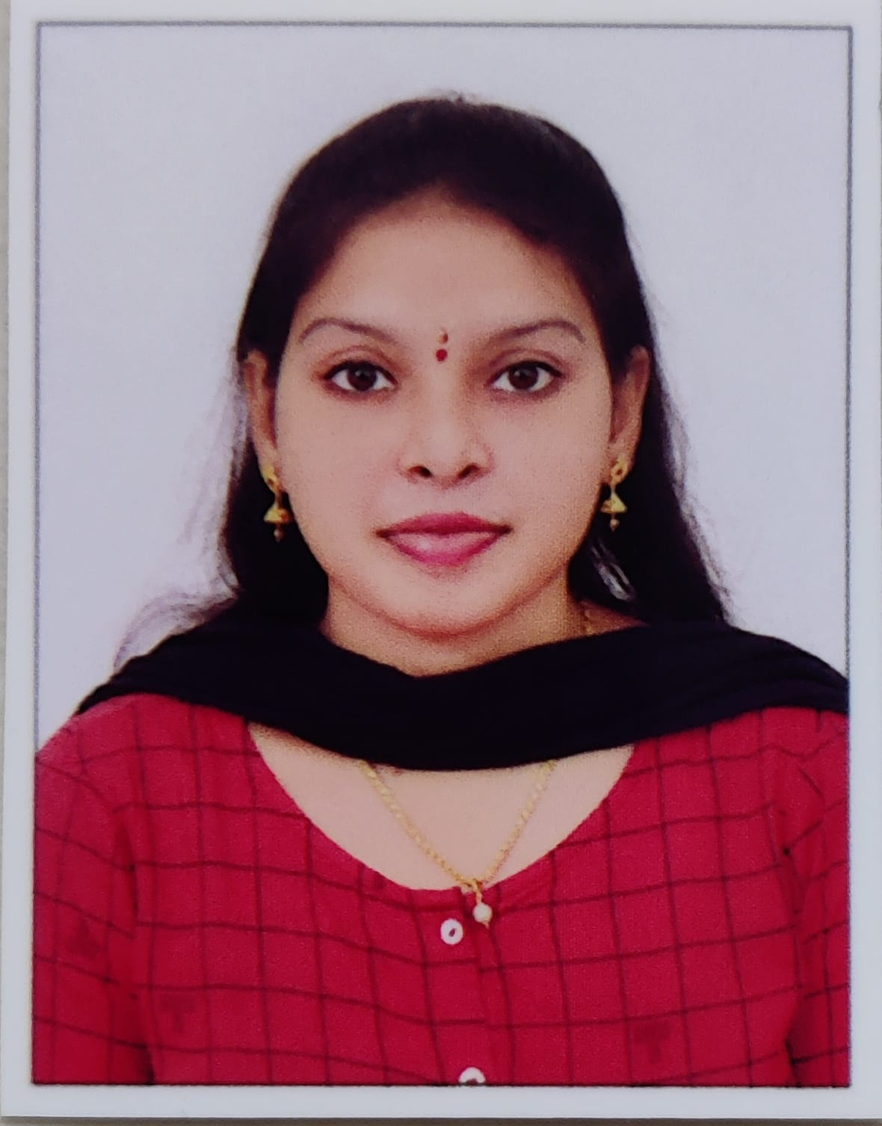


KUNNERLA NAGAJYOTHI
Analyst/Software Engineer
Bachelor of Technology in
Computer Science and
Engineering :2017-2021
Skills Java 8 /J2EE
Spring Boot
Spring MVC
JPA CRUD
Bootstrap
React
RPA(UIPath)
Database
SQL database – MySQL
Web Technologies
HTML5
CSS3
JavaScript
Add-ons
GitHub
Maven
Postman
Additional Details
Leadership
Excellent Communication Skills
Team management
Quick Learner
Mumbai
nagajyothi.kunnerla@capgemini.com
+91 6281418317
A4
A self driven learner with Front-End and Back-End Knowledge. Passionate about implementing and launching new projects.
A team player with good communication skill always ready to work for the enrichment of knowledge.
Hands on experience in creating Web Application with Spring boot , Java, Rest API, React.
Hands on experience in developing web pages using HTML5, CSS3, Object Oriented Programming, JSON, XML. Good understanding of Document Object Model DOM) and DOM Functions.
Proficient in creating Web Application in React with Authentication with routing.
Experience in creating documentation with swagger and unit testing using JUnit and Mockito.
Online Plant Nursery Application
Completed end to end case study of Online Plant Nursery application System . along with API Gateway, Swagger, Postman, responsive UI with HTML5, CSS, Bootstrap and React used as User Interface.
HTML, CSS, JAVASCRIPT for web developers at Coursera
Completed this course with 91.6% and Designed responsive Restaurant website using HTML5 CSS3 Bootstrap and JavaScript.
Certifications
Automation Anywhere University certified ESSENTIALS RPA Professional

