Slide 1
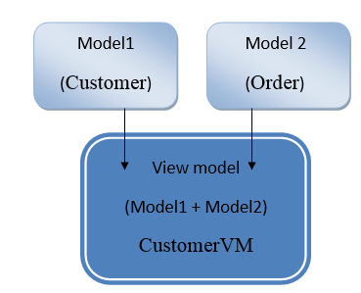
ViewModel in Asp.Net MVC
The viewmodel in asp.net mvc represent only the data we want to display on view whether it is used for displaying or for taking input from view. If we want to display more than one model on view in asp.net mvc then we need to create a new viewmodel. Following image shows visual representation of view model in asp.net mvc.
with simple example if we have a Customer entity and Order entity. In view to display both entities (Customer entity + Order entity) data then we need to create viewmodel (CustomerVM) and we will select the properties whichever we want to display from both entities (Customer entity + Order entity) and create a viewmodel.

