Slide 1
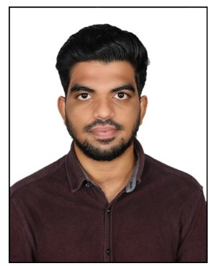



Naga Manindra Golla
Bachelor of Technology (B-Tech)
Computer Science Engineering : 2018-2022
Analyst/Software Engineer
Skills
Mumbai
Java 8 /J2EE | Java Basics, OOPS, Generics, Collections, Arrays, Loops, Lambda Exp, Stream API Junit, Mockito, Servlets
Spring core | IOC & Dependency Injection, Autowire
Spring REST | REST controllers, Implementation of GET, POST, PUT & DELETE, Bean Validation & Exception Handling, Testing Services, Controller & Repository layer
Spring Data JPA | Implement DAO layer using spring Data repositories, Transaction Management
Spring Boot Microservices | Spring Boot Starters, annotations, Messaging Service, Sync/Async comms, Swagger API specifications
Spring Cloud | Eureka, Hystrix, Config Server
React | Components, Hooks, Event handling, validation
Database | MongoDB Non-SQL
UI Tech | HTML 5 & CSS 3,JavaScript, ES6 & TypeScript Reusable templates, Optimized UI Designed
Tools | Git, Postman, Maven, Eclipse IDE, Visual Studio, SonarQube.
Add On skills | Communications, Team management.
NAGA.MANINDRA-GOLLA@CAPGEMINI.COM
+91 9515962633
A4
Java Full Stack Developer
Hands on experience in creating microservices with Spring Boot, Spring Security, Spring Cloud API Gateway, Eureka server.
Hands on experience in creating Single page Web Application in React.
Hands on experience in connecting MongoDB with spring boot and React.
Experience in creating documentation with Java docs and swagger and in unit testing using Junit, Mockito.
Experience in using Java DevTools like SonarQube.
Experience in unit testing like Junit, Mockito for Backend and Jest for React.
understanding of deploying spring boot applications in AWS Cloud environment.
Implementation of RabbitMQ
E-Shopping Zone
It is a Shopping Cart application built using Java Spring Boot and React. MongoDB was used as the backend. it was built by using microservices connected with Discovery Server and API Gateway. Java dev tools like SonarQube are also used. API Swaggers 3 is used for documentation. Unit testing with Junit in backend and Jest for frontend.
E-Voting System based on Block Chain Technology
It is Online voting system based on Block Chain Technology using python. It which SHA256 algorithm is used from encryption of data.
AWS Certified Cloud Practitioner
Certified in AWS Cloud Practitioner on AUG 30, 2022.
GCP Cloud Digital Leader
Certified in GCP Cloud Digital Leader on OCT 31, 2022.
Check out my work on GitHub & Video Profile

