Slide 1

A Visual Exploration of Refrigerator
Attributes

Slide 2

ABOUT US
Name:- Gogineni Naga Sai
Background :- MBA
Why you want to learn Data Science:- Data science is a very expanding and challenging field .This field is most exciting one that helps us to keep learning in continuous manner, which becomes an interest fact about this field where we can really never get bored of dealing with data.
Any work experience:- Fresher
Name:- Sri Naga Padmini
Background :- B-Tech
Why you want to learn Data Science:- Data science is a field that involves analyzing large and complex data sets to extract insights and inform decision-making. With the explosion of data in recent years, there is a high demand for us where we can collect, clean, and analyze data to derive meaningful insights.
Any work experience:- Fresher

Slide 3
CONTENTS
Introduction
Data Collection and Cleaning
Exploratory Data Analysis
UniVariate Analysis
BiVariate Analysis
MultiVariate Analysis
Conclusion

Slide 4
PROBLEM STATEMENT
Here the problem statement is when we are going to buy a certain item in online we will compare lot of brands with lot of features before making a choice.
In this, our analysis is on refrigerators using online webiste which brand is having more count and which price range the brand varies.
By this project, the consumers can buy easily and make a choice which brand is best with the price by seeing our analysis.

Slide 5
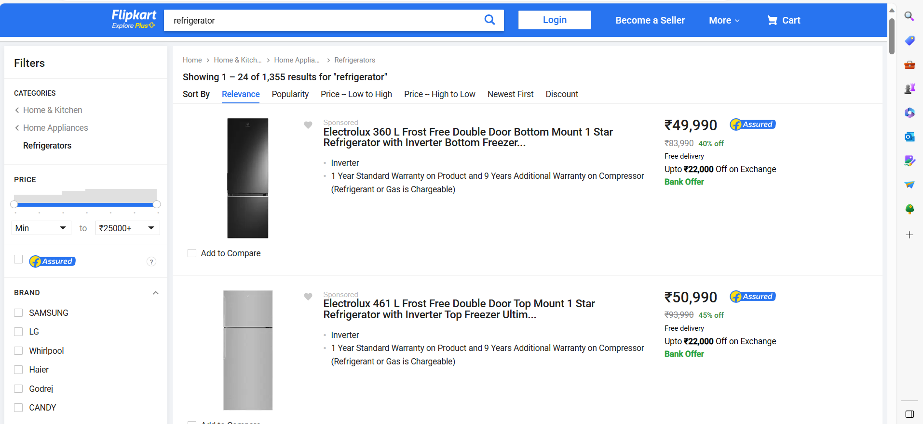
WEB SCRAPING-DETAILS Here we have taken Flipkart website for our analysis

Slide 6
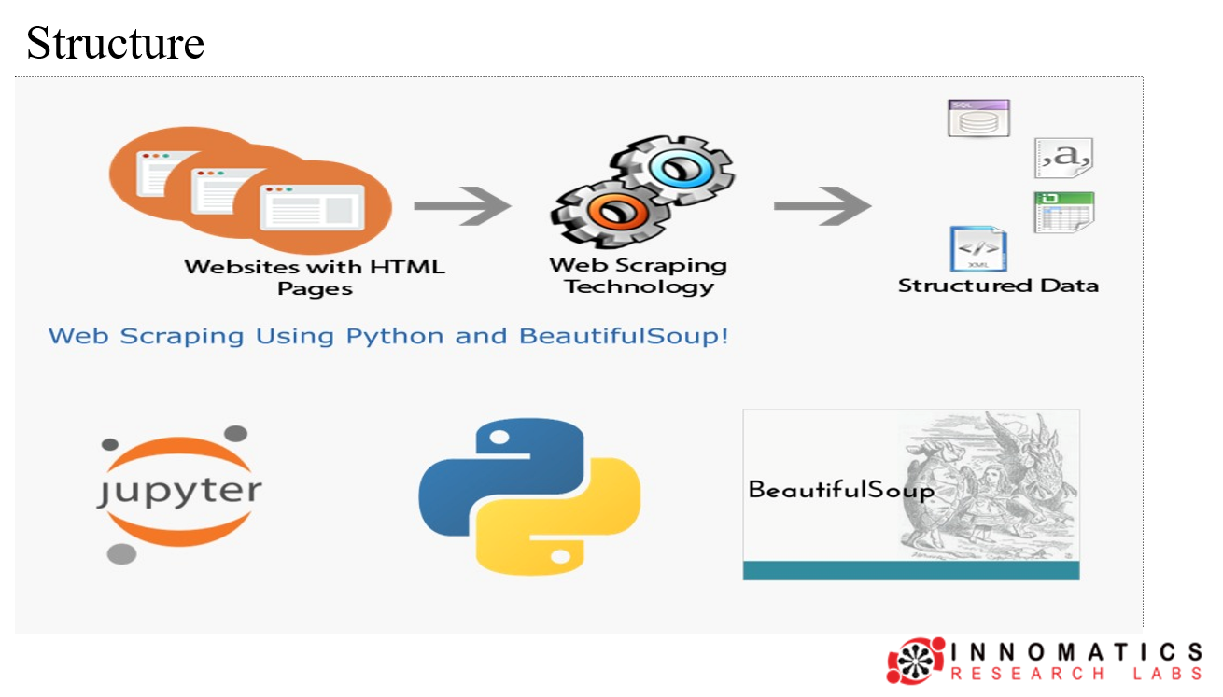
The Structure of the Web Scraping and tools used

Slide 7
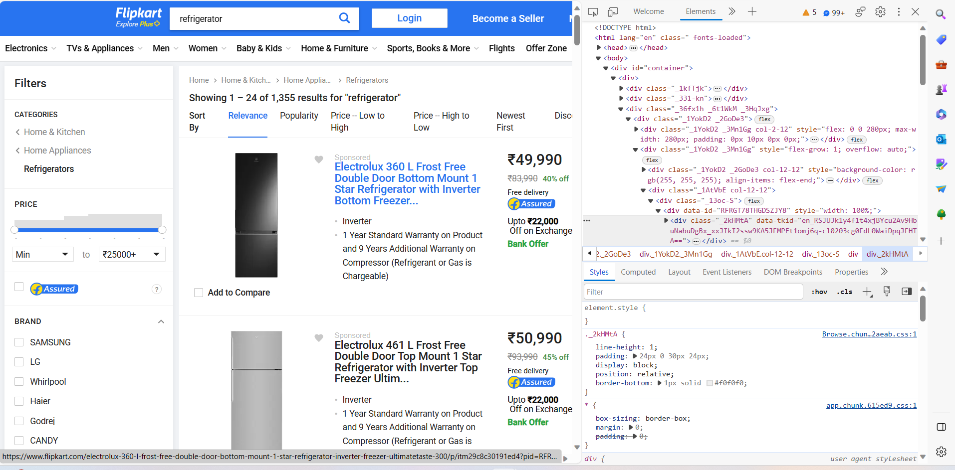
Extracting the Html Tags from website

Slide 8
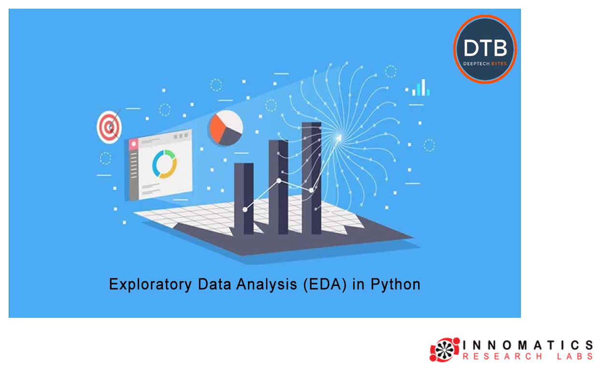

Slide 9
The Steps we did for Data cleaning and manipulation
we have some missing values in data we collected
We drop the duplicate values
We replaced that missing values of numerical columns with mean
We replaced that missing values of string columns with mode
We got all our columns with objective dtype
We change dtypes to respective data types

Slide 10
DATA VISUALIZATION
Univariate Analysis : The examination of the distribution of cases on only one variable at a time (e.g., weight of innomatics students)
Bivariate Analysis : The examination of two variables simultaneously (e.g., the relation between gender and weight of innomatics students)
Multivariate Analysis : The examination of more than two variables simultaneously (e.g., the relationship between gender, height and weight of innomatics students)

Slide 11
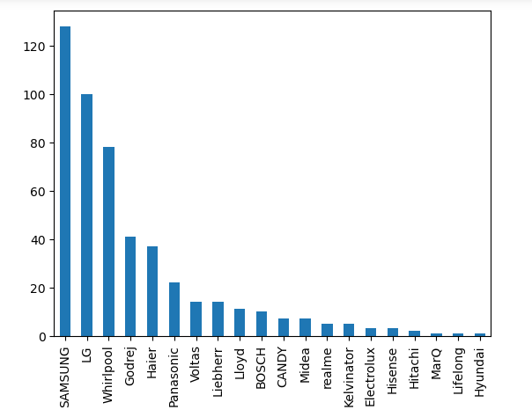
Uni Variate Analysis
In the above bar plot the Samsung refrigerator brand is having more count followed by LG and
less count is having Hyundai,Lifelong and MarQ

Slide 12
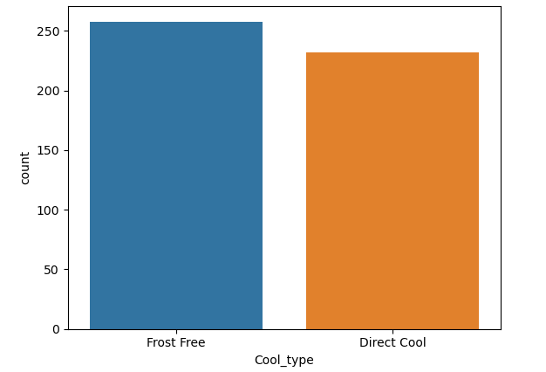
In the above count plot the frost free is having more count compare to direct cool type

Slide 13
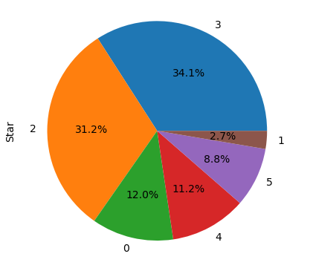
In the above pie chart the 3 star refrigerators are having high percentage ,
the 2 star also having good percentage similar to 3 star and
one star refrigerators are with very low percentage.

Slide 14
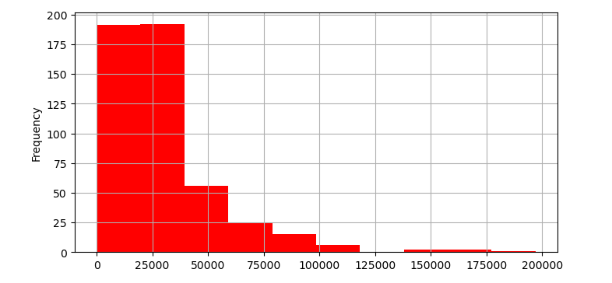
In the above histogram the no of fridges are Occured in the price range is above 20k and below 35k,
the least Occured are in the price range of 175k to 195k,
the second highest are in the price range of below 20k and there are no fridges between 120k to 135k and above 195k.

Slide 15
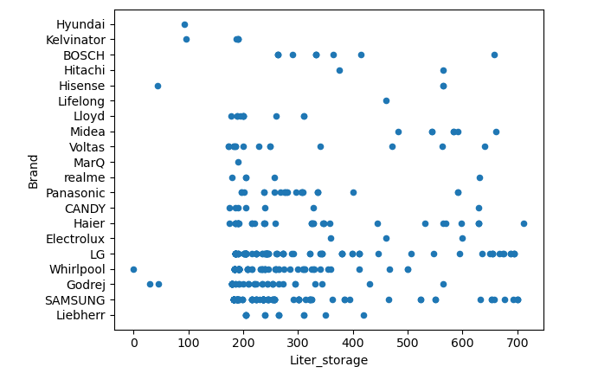
Bi Variate Analysis - Liter storage Vs Brand
In the above scatterplot there are more brand fridges which are having 200Liter storage to 350Liter storage,
and 0L to 100L storage are very brands

Slide 16
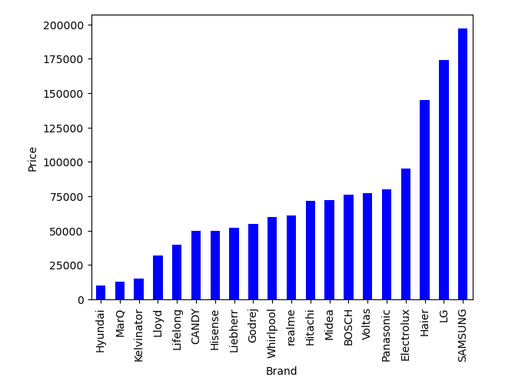
Brand Vs Price
In the above barplot the samsung brand with the high price is having more count followed by haier and
LG and the less count with least price are hyundai brand.

Slide 17
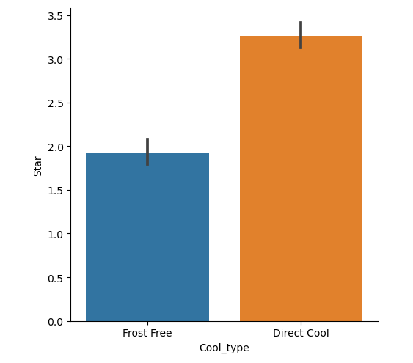
Cool type Vs Star
In the above barplot the direct cool type refrigerators with upto 4 star are more and
less are frost free with below 2 star

Slide 18
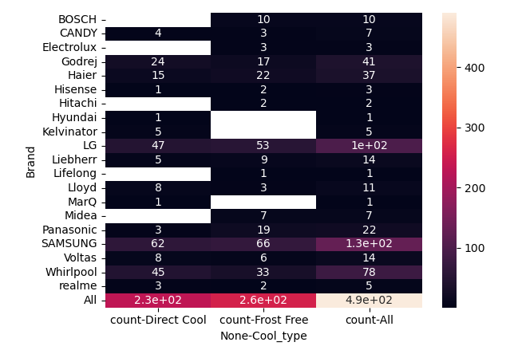
Multivariate Analysis- Brand Vs Cool type Vs Star
In the above Heatmap there are more number of star fridges are in Samsung brand with frost free and none cool_type
followed by LG and less star fridges are in lifelong and Hyundai.

Slide 19
CONCLUSION By doing analysis we can conclude that
Most People have to buy Refrigerator
In the price range of between 20k to 35k.
Which are having 200Liter storage to 350Liter storage
Better to prefer direct cool type fridges
Highly prefer the 3 star fridges
According to the data the Samsung refrigerator company has more number of count with good price and with best features.

Slide 20


Slide 21
CHALLENGES FACED
We have to scrape the data of every tabs in the website, there is a huge work to take the data from the website.
The major challenge is finding website which we will be having whole data we want where we face a lot of null values in column .
Missing values are the main thing u struggle of where it is a dataset of fact where we cannot take mean mode or median for these

Slide 22

THANK YOU

