Slide 1
DONATEKART
- Alone we can do little, Together we can do so much

Slide 2
Overview:
Don’t we all have a lot of clothes, books, and other household goods just lying in some corner and getting dusted? It’s time to give them a new life by donating them to those who are in need and bringing smiles to their faces!! Think Donatekart.
DonateKart lets you create and customize a donation page with complete ease.

Slide 3
DONATE ALMOST ANYTHING:
Food
Clothes
Gadgets
Sponsorships for Education
Books, Stationery etc.

Slide 4
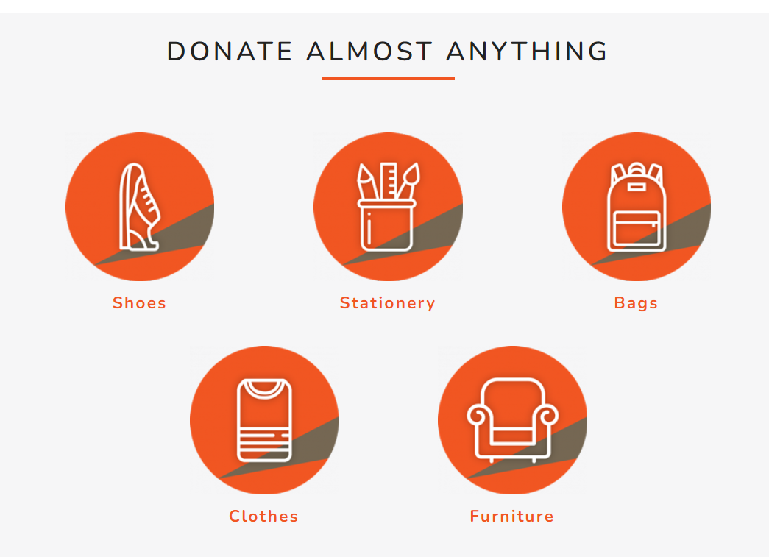

Slide 5
Why donate through donatekart
Your Donations are Valued
We make sure your donations reach someone who really requires them by delivering them to the beneficiaries directly.
Save the Environment
Keep your unwanted belongings out of landfill by giving them a new life and getting them in hands of someone who really requires them.
Feel Good Factor
Giving gives you pleasure and makes you happier bringing a positive and uplifting effect on you.
Super Convenient
Donate reusable items from the convenience of your house.

Slide 6
HOW WE WORK
Register on the homepage as a donor.
Using the credentials, log in to the webpage.
Donate supplies like groceries, stationery, toys, computers, books, etc.
Donate at your ease from, the convenience of your house according to the needs of the needy ones.
Also we include campaigns like Backpack of Hope where donation boxes were installed across the colleges so that students can donate their unwanted belongings with a focus on educational material and Virtual Classroom to put your old mobiles, laptops, and tablets to good use and help underprivileged kids continue their education online.
Help us motivate people to give away the items that are gathering dust in some corner of their house- Be part of our amazing campaigns or help us design one!!

Slide 7
Technologies used
FRONTEND
HTML
CSS
JAVASCRIPT
BOOTSTRAP
BACKEND
JSON
PYTHON PACKAGES

Slide 8
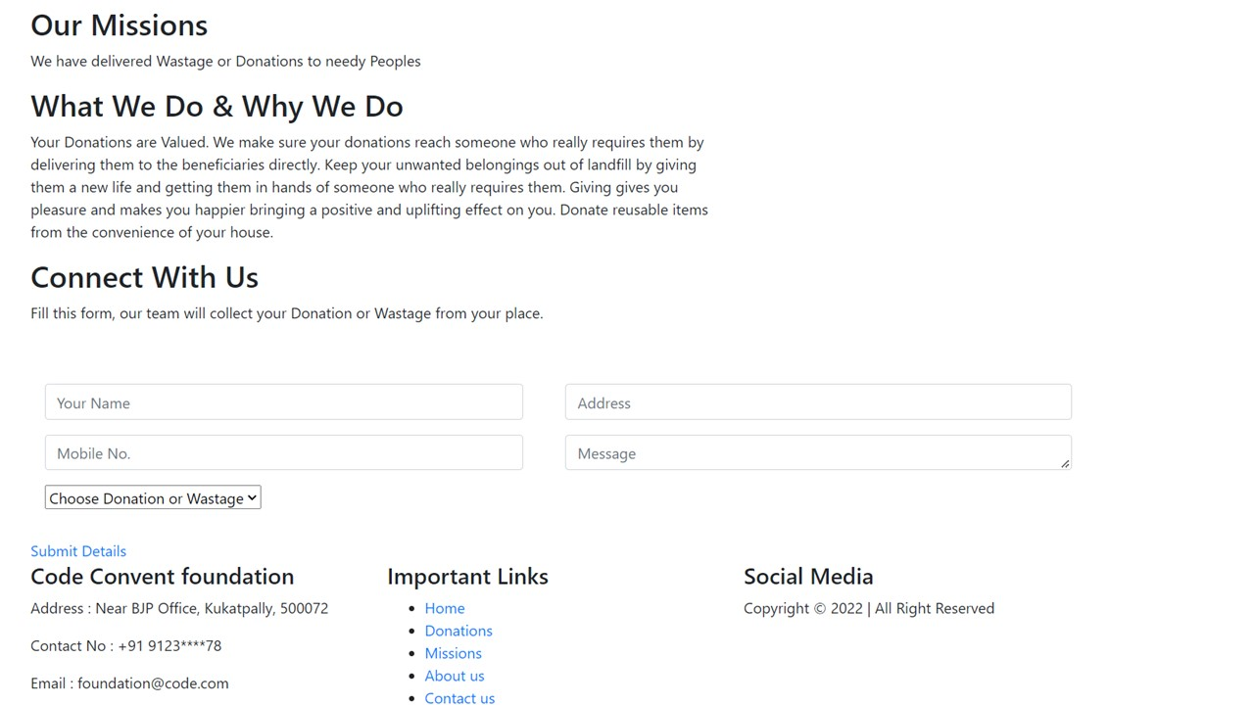
Home page of donatekart

Slide 9
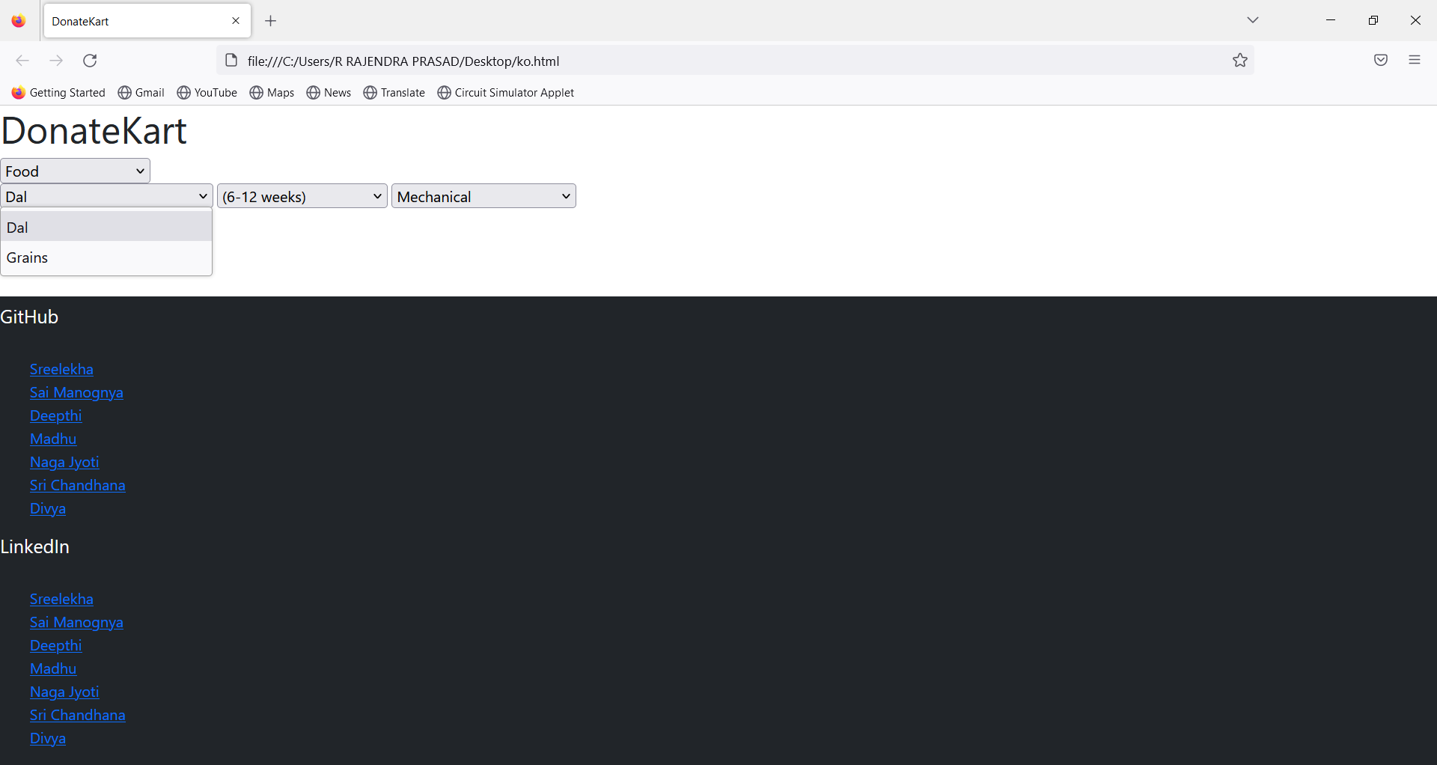
LOGIN PAGE OF DONATEKART

Slide 10
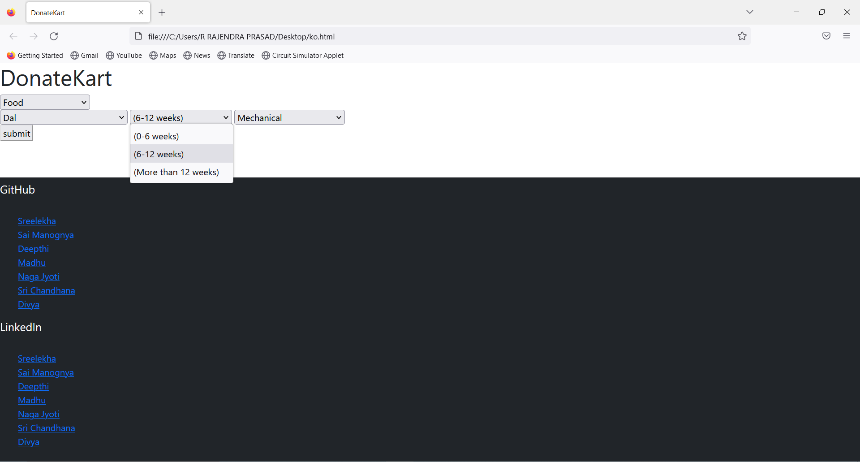
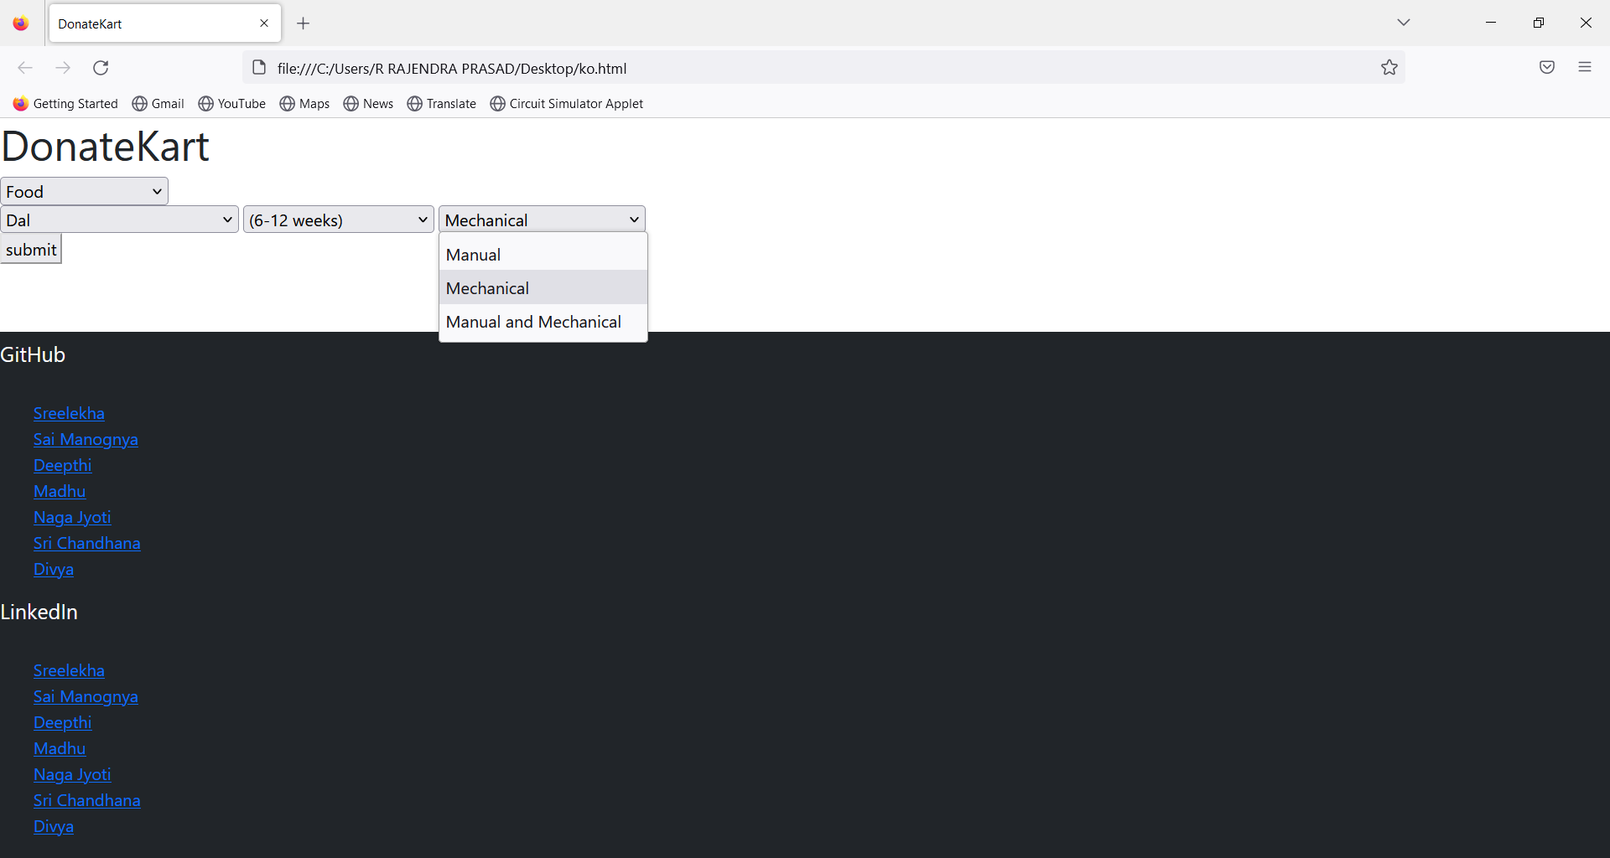

Slide 11


