Slide 1
Hazard detection of websites using Machine Learning
Project guide :
Ms. K. JAYASRI, m.tech
ASSISTANT PROFESSOR
DEPT. OF CSE
RGMCET
NANDYAL
PROJECT Team :
M. Naga Santhosh(19091a0587)
m. mahesh(19091a0571)
S. Mansoor vali (19091a0578)
l. Vijaya kumar (19091a05j8)

Slide 2
Contents
Abstract
Introduction
Domain description
Existing system
Disadvantages of existing system
Proposed work
Advantages
System requirements
Architecture
List of modules
Screenshots of output
Result analysis
Conclusion
References

Slide 3
Abstract
Internet surfing has become a vital part of our daily life. So, to catch the attention of the users' different browser vendors compete to set up the new functionality and advanced features that become the source of attacks for the intruder and the websites are put at hazard.
However, the existing approaches are not adequate to protect the surfers which require an expeditious and precise model that can be able to distinguish between the benign or malicious webpages.
We design a new classification system to analyze and detect the malicious web pages using machine learning classifiers such as, random forest, support vector machine, naive bayes, logistic regression and some special URL (uniform resource locator) based on extricated features the classifiers are trained to predict the malicious web pages.

Slide 4
Introduction
With the rapid development of the web, more and more services like internet banking, e-commerce, social networking, shopping, making a bill payment, e-learning, etc. Are available to users and they are surfing the internet via browsers or web application.
Malicious web sites which allows the invaders to detect the vulnerabilities on the web page and inject the payloads to get remote access to victim’s web page.
We use four machine learning classifiers to classify the web site into two classes malicious and friendly web page.
The web pages were distinguished as malicious or not based upon features.

Slide 5
Domain description
Machine learning is a technology which has ability to learn from the past experience and able to make the predictions based on it’s experience.
The major objective of machine learning algorithms is mainly used for classification, prediction, image recognition etc.
The major building blocks of machine learning is:
Building a model
Training the data
Testing the data
Evaluation of model

Slide 6
Existing system
Detection of harmful web pages can be done by using Naive bayes classifier.
By using this classifier it typically detects URLs which are harmful.
The results of using this classifier is more expensive and time consuming.

Slide 7
Drawbacks of existing system
More expensive.
Difficult to scale up.
Time consuming.

Slide 8
Proposed system
Our method uses a variety of discriminative features including textual properties, link structures, webpage contents, DNS information, and network trafﬁc.
Many of these features are novel and highly effective.

Slide 9
Advantages
Cheaper to operate.
It can be scaled up quickly.
Accuracy is maximum.
Prediction results are accurate.

Slide 10
System requirements
H/W Configuration:
Processor - I3/intel processor
Hard disk - 160GB
RAM - 8GB
S/W Configuration:
IDE : PyCharm
Libraries used : sklearn, pandas, NumPy, matplotlib, random forest classifiers, naive bayes
Technology : python 3.6+

Slide 11
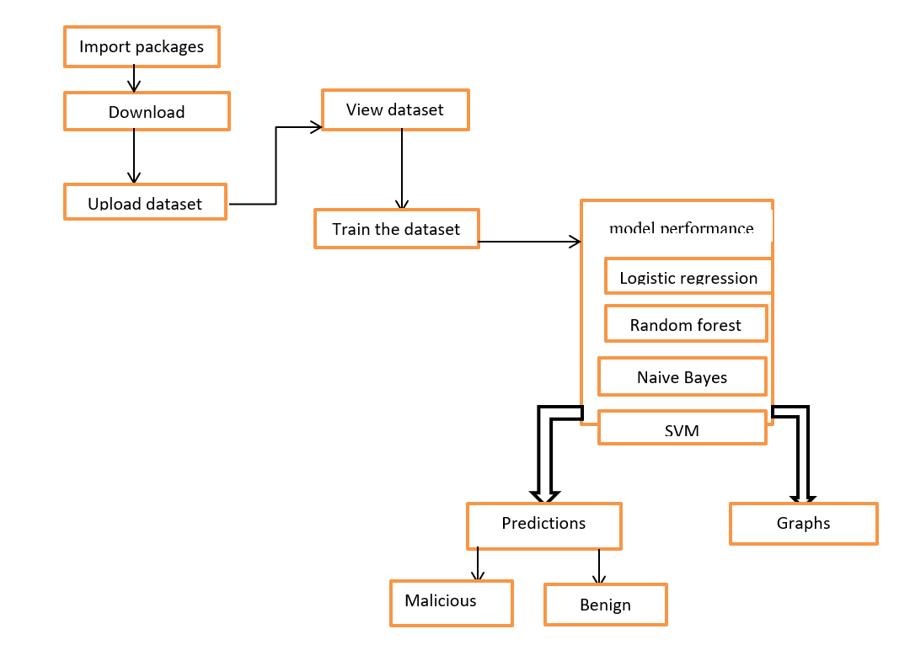
Architecture

Slide 12
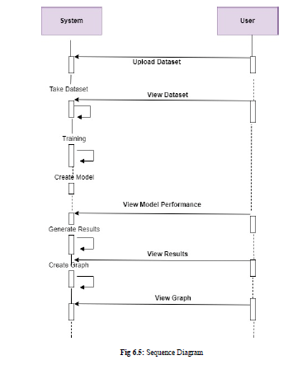

Slide 13
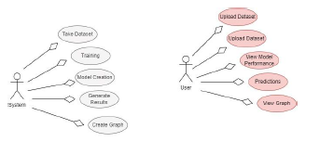

Slide 14
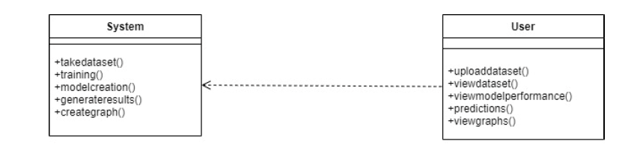

Slide 15
List of modules
Data Collection
Building Dataset
Building the models
Select the model for training
Evaluation the model

Slide 16
1. Data Collection:
The dataset we have used for the development of this project is .CSV file which consists of various features which are extracted from the various resources. In the proposed dataset, we have different types of parameters which is taken as features for URL. We have different type of features like textual properties, link structures, webpage contents, DNS information, and network trafﬁc.
2. Building Dataset:
The dataset we have used for the development of this project is .CSV file which consists of various features which are extracted from the various resources. In the proposed dataset, we have different types of parameters which is taken as features for URLS. We have different type of features like URL, URL_length, Number_special_characters, Content_length, Remote_app_packets, Source_app_packets,
3. Building the models:
After the collection of data and creation of dataset the next step is developing a models for the detection of either URLS are malicious or benign.. For building a models we have used a machine learning algorithms like random forest, support vector machine, naive bayes, logistic regression.

Slide 17
4. Select the model for training:
We have to train the given data by selecting one of the developed algorithm. We have to train the model based up on their features. The training for the each model can be given by selecting the respective machine learning algorithm.
5. Evaluation the model:
The last step is to evaluate the model whether our trained model is working properly for the user input. These evaluation can be done based up on certain parameters like accuracy, precision and recall.

Slide 18

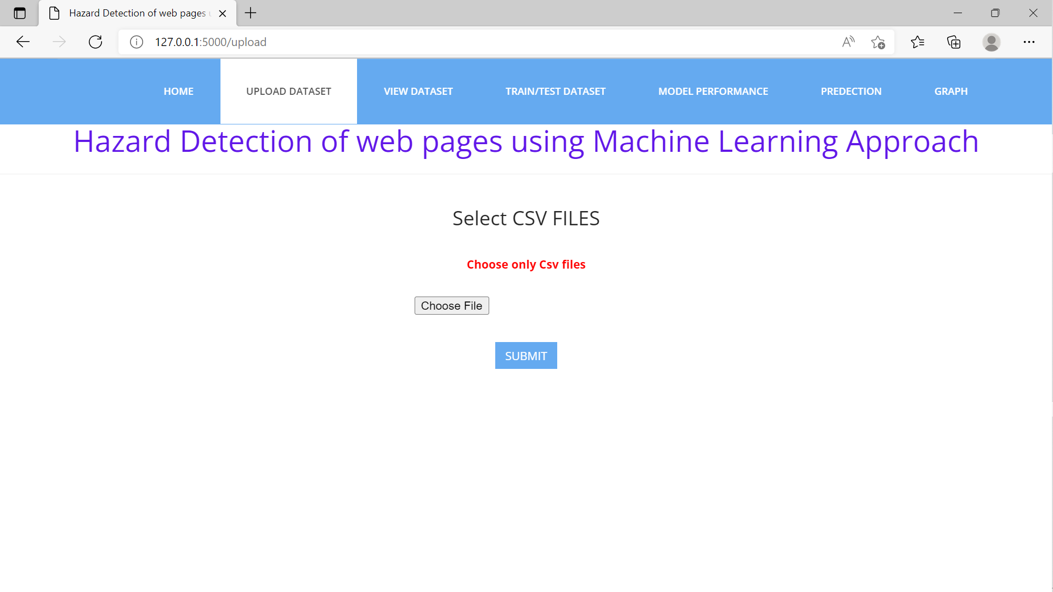
Screenshots of output

Slide 19
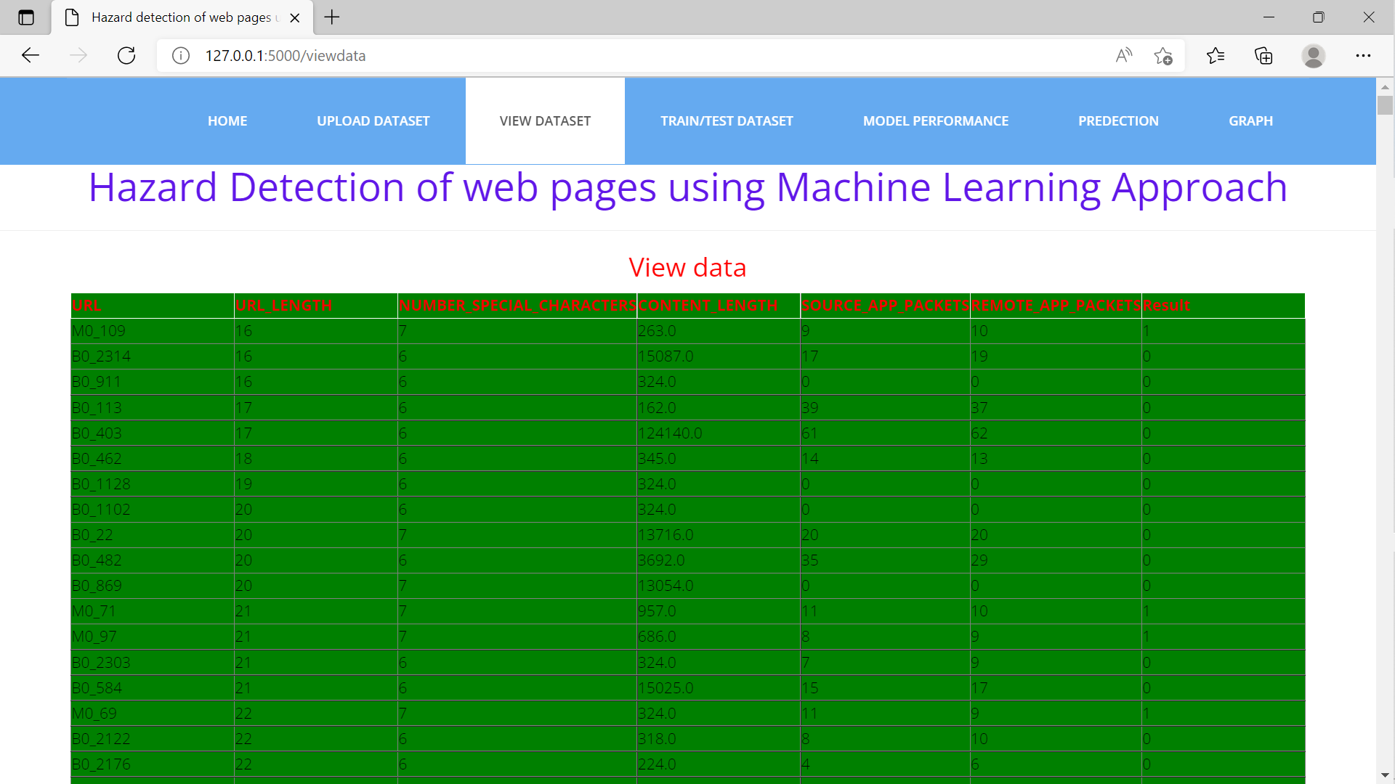
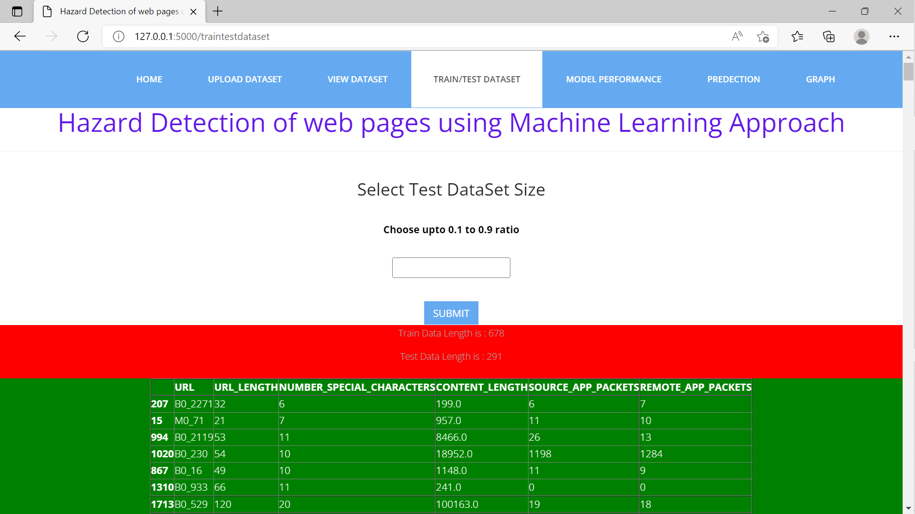

Slide 20
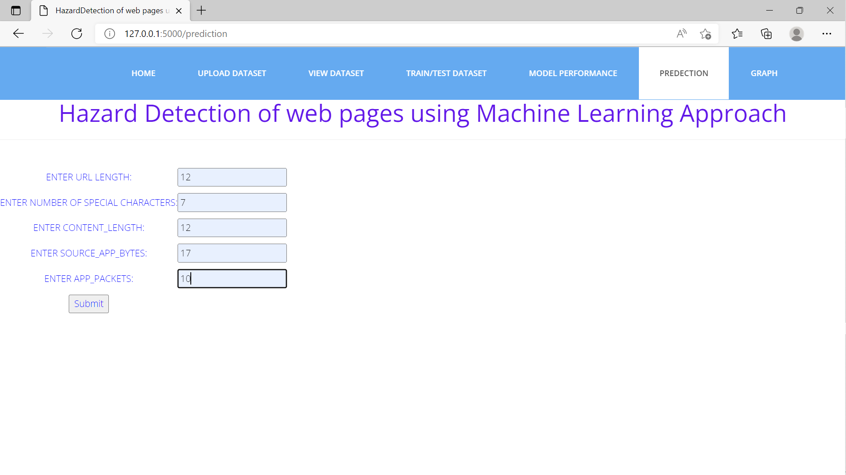
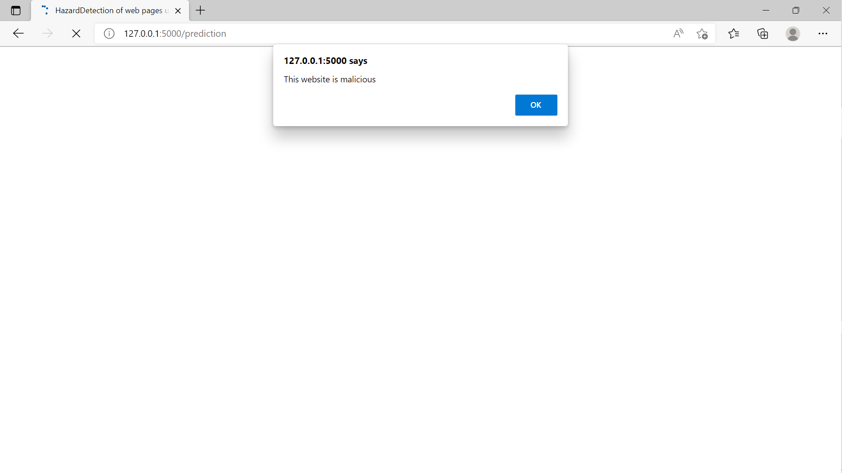

Slide 21
Result analysis
In this we have used different classifiers in order to calculate the accuracy
Naive bayes
Support vector machine
Random forest
Logistic regression
By considering the each model accuracy, the machine learning classifiers random forest(rf) achieves a higher accuracy of 95%.

Slide 22
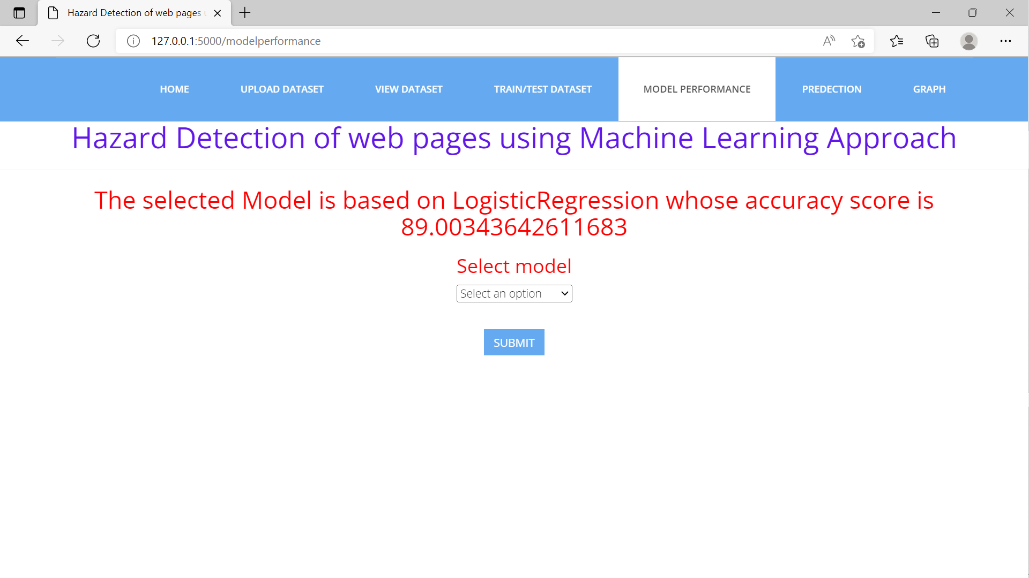
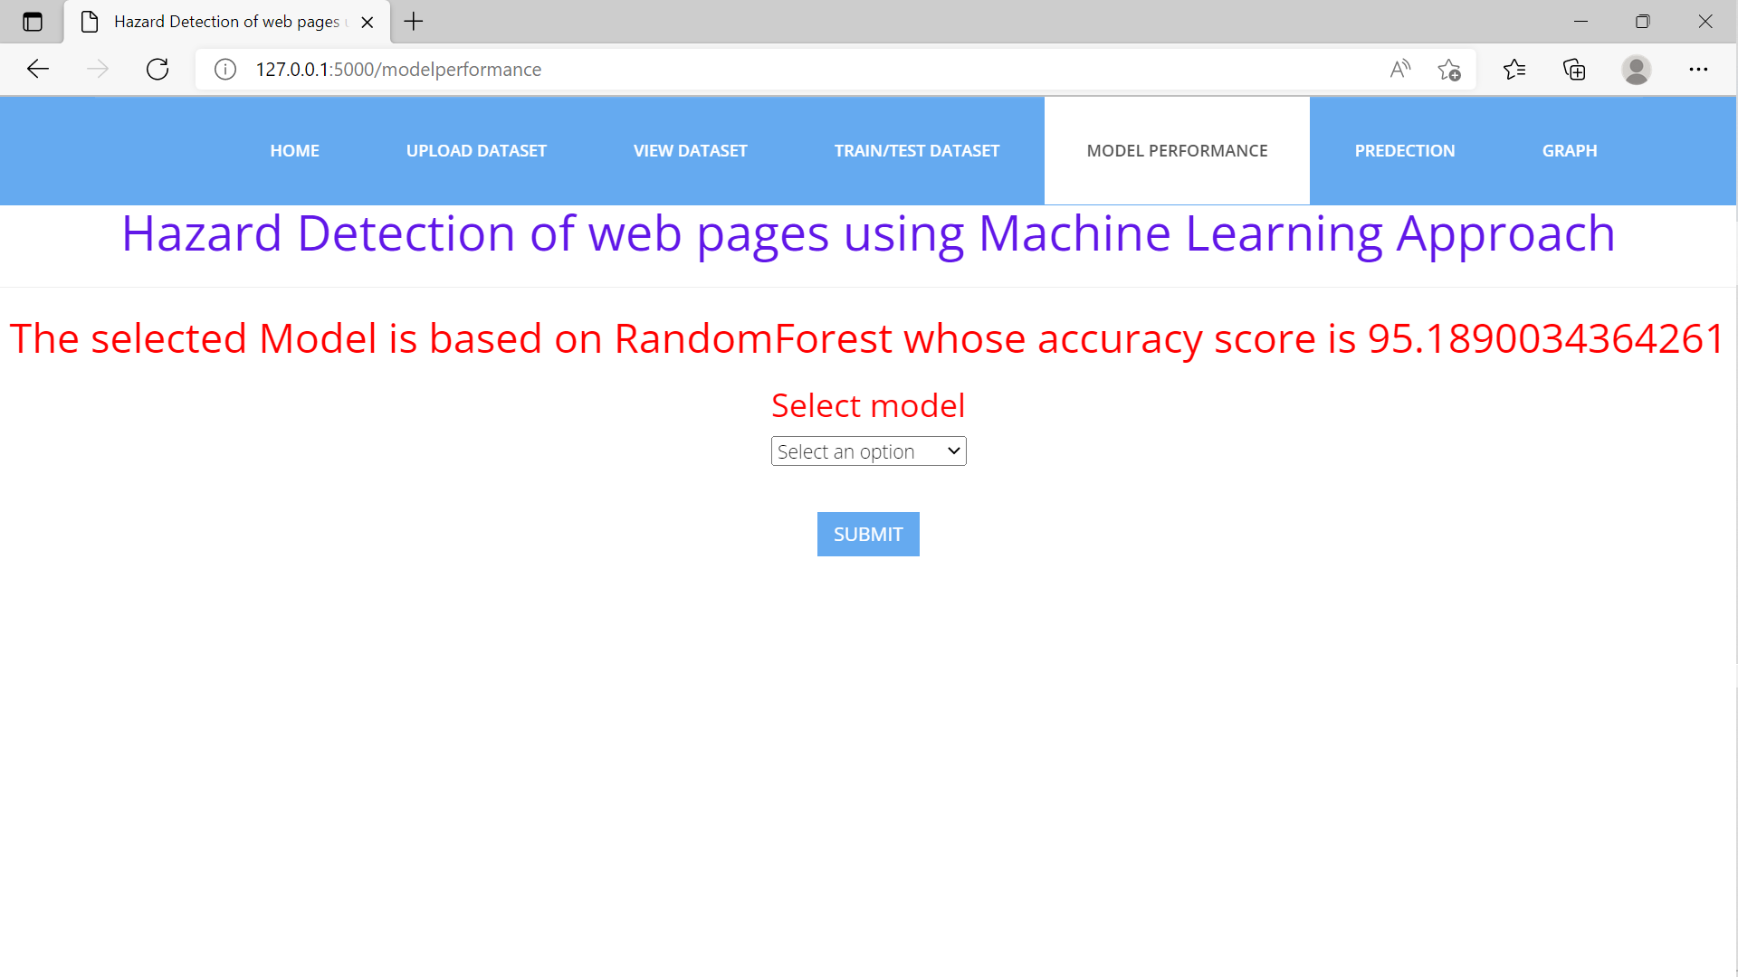

Slide 23
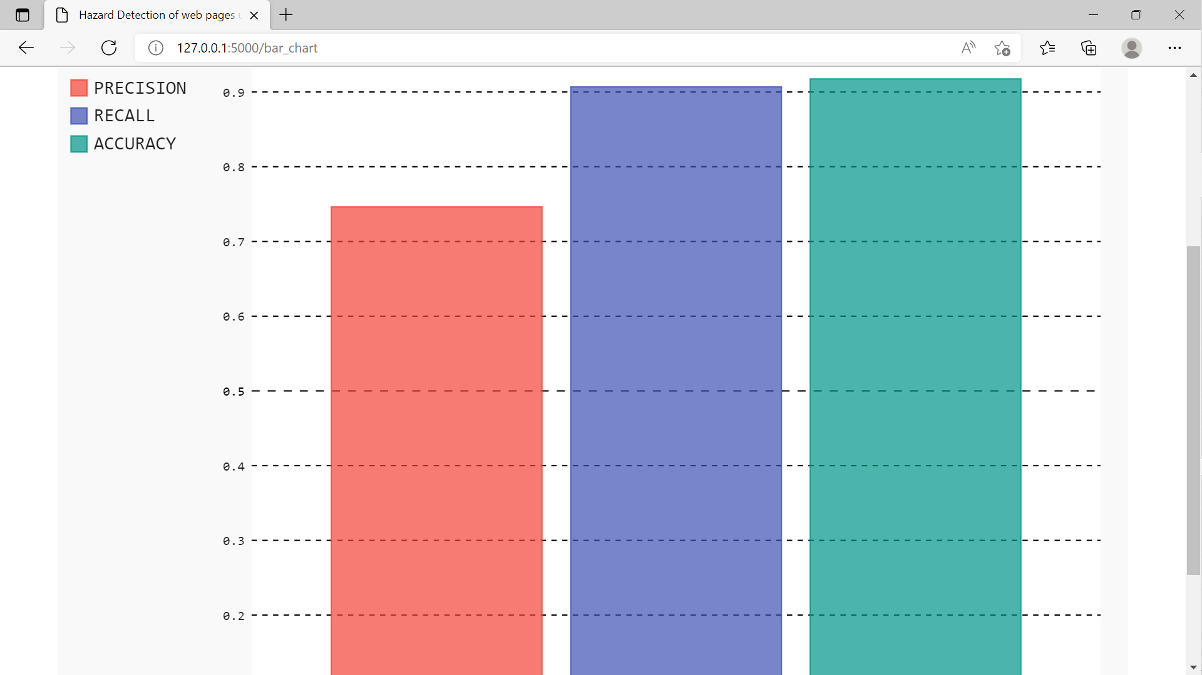
Graph

Slide 24
conclusion
Malicious web page identification is an emerging topic in cybersecurity. Though several research studies have been performed relating to the issues of malicious web page detection these are very costly as they consume more time and resources. In this, we employed a new web site classification system based on URL features to predict the web pages as malicious or benign using machine learning algorithms. The machine learning classifiers random forest(rf) achieves a higher accuracy of 95%. The experimental results have shown that our method can perform effectively for detecting the malicious web page

Slide 25
References
Urcuqui, Christian, Andres Navarro, Jose Osorio, and Melisa García. "Machine learning classifiers to detect malicious websites." In SSN, (2020).
Sun, Bo, Mitsuaki Akiyama, Takeshi Yagi, Mitsuhiro Hatada, and Tatsuya mori. "Automating URL blacklist generation with similarity search approach." IEICE TRANSACTIONS on information and systems (2016).
Krishnaveni, S., And K. Sathiyakumari. "Spidernet: An interaction tool for predicting malicious web pages." In international conference on information communication and embedded systems (ICICES2014). IEEE, (2014).
Yoo, Suyeon, Sehun Kim, Anil Choudhary, O. P. Roy, and T. Tuithung. "Two-phase malicious web page detection scheme using misuse and anomaly detection." International journal of reliable information and assurance 2, no. 1 (2014).

Slide 26
THANK YOU

