Slide 1
CureWell Hospital Management Web Application
Presentees :
B. Kumar
M. Santhosh
R. Vinay
M. Mothish
P. Naveen

Slide 2

Agenda
Introduction
Project Overview
Goals & Objectives
Methodology
Project TimeLine
Challenges & Solutions
Results and Findings
Demonstration
Lessons Learned
Future Work
Conclusion

Slide 3
Introduction
CureWell Hospital Management is a robust web application designed for the healthcare industry. It offers a wide range of features, including the ability to view and manage all doctors, along with their Specializations. The application provides a seamless overview of surgeries scheduled for the day. Admins can effortlessly add and update doctor information, ensuring accurate records. Additionally, CureWell prioritizes data security through robust authentication mechanisms, safeguarding sensitive information. This comprehensive solution empowers hospitals to streamline operations and deliver all the information to the users.

Slide 4
Project Overview
CureWell Hospital Management is a comprehensive web application designed to enhance the efficiency and effectiveness of healthcare facility operations. This system offers a wide range of features and functionalities designed to meet the specific needs of hospital management:
1. Doctor Management:
View and manage all doctors within the hospital.
Organize doctors based on their specializations, including CAR, ANE, GYN, and more..
2. Surgery Tracking:
Provide a daily overview of Surgeries scheduled for the day.
Ensure that surgical procedures are well-coordinated and can update the Scheduled Surgeries.

Slide 5
Project Overview
3. Doctor Information Management:
Add new doctors to the Hospital's database.
Update and maintain accurate records for existing doctors.
4. Authentication and Security:
Implement robust authentication mechanisms to Secure access to the system by allowing only admins to do the operations.
5. User-Friendly Interface:
Deliver a user-friendly and intuitive interface for administrative purpose.

Slide 6
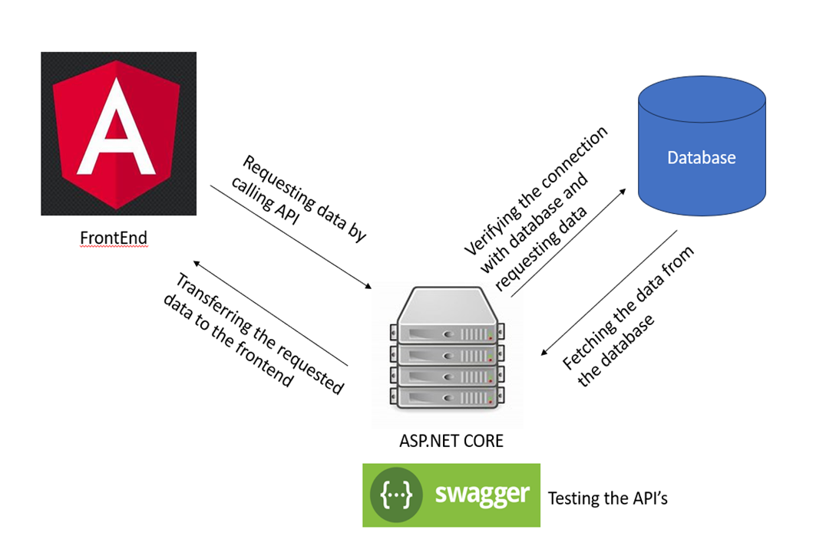
System Architecture

Slide 7
Goals & Objectives
Goals & Objectives :
1. Efficient Hospital Administration: Streamline and automate hospital administrative tasks to improve overall efficiency and to maintain digital records easily.
2. Enhanced Information:
Facilitate better patient care by providing easy access to doctor information, specializations, and surgical schedules.
3. Data Security and Compliance:
Ensure data security and compliance with healthcare regulations to protect internal and hospital data.
4. User-Friendly Interface:
Develop an intuitive and user-friendly interface for hospital staff, making it easy to manage doctors and access critical information.

Slide 8
Methodology
Tools:
Visual Studio Code
Visual Studio 2022
SQL Server Management Studio
Swagger
Technologies:
Angular16
Asp.net Core Web
MSSQL
Approach:
Created database using SQL server and Connected to it using Asp.net core for the creation of models and controllers and created Api’s. By using the Angular application we have fetched the data from database using these Api’s.

Slide 9
Project Timeline
Day-1: Analysis:
Analyzed the Project based on the given SRS Document.
Day-2&3: Backend Development:
We have Created a database. Based on the database design we have designed a prototype of the back end .
Day-4&5: Frontend Development:
We have implemented the Frontend based on the prototype given in the SRS.

Slide 10
Challenges & Solutions
Challenges:
Creating API’s
→ We have created all the required API’s by analyzing the given SRS document.
2. Providing Data Security
By using the guide reference and online resources we have developed the Authentication Model
3. Additional Stylings
→ While using Model Components we are facing issues so for that we used Bootstrap for adding more beautification.

Slide 11
Results & Findings

Slide 12
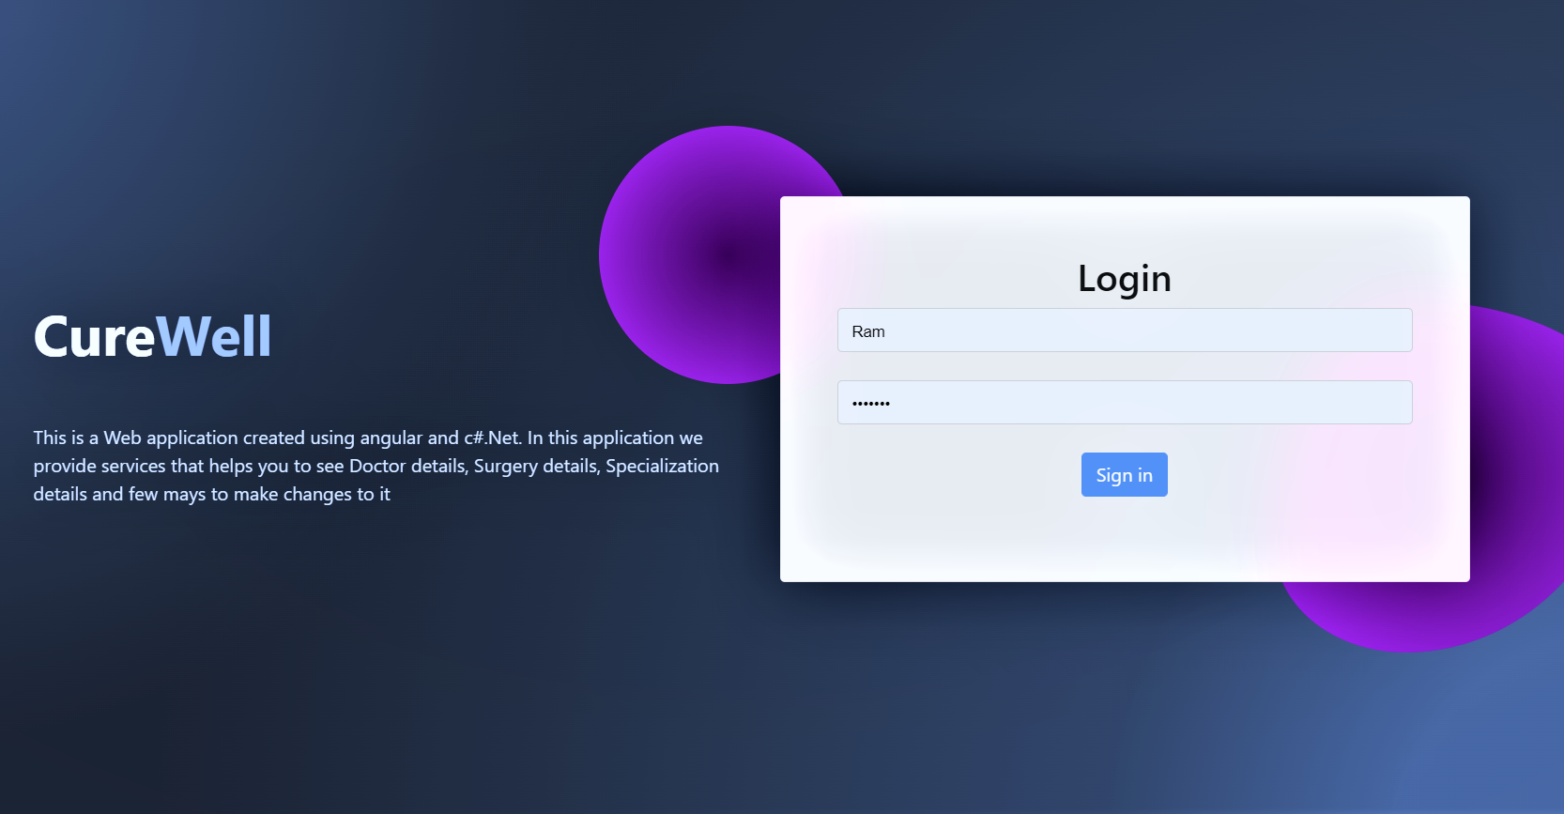
Login Page

Slide 13
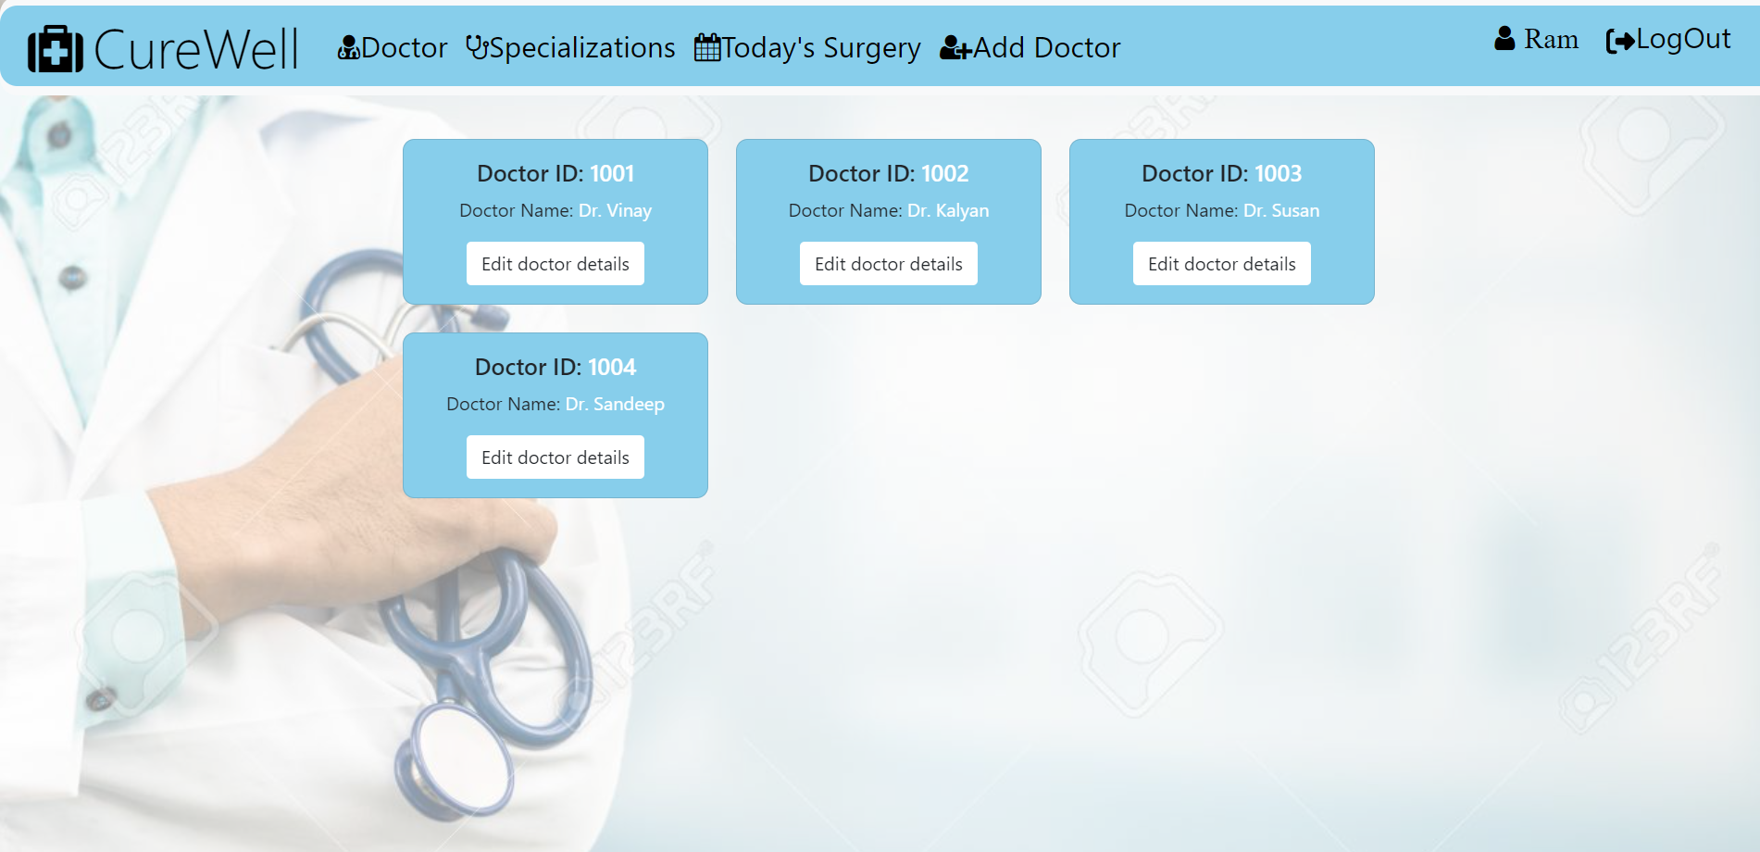
Doctors Page

Slide 14
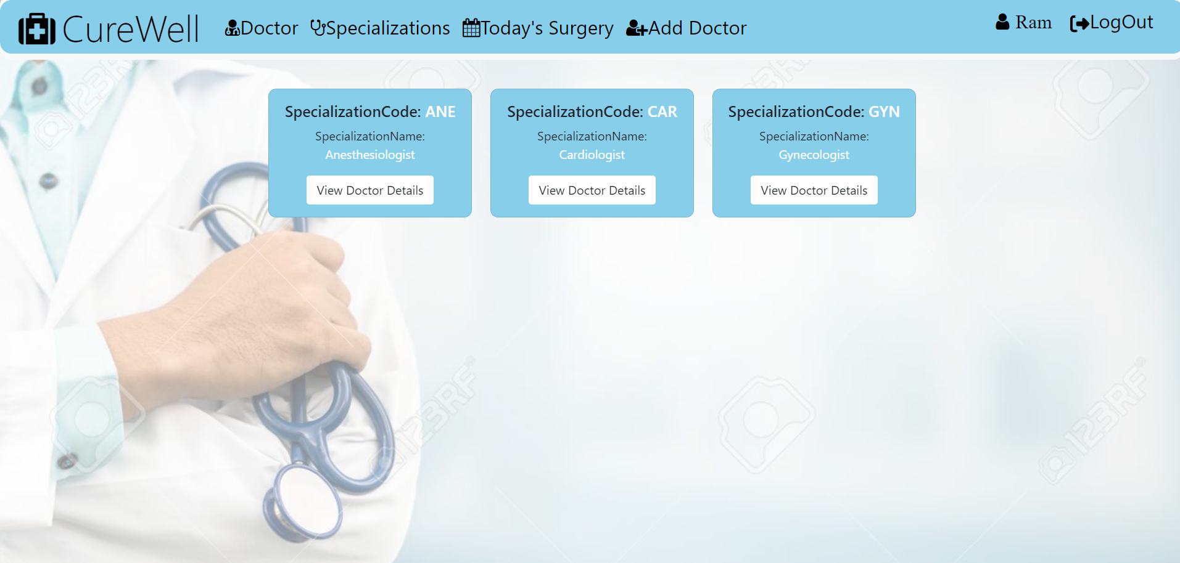
Doctors Specializations

Slide 15
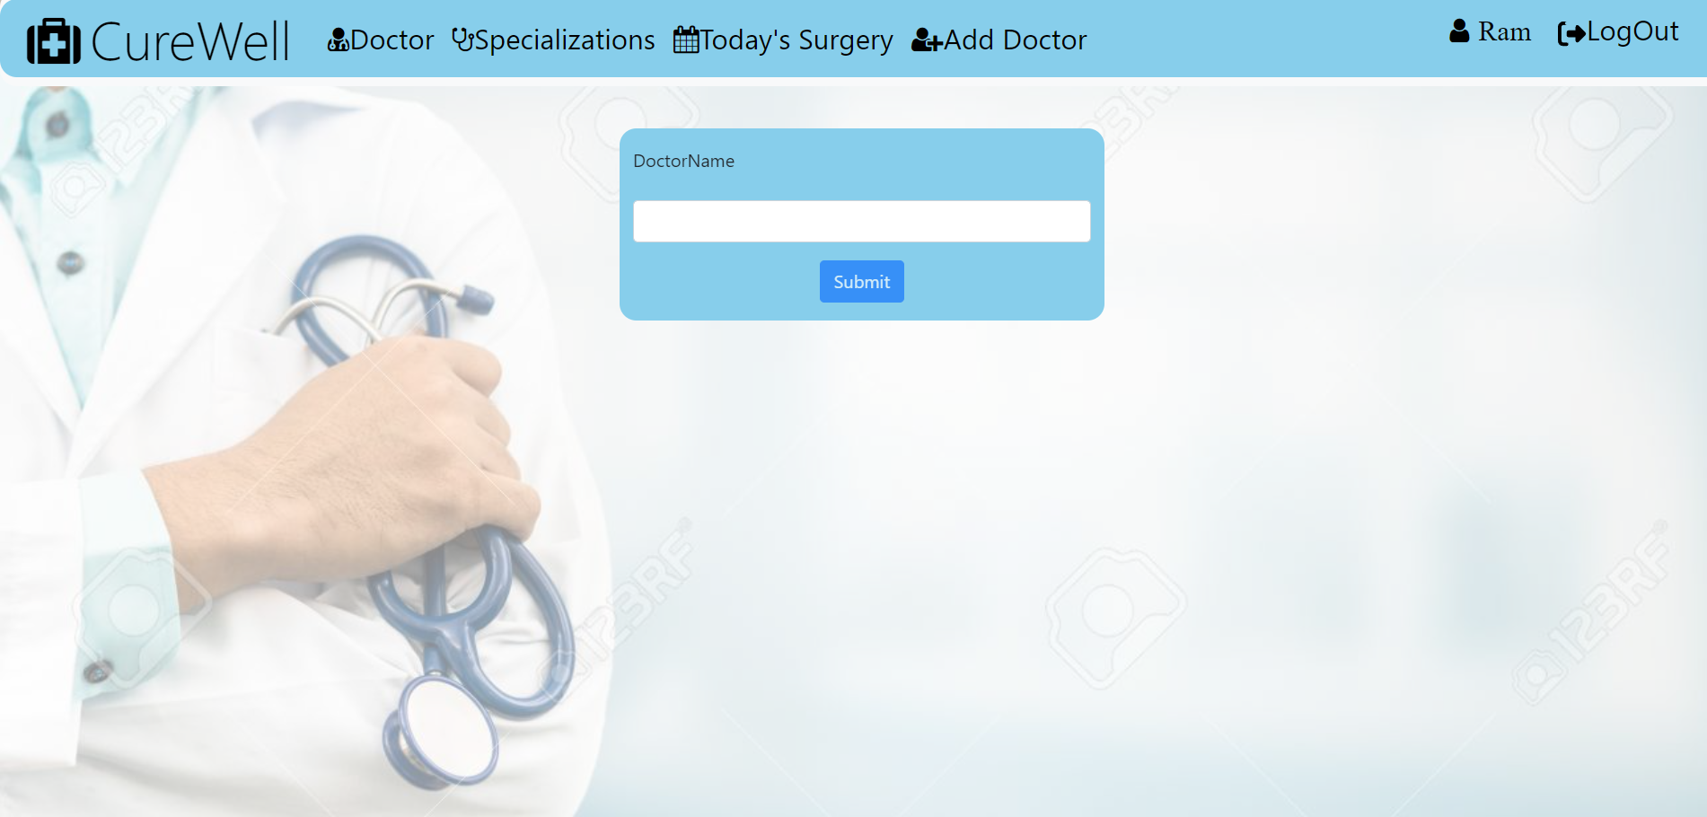
Add Doctor

Slide 16
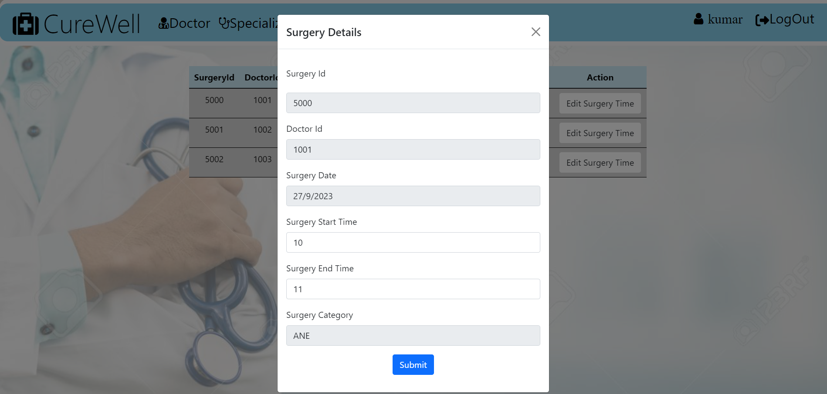
Edit Surgery Timings

Slide 17
Future Work
Deploying the Project which will we accessible for all users.
The project can also be extended to recognize the images of doctors instead of accepting any image.

Slide 18
Conclusion
The Curewell Hospital Management project is a comprehensive and ambitious initiative designed to revolutionize healthcare operations by implementing a robust web application designed for the healthcare industry. This project aims to streamline and enhance various aspects of hospital management, from doctor information and surgery scheduling to data security and patient care.

Slide 19


