Slide 1
STUDENT SUPERVISION SYSTEM
BY: SAI KIRAN
srinivas pavan kalyan
SURYA VALLABHANENI

Slide 2
CONTENTS
INTRODUCTION.
MODULES.
FUNCTIONAL REQUIREMENTS
NON FUNCTIONAL REQUIREMENTS.
REQUIREMENTS.
HARDWARE REQUIREMENTS.
SOFTWARE REQUIREMENTS.
TECHNOLOGIES REQUIRED.

Slide 3
CONTENTS
DESIGN.
USECASE DIAGRAMS.
SEQUENCE DIAGRAMS.
CLASS DIAGRAM
ACTIVITY DIAGRAM.
STATE-CHART DIAGRAM.
OBJECT DIAGRAM.
DEPLOYMENT DIAGRAM.
ER DIAGRAM.
SCREENSHOTS.
DATABASE.

Slide 4
INTRODUCTION
This system is intended to ease the burden on administration duties for managing the staff in processing Supervision and Management by making information retrieval and management faster, easier, and more efficient compared to the normal manual system.
Student supervision system is a software used by supervisors in order to monitor and reviews students’ performance throughout a term and generate reports.This system is helpful for the academicians as well as school administrators to reduce the paperwork which most of the schools are familiar with.

Slide 5
MODULES
1.User module.
2.Supervisor module.
3.Admin module.

Slide 6
FUNCTIONAL REQUIREMENTS
Admin :
Admin has to log in.
Track down the total number of users in the system.
Add, activate and deactivate any user.
Count the number of supervisors, students.
Supervisor:
Log in as supervisor.
View assigned student profile.
Post the marks of students.

Slide 7
FUNCTIONAL REQUIREMENTS
Student:
Log in as student.
Know about the supervisor assigned to him.
Able to update their profile details.
Can view marks secured.

Slide 8
NON-FUNCTIONAL REQUIREMENTS
1.Scalability.
2. Robust.
3. Performance.
4. Reliability.

Slide 9
HARDWARE REQUIREMENTS
PROCESSOR : Intel dual Core ,i3
RAM : 1 GB
HARD DISK : 80 GB or more.

Slide 10
SOFTWARE REQUIREMTS
OPERATING SYSTEM : Windows 7/XP/8/10
FRONT END : Angular 6.
BACK END : NodeJS.
DATABASE : Mongo DB.
TOOLS USED : WebStorm.

Slide 11
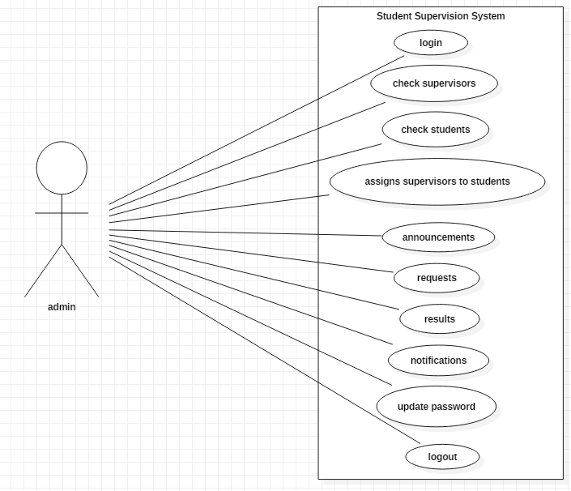
USECASE DIAGRAMS
Fig: Usecase Diagram for Admin

Slide 12
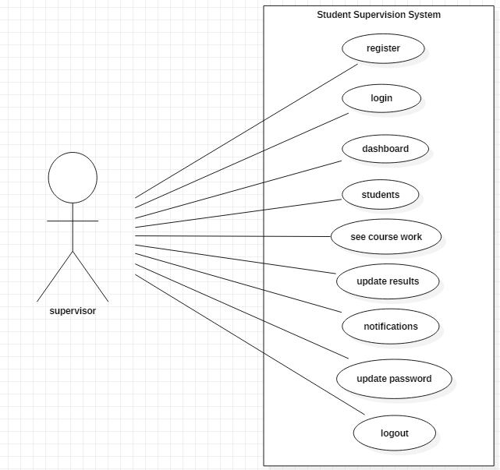
Fig: Usecase diagram for Supervisor

Slide 13
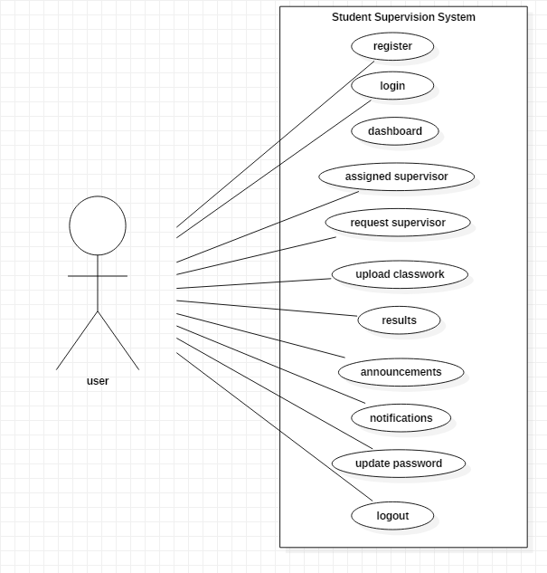
Fig: Usecase diagram for User

Slide 14
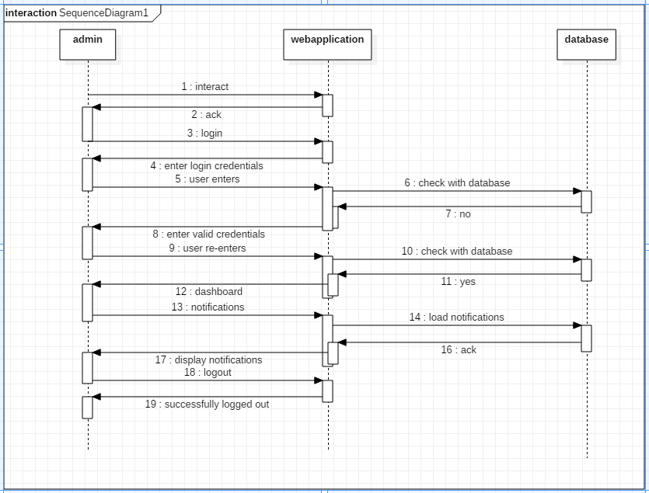
SEQUENCE DIAGRAMS
Fig: Sequence diagram for Admin

Slide 15
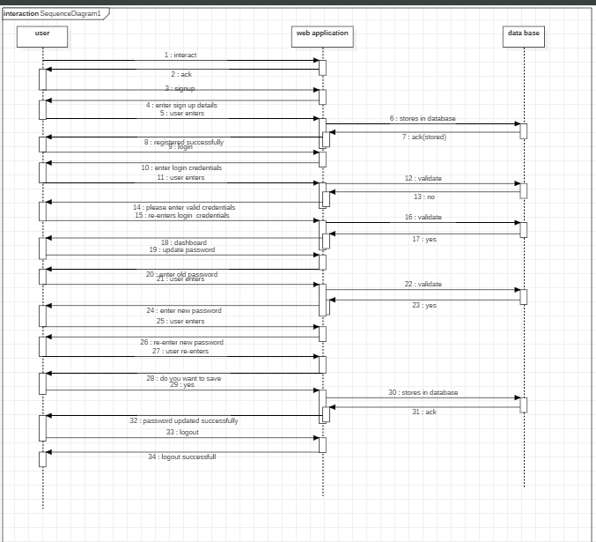

Slide 16
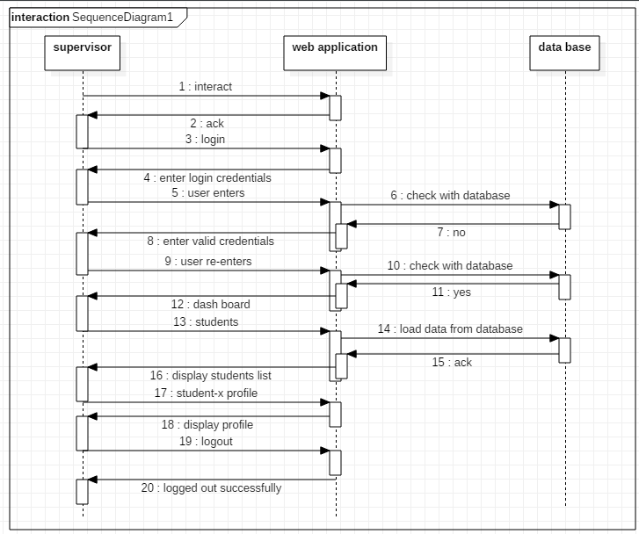
Fig:Sequence diagram for Supervisor

Slide 17
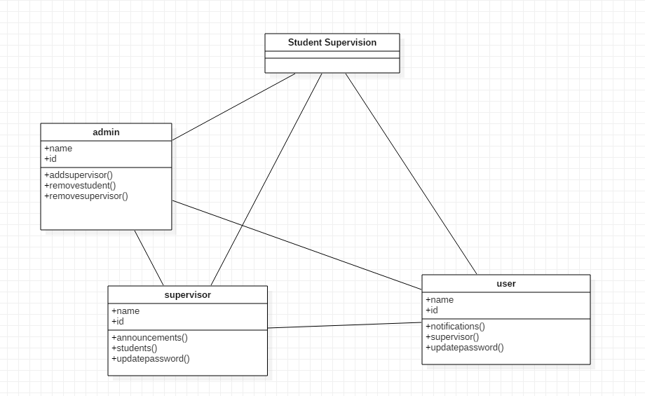
CLASS DIAGRAM

Slide 18
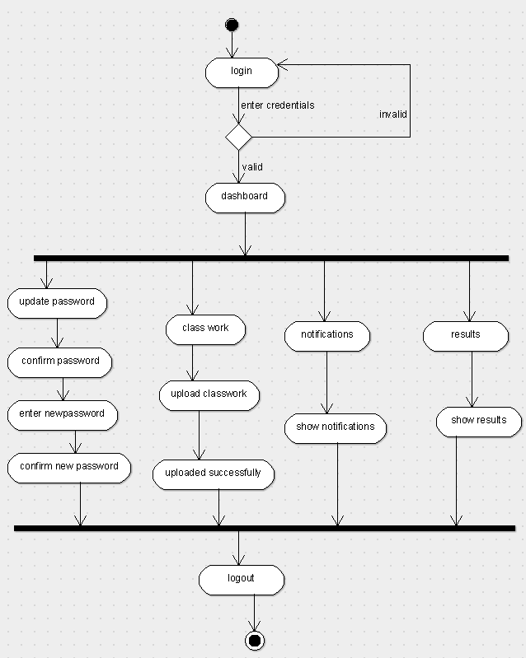
ACTIVITY DIAGRAM

Slide 19
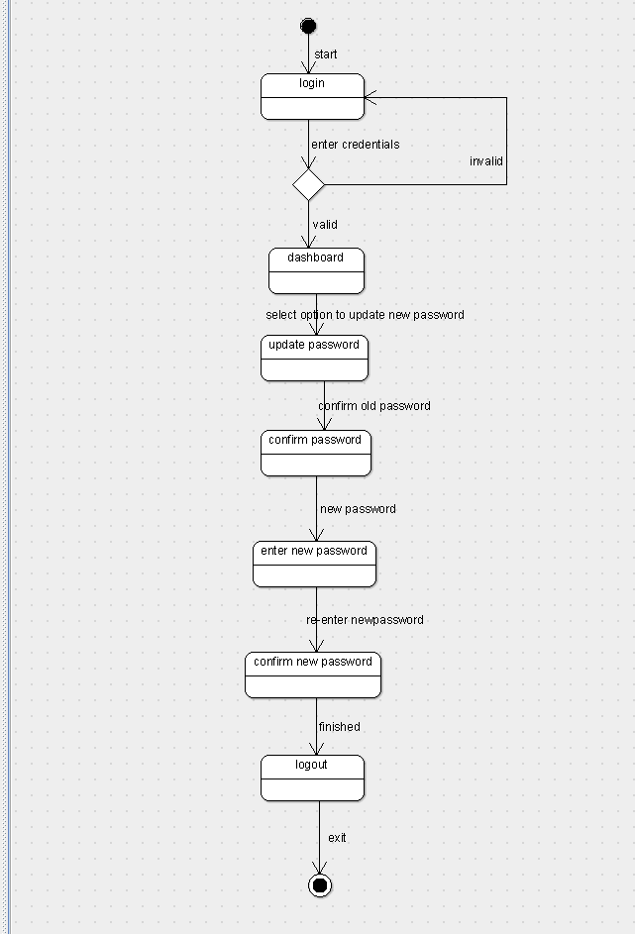
STATECHART DIAGRAM

Slide 20
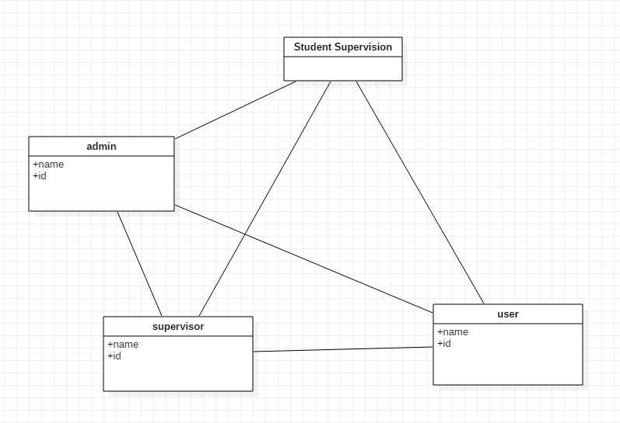
OBJECT DIAGRAM

Slide 21
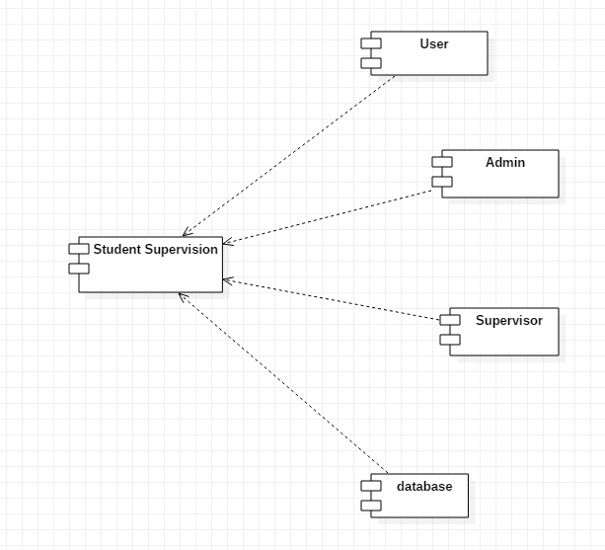
COMPONENT DIAGRAM

Slide 22
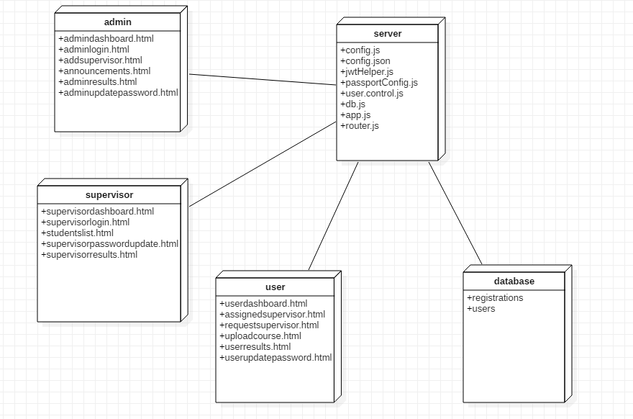
DEPLOYMENT DIAGRAM

Slide 23
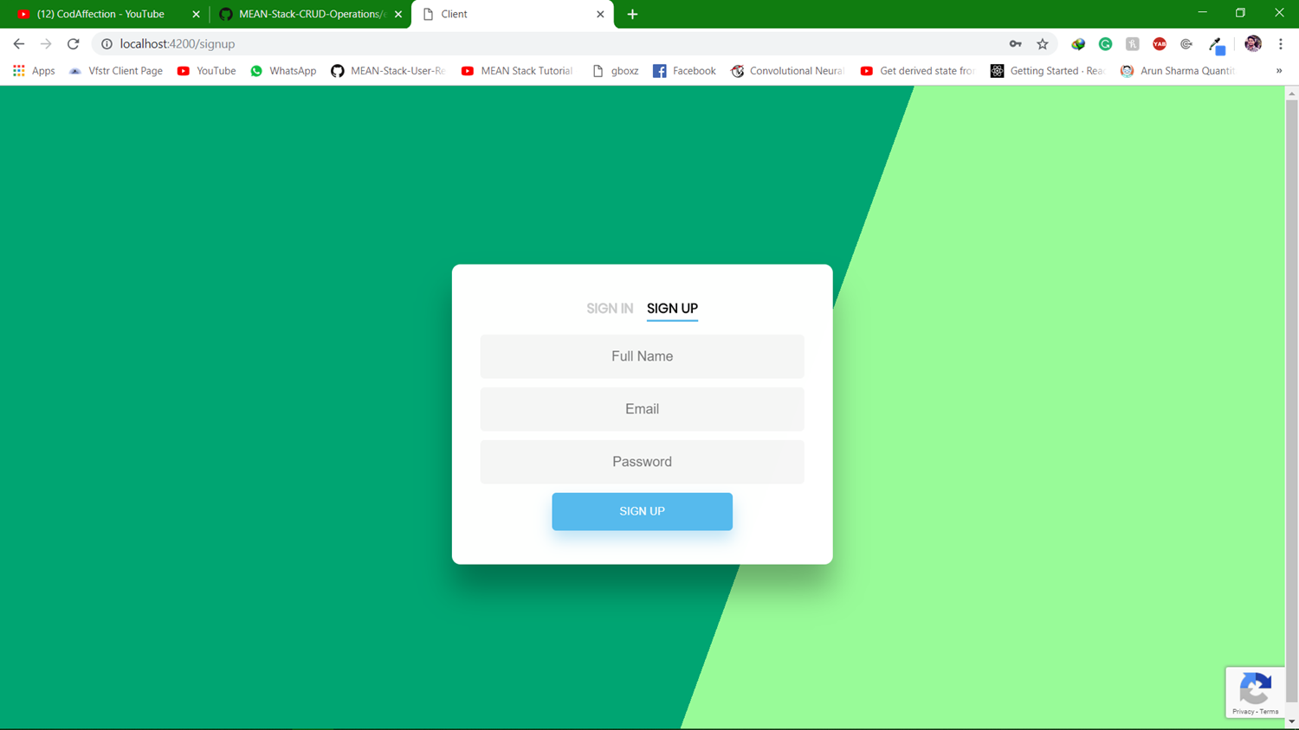
Screenshots
Fig : Signup page

Slide 24
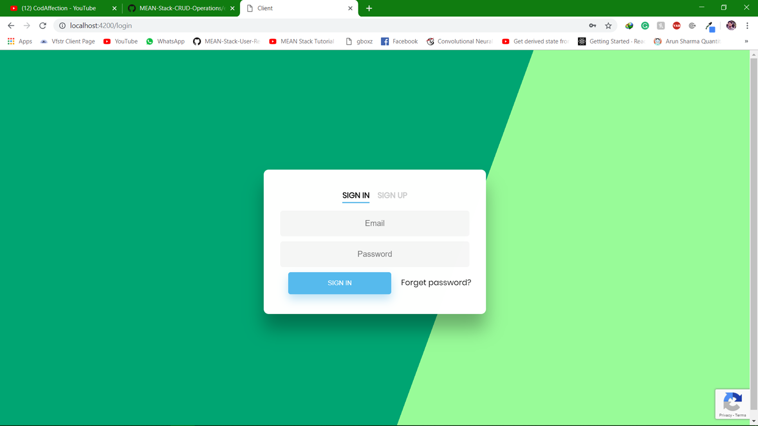
Fig : SignIn page

Slide 25
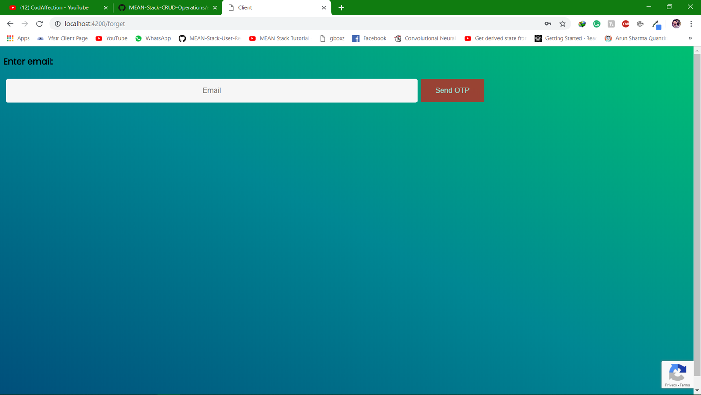
Fig : Forgot Password page

Slide 26
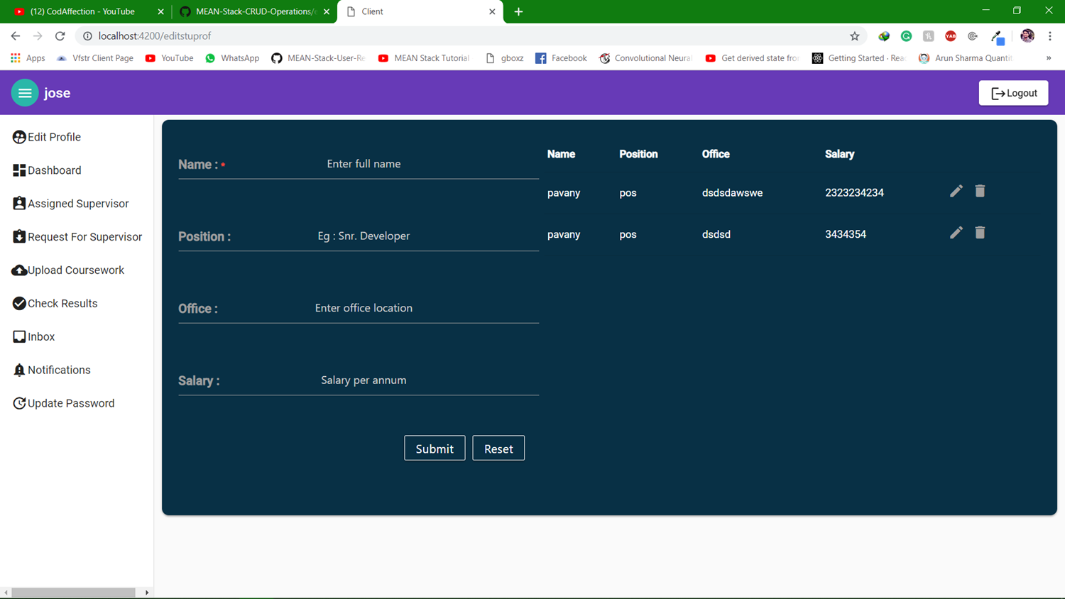
Fig : User can edit profile

Slide 27
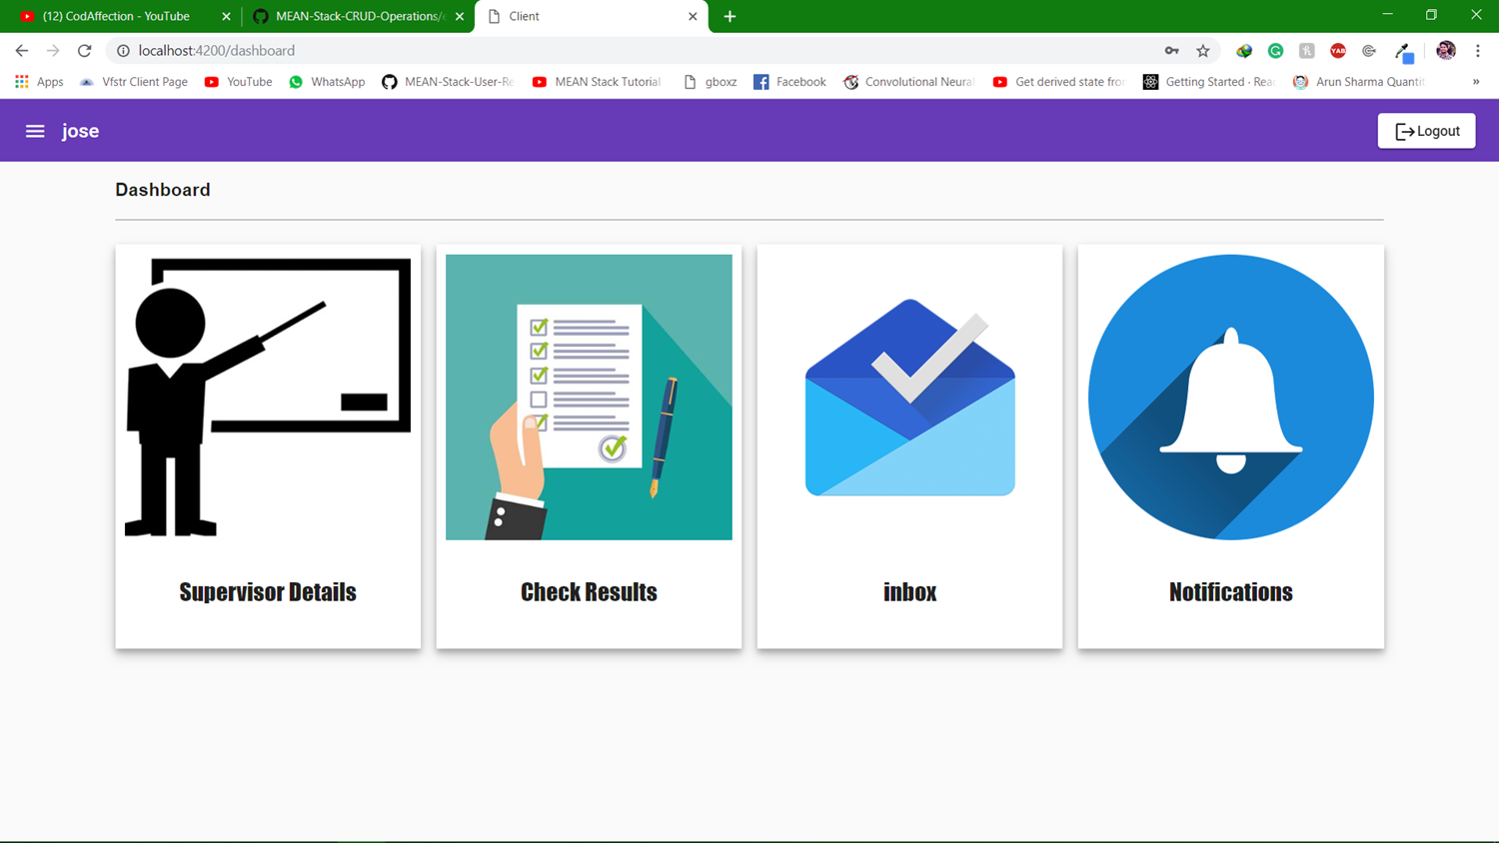
Fig : Dashboard of the User

Slide 28
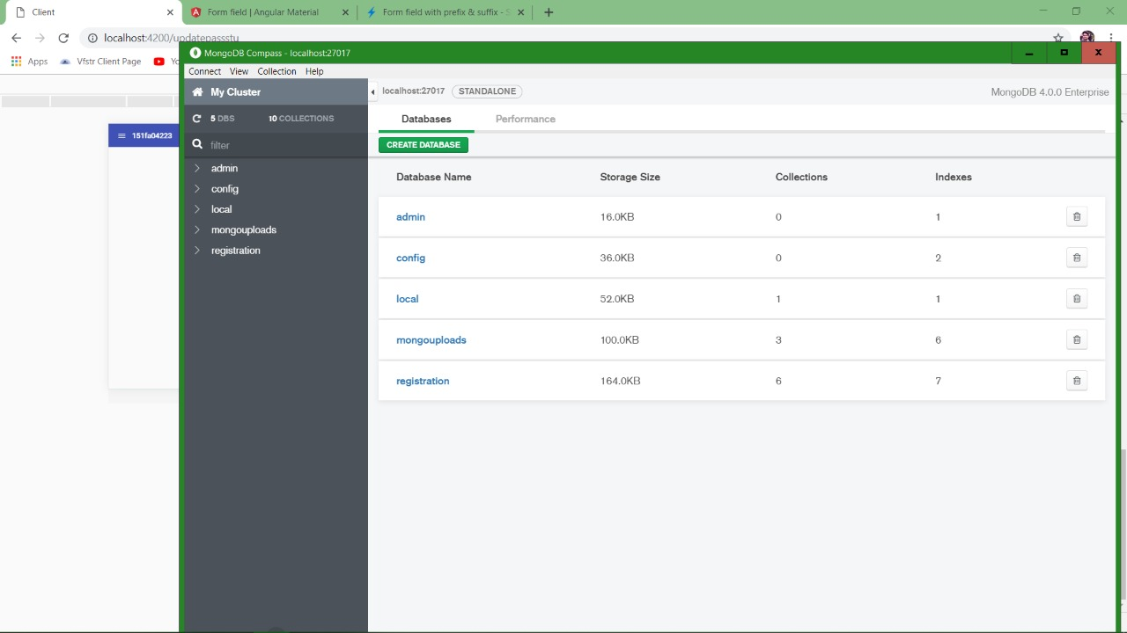
DATABASE
Fig : Databases

Slide 29
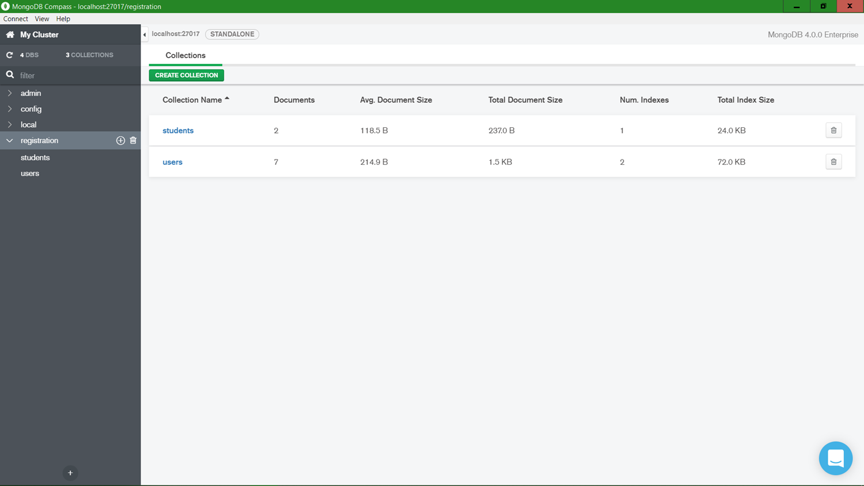
Fig : Database Collections

Slide 30
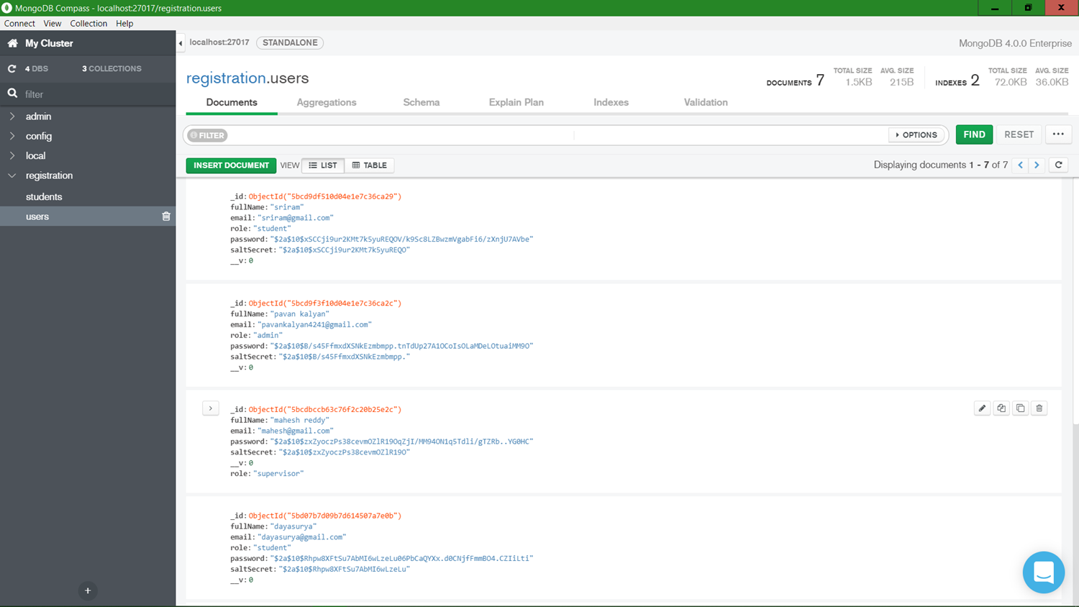
Fig : Database Sample Document

Slide 31
THANKYOU!

